Slide 1
Virtual Memory

Slide 2
Background
Virtual memory – separation of user logical memory from physical memory.
➔Only part of the program needs to be in memory for execution.
➔Logical address space can therefore be much larger than physical address space.
➔Allows address spaces to be shared by several processes.
➔Allows for more efficient process creation.
Virtual memory can be implemented via:
➔Demand paging
➔Demand segmentation

Slide 3
Demand Paging
Bring a page into memory only when it is needed.
➔Less I/O needed
➔Less memory needed
➔Faster response
➔More users
Page is needed ⇒ reference to it
➔invalid reference ⇒ abort
➔not-in-memory ⇒ bring to memory

Slide 4
Valid-Invalid Bit
With each page table entry a valid–invalid bit is associated (1 ⇒ in-memory, 0 ⇒ not-in-memory)
Initially valid–invalid but is set to 0 on all entries.
Example of a page table snapshot.
During address translation, if valid–invalid bit in page table entry is 0 ⇒ page fault.
Frame #
valid-invalid bit
1
1
1
1
0

0
0
page table

Slide 5
Page Fault
If there is ever a reference to a page, first reference will trap to OS ⇒ page fault
OS looks at another table to decide:
➔Invalid reference ⇒ abort.
➔Just not in memory.
Get empty frame.
Swap page into frame.
Reset tables, validation bit = 1.
Restart instruction:

Slide 6
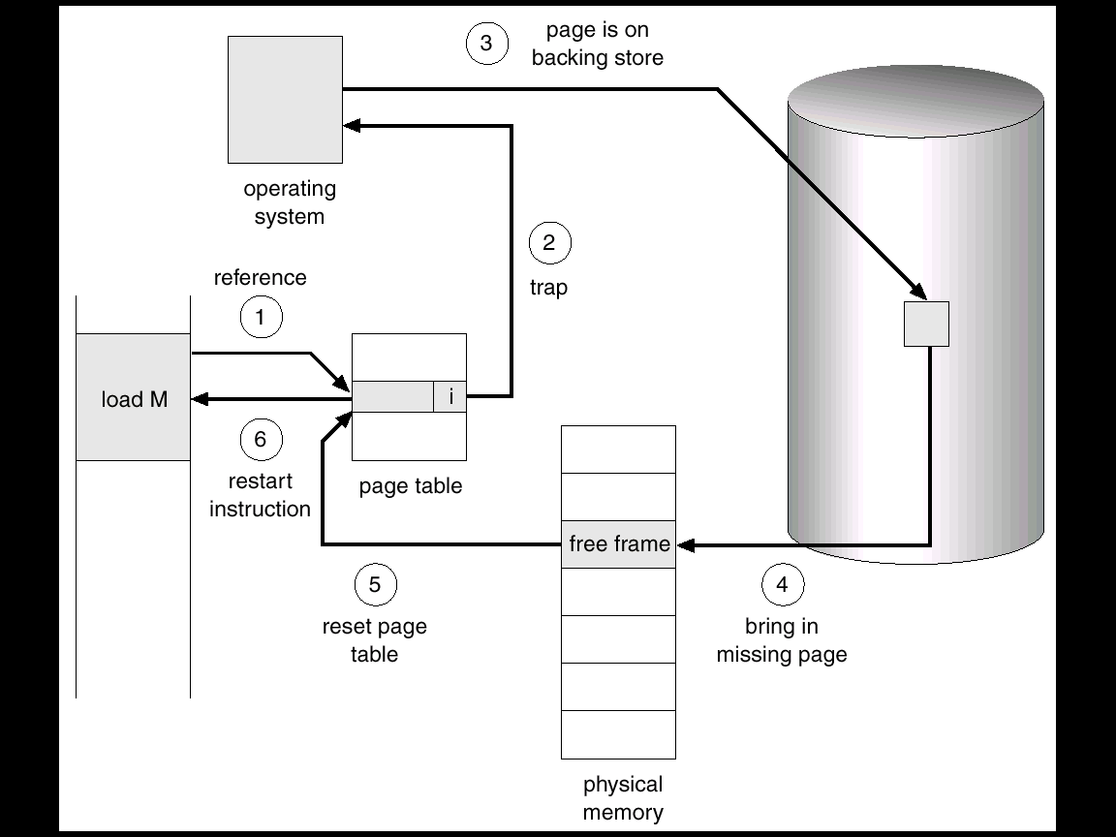
Steps in Handling a Page Fault

Slide 7
What happens if there is no free frame?
Page replacement – find some page in memory, but not really in use, swap it out.
➔algorithm
➔performance – want an algorithm which will result in minimum number of page faults.
Same page may be brought into memory several times.

Slide 8
Performance of Demand Paging
Page Fault Rate 0 ≤ p ≤ 1.0
➔if p = 0 no page faults
➔if p = 1, every reference is a fault
Effective Access Time (EAT)
EAT = (1 – p) x memory access
+ p (page fault overhead)
[swap page out + swap page in+ restart overhead]

Slide 9
Demand Paging Example
Memory access time = 1 microsecond
50% of the time the page that is being replaced has been modified and therefore needs to be swapped out.
Swap Page Time = 10 msec = 10,000 microsec
EAT = (1 – p) x 1 + p (10000)
1 + 10000p

Slide 10
Page Replacement
Page-fault service routine includes page replacement.
Use modify (dirty) bit to reduce overhead of page transfers – only modified pages are written to disk.
large virtual memory can be provided on a smaller physical memory.

Slide 11
Replacement Policy
Which page to replace?
Page removed should be the page least likely to be referenced in the near future
Most policies predict the future behavior on the basis of past behavior
Notes:
11

Slide 12
Replacement Policy
Frame Locking
➔If frame is locked, it may not be replaced
➔Kernel of the operating system
➔Key control structures
➔I/O buffers
➔Associate a lock bit with each frame
Notes:
12

Slide 13
Page Replacement Algorithms
Want lowest page-fault rate.
Evaluate algorithm by running it on a particular string of memory references (reference string) and computing the number of page faults on that string.
In all our examples, the reference string is
1, 2, 3, 4, 1, 2, 5, 1, 2, 3, 4, 5.

Slide 14
First-In-First-Out (FIFO) Algorithm
Reference string: 1, 2, 3, 4, 1, 2, 5, 1, 2, 3, 4, 5
3 frames (3 pages can be in memory at a time per process)
1
1
1
4
4
4
5
5
5
2
2
2
1
1
1
3
3
9 page faults
3
3
3
2
2
2
4
1 | 2 | 3 | 4 | 1 | 2 | 5 | 1 | 2 | 3 | 4 | 5

Slide 15
First-In-First-Out (FIFO) Algorithm
Reference string: 1, 2, 3, 4, 1, 2, 5, 1, 2, 3, 4, 5
4 frames (4 pages can be in memory at a time )
In general more frames ⇒ less page faults
FIFO Replacement – Belady’s Anomaly
10 page faults
1
1
1
1
5
5
5
5
4
4
2
2
2
2
1
1
1
1
5
3
3
3
3
2
2
2
2
4
4
4
4
3
3
3
1 | 2 | 3 | 4 | 1 | 2 | 5 | 1 | 2 | 3 | 4 | 5

Slide 16
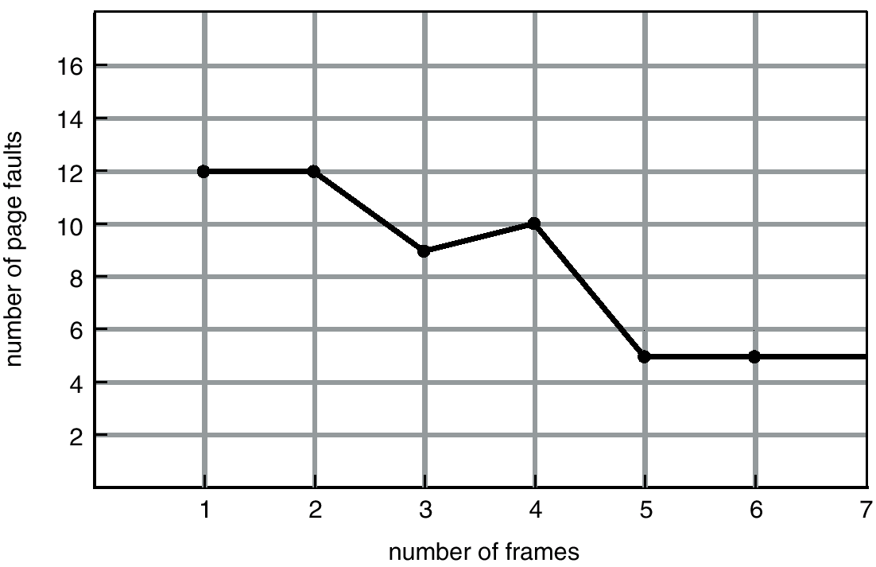
FIFO Illustrating Belady’s Anomaly

Slide 17
Optimal Algorithm
Replace page that will not be used for longest period of time.
4 frames example
1, 2, 3, 4, 1, 2, 5, 1, 2, 3, 4, 5
Used for measuring how well algorithm performs.
1
1
1
1
1
4
2
2
2
2
2
3
3
3
3
4
5
5
1 | 2 | 3 | 4 | 1 | 2 | 5 | 1 | 2 | 3 | 4 | 5
6 page faults

Slide 18
Least Recently Used (LRU) Algorithm
Reference string: 1, 2, 3, 4, 1, 2, 5, 1, 2, 3, 4, 5
1
1
1
1
1
1
1
5
2
2
2
2
2
2
2
3
3
5
5
4
4
4
4
3
3
3
1
2
3
4
1
2
5
1
2
3
4
5

Slide 19
LRU Implementation
Counter implementation
➔Every page entry has a counter; every time page is referenced through this entry, copy the clock into the counter.
➔When a page needs to be changed, look at the counters to determine which are to change.

Slide 20
LRU Algorithm (Cont.)
Stack implementation – keep a stack of page numbers in a double link form:
➔Page referenced:
➔move it to the top
➔No search for replacement
No Belady’s anomaly➔ Stack Algorithms

Slide 21
LRU Approximation Algorithms
Reference bit
➔With each page associate a bit, initially = 0
➔When page is referenced bit set to 1.
➔Replace the one which is 0 (if one exists). We do not know the order, however.
Second chance
➔Need reference bit.
➔If page to be replaced (in clock wise order) has reference bit = 1. then:
➔set reference bit 0.
➔leave page in memory.
➔replace next page (in clock wise order), subject to same rules.

Slide 22
The Clock Policy
A method to give ‘a chance’ to recently used pages
➔a new page is not replaced unless there is no other choice
The set of frames candidate for replacement is considered as a circular buffer
When a page is replaced, a pointer is set to point to the next frame in buffer
A use bit for each frame is set to 1 whenever
➔a page is first loaded into the frame
➔the corresponding page is referenced
When it is time to replace a page, the first frame encountered with the use bit = 0 is replaced.
➔During the search for replacement, each use bit set to 1 is changed to 0

Slide 23
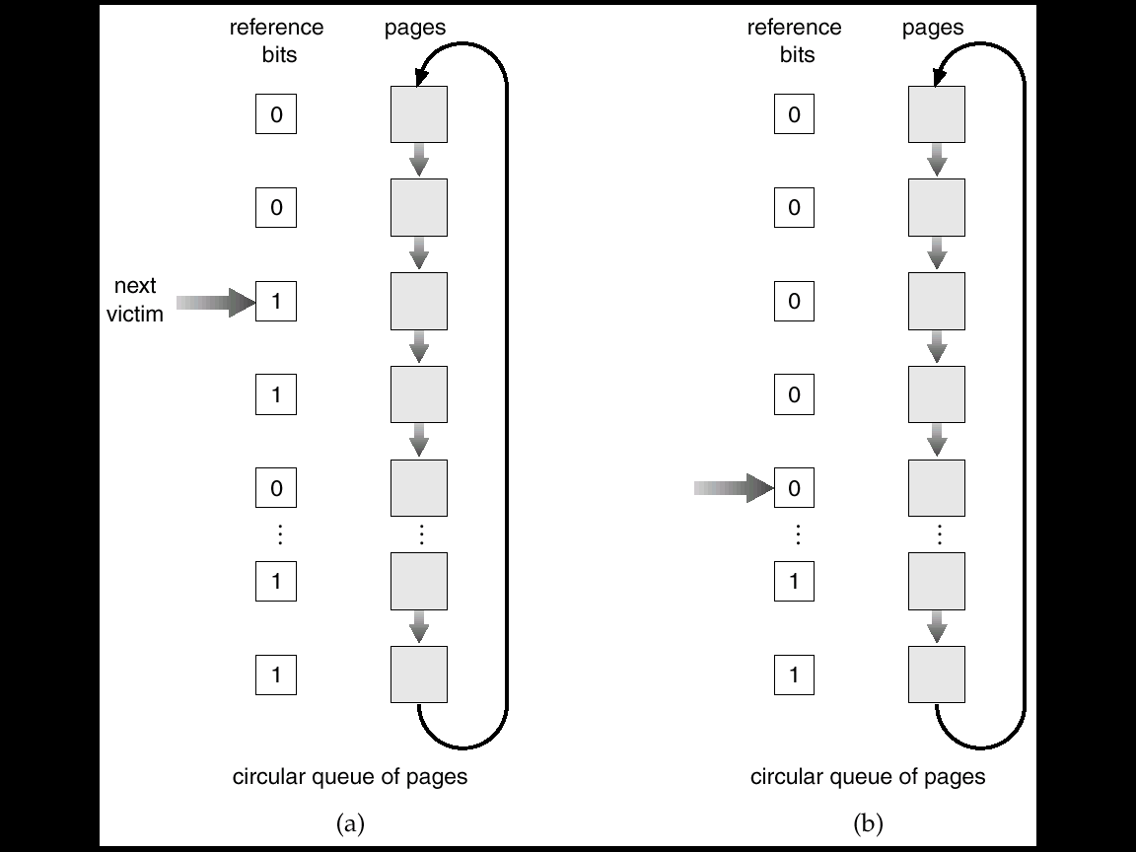
Second-Chance (clock) Page-Replacement Algorithm

Slide 24
Enhanced Clock Policy
In addition to reference bit use modify bit also
(0 ,0) not referenced not modified
(0, 1) Not recently used but modified
(1,0) recently used but not modified
(1,1) recently used and modified

Slide 25
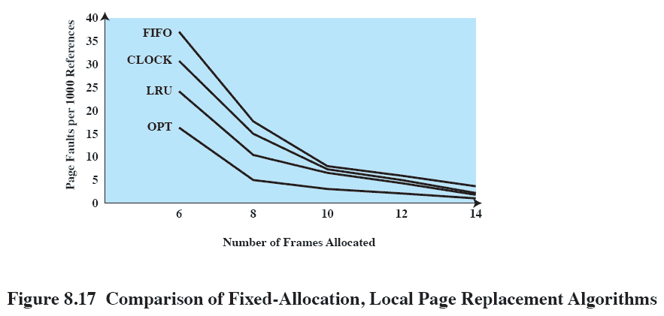
Comparison
Notes:
25

Slide 26
Counting Algorithms
Keep a counter of the number of references that have been made to each page.
LFU Algorithm: replaces page with smallest count.
MFU Algorithm: based on the argument that the page with the smallest count was probably just brought in and has yet to be used.

Slide 27
Allocation of Frames
Each process needs minimum number of pages.
Example:
MOV source, destination
➔instruction is 4 bytes, might span 2 pages.
➔2 pages to handle from.
➔2 pages to handle to.
Two major allocation schemes.
➔fixed allocation
➔priority allocation

Slide 28
Fixed Allocation
Equal allocation – e.g., if 100 frames and 5 processes, give each 20 pages.
Proportional allocation – Allocate according to the size of process.
m
=
64
s₁
=
10
i
s
=
127
2
=
10
×
≈
a
64
5
1
137
=
127
×
≈
a
64
59
2
137

Slide 29
Priority Allocation
Use a proportional allocation scheme using priorities rather than size.
If process P_{i} generates a page fault,
➔select for replacement one of its frames.
➔select for replacement a frame from a process with lower priority number.

Slide 30
Global vs. Local Allocation
Global replacement – process selects a replacement frame from the set of all frames; one process can take a frame from another.
➔ Process cannot control its own Page fault rate
Local replacement – each process selects from only its own set of allocated frames.
➔Number of frames allocated to a process do not change
➔Does not make use of less used pages belonging to other processes

Slide 31
Thrashing
If a process does not have “enough” pages, the page-fault rate is very high. This leads to:
➔low CPU utilization.
➔operating system thinks that it needs to increase the degree of multiprogramming.
➔another process added to the system.
Thrashing ≡ a process is busy swapping pages in and out.
➔ More pronounced for Global page replacement policy

Slide 32
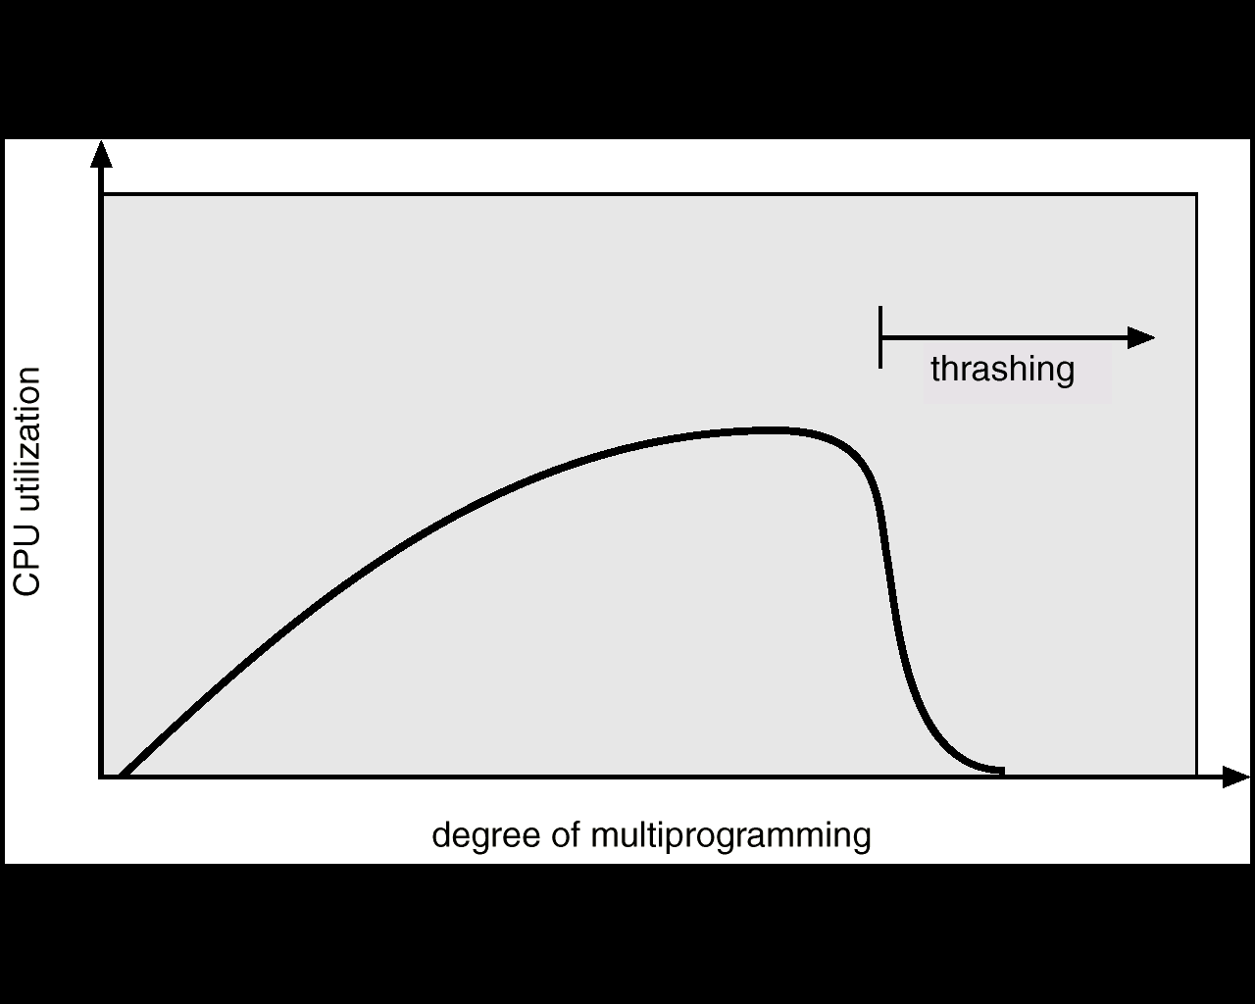
Thrashing
Why does paging work? Locality model
➔Process migrates from one locality to another.
➔Localities may overlap.
Why does thrashing occur? Σ size of locality > total memory size

Slide 33
Working-Set Model
Δ ≡ working-set window ≡ a fixed number of page references Example: 10,000 instruction
WSS_{i} (working set of Process P_{i}) = total number of pages referenced in the most recent Δ (varies in time)
➔if Δ too small will not encompass entire locality.
➔if Δ too large will encompass several localities.
➔if Δ = ∞ ⇒ will encompass entire program.
D = Σ WSS_{i} ≡ total demand frames
if D > m(Total number of available frames) ⇒ Thrashing
Policy if D > m, then suspend one of the processes.

Slide 34
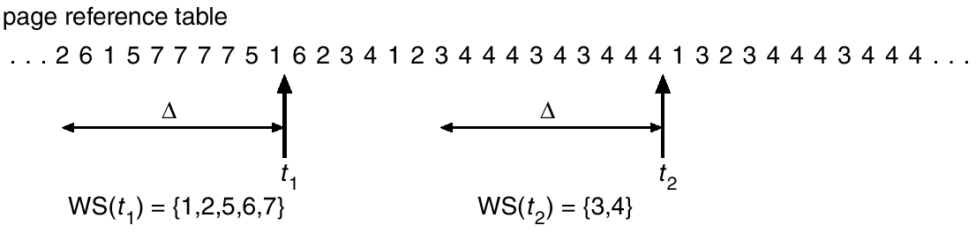
Working-set model

Slide 35
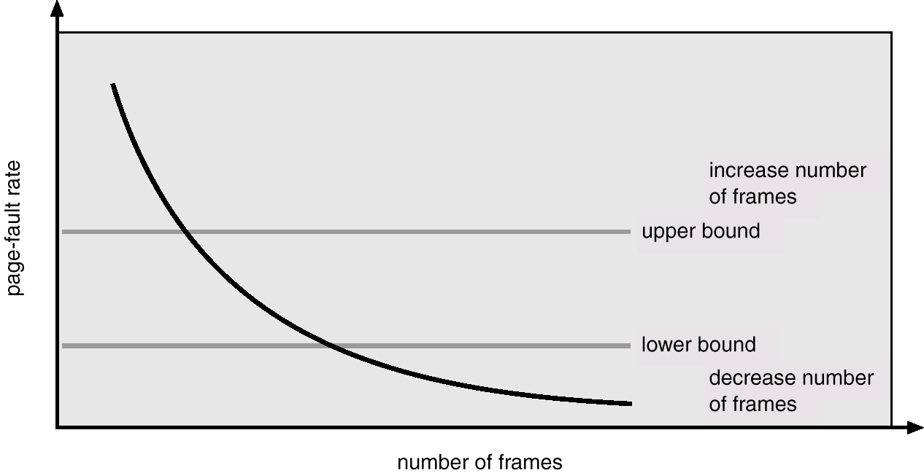
Page-Fault Frequency Scheme
Establish “acceptable” page-fault rate.
➔If actual rate too low, process loses frame.
➔If actual rate too high, process gains frame.

Slide 36
Other Considerations
Page Buffering:
➔Maintain a pool of free frames to quickly restart a faulting process
Can be used to improve performance of some simple page replacement algorithms like FIFO
Prepaging: ➔Bring in the complete working set of a swapped out process to avoid initial multiple faults

Slide 37
Other Considerations (Cont.)
TLB Reach - The amount of memory accessible from the TLB.
TLB Reach = (TLB Size) X (Page Size)
Ideally, the working set of each process is stored in the TLB. Otherwise there is a high degree of page faults.

Slide 38
Other Considerations (Cont.)
Program structure
➔int A[ ][ ] = new int[1024][1024];
➔Each row is stored in one page
➔Program 1 for (j = 0; j < A.length; j++) for (i = 0; i < A.length; i++) A[i,j] = 0; 1024 x 1024 page faults
➔Program 2 for (i = 0; i < A.length; i++) for (j = 0; j < A.length; j++) A[i,j] = 0;
1024 page faults

Slide 39
Thanks

