Slide 1
Replicate CPP usage study
"An analysis of the variability in forty preprocessor-based software product lines
https://github.com/jodokae/cmput663-cpp-replic
Johannes Kaestle and Moein Owhadi Kareshk
University of Alberta

Slide 2
The Motivation
How does program size influence variability?
How complex are extensions made via cpp’s variability mechanisms?
At which level of granularity are extensions applied?
Which types of extension occur?

Slide 3
The Replication
Step #1: Run cppstats on Apache 2.2.11
Step #2: Run cpp on the 5 latest version of Apache and compare them together
Write a straightforward script to generate result and plot everything

Slide 4
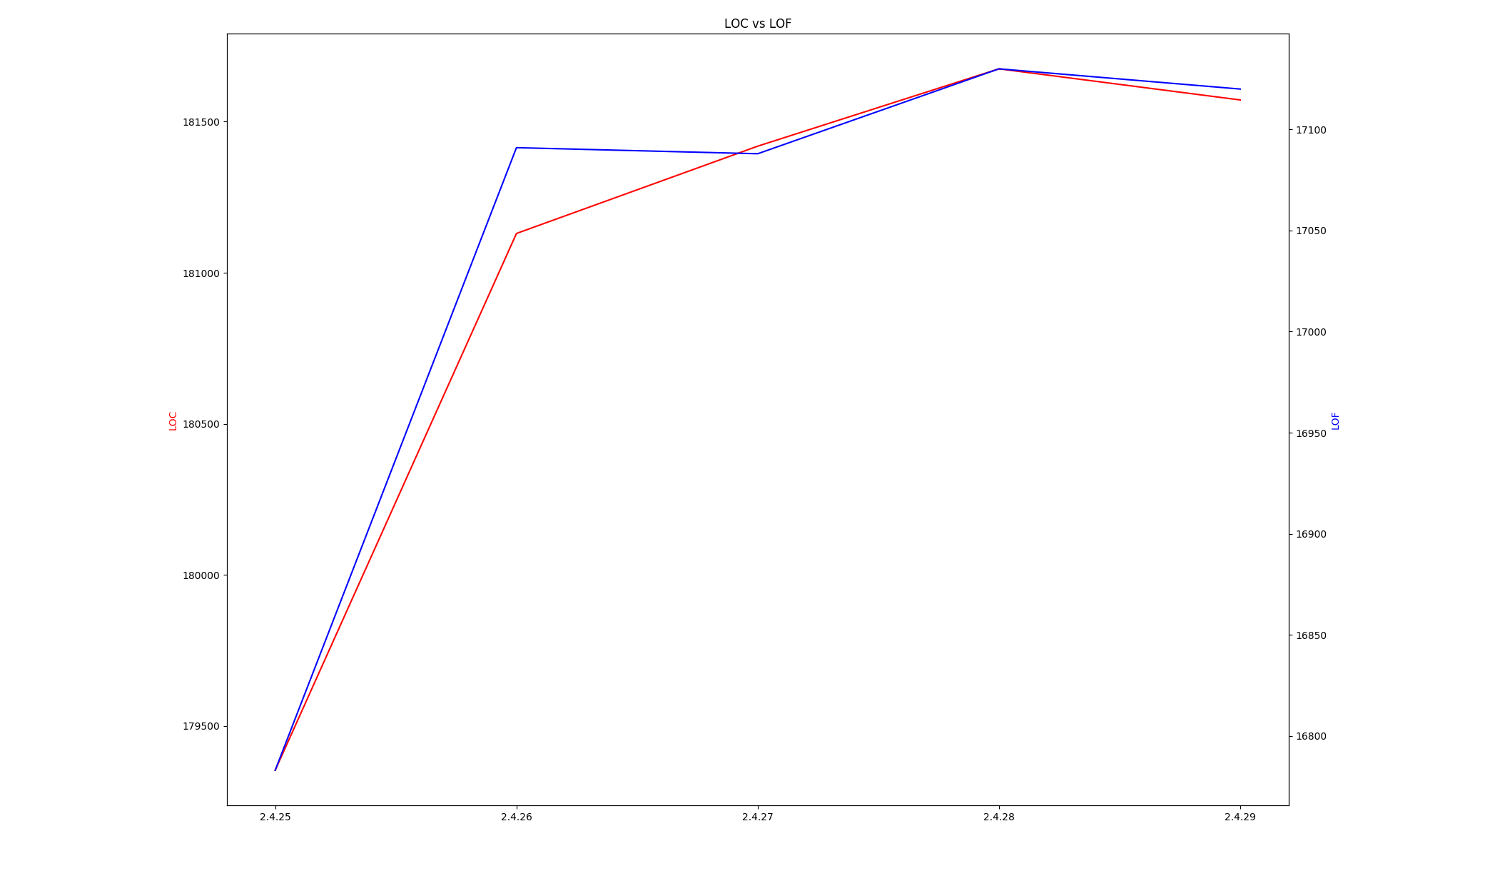
LOC-LOF

Slide 5
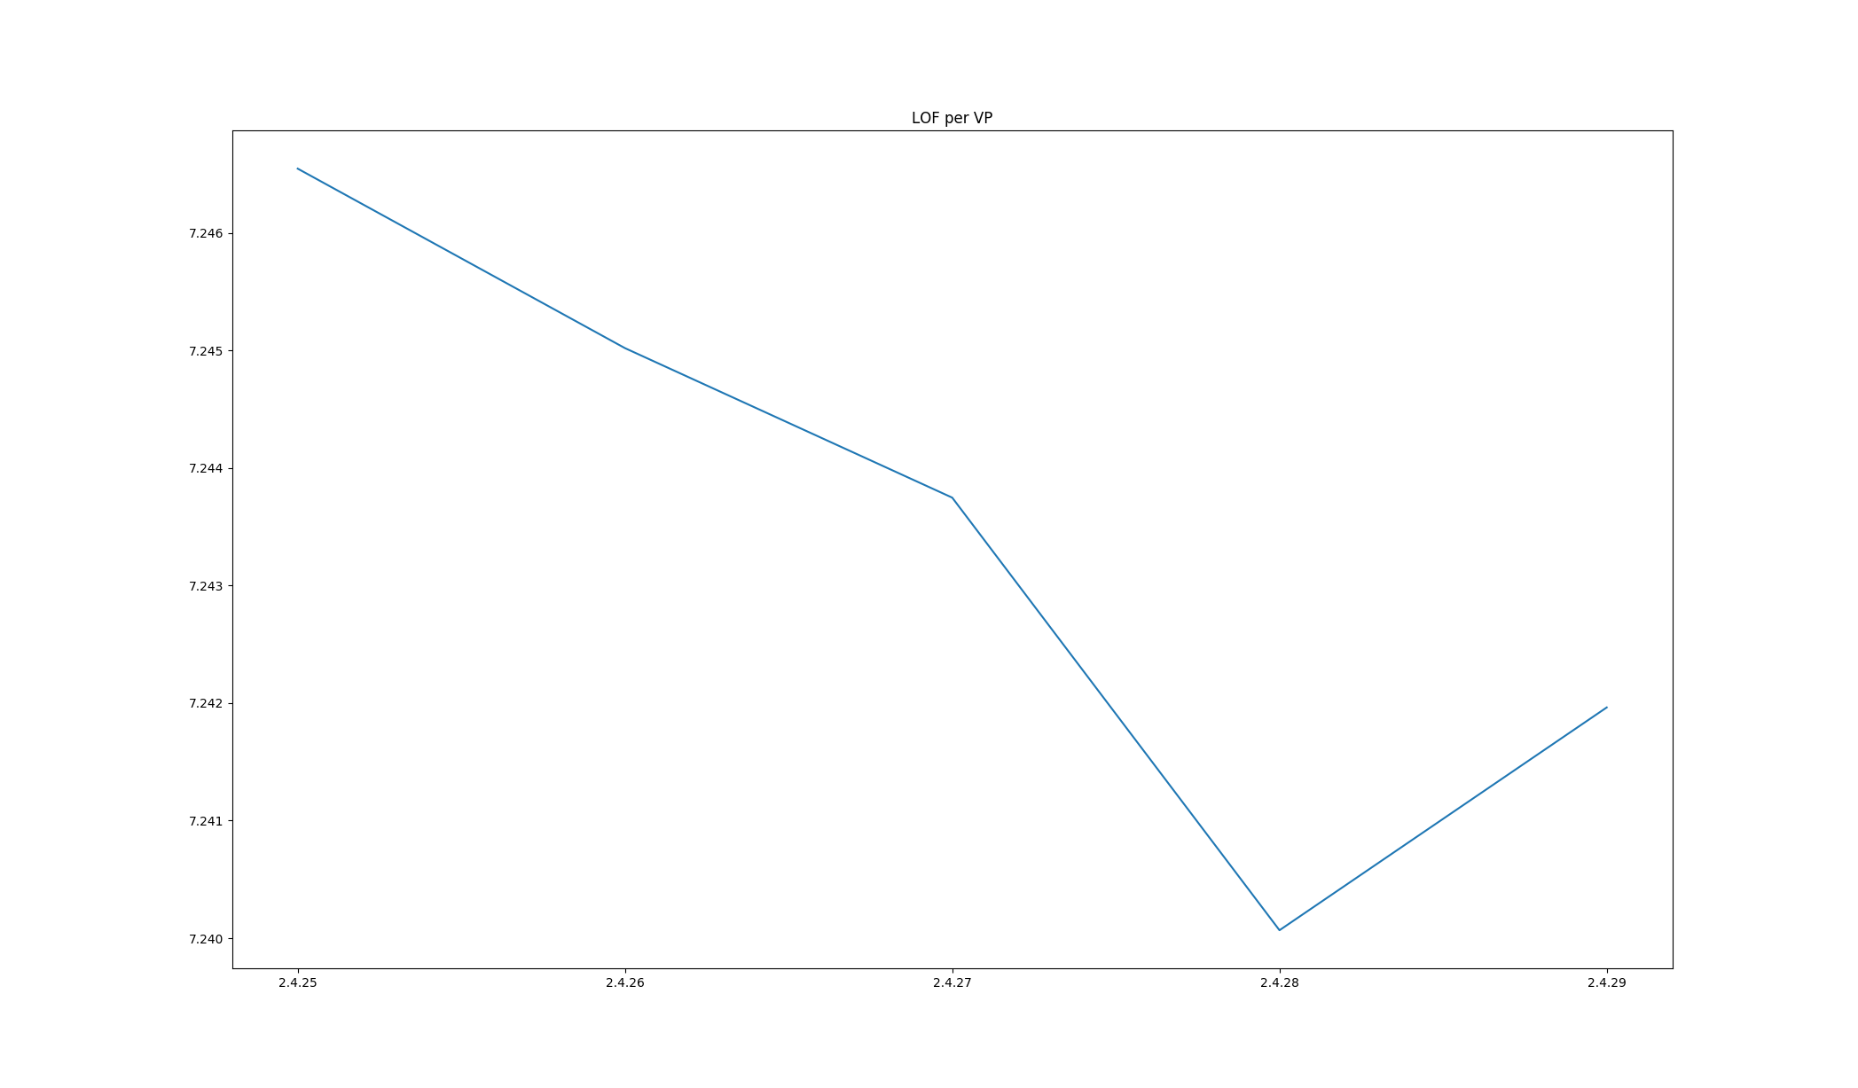
LOF-VP

Slide 6
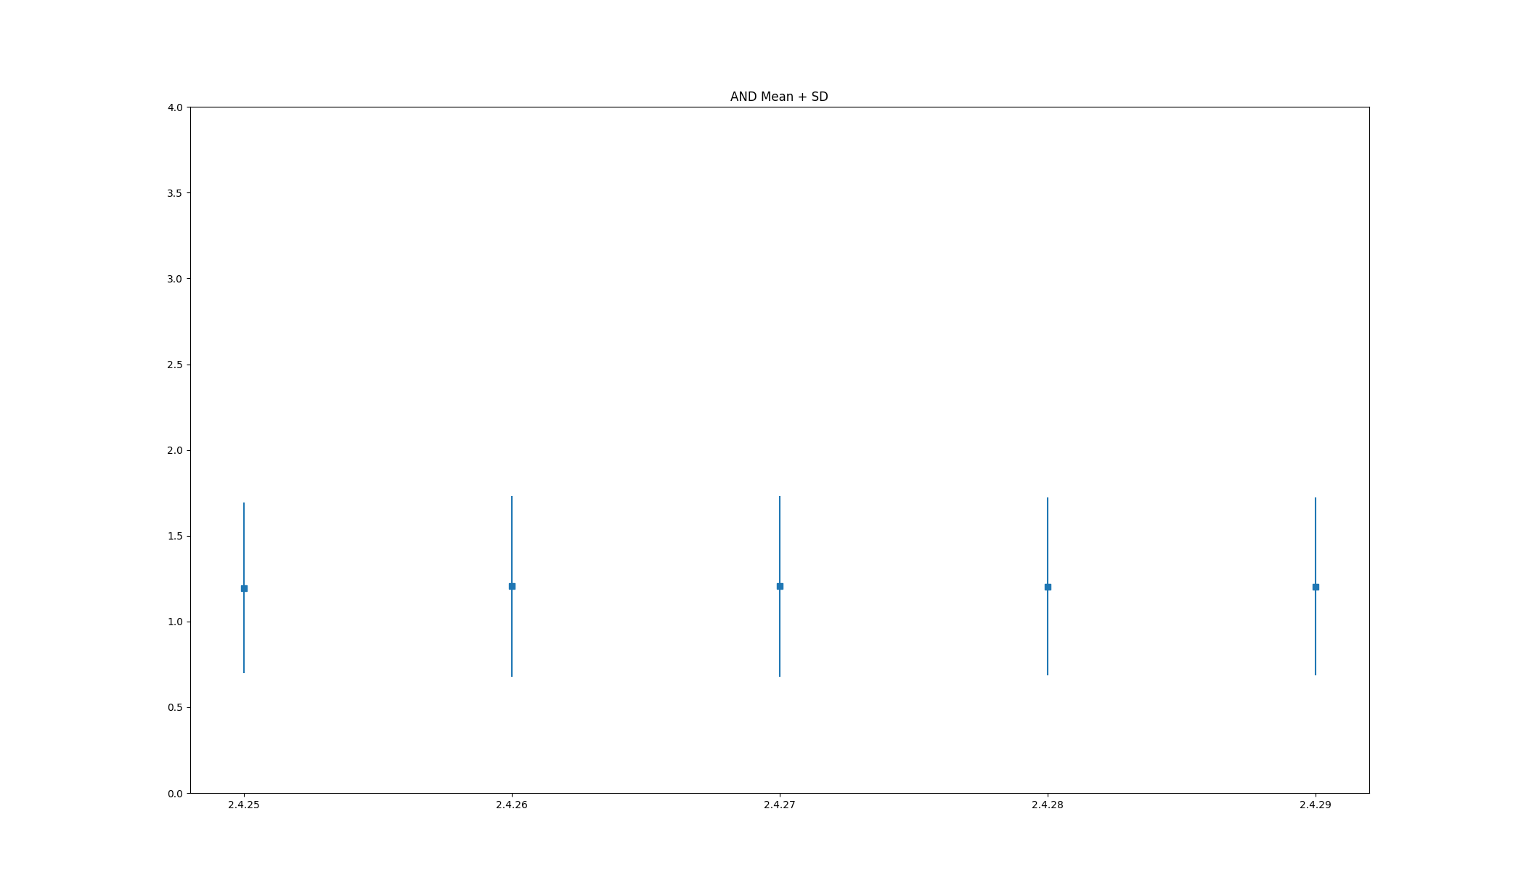
AND

Slide 7
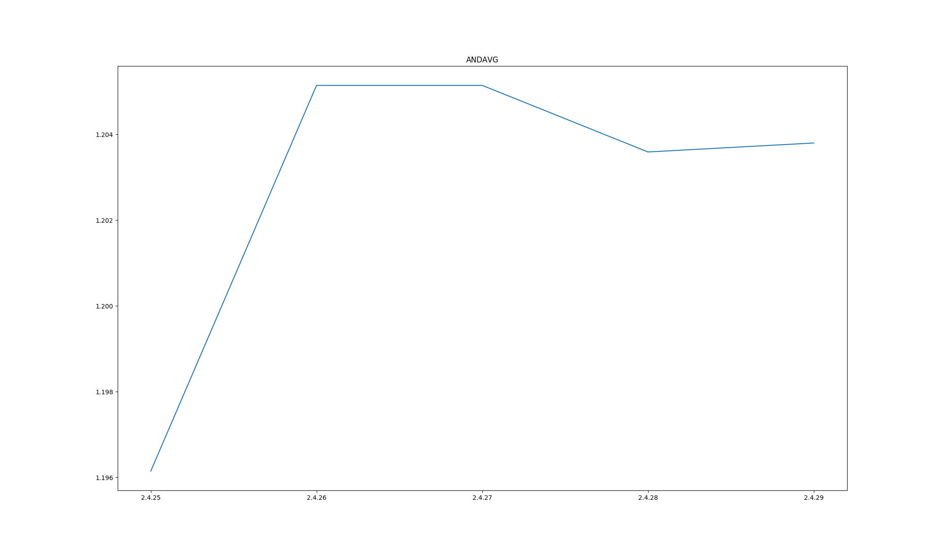
AND - Mean

Slide 8
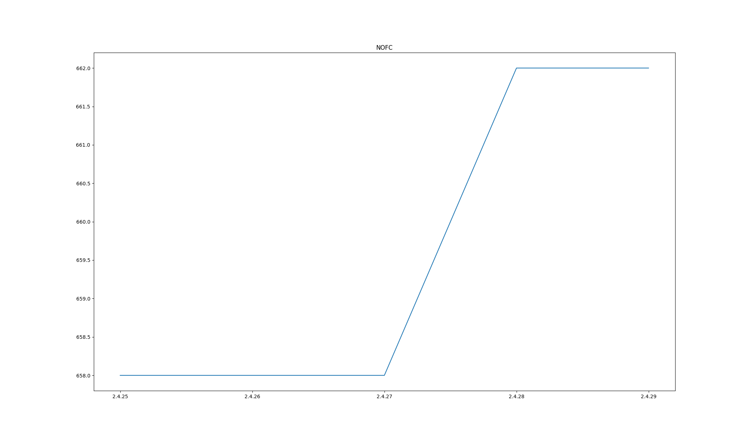
NOFC

Slide 9
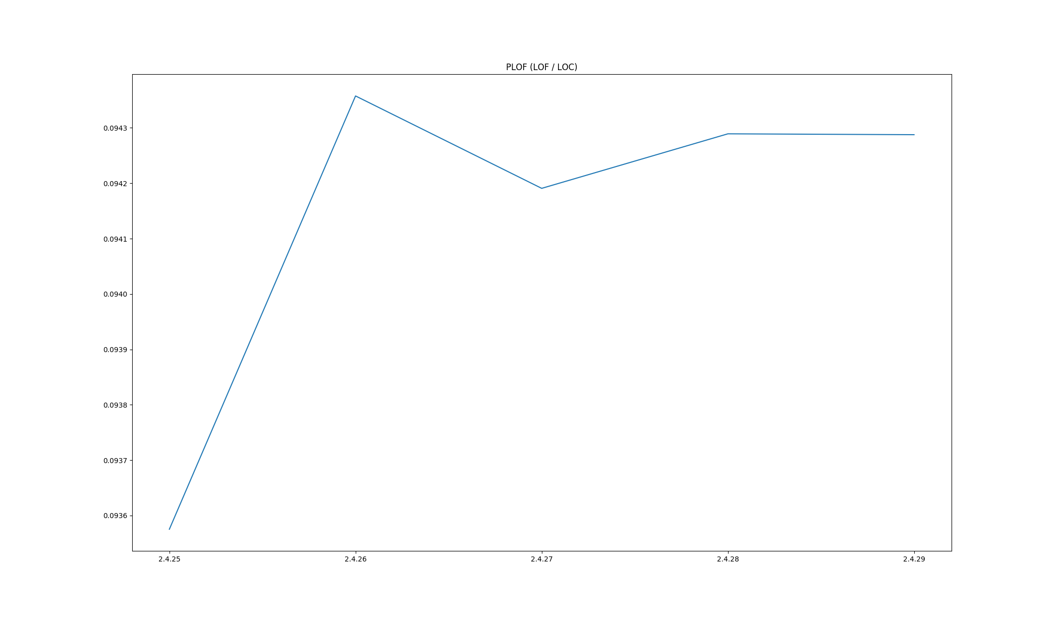
PLOF

Slide 10
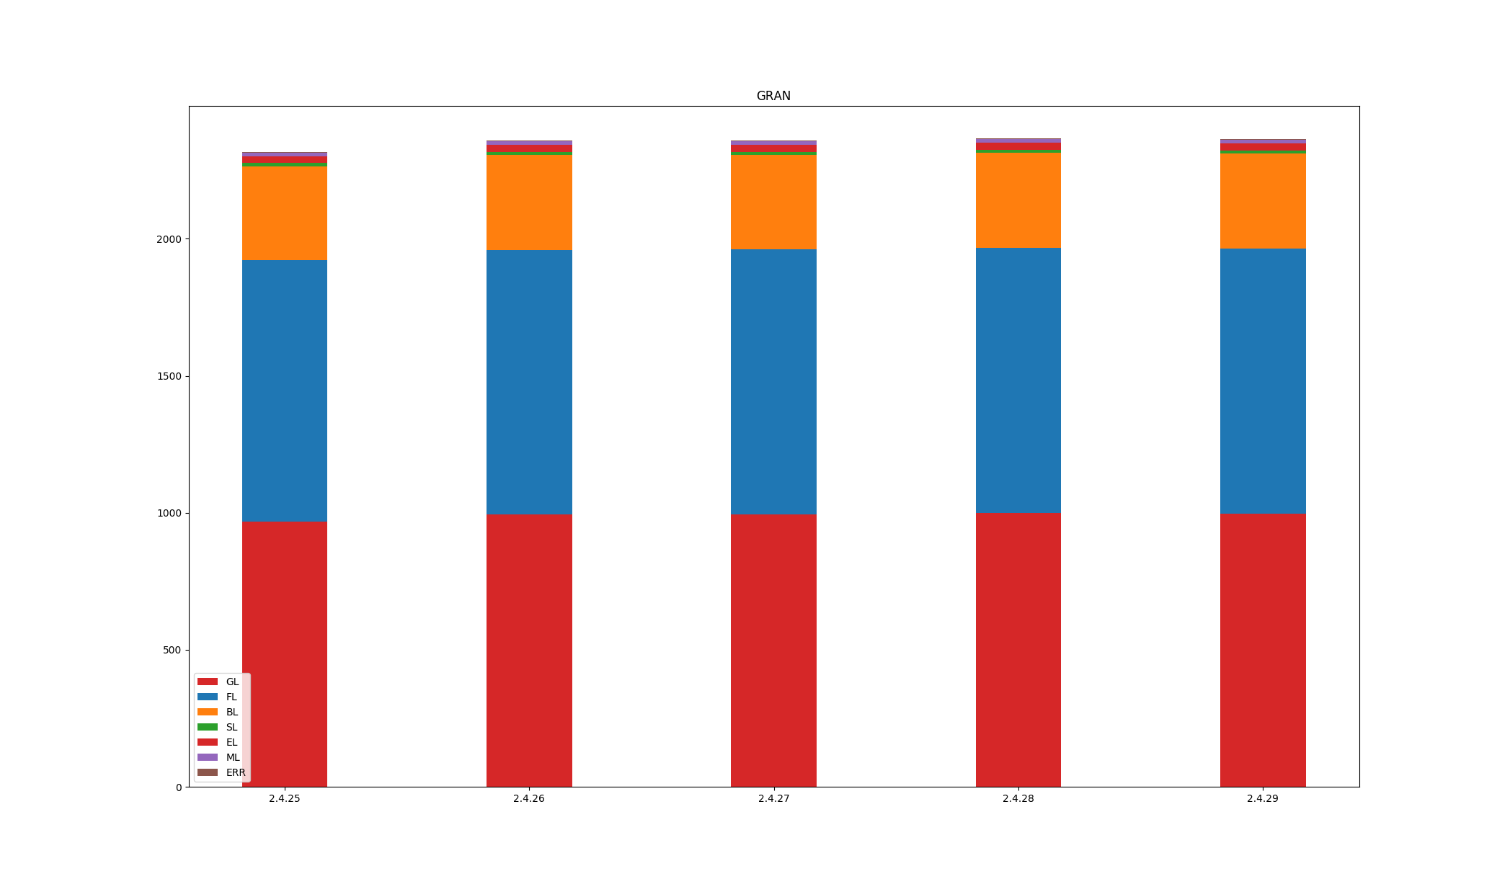
GRAN

Slide 11
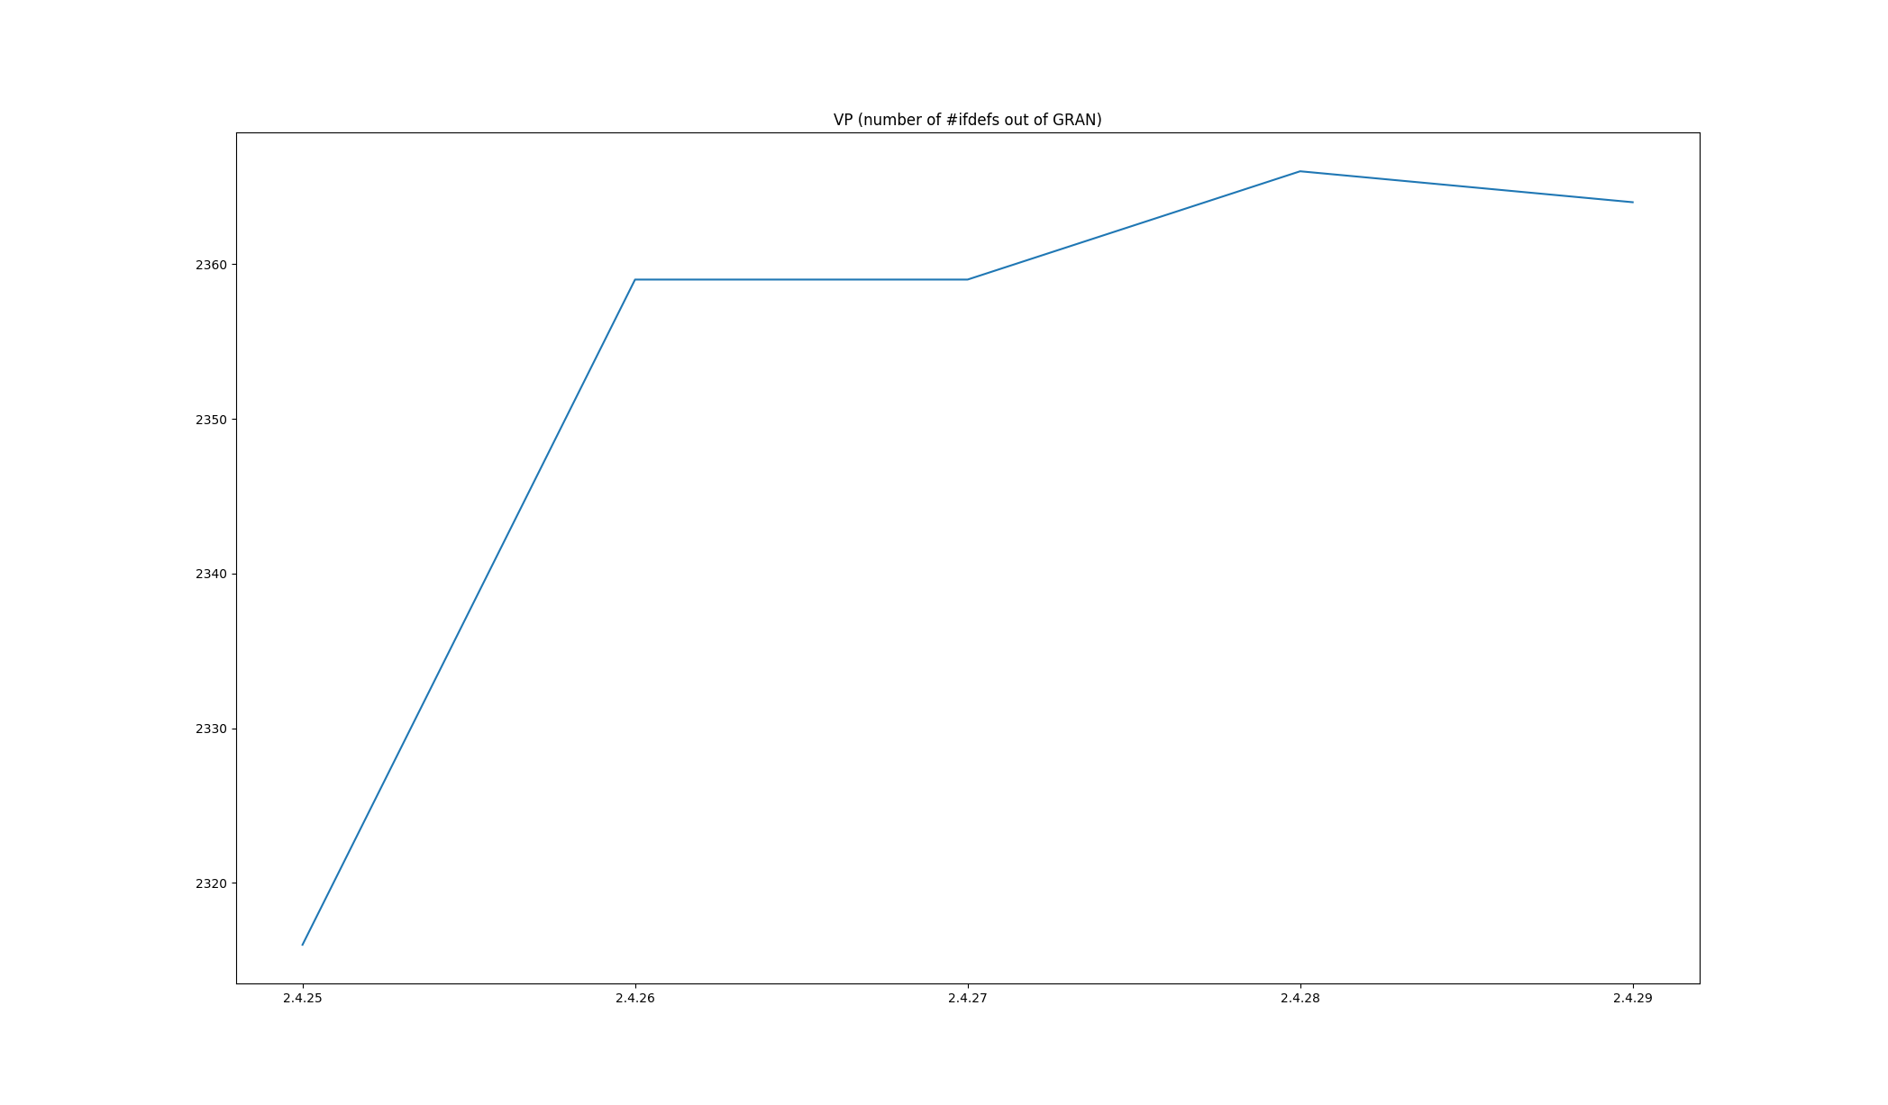
VP

Slide 12
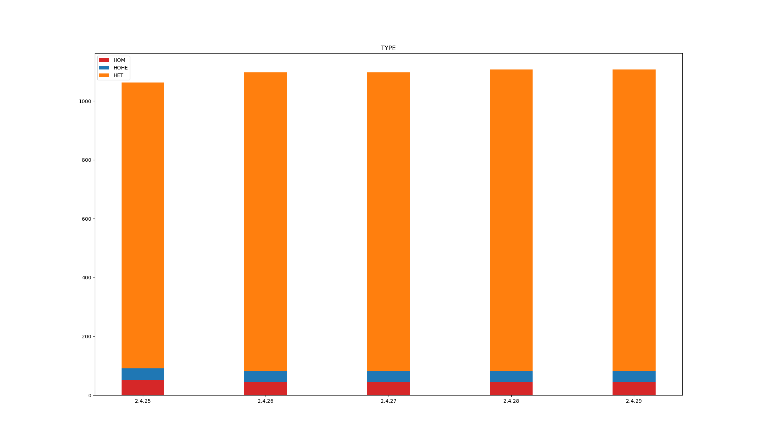
TYPE

Slide 13
Conclusion
Still, Version differences of tools
There are several version of code in different repositories
The script for plotting the figures are not provided by the authors

