Slide 1
Replicate CPP usage study
"An analysis of the variability in forty preprocessor-based software product lines
https://github.com/jodokae/cmput663-cpp-replic
Johannes Kaestle and Moein Owhadi Kareshk
University of Alberta

Slide 2
The Motivation
How does program size influence variability?
How complex are extensions made via cpp’s variability mechanisms?
At which level of granularity are extensions applied?
Which types of extension occur?

Slide 3
The Replication
Step #1: Run cppstats on Apache 2.2.11
Step #2: Run cpp on the 5 latest version of Apache and compare them together
Write a straightforward script to generate result and plot everything

Slide 4
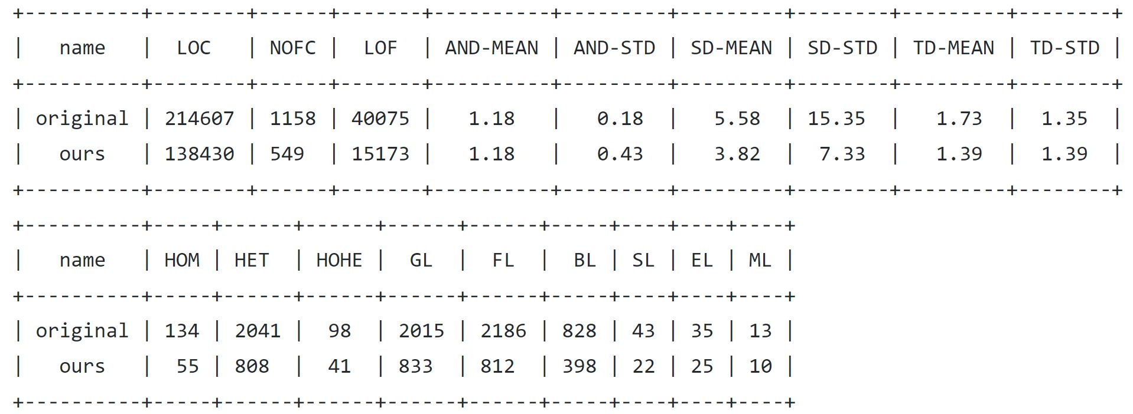
Comparison

Slide 5
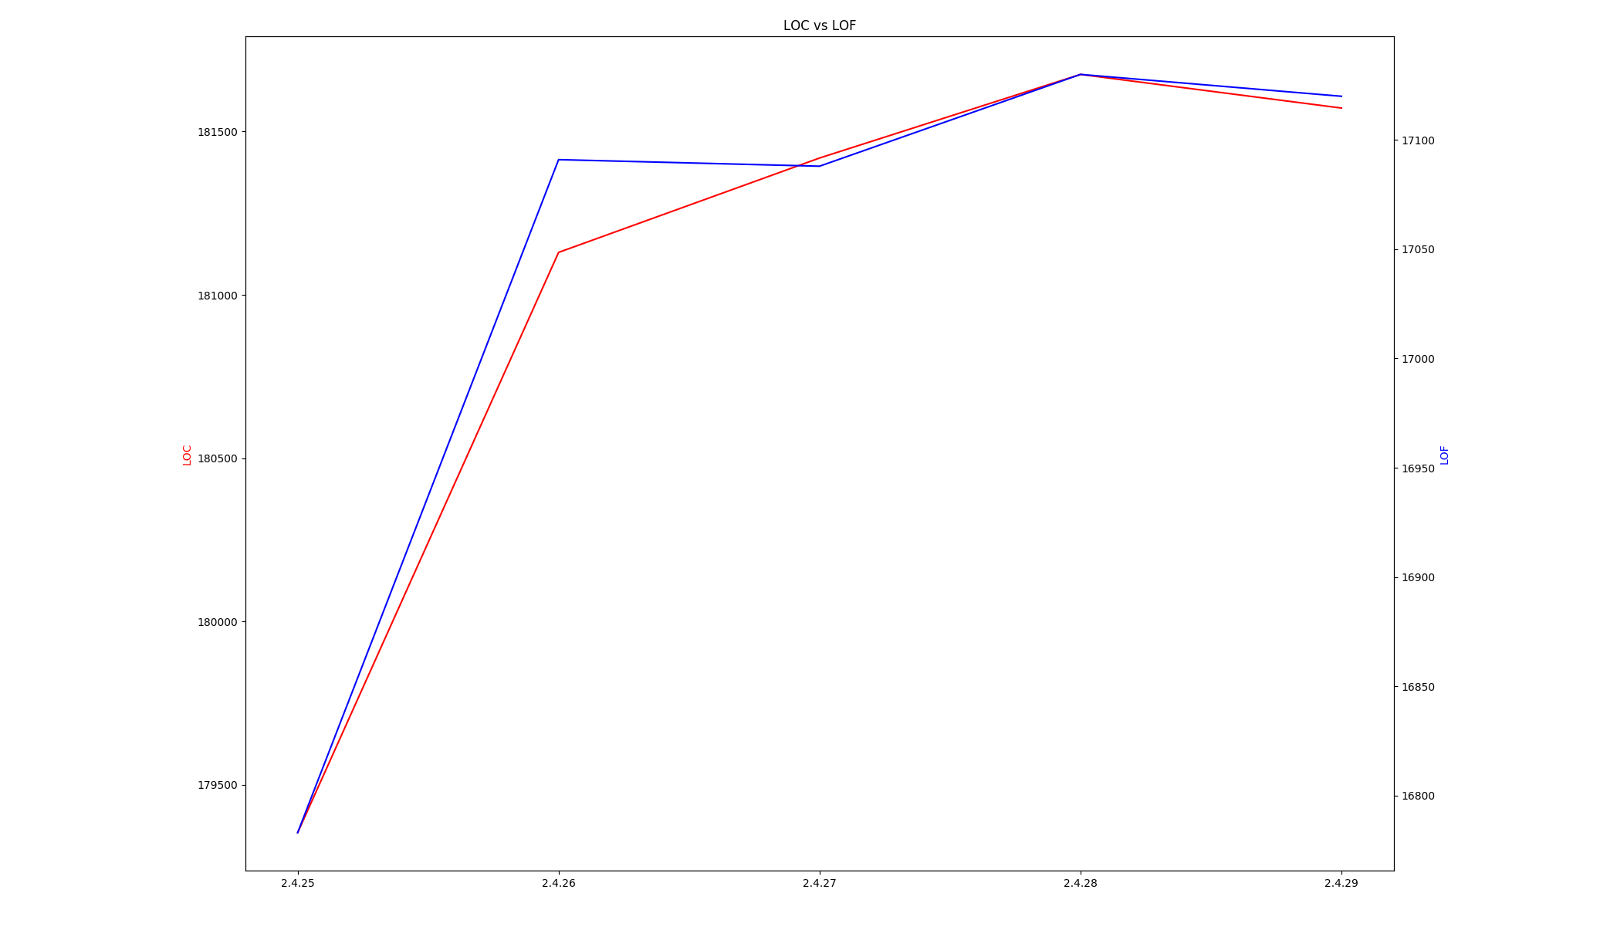
LOC-LOF

Slide 6
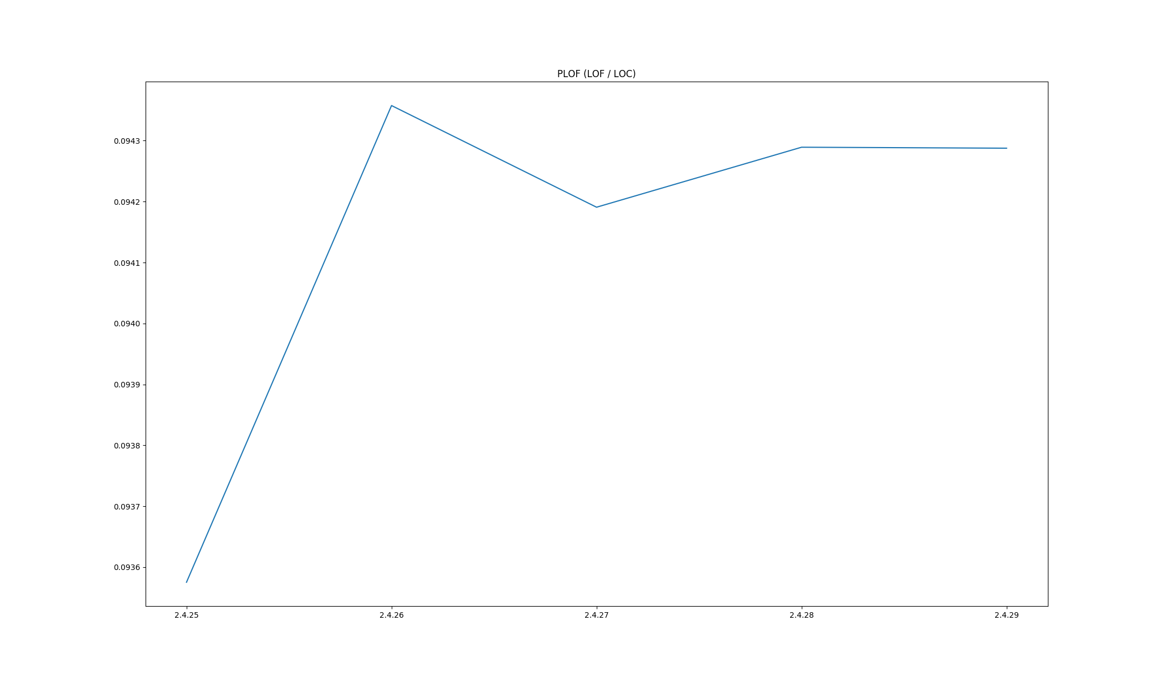
PLOF

Slide 7
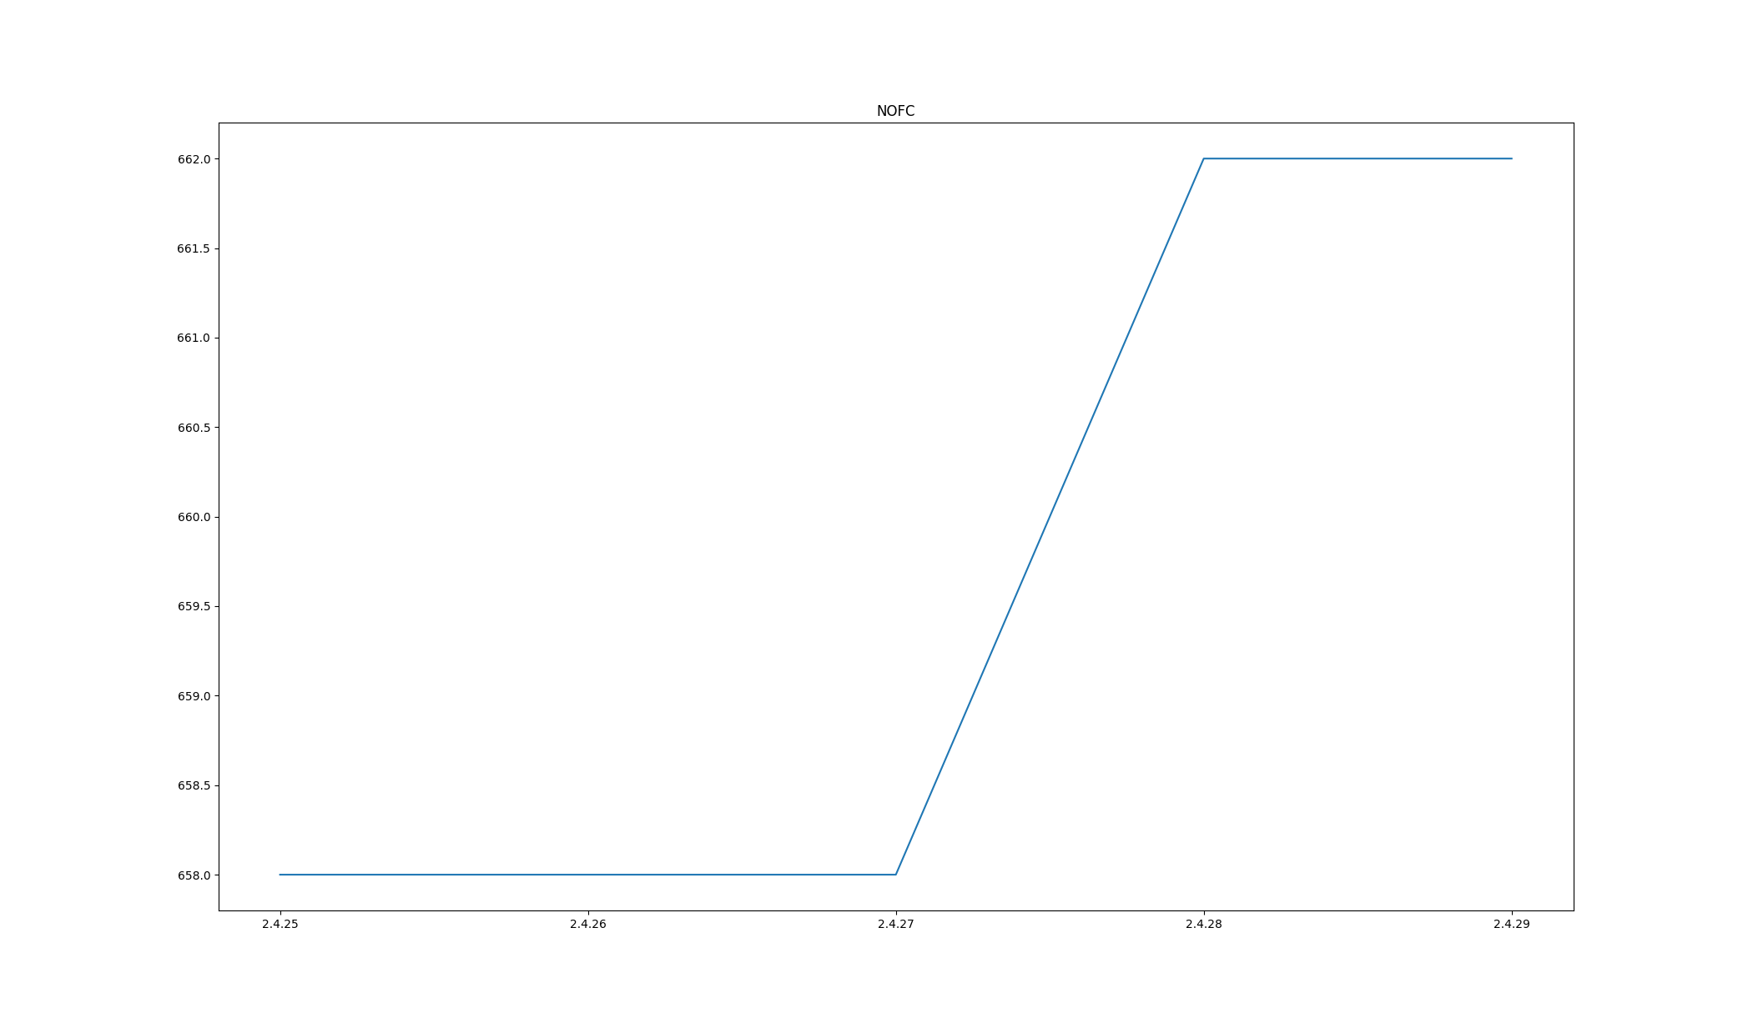
NOFC

Slide 8
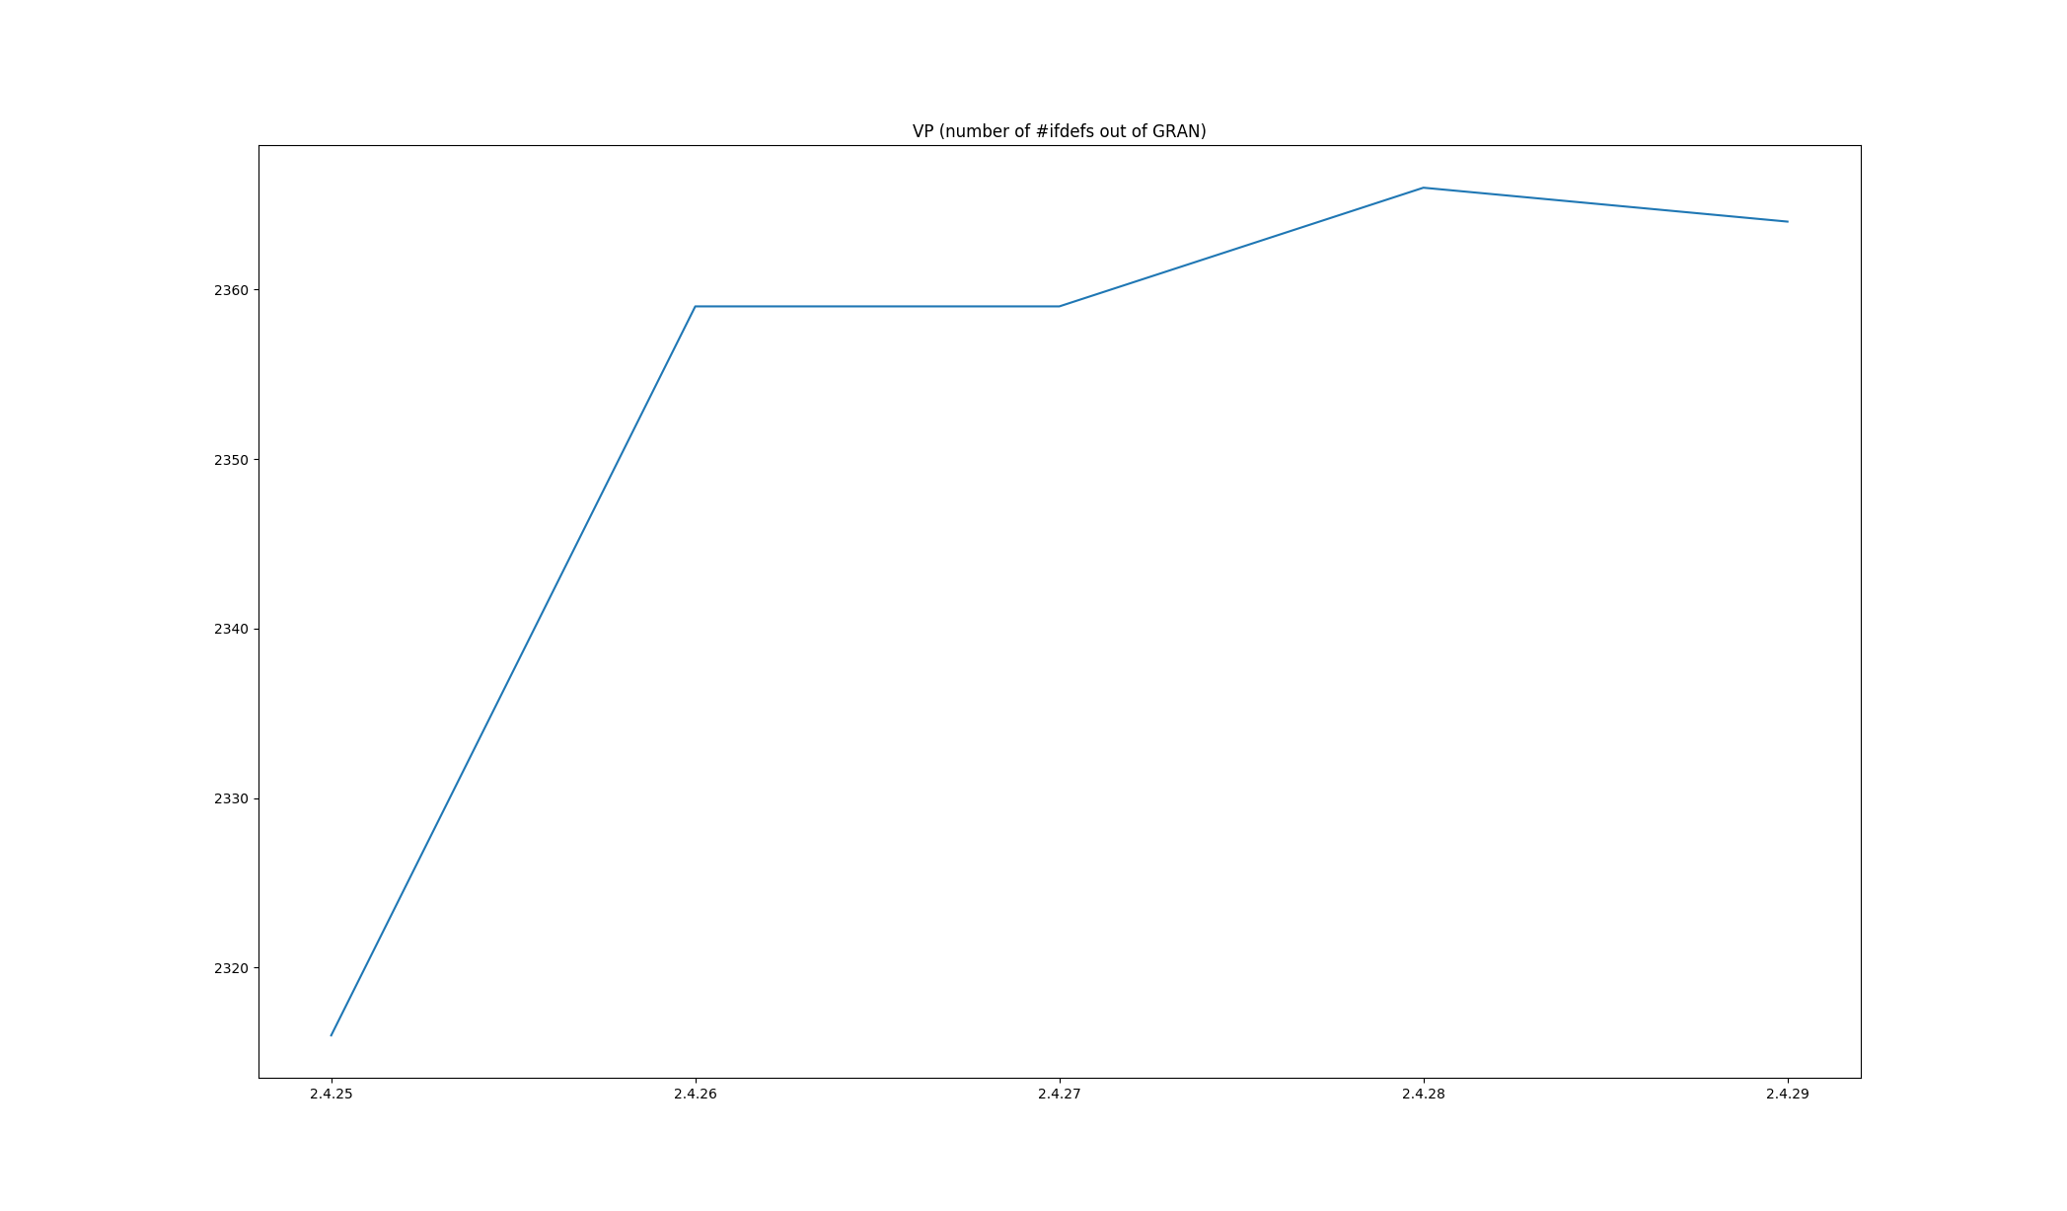
VP

Slide 9
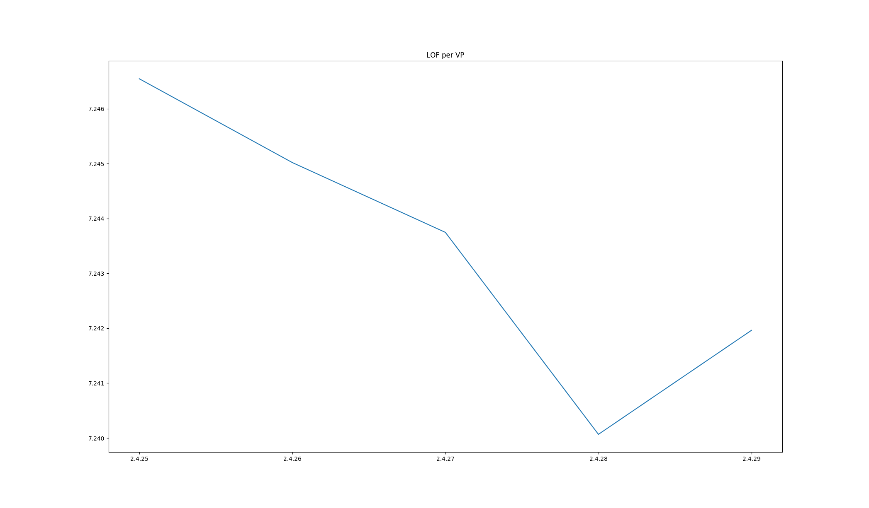
LOF-VP

Slide 10
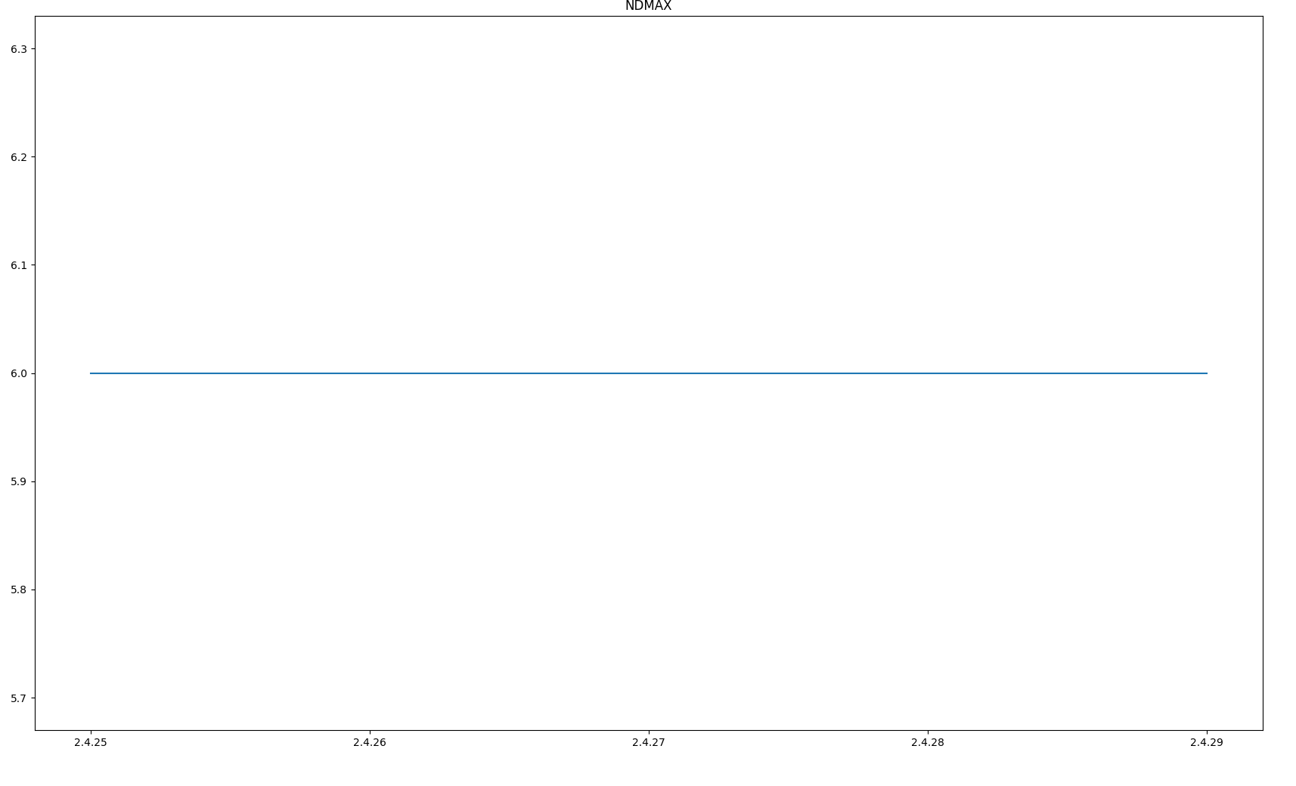
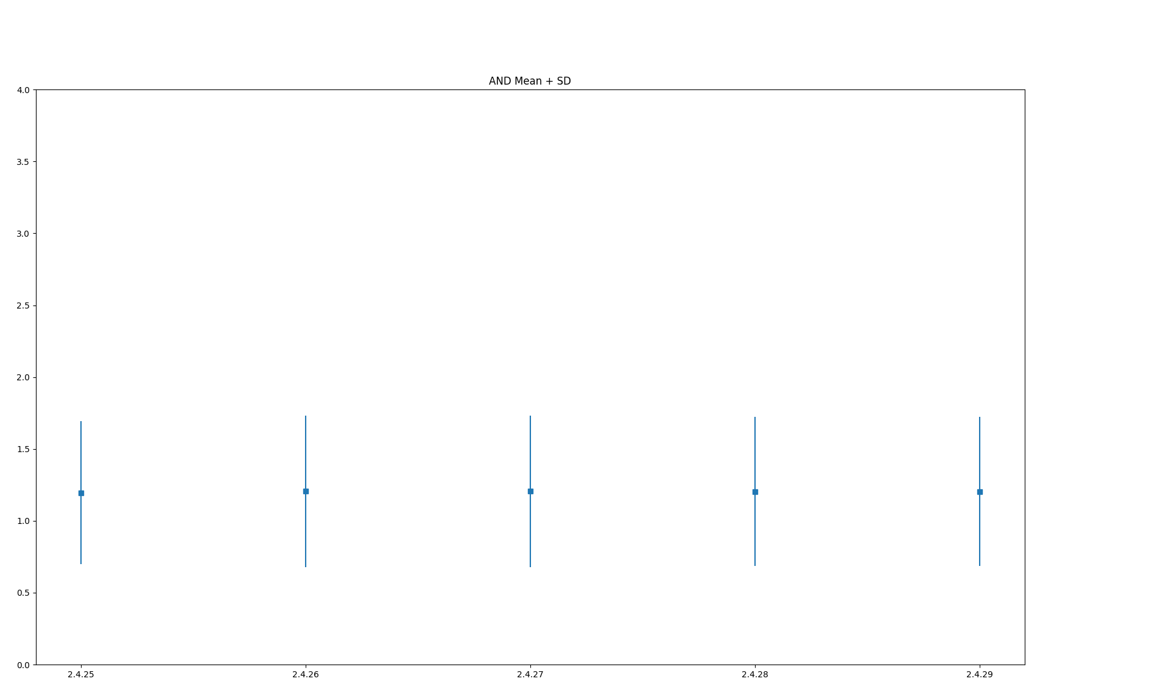
AND

Slide 11
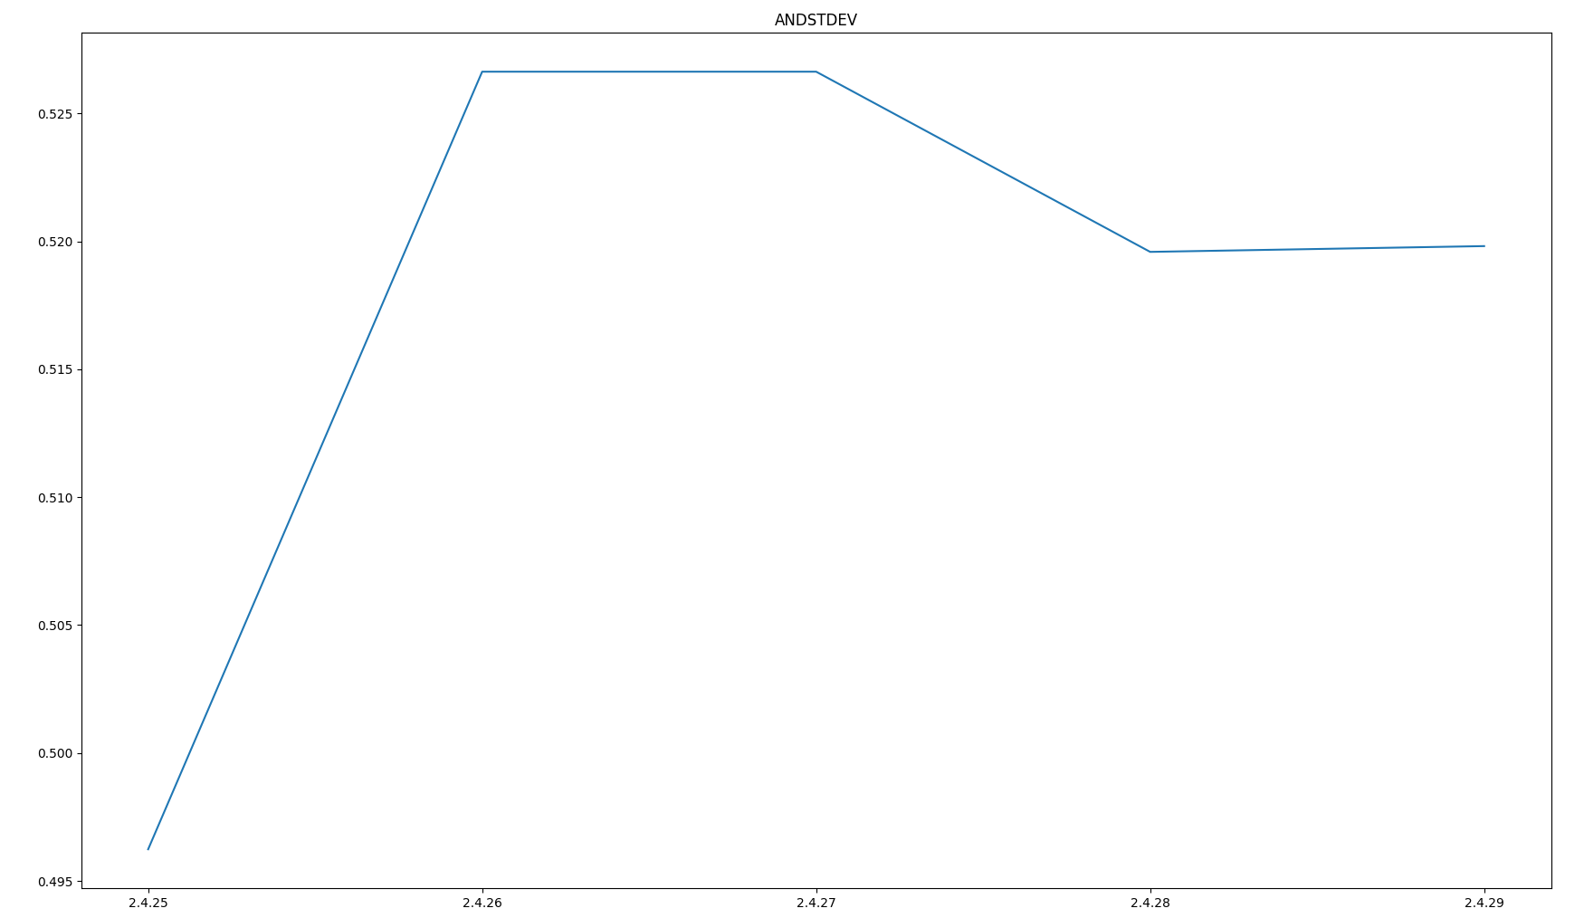
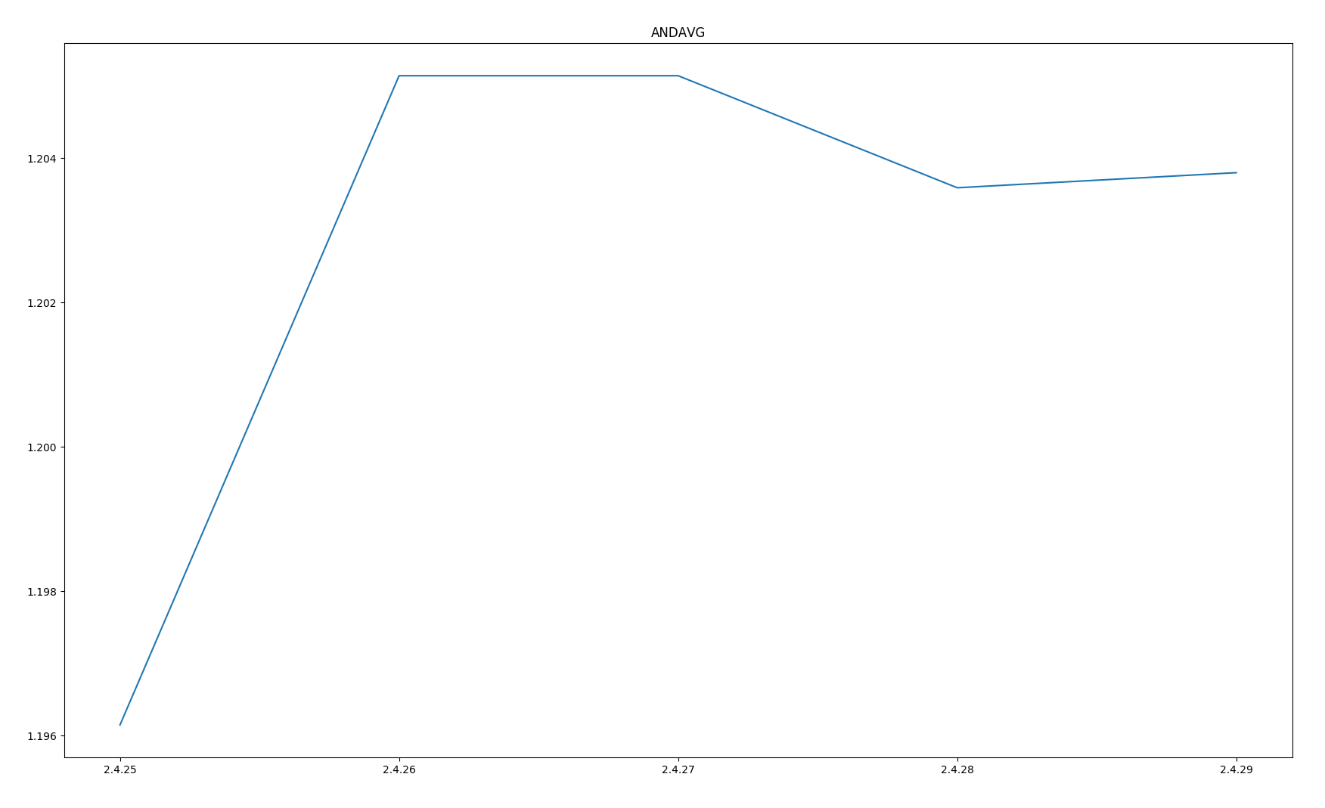
AND - Mean
Similar figures for SD and TD

Slide 12
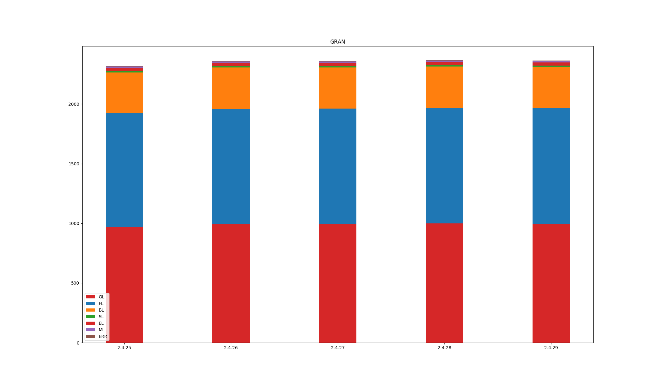
GRAN

Slide 13
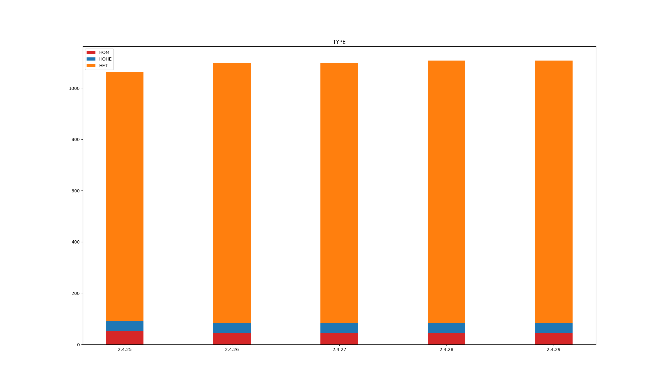
TYPE

Slide 14
Conclusion
Still version differences of tools
Could not reproduce exact results
There are several version of code in different repositories
The script for plotting the figures are not provided by the authors

