Slide 1
Replicate an MSR challenge paper
Sentiment Analysis of Commit Comments in GitHub: An
Empirical Study
(MSR’14)
https://github.com/jodokae/cmput663-msr14-replic
Johannes Kaestle and Moein Owhadi Kareshk
University of Alberta

Slide 2
The Motivation
Is there any relation between the programming language and the sentiment of commit messages?
What is the impact of the weekday on the sentiment of commit messages?
Is the sentiment in commit messages related to the geographical distribution of team members?
Are project approval and the sentiment of commit messages related?

Slide 3
Dataset
90 of the 10-top starred software projects for the 14 top programming languages on Github
In this paper: all projects having more than 200 comments, results in analyzing 29 projects.
60,425 commit comments
Dataset: MSR 2014 Mining Challenge Dataset (http://ghtorrent.org/msr14.html)
Tools for sentiment analysis: SentiStrength (http://sentistrength.wlv.ac.uk/)

Slide 4
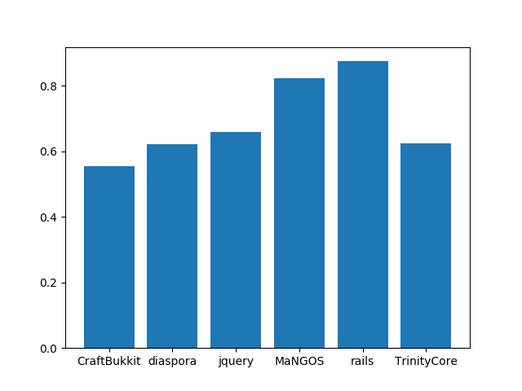
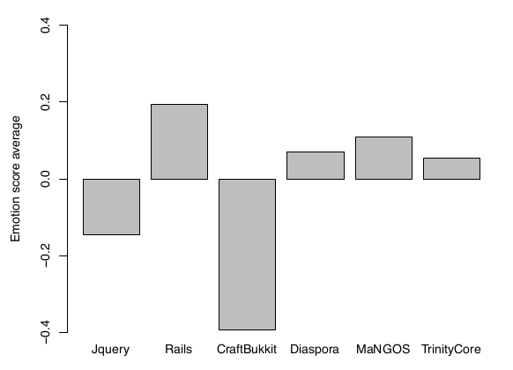
1- Emotions in Commit Comments

Slide 5
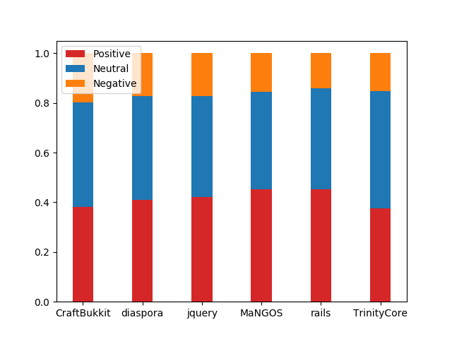
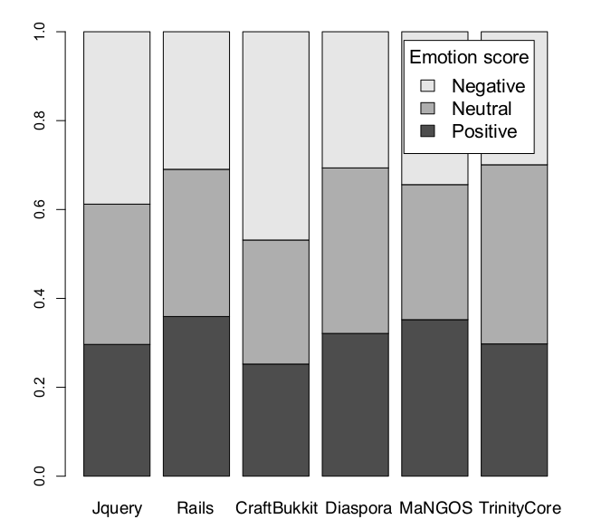
1- Emotions in Commit Comments

Slide 6
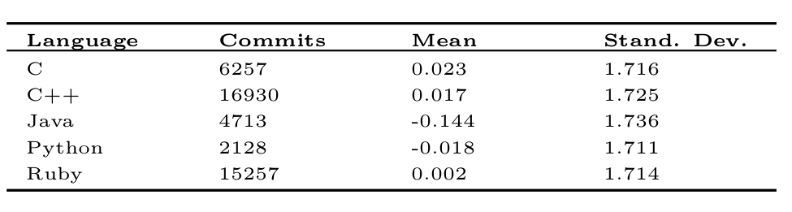
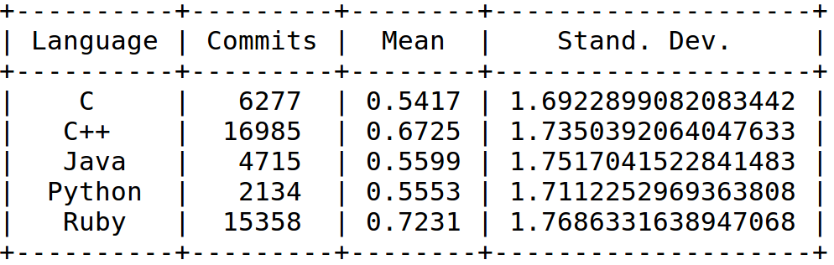
2- Emotions and Programming Language

Slide 7
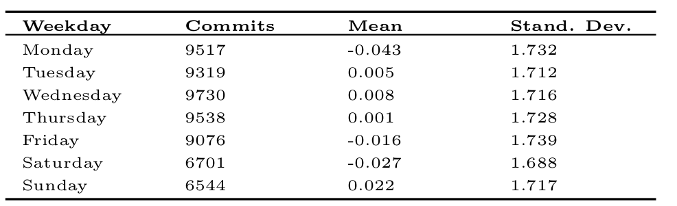
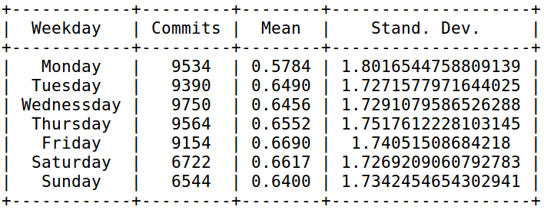
3- Emotions, Day and Time of the Week

Slide 8
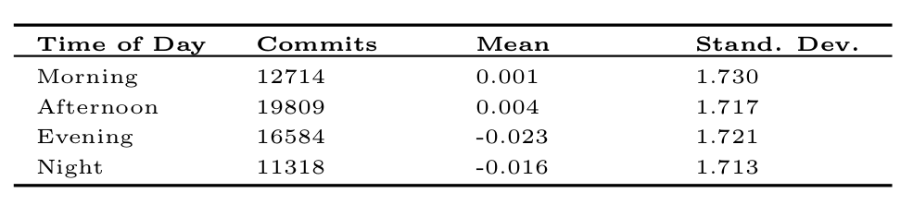
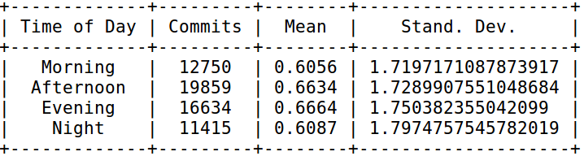
3- Emotions, Day and Time of the Week

Slide 9
4- Emotions and Team Distribution
The authors also worked on the greaographocally distribution of team members.
For this analysis, additional information (continent) is rqureed that is not provided by GitHub, GHTorrent, and the authors.

Slide 10
Conclusion
Version differences of dataset and tools
Unclear description of the procedure of sentiment analysis

