Slide 1
Replicate an MSR challenge paper
Sentiment Analysis of Commit Comments in GitHub: An
Empirical Study
(MSR’14)
Johannes Kaestle and Moein Owhadi Kareshk

Slide 2
The Motivation
Is there any relation between the programming language and the sentiment of commit messages?
What is the impact of data of week on the sentiment of commit messages?
Is the sentiment in commit messages related to the geographical distribution of team members?
Are project approval and the sentiment of commit messages related?
R4) Are emotions in commit comments related to project approval?

Slide 3
Dataset
90 of the 10-top starred software projects for the 14 top programming languages on Github
In this paper: all projects having more than 200 comments, results in analyzing 29 projects.
60,425 commit comments
Dataset: MSR 2014 Mining Challenge Dataset (http://ghtorrent.org/msr14.html)
Tools for sentiment analysis: SentiStrength (http://sentistrength.wlv.ac.uk/)

Slide 4
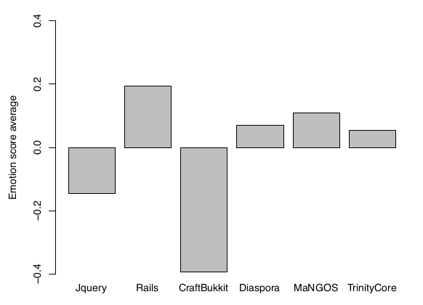
1- Emotions in Commit Comments
Six projects with the highest number of commit comments

Slide 5
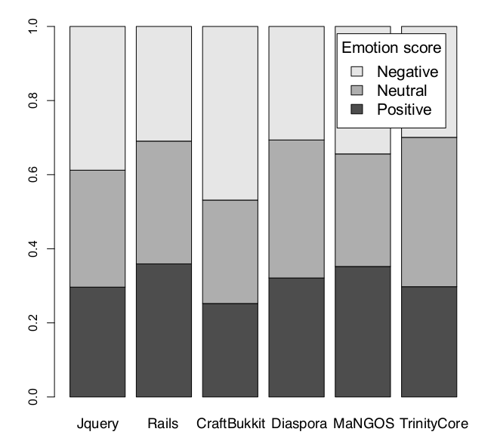

Slide 6
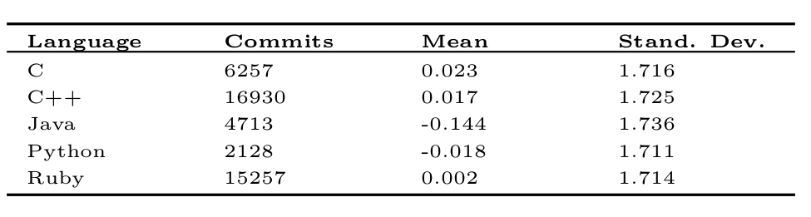

Slide 7
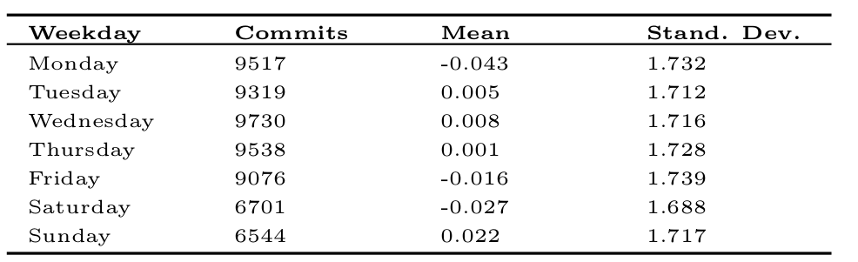

Slide 8
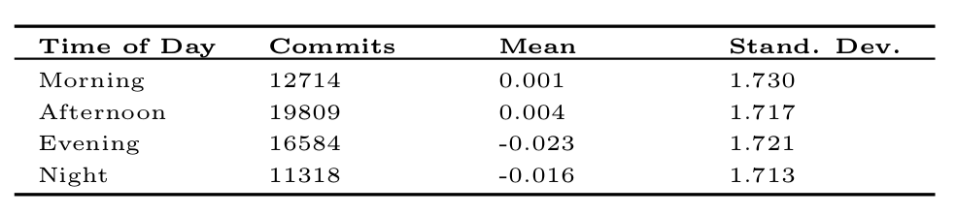

Slide 9
Emotions and Team Distribution
The authors also worked on the greaographocally distribution of team members.
For this analysis, additional information (continent) is rqureed that is not provided by GitHub, GHTorrent, and the authors.

