Slide 1
COP 5556 Programming Language Principles
Language implementation and code improvement

Slide 2
Reference
Scott Chapter 15
Scott Sections 17.1 and 17.2. Skim the rest
I highly recommend reading Chapter 16 when you have a chance, but the material will not be on the exam.

Slide 3
The phases of compilation are commonly grouped in
front end responsible for the analysis of source code
back end responsible for the synthesis of target code.

Slide 4
A plausible seven-phase structure for a conventional compiler is shown on the next slide
First three phases (scanning, parsing, and semantic analysis) are language-dependent
Last two (target code generation and machine-specific code improvement) are machine dependent
The middle two (intermediate code generation and machine-independent code improvement) are dependent on neither the language nor the machine

Slide 5
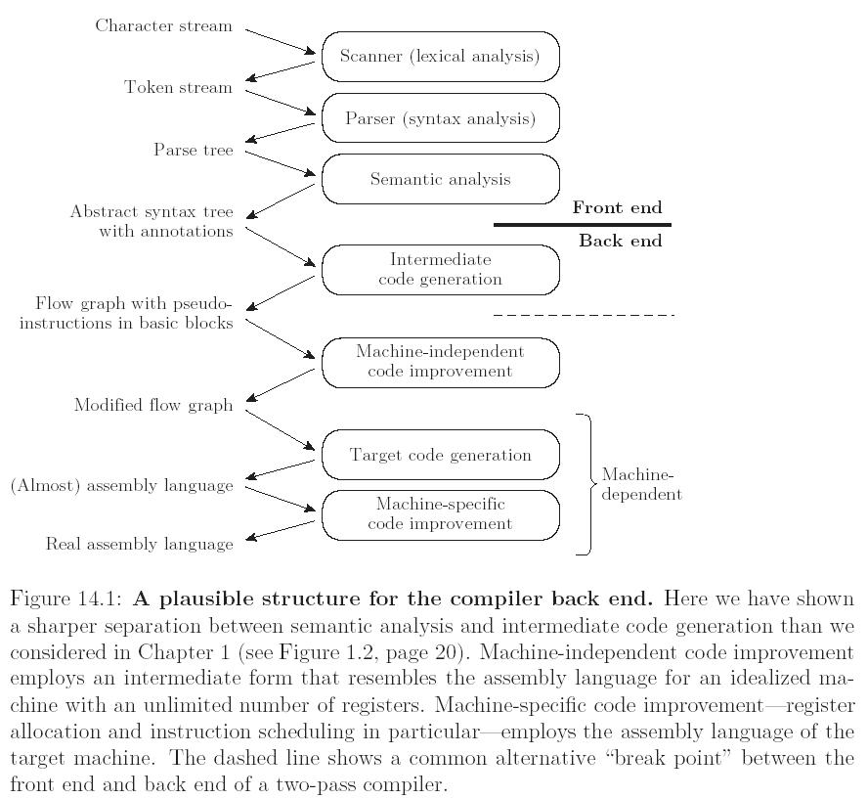

Slide 6
Why intermediate code generation?
Most code improvement can be done more easily on less hierarchical structure than AST
Typical approach
The code generator groups the nodes into basic blocks
It then creates a control flow graph

Slide 7
Defintions
Basic block
maximal-length set of instructions that should execute sequentially at runtime, with no branches in or out.
start with target of jump, or a statement after a conditional jump (ignoring beginning and end of program)
ends with a jump
In this example compiler, operations are instructions for idealized machine with an unlimited number of virtual registers
By allocating a new register for every computed value, the compiler can avoid creating artificial connections between otherwise independent computations too early in the compilation process
Control flow graph
nodes are basic blocks
arcs are interblock control flow

Slide 8
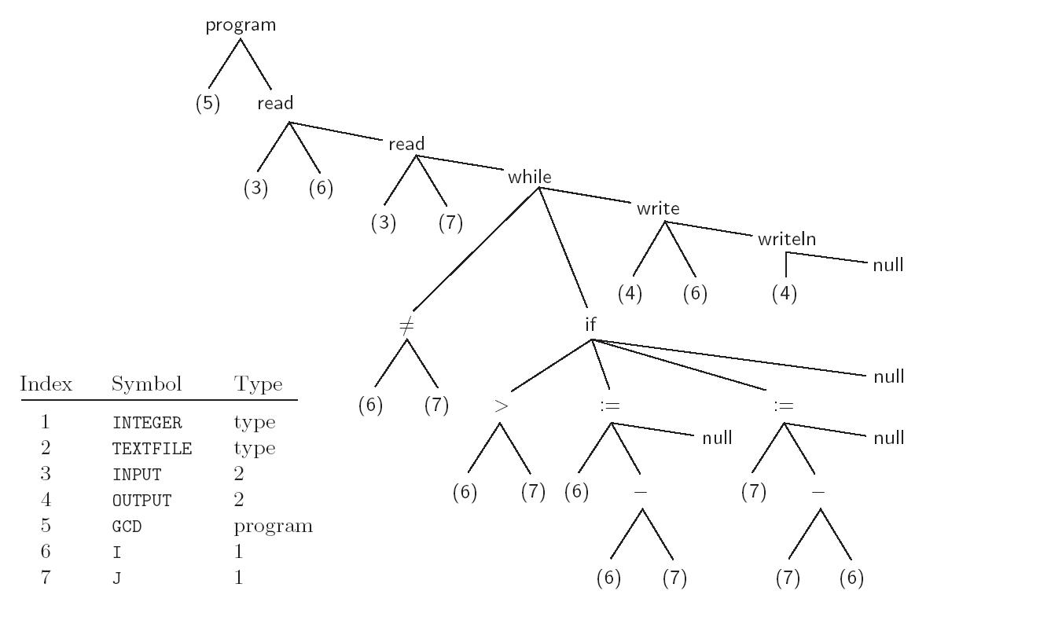

Slide 9
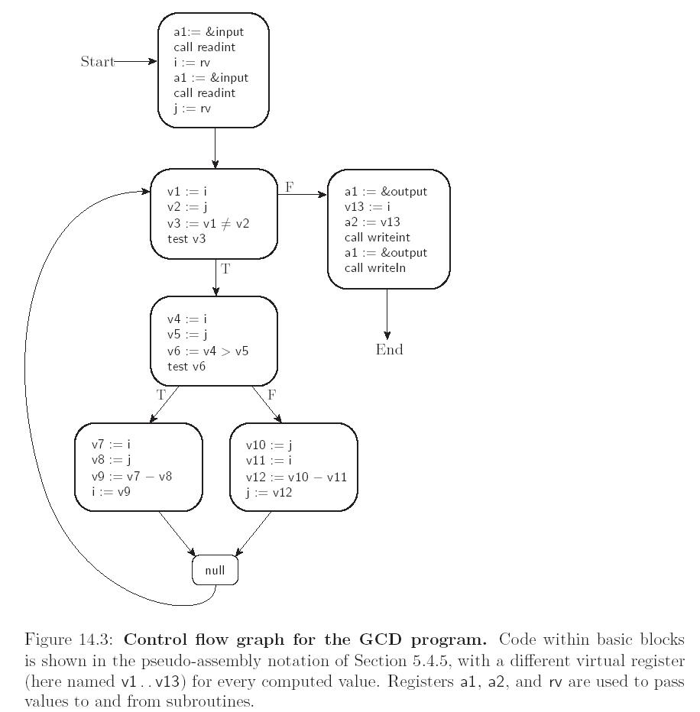

Slide 10
Machine independent code improvement
Transformations on the control flow graph.
local code improvement modifies the instruction sequence within each basic block to eliminate redundant loads, stores, and arithmetic computations
global code improvement identifies and removes a variety of redundancies across the boundaries between basic blocks within a subroutine
an expression whose value is computed immediately before an if statement need not be recomputed after else
An expression that appears within the body of a loop need only be evaluated once if its value will not change in subsequent iterations
Some global improvements change the number of basic blocks and/or the arcs among them

Slide 11
Target code generation
strings the basic blocks together into a linear program,
translates each block into the instruction set of the target machine
generates branch instructions (or “fall-throughs”) that correspond to the arcs of the control flow graph.
The output of this phase differs from real assembly language primarily in its continued reliance on virtual registers

Slide 12
Machine specific code improvement
register allocation
map the unlimited virtual registers onto the bounded set of registers available in the target machine
If there aren’t enough architectural registers to go around, we may need to generate additional loads and stores to multiplex a given architectural register among two or more virtual registers
instruction scheduling
reordering the instructions of each basic block to fill the pipeline(s) of the target machine
code improvement

Slide 13
IF Intermediate forms:
Link between front and back end of compilers
Can be classified by their level—degree of machine independence
Common examples:
trees or DAGs
stack-based
3-address instructions
Many compilers use more than one intermediate form

Slide 14
trees or DAGs
reflect structure of language
facilitates
incremental program updates (e.g. in a language-based editor)
direct interpretation
can be specified by attribute grammars

Slide 15
stack based IF (Java byte code, Pascal pcode)
simple and compact
don’t lend themselves to many important code improvements on modern machines
examples
Java byte code
Pascal P-code
Postscript
compactness more important than efficiency
printing time dominated by network delays, handling paper, etc.

Slide 16
3 address instructions
instructions for simple, idealized machine
typically with infinite register
typical instruction specifies two operands, an operator, and a destination
sometimes called quadruples

Slide 17
Different compilers use different IFs
Many compilers use more than one IF internally
the syntax trees passed from semantic analysis to intermediate code generation constitute a high level IF
control flow graphs containing pseudo-assembly language (passed in and out of machine-independent code improvement) are a medium level IF
the assembly language of the target machine serves as a low level IF
Compilers that have back ends for different target architectures do as much work as possible on a high or medium level IF
the machine-independent parts of the code improvement can be shared by different back ends

Slide 18
Address space organization
Assemblers, linkers, and loaders typically operate on a pair of related file formats
relocatable object code
executable object code
Relocatable object code is acceptable as input to a linker
multiple files in this format can be combined to create an executable program
Executable object code is acceptable as input to a loader:
it can be brought into memory and run

Slide 19
A relocatable object file includes:
import table: Identifies instructions that refer to named locations whose addresses are unknown, but are presumed to lie in other files yet to be linked to this one
relocation table: Identifies instructions that refer to locations within the current file, but that must be modified at link time to reflect the offset of the current file within the final, executable program
export table: Lists the names and addresses of locations in the current file that may be referred to in other files
Imported and exported names are known as external symbols

Slide 20
Running program segments
code
constants
initialized data
uninitialized data: may be allocated at load time or on demand in response to page faults
Usually zero filled to provide repeatable symptoms for programs that erroneously read data they have not yet written
(JVM doesn’t allow uninitialized data to be used)
stack: may be allocated in some fixed amount at load time
more commonly, is given a small initial size, and then
extended automatically by the operating system in response to (faulting) accesses beyond the current segment end.
continued on next slide

Slide 21
heap: may also be allocated in some fixed amount at load time.
more commonly, is given a small initial size, and is then
extended in response to explicit requests from heap-management library routines
files: In many systems, library routines allow a program to map a file into memory
The map routine interacts with the operating system to create a new segment for the file, and returns the address of the beginning of the segment
the contents of the segment are usually fetched from disk on demand, in response to page faults
dynamic libraries: Modern operating systems typically arrange for most programs to share a single copy of the code for popular libraries

Slide 22
Some compilers translate source files directly into object files acceptable to the linker
More commonly, they generate assembly language that must subsequently be processed by an assembler to create an object file
symbolic (textual) notation for code.
within a compiler it would still be symbolic, most likely consisting of records and linked lists
To translate this symbolic representation into executable code, we must
replace opcodes and operands with their machine language encodings
replace uses of symbolic names with actual addresses

Slide 23
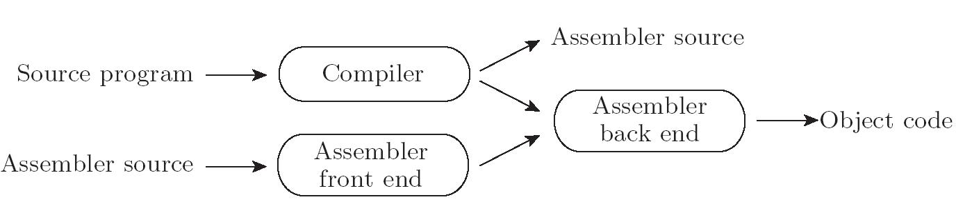
Assembly
When passing assembly language from the compiler to the assembler, it makes sense to use some internal (records and linked lists) representation
At the same time, we must provide a textual front end to accommodate the occasional need for human input:

Slide 24
Linking
Most language implementations - certainly all that are intended for the construction of large programs - support separate compilation
fragments of the program can be compiled and assembled more-or-less independently
(recall discussion of Modula-2)
After compilation, these fragments (known as compilation units) are “glued together” by a linker
programmer explicitly divides the program into modules or files separately compiled
integrated environments may abandon the notion of a file in favor of a database of subroutines separately compiled
Linker joins together compilation units

Slide 25
A static linker does its work prior to program execution, producing an executable object file
A dynamic linker does its work after the program has been brought into memory for execution
Each of the compilation units of a program to be linked must be a relocatable object file
some files will have been produced by compiling fragments of the application being constructed
others will be general purpose library packages needed by the application
Since most programs make use of libraries, even a “one-file” application typically needs to be linked

Slide 26
Linking involves two subtasks:
relocation
resolution of external references
Some authors refer to relocation as loading, and call the entire “joining together” process “link-loading.”
Scott uses “loading” to refer to the process of bringing an executable object file into memory for execution
on very simple machines loading entails relocation
the operating system uses virtual memory to giving the impression that it starts at some standard address (zero)
often loading also entails a certain amount of linking

Slide 27
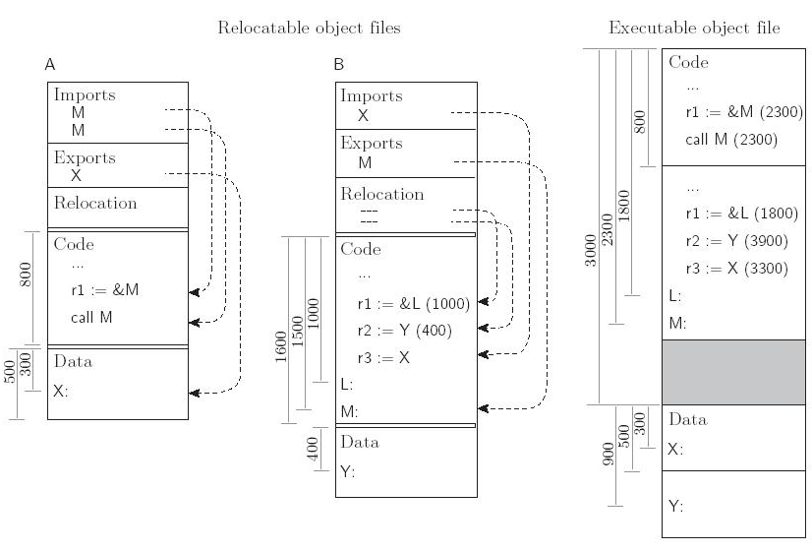

Slide 28
On a multi-user system, it is common for several instances of a program (an editor or web browser, for example) to be executing simultaneously
It would be highly wasteful to allocate space in memory for a separate, identical copy of the code of such a program for every running instance
Many operating systems therefore keep track of the programs that are running, and set up memory mapping tables so that all instances of the same program share the same read-only copy of the program’s code segment
Each instance receives its own writable copy of the data segment
Code segment sharing can save enormous amounts of space
It does not work, however, for instances of programs that are similar but not identical

Slide 29
Java Classloader
Java uses Classloaders to load and link class files.
Isolate JVM from local file system.
Starts with 3 classloaders
Bootstrap class loader
written in native code
Loads core Java libraries in <JAVA_HOME>/jre/lib
Extensions class loader
Loads code in <JAVA_HOME>/jre/lib/ext (or others specified by java.ext.dirs property
sun.misc.Launcher$ExtClassLoader
System class loader
Loads codefound on java.class.path
sun.misc.Launcher$AppClassLoader class

Slide 30
User defined classloaders
The Java class loader is written in Java.
So can create your own class loader without understanding the finer details of the Java Virtual Machine.
Every Java class loader has a parent class loader, defined when a new class loader is instantiated or set to the virtual machine's system default class loader.
This makes it possible (for example):
to load or unload classes at runtime (for example to load libraries dynamically at runtime, even from an HTTP resource).
This is an important feature for:
implementing scripting languages, such as Jython
using bean builders
allowing user-defined extensibility
to change the way the bytecode is loaded (for example, it is possible to use encrypted Java class bytecode^{[7]}).
to modify the loaded bytecode (for example, for load-time weaving of aspects when using aspect-oriented programming).
Junit tests for code generation in our project

Slide 31
public static class DynamicClassLoader extends ClassLoader {
public DynamicClassLoader(ClassLoader parent) {
super(parent);
}
public Class<?> define(String className, byte[] bytecode) {
return super.defineClass(className, bytecode, 0, bytecode.length);
}
};

Slide 32
Code improvement
(Chapter 15 on the CD)
Naïve code generation gives usually yields highly suboptimal code
redundant computations
inefficient use of the registers, multiple functional units, and cache
Code improvement (sometimes called code optimization) are transformations to generate better code
we interpret “better” to mean faster
occasionally program transformations are done to decrease memory requirements

Slide 33
Machine-independent code improvement has three separate phases
Local redundancy elimination: identifies and eliminates redundant loads, stores, and computations within each basic block
Global redundancy elimination: identifies similar redundancies across the boundaries between basic blocks (but within the bounds of a single subroutine)
Loop improvement: effects several improvements specific to loops
these are particularly important, since most programs spend most of their time in loops.
Global redundancy elimination and loop improvement may actually be subdivided into several separate phases

Slide 34
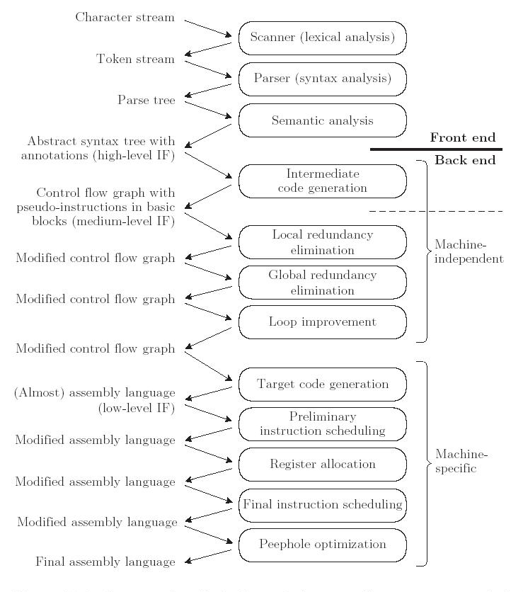

Slide 35
Peephole optimization
Slide a several-instruction-sized window over the code in a basic block
Use heuristics to match patterns in suboptimal sequences of instructions.
Recall how we generated code.
Traverse AST.
Every var on left side of assignment results in store.
Every var on right side results in load.
There are many redundant loads and stores that can be eliminated by peephole optimization

Slide 36
Example:
If there are two stores to the same location with no intervening read, the first can be eliminated.
x := 0;
x := 1;
ldc 0
store x…
ldc 1
store x…
ldc 1
store x…

Slide 37
Replace load with dup
There are even more possibilities in a register machine
load x
ldc 1
add
store x
load x
store y
load x
ldc 1
add
dup
store x
store y
x := x + 1;
y := x;

Slide 38
constant folding
evaluates expressions that involve constants at compile time
ldc 2
ldc 4
iadd
store x
ldc 6
store x
x := 2 + 4

Slide 39
Constant propagation
Sometimes we can tell that a variable will have a constant value at a particular point in a program
We can then replace occurrences of the variable with occurrences of the constant
r2 := 4
r3 := r1 + r2
r2 := . . .
r2 := 4
r3 := r1 + 4
r2 := . . .
r3 := r1 + 4
r2 := . . .

Slide 40
Common subexpression elimination
When the same calculation occurs twice within the peephole of the optimizer, we can often eliminate the second calculation.
Often, an extra register will be needed to hold the common value (here, r4)
r2 := r1 × 5
r2 := r2 + r3
r3 := r1 × 5
r4 := r1 × 5
r2 := r4 + r3
r3 := r4

Slide 41
Copy propagation
Even when we cannot tell that the contents of register b will be constant, we may sometimes be able to tell that register b will contain the same value as register a
replace uses of b with uses of a, so long as neither a nor b is modified
r2 := r1
r3 := r1 + r2
r2 := 5
r2 := r1
r3 := r1 + r1
r2 := 5
r3 := r1 + r1
r2 := 5

Slide 42
Strength reduction
Numeric identities can sometimes be used to replace a comparatively expensive instruction with a cheaper one
In particular, multiplication or division by powers of two can be replaced with adds or shifts:
r1 := r2 + r2
r1 := r2 × 2
or
r1 := r2 << 1
r1 := r2 / 2
r1 := r2 >> 1

Slide 43
eliminate useless instructions
r := r + 0 can be eliminated
r := r * 1 can be eliminated
exploit the instruction set
especially in CISC architectures, it may be possible to replace several instructions with one more complex instruction
peephole optimizers are fast and relatively easy to write. They can yield dramatic improvements in execution speed.

Slide 44
Other types of optimization
basic block optimization
analyzes an entire basic block
can be done nearly optimally
global redundancy and loop improvement:
analyze entire subroutine
typically employ a control flow graph representation of the program
ise a family of algorithms known as data flow analysis (flow of information between basic blocks)
interprocedural code improvement
recent development
Interprocedural improvement is difficult
subroutines may be called from many different places
hard to identify available registers, common subexpressions, etc.
subroutines are separately compiled

Slide 45
loop improvement
2 classes of improvements
move invariant computations out of loop into header
reduce the amount of time maintaining induction variables

Slide 46
invariant
computation guaranteed to the be same in every interation.
Move the computation before the loop, but test for zero iterations
In order to tell whether an instruction is invariant, we need to identify the bodies of loops, and we need to track the locations at which operand values are defined

Slide 47
induction variables
An induction variable (or register) is one that takes on a simple progression of values in successive iterations of a loop.
Induction variables appear as loop indices, subscript computations, or variables incremented or decremented explicitly within the body of the loop
Induction variables important because:
often provide opportunities for strength reduction, replacing multiplication with addition
are often redundant: instead of keeping several induction variables in registers, keep a smaller number and calculate the remainder from those when needed

Slide 48
Loop Unrolling and Software Pipelining
Loop unrolling is a transformation that embeds two or more iterations of a source-level loop in a single iteration of a new, longer loop
This allows the scheduler to intermingle the instructions of the original iterations
The additional freedom in instruction scheduling can help eliminate stalls in instruction pipeline

Slide 49
Loop Reordering
The code improvement techniques that we have considered thus far have served two principal purposes
eliminate redundant or unnecessary instructions
minimize stalls on a pipelined machine.
Two other goals have become increasingly important in recent years
minimize cache misses (processor speed outstrips memory latency)
identify sections of code that can execute concurrently (parallel machines)
As with other optimizations, the largest benefits come from changing the behavior of loops

Slide 50
interchanging the nested loops:
for j := 1 to n
for i := 1 to n
A[i, j] := 0

Slide 51
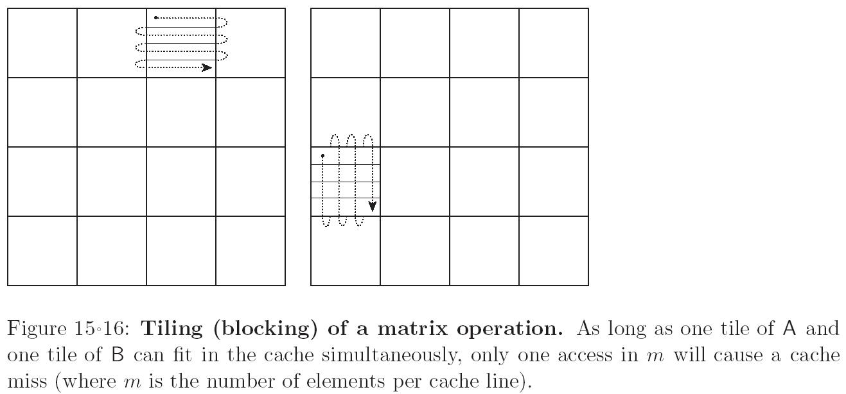
Tiling matrix operation to avoid cache misses

Slide 52
Other optimizations
instruction scheduling to improve pipeline performance
scheduling to improve cache performance
parallelization
loop iterations can sometimes be done independently
logic programming and functional programming offer lots of room for parallelization, in principle, but getting this to work well has been difficult

Slide 53
Many research areas
static resolution for virtual method calls in OO languages (to permit in lining and interprocedural optimization)
JIT—goals change as speed of optimizer as important as speed of generated code.
Use feedback from runtime profiling to improve code “on the fly”
Intermediate languages that support compiling to different types of architectures (GPU, manycore, etc.)

