Slide 1
COP 5556 Programming Language Principles
Introduction

Slide 2
Reference
Syllabus
Scott, chapter 1

Slide 3
Why study programming languages?
Programming languages are central to computing
It is just interesting to know what is “beneath the hood”
Helps you choose a language
Some tasks are much easier to do in a particular paradigm*
You won’t be able to choose a paradigm you don’t know about.
*Some people object using paradigm, but I’ll use it here for lack of a better one.

Slide 4
Makes it easier to learn new languages
Some languages are similar; easy to walk down family tree
Concepts have even more similarity;
Thinking in terms of iteration, recursion, abstraction (for example) make it easier to assimilate the syntax and semantic details of a new language
Analogy to human languages: a good grasp of grammar makes it easier to pick up new languages (at least Indo-European).

Slide 5
Help you make better use of whatever language you use
understand non-obvious features
lambdas in C++ and Java
choose between alternative ways of expressing things based on knowledge of implementation costs
use simple arithmetic when possible (use x*x instead of x**2)
avoid call-by-value with large data items
parameter passing modes that require copying
Use StringBuffer instead of + to construct Strings in Java

Slide 6
know do things in languages that don't support them explicitly:
lack of suitable control and data structures in Fortran
use comments and programmer discipline
lack of recursion in Fortran, CSP, etc
write a recursive algorithm then use mechanical recursion elimination
make good use of debuggers, assemblers, linkers, decompilers, and related tools

Slide 7
Make better use of language technology wherever it appears or may be useful!!!
You probably won’t ever design or implement a conventional programming language, but you likely will need language technology for other programming tasks.
Code to parse, analyze, generate, optimize, and otherwise manipulate structured data can be found in almost any sophisticated program—all based on programming language technology.
Many tools can be customized: the tool designer must design the customization language

Slide 8
Programming languages give us
Ways of expressing algorithms
different languages encourage different ways of thinking about problems
Abstraction of virtual machine
a way of specifying what you want the hardware to do without getting down with bit-level details
Formal notations
can be analyzed and processed by a program (i.e. compilers and other tools)

Slide 9
Topics
Specification of programming languages
Syntax
How can we describe what a legal program looks like?
Semantics
How can we describe what a program means?
Operational Semantics
Denotational Semantics
Axiomatic Semantics
Attribute Grammars

Slide 10
Topics
Programming language spectrum (more later)
Imperative
Declarative
functional
logic
query
Concurrent
Issues in language design and implementation
Language features
Compilers and interpreters

Slide 11
Topics
Points of View
Designer
Implementer (i.e. compiler writer)
User (programmer)
We will be interested in all three

Slide 12
Topics
The topic list is organized thematically, not chronologically.
We will rearrange
to meet the needs of our project
to take advantage of synergies in the material (for example functional programming and denotational semantics)

Slide 13
Administrative issues

Slide 14
Administrative issues
Canvas: elearning.ufl.edu
announcements
videos of lectures
homework assignments and submission
grades
communicate with instruction staff

Slide 15
Administrative issues
Instructor
Dr. Beverly Sanders
TAs
Yunhao Wan
Hang Guan
Communicating with us:
Questions of general interest
Canvas discussion
Seen by entire class
Questions about assignments not of general interest:
Comment on assignment in canvas
Seen by instructor and TAs
Other topics
Message in canvas to individual or
Email: PUT COP5556 in the subject line

Slide 16
Textbooks
Title: Programming Language Pragmatics Author: Michael L. Scott Publication date and edition: 2016, fourth edition
(Earlier editions are not good enough)
Title: Syntax and Semantics of Programming Languages Author: Ken Slonneger and Barry Kurtz Out of print, but available at http://www.cs.uiowa.edu/~slonnegr/plf/Book We will use selected chapters only
Scott will be the main reference for most of the course. Units on semantics will use Slonneger and Kurtz.

Slide 17
Required Software for the project
Java 8
JUnit 4
An IDE for java
Eclipse www.eclipse.org
ASM
java bytecode manipulation framework
asm.objectweb.org
See the Java resources module on Canvas for links to the download site and Java tutorial.
I recommend using Eclipse for this course.
Get these now!!

Slide 18
Evaluation
Exams
Midterm 15%
Final exam 30%
Assignments
Assignments 1- 6. 30%
The three lowest scoring assignments will be dropped.
Assignment 7 15%
Assignment 7 is resubmission of assignment 6 with errors corrected and will not be dropped.
Important:
Each part builds on previous ones.
Errors will cause point reductions in every assignment where they appear.
Even if your submission doesn’t get many points when graded, it still needs to be done correctly.

Slide 19
Evaluation
Secret of success:
Don’t get behind!
Exams
Midterm 15%
Final exam 30%
Assignments
Assignments 1- 6. 30%
The three lowest scoring assignments will be dropped.
Assignment 7 15%
Assignment 7 is resubmission of assignment 6 with errors corrected and will not be dropped.
Important:
Each part builds on previous ones.
Errors will cause point reductions in every assignment where they appear.
Even if your submission doesn’t get many points when graded, it still needs to be done correctly.

Slide 20
Exam Schedule
Midterm
TBA
probably evening of March 15
Final Exam
TBA
probably April 27
Final dates and times will be announced as soon as possible.

Slide 21
Assignments
Cumulative project
Implementation of a small programming language
Assigned in seven (really six—project 7 is a corrected resubmission of project 6) parts over the course of the semester approximately every two weeks

Slide 22
More about the project
Outline
Scanner
Parser
Abstract Syntax Tree
Type Checking
Code Generation 1
Code Generation 2
Fix errors and resubmit
The project must be written in Java
We will generate java byte code
Our language can run on any platform with a JRE
Will use the ASM package to help
Will use junit for testing
This project is cumulative. DO NOT GET BEHIND!

Slide 23
Policies
All homework assignments are to be done independently and created for this course
Sharing your project, or using another student's project, even after that part of the assignment has been graded, is a violation of the honor code.
http://www.dso.ufl.edu/sccr/honorcodes/honorcode.php
No extensions to deadlines for individuals will be granted*. Don’t ask—just use one of your drops.
Everyone has job interviews and other classes
No late assignments will be accepted*. Don’t ask for special treatment—just use one of your drops.
*except as required by University policy.

Slide 24
Policies for EDGE students
Unless otherwise specified
EDGE students have the same deadlines for assignments as on-campus students.
Exams must be returned to me via email within 48 hours of the time the on-campus exam ends.
Proctors will be used as before
New: vetting and interacting with proctors will be done by CISE staff rather than EDGE staff.

Slide 25
Administrative questions? Back to PLP Scott, Chapter 1

Slide 26
Why so many programming languages?
Evolution -- we've learned better ways of doing things over time
Special purposes-- some language are designed with a specific domain in mind
Lisp good for manipulating symbolic data
C for low level systems programming
Prolog for reasoning about relationships between data
Some languages are intended for specific hardware
Personal preference

Slide 27
What makes a language successful?
Expressive power
Most programming languages are Turing complete and can be used (if you try hard enough) to implement arbitrary algorithms
Nevertheless, some language features make it much easier than others to write clear, maintainable code
Ease of implementation and availability
Ease of use for novice
Standardization
Excellent compilers
Economics, patronage and inertia
Notes:
Many, many programming languages have been designed, only a few are in widespread use

Slide 28
Interplay of design and implementation
We’ll look at languages from the points of view of both the programmer and the language implementer
Throughout the course, we’ll see examples of
Cases where implementation ease or difficulty affected success of language
Language features now viewed as mistakes
Useful features omitted
Machine architecture made a feature too expensive
Other tradeoffs

Slide 29
History of programming languages
Machine language
Program is a sequence of bits interpreted by the hardware
Primitive operations (load, store, jump if a register not zero, etc.)
1100 0000 0000 1101
Difficult to read, write, edit
Notes:
Might even be loaded through switches on the front of the machine. Debug by manually steping through code and looking at the lights.

Slide 30
Assembly language
Defines symbolic names for operations and memory locations
Can write (for example)
jumpz a instead of, say
1100 0000 0000 1101
Each instruction corresponds to a single machine code instruction
Low level
cannot write x := a + b
Must write something like
load a, load b, add, store x

Slide 31
High level languages
Allow algorithms to be expressed in a more abstract way
Typical Features
expressions: (a rule for computing a value) can be expressed in ordinary mathematical notation
data types: booleans, integers, characters, …, composite types, with operations that respect semantics of the types.
control structures: selection and iteration
declarations: introduce identifiers for things like constants, variables, procedures, functions, types, etc.
abstraction: separate what from how (named procedures, parameterization)
encapsulation: group related items together, possibly hiding some of them

Slide 32
Programming Language Spectrum
Different high level languages support different programming paradigms (ways of thinking about algorithms)
Declarative languages focus on “what”
Imperative languages focus on “how”

Slide 33
Declarative language families
Functional
Computational model based on recursive definition of functions
Computation is evaluation of an expression
Normal mathematical reasoning works
Lisp/Scheme, ML, Haskell, OCaml
Dataflow
Model computation as flow of information between nodes
Inherently parallel
ID, Val

Slide 34
Declarative language families (2)
Logic, constraint-based
Inspired by predicate logic
Computation attempts to find values that satisfy certain relationships using goal directed search through a list of rules
Prolog
Also SQL, XSLT, programmable aspects of spreadsheets

Slide 35
Imperative language families
von Neuman
Basic means of computation is modification of variables
Based on statements (assignments) with side effects
Fortran, Ada, 83, Pascal, C, etc
object oriented
Related to von Neuman, but have a more structured and distributed view of memory and computation
Computation is collection of interactions between “objects” with their own internal state and routines to manage the state
Simula 67, Smalltalk, C++, Eiffel, Java, C#
scripting languages
Subset of von Neuman languages
Focus on “gluing” independently developed components together.
Flexibility and ease of programming more important than efficiency.
Often “dynamic”
csh, bash, awk, PHP, JavaScript, Perl, Python, Ruby, Tcl, Groovy, Lua
DSLs and Embedded languages

Slide 36
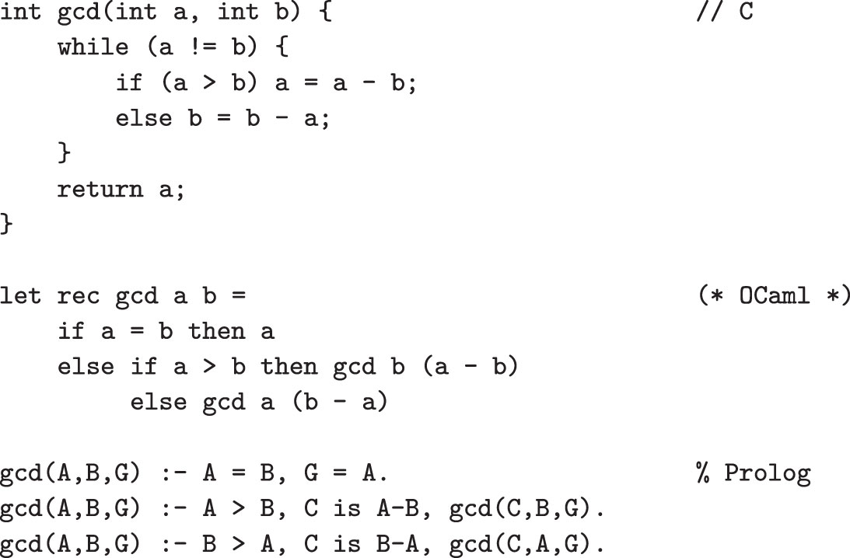
GCD in C, OCaml, and Prolog

Slide 37
Concurrent Languages
Concurrent vs. sequential is mostly independent of the declarative vs. imperative classification
Researchers are investigating expressing concurrency in all of the language classes mentioned earlier
Currently, most concurrent programs written with special library packages and/or compilers together with a sequential language
A few widely used languages (Java, C#, Ada, and C++11, Go) have explicitly concurrent features

Slide 38
Overview of language translation
Compilation
Interpretation
Combination

Slide 39
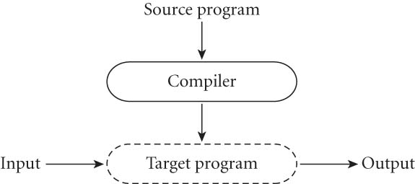
Compilation—high level view
Compiler translates source program to equivalent program in target language
Output is called object code when written to a file in a form understood by the OS

Slide 40
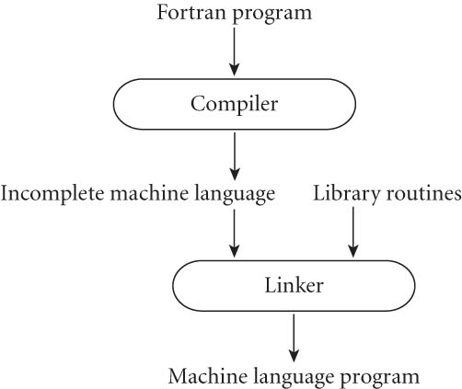
Example: Fortran
Almost pure compilation
Linker merges application source code with library

Slide 41
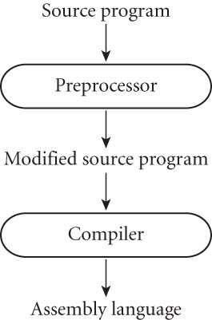
Example: C
Preprocessor removes comments and expand macros
May delete code to provide conditional compilation allowing several versions of a program to be built from the same source
Generates assembly language which must be translated to machine code by an assembler

Slide 42
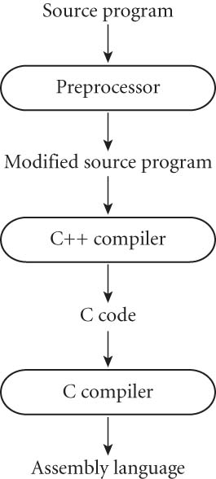
Example: (early) C++
Many first implementations of new languages generate C
Easier, more portable
Take advantage of optimizing capabilities of the C compiler

Slide 43

Interpretation—high level view
Interpreter implements a virtual machine
Fetches, analyzes, and execute source code (more or less) one instruction at a time.
Interpretation is usually slower than running compiled code, but more interactive
Examples: basic interpreter, lisp, prolog, many functional languages, Unix shell, SQL interpreter, many scripting languages
Notes:
Compiled programs often faster because certain decision can be made (once) at compile time.

Slide 44
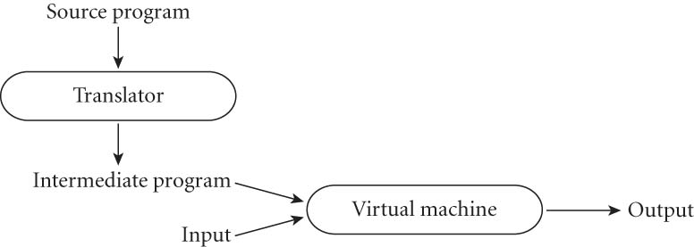
Combine compilation with interpretation
Interpreted: initial translator is “simple”
Most interpreted languages use a preprocessor to remove comments and white space, group characters (such as keywords, identifiers, numbers, and symbols) into tokens
Compiled: translator is “complicated”
Translator analyses it thoroughly
Generates code in a language that is not similar to source language

Slide 45
Example: Java
Early implementations
java source code → javac → java byte code →
→interpreted by the JVM (java virtual machine)
JVM simulates stack oriented machine with support for OOP, exceptions, and threads
Most current implementations
java source code → javac → java byte code →
→ interpreted → JIT compiler → machine code
JIT (just in time) compiler compiles at runtime based on runtime behavior

Slide 46
Programming environments
Compilers do not exist in isolation—programmers are assisted by many tools
Cross referencing: find point where object is defined given where it is used
Style checking and pretty printing
Configuration management
Perusal tools to view intermediate languages
Profilers
Debuggers
IDE (Integrated development environments)
Editors specialized for language syntax
Internally maintain AST (abstract syntax tree)
Convenient access to other tools
Refactoring
Examples: Eclipse, Netbeans, Visual Studio, Xcode, Jgrasp, IntelliJ

Slide 47
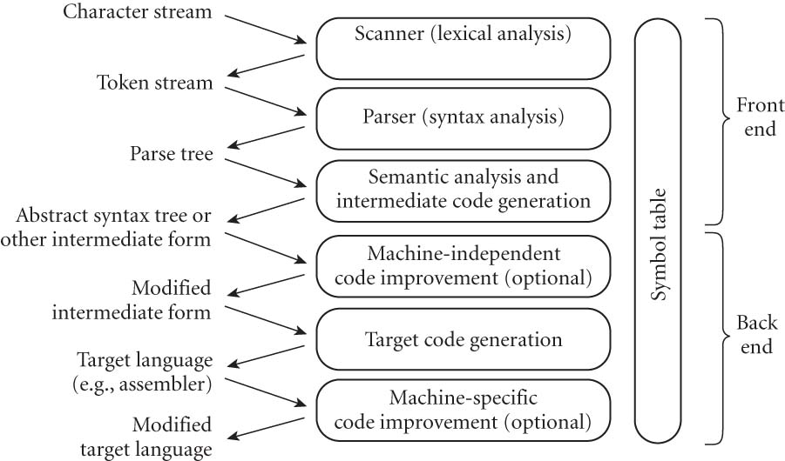
Compilation Overview

Slide 48
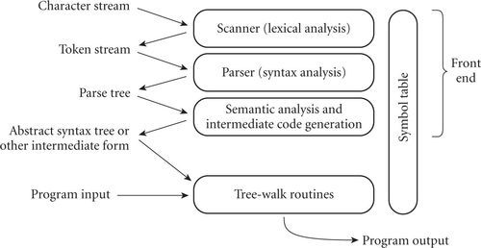
Interpretation Overview
Notes:
First phases similar to compiler, but traverse AST and execute it directly.

Slide 49
Questions?

Slide 50
Additional slides

Slide 51
Vocabulary
Translator: accepts a text in one (source) language and generates a semantically equivalent text in some other (target) language.
assembler
source: assembler code
target: machine code
compiler
source: high level language
target: lower level language
disassembler:
source: machine code
target: assembly language
decompiler:
source: low level language
target: higher level language

Slide 52
Implementation language: the language the translator is written in
Interpreter: program to fetch, analyze, and execute source code one instruction at a time.
Interpretation is slower than running compiled code, but more interactive
Examples:
basic interpreter
lisp, scheme
many other functional languages (but many have a read/evaluate/print loop even though they are compiled)
prolog
Unix shell
SQL interpreter
many scripting languages

Slide 53
Abstract machine:
interpreter for low level language
To use--translate high level code to low level code that is interpreted
Advantages:
portability (may be easier to write interpreter for the low level language than a compiler).
can often be used by more than one high level language
Interpretive compilation:
interpreter that can compile instructions (java JIT)

Slide 54
Examples
c source code → gcc → object code (partially complete machine code that will be finished when linked and loaded)
scheme source code → interpreted by scheme interpreter, which directly executes program (simulates higher level on low level hardware)
Eiffel source → Eiffel compiler → c code → some c compiler → object code

