Slide 1
COP5556 Progamming Language Principes
Overview of the Java Virtual Machine

Slide 2
References
The Java Virtual Machine Specification
See the module “ASM Bytecode Manipulation Resources” on elearning.
Software
ASM framework
see module on elearning for links

Slide 3
Java compilers start with Java source code and create class files containing Java byte code
When a Java program is executed, the byte code in the class file is
interpreted
or compiled (at load or run time)
or some mixture of the two

Slide 4
Other language also compile to java byte code
Advantages of this approach
architecture independent
stack-based architecture
easier code generation target than register-based
Can use Java to implement some of the runtime support
several public domain tools to create class files
ASM

Slide 5
Overview of the class file format
A java class file is defined as a stream of 8-bit bytes consisting of a single ClassFile structure (where the structure is as in the C programming language):
Tools will take care of most of the details of constructing a classfile, but it is useful to understand the overall structure.

Slide 6
ClassFile {
u4 magic; u2 minor_version; u2 major_version; u2 constant_pool_count; cp_info constant_pool[constant_pool_count-1]; u2 access_flags; u2 this_class; u2 super_class; u2 interfaces_count; u2 interfaces[interfaces_count]; u2 fields_count; field_info fields[fields_count]; u2 methods_count; method_info methods[methods_count]; u2 attributes_count; attribute_info attributes[attributes_count];
}

Slide 7
These values are fixed. Magic=0xCAFEBABE and indicates that this is a Java class file, the others indicate the classfile version
ClassFile {
u4 magic;
u2 minor_version;
u2 major_version; u2 constant_pool_count; cp_info constant_pool[constant_pool_count-1]; u2 access_flags; u2 this_class; u2 super_class; u2 interfaces_count; u2 interfaces[interfaces_count]; u2 fields_count; field_info fields[fields_count]; u2 methods_count; method_info methods[methods_count]; u2 attributes_count; attribute_info attributes[attributes_count];
}

Slide 8
ClassFile {
u4 magic; u2 minor_version; u2 major_version; u2 constant_pool_count; cp_info constant_pool[constant_pool_count-1]; u2 access_flags; u2 this_class; u2 super_class; u2 interfaces_count; u2 interfaces[interfaces_count]; u2 fields_count; field_info fields[fields_count]; u2 methods_count; method_info methods[methods_count]; u2 attributes_count; attribute_info attributes[attributes_count];
}
The constant pool contains all the constants in the program. This includes field, method, and interface names, string literals, etc.

Slide 9
Indicates if the class is public, final, (super), interface, abstract
ClassFile {
u4 magic; u2 minor_version; u2 major_version; u2 constant_pool_count; cp_info constant_pool[constant_pool_count-1]; u2 access_flags; u2 this_class; u2 super_class; u2 interfaces_count; u2 interfaces[interfaces_count]; u2 fields_count; field_info fields[fields_count]; u2 methods_count; method_info methods[methods_count]; u2 attributes_count; attribute_info attributes[attributes_count];
}

Slide 10
ClassFile {
u4 magic; u2 minor_version; u2 major_version; u2 constant_pool_count; cp_info constant_pool[constant_pool_count-1]; u2 access_flags; u2 this_class; u2 super_class; u2 interfaces_count; u2 interfaces[interfaces_count]; u2 fields_count; field_info fields[fields_count]; u2 methods_count; method_info methods[methods_count]; u2 attributes_count; attribute_info attributes[attributes_count];
}
Indexes for the constant pool entries for this class and its superclass

Slide 11
ClassFile {
u4 magic; u2 minor_version; u2 major_version; u2 constant_pool_count; cp_info constant_pool[constant_pool_count-1]; u2 access_flags; u2 this_class; u2 super_class; u2 interfaces_count; u2 interfaces[interfaces_count]; u2 fields_count; field_info fields[fields_count]; u2 methods_count; method_info methods[methods_count]; u2 attributes_count; attribute_info attributes[attributes_count];
}
Interfaces that are implemented by this class, also as indexes into constant pool

Slide 12
ClassFile {
u4 magic; u2 minor_version; u2 major_version; u2 constant_pool_count; cp_info constant_pool[constant_pool_count-1]; u2 access_flags; u2 this_class; u2 super_class; u2 interfaces_count; u2 interfaces[interfaces_count]; u2 fields_count; field_info fields[fields_count]; u2 methods_count; method_info methods[methods_count]; u2 attributes_count; attribute_info attributes[attributes_count];
}
Number of fields, each field_info item provides complete information about a field

Slide 13
ClassFile {
u4 magic; u2 minor_version; u2 major_version; u2 constant_pool_count; cp_info constant_pool[constant_pool_count-1]; u2 access_flags; u2 this_class; u2 super_class; u2 interfaces_count; u2 interfaces[interfaces_count]; u2 fields_count; field_info fields[fields_count]; u2 methods_count; method_info methods[methods_count]; u2 attributes_count; attribute_info attributes[attributes_count];
}
Number of methods, each method_info item provides complete information about a method, including its byte code, if any

Slide 14
ClassFile {
u4 magic; u2 minor_version; u2 major_version; u2 constant_pool_count; cp_info constant_pool[constant_pool_count-1]; u2 access_flags; u2 this_class; u2 super_class; u2 interfaces_count; u2 interfaces[interfaces_count]; u2 fields_count; field_info fields[fields_count]; u2 methods_count; method_info methods[methods_count]; u2 attributes_count; attribute_info attributes[attributes_count];
}
attributes are optional and provide descriptive information such as information about the source file, line numbers, deprecated, etc.

Slide 15
Instruction Summary
The Java virtual machine is stack based.
There are no operand registers—loads and stores are between the stack and memory
arithmetic operations get their operands from the stack, and leave their results on the stack.
A Java virtual machine instruction consists of a
one-byte opcode specifying the operation to be performed
the opcode is followed by zero or more operands supplying arguments or data that are used by the operation.
Many instructions have no operands and consist only of an opcode. (Values read and consumed from the stack are not considered operands—an operand is part of the instruction.)

Slide 16
Ignoring some details (such as exceptions), the inner loop of a Java virtual machine interpreter is essentially
do
{ fetch next opcode;
if (this instruction has operands)
{ fetch the operands; }
execute the action for the opcode;
} while (there are more instructions);
The number and size of the operands are determined by the opcode, so once the opcode has been read, the number and size of operands are known.

Slide 17
Types
Variables in the JVM are typed.
Types of variables and method signatures are denoted using a specific syntax.
Primitive types: each has a one-letter type code.
I (int), Z(boolean), V(void), D(double), etc.
Class names used as types:
‘L’
followed by the fully qualified name
where parts of the name are separated by ‘/’ , not ‘.’
terminated with ‘;’.
Arrays: preceding the element type with a ‘[‘.

Slide 18
int | I
boolean | Z
void | V
String | Ljava/lang/String;
String[] | [Ljava/lang/String;
ArrayList | Ljava/util/ArrayList;

Slide 19
Method signatures are indicated by
‘(‘,
followed by
list of the types of parameters of the method
these are NOT separated by white space or punctuation
followed by a ‘)’
followed by the return type.

Slide 20
Method signature as expressed in Java | JVM notation
void main(String[] args) | ([Ljava/lang/String;)V
int f(int y, boolean b) | (IZ)I
String g(int x, int y, String s) | (IILjava/lang/String;)Ljava/lang/String;
boolean a( HashMap m1, HashMap m2) | (Ljava/util/HashMap;Ljava/util/HashMap;)Z

Slide 21
Variables
The JVM has three kinds of variables
static members of a class,
non-static members of a class,
local variables in methods.
Each kind is accessed in a different way.

Slide 22
Static variables
getstatic
operands: classname, fieldname, type
loads the value in the indicated static field onto the stack
putstatic
operands: classname, fieldname, type
removes the value from the top of the stack and stores it in the indicated static field

Slide 23
Non-static class members
getfield
operands: classname, fieldname, type
removes an object reference from the stack and loads the value in the indicated field in the referenced object onto the stack
putfield
operands: classname, fieldname, type
removes a value from the top of the stack, then and object reference, and stores the value in the indicated field of the referenced object

Slide 24
Local variables in methods
Each method invocation causes the creation of a new frame.
The frame contains
operand stack where most of the work is done.
array of local variables
All values in the local variable array are accessed by their index, or slot number, in the array.
Method’s parameters are first
The values of the actual parameters are automatically copied to the local variable array when a method is called
Then variable declared locally in the method
Load and Store instructions transfer values between local variables and the stack.

Slide 25
Load and Store local variables
Several variations depending on type of
For integers
iload
operand: slot number of local variable
loads the int (or boolean) variable from the given slot in the local variable array to the top of the stack.
istore
operand: slot number of local variable
removes the int (or boolean) value on top of the stack and stores it in the local variable in the given slot
For booleans
use iload and istore

Slide 26
Load and Store local variables (2)
For objects
aload
the same as iload, except this loads a reference to an object
astore
the same as astore, except this stores a reference to an object
For double
dload
dstore
etc.

Slide 27
Load constants
ldc
operand: the constant
loads the indicated constant onto the stack
iconst_0, iconst_1, …iconst_5
no operand
loads the constant which is implicit in instruction onto stack

Slide 28
Arithmetic and logical operations.
There are separate instructions for the operations on each primitive type.
Examples
iadd add two ints
ladd add two longs
fadd add two floats
dadd add two doubles
All binary operations remove the top two items from the stack, and leave the resulting value on top of the stack.

Slide 29
Arithmetic and logical operations (2)
Some binary operations
addition: iadd
subtraction: isub
multiplication: imul
integer division : idiv
remainder: irem
bitwise or: ior
bitwise and: iand
bitwise exclusive or: ixor
A unary op
negate: ineg
This removes the top item from the stack, negates it, and leaves the result on top of the stack.

Slide 30
Example
package jvmExamples;
public class SimpleProgram {
int x;
static int y;
int sumXY(int val){
x = val;
y = 2;
return x + y;
}
}
// Compiled from SimpleProgram.java (version 1.8 : 52.0, super bit)
public class jvmExamples.SimpleProgram {
// Field descriptor #6 I
int x;
// Field descriptor #6 I
static int y;
}

Slide 31
Example
// Method descriptor #9 ()V
// Stack: 1, Locals: 1
public SimpleProgram();
0 aload_0 [this]
1 invokespecial java.lang.Object() [11]
4 return
Line numbers:
[pc: 0, line: 3]
Local variable table:
[pc: 0, pc: 5] local: this index: 0 type: jvmExamples.SimpleProgram
package jvmExamples;
public class SimpleProgram {
int x;
static int y;
int sumXY(int val){
x = val;
y = 2;
return x + y;
}
}

Slide 32
Example
// Method descriptor #18 (I)I
// Stack: 2, Locals: 2
int sumXY(int val);
0 aload_0 [this]
1 iload_1 [val]
2 putfield jvmExamples.SimpleProgram.x : int [19]
5 iconst_2
6 putstatic jvmExamples.SimpleProgram.y : int [21]
9 aload_0 [this]
10 getfield jvmExamples.SimpleProgram.x : int [19]
13 getstatic jvmExamples.SimpleProgram.y : int [21]
16 iadd
17 ireturn
Line numbers:
[pc: 0, line: 10]
[pc: 5, line: 11]
[pc: 9, line: 12]
Local variable table:
[pc: 0, pc: 18] local: this index: 0 type: jvmExamples.SimpleProgram
[pc: 0, pc: 18] local: val index: 1 type: int
package jvmExamples;
public class SimpleProgram {
int x;
static int y;
int sumXY(int val){
x = val;
y = 2;
return x + y;
}
}

Slide 33
static void f(int x, String s)
{ int y = x;
String t = s;
return;
}
What is the signature of f?

Slide 34
static void f(int x, String s)
{ int y = x;
String t = s;
return;
}
What is the signature of f?
(ILjava/lang/String;)V

Slide 35
static void f(int x, String s)
{ int y = x;
String t = s;
return;
}
What does the local variable array contain?

Slide 36
static void f(int x, String s)
{ int y = x;
String t = s;
return;
}
name in source code | slot number
x | 0
s | 1
y | 2
t | 3

Slide 37
static void f(int x, String s)
{ int y = x;
String t = s;
return;
}
iload 0
istore 2
name in source code | slot number
x | 0
s | 1
y | 2
t | 3

Slide 38
static void f(int x, String s)
{ int y = x;
String t = s;
return;
}
iload 0
istore 2
aload 1
astore 3
return
name in source code | slot number
x | 0
s | 1
y | 2
t | 3

Slide 39
class X
{ static int x;
int y;
…
void f(int z, int w)
{ x = z;
y = w;
return
}
…

Slide 40
class X
{ static int x; I
int y; I
…
void f(int z, int w) (II)V
{ x = z;
y = w;
return;
}
…

Slide 41
class X
{ static int x;
int y;
…
void f(int z, int w)
{ x = z;
y = w;
return;
}
…
name in source code | slot number in f’s local variable array
this | 0
z | 1
w | 2
Notes:
The implicit first argument of a non-static method is always “this”.

Slide 42
this | 0
z | 1
w | 2
class X
{ static int x;
int y;
…
void f(int z, int w)
{ x = z;
y = w;
return;
}
}
iload 1
putstatic “X”, “x”, “I”

Slide 43
this | 0
z | 1
w | 2
class X
{ static int x;
int y;
…
void f(int z, int w)
{ x = z;
y = w;
return;
}
}
iload 1
putstatic “X”, “x”, “I”
aload 0
iload 2
putfield “X”, “y”, “I”
return

Slide 44
Control transfer instructions
These cause the Java virtual machine to continue execution with an instruction other than the one following the control transfer instruction
ASM allows us to insert labels in the instruction sequence and jump to the label. In the class files, the jumps take a virtual address of the instruction to jump to
Several kinds of control transfer instruction:
conditional compare to zero
compare the top of the stack to zero and depending on the result, continue with the next instruction, or jump to the labeled instruction
conditional compare to null
compare the top of the stack to null and depending on the result, continue with the next instruction or jump to the label
compare the top two elements on the stack
compare the top two elements on the stack and jump depending on the result
unconditional transfer

Slide 45
Conditional compare to zero
These instructions take the destination of a jump as operand.
They compare the top of the stack to zero, and depending on the result, jump to the label, or continue with the next instruction.
The value on the top of the stack is consumed.
The value on the top of the stack must be an int (or boolean).

Slide 46
Conditional compare to zero (2)
val is the value on top of the stack
ifeq jump to label if val = 0
iflt jump to label if val < 0
ifle jump to label if val ≤ 0
ifne jump to label if val ≠ 0
ifgt jump to label if val > 0
ifge jump to label if val ≥ 0

Slide 47
Conditional compare to null
Similar to compare to zero
The value on the top of the stack is consumed and
The value on top of the stack must be a reference to an object
ifnull jump to label if val = null
ifnonnull jump to label if val ≠ null

Slide 48
Compare top two elements on stack
compare the top two elements of the stack and jump if the indicate relation is satisfied.
The two elements are consumed.
The instructions have one operand, the destination of the jump
Examples
ldc 0; ldc 1 if_icmne L0
would result in a jump to label L0 since the top two elements (0 and 1) of the stack are not equal.
ldc 0; ldc 1; if_icmplt L1
would result in a jump to L1.

Slide 49
Compare top two elements on stack (2)
if_icmpeq
if_icmpne
if_icmplt
if_icmpgt
if_icmple
if_icmpge
if_acmpeq
if_acmpne
use int or boolean stack arguments
use reference stack arguments

Slide 50
Unconditional branch
takes a destination (label) as operand and jumps unconditionally to that location
goto

Slide 51
Stack manipulation
dup
duplicates the top of the stack
swap
swaps the top two elements of the stack
pop
removes element from top of stack
there are more—see JVM spec

Slide 52
Method invocation
Three instructions invoke methods.
invokevirtual
for normal methods
invokestatic
for static methods
invokespecial
used during object initialization

Slide 53
Method invocation (2)
invokevirtual
Operands: class name, method name, desciptor
Prior to the instruction, the stack should contain
reference to object whose method is being invoked
parameters of the method
Execution causes a new frame to be created which invokes the indicated method.
Parameters are automatically copied into the appropriate slots of the new frame’s local variable array and removed (along with the object reference) from the stack
If the method returns a value, it will be left on top of the stack after the method terminates.

Slide 54
Method invocation (3)
invokestatic
Operands: class name, static method name, descriptor
Prior to the instruction, the stack should contain the parameters of the method
Execution causes a new frame to be created which invokes the indicated method.
Parameters are automatically copied into the appropriate slots of the new frame’s local variable array and removed from the stack
If the method returns a value, it will be left on top of the stack after the method terminates.

Slide 55
Method invocation (4)
invokespecial
operands: class name, initializer name—always “<init>”, descriptor
Prior to the instruction, the stack should contain
reference to object whose method is being invoked
parameters of the method
Execution causes a new frame to be created which invokes the <init> method.
Parameters are automatically copied into the appropriate slots of the new frame’s local variable array and removed (along with the object reference) from the stack
This instruction is used to invoke the “<init>” method which must be called to initialize new objects.

Slide 56
Method invocation (5)
Remarks on parameters and return values
Before a method is invoked, its arguments are placed on the operand stack in the order they appear in the descriptor, and after the reference to the object (if invokespecial or invokevirtual).
The invoke instruction then places these in the local variable array of the frame for the invoked method where they can be accessed as local variables.
The return instruction leaves the result, if any on top of the stack of the caller.

Slide 57
Returning from a method
The choice of return instruction depends on the type of result to be returned from the method.
If a value is returned, it is placed on top of the stack before invoking return
return
used to return from methods with void type
ireturn
used to return from methods that return an int
before calling, load the int to be returned on top of the stack
areturn
used to return from methods that return an object reference
before calling, load the reference to be returned on top of the stack

Slide 58
Instantiating objects
Instantiate objects using the new instruction.
this leaves the address of the newly created object on top of the stack
This must be immediately followed by an invocation of its init method using invokespecial.
Since invokespecial will consume the reference, we dup it first
new
operand: fully qualified class name

Slide 59
Example: object instantiation
Example:
class MyClass
{ static ten;
…
ten = new Integer(10);
…
}
//create an uninitialized Integer object and leave a reference on top of the stack.
new “java/lang/Integer”
//duplicate the reference, since one reference will be consumed in the call to init
dup
//this initializer takes an int parameter, load it onto the stack
ldc 10
//invoke the <init> method. The parameter and reference to object consumed
invokespecial “java/lang/Integer” ”<init>” ”(I)V”
//store the remaining reference to the object in the static variable ten
putstatic “MyClass” ”ten” ”Ljava/lang/Integer;”

Slide 60
JVM verification
The JVM verifies the source code before executing it.
This includes type checking and ensuring that the code satisfies certain well-formed conditions.
It is possible that a compiler will generate code that does not pass verification (but conforming Java compilers only generate code that will pass verification)
In some cases, this will be due to programmer errors, in others it will indicate a problem with your code generation.
Example: method without a return statement

Slide 61
Typical verification errors:
“falling off the end of the code”.
problem is a missing return statement
“unequal stack sizes”
problem is that you have branching code where the alternative paths have different effects on the stack. This indicates a problem with code generation
it is likely to come up with if and while statements

Slide 62
Tools
javap
comes with the Java distribution
parses a class file
eclipse class file byte code viewer

Slide 63
javap
comes with the standard java distribution.
javap –c X will decompile the classfile X.class and show the corresponding java code.
javap –c –v X gives a more verbose output.
Two ways to use javap
inspect the byte code that your compiler generates to ensure that it is what you think it is.
find out how to generate code to do something by writing a little java program that does that, compiling it, and then using javap to decompile the classfile.
javap –c X

Slide 64
Compiled from "X.java"
class X extends java.lang.Object{
static int x;
X();
Code:
0: aload_0
1: invokespecial #1;
//Method java/lang/Object."<init>":()V
4: return
<init> method
for class X

Slide 65
bytecode for
method inc
static int inc(int);
Code:
0: iload_0
1: iconst_2
2: imul
3: istore_1
4: getstatic #2; //Field x:I
7: iload_1
8: iadd
9: ireturn
#2 is an index in the constant pool The comment tells you what it is. Use the –verbose switch to see the constant pool

Slide 66
public static void main(java.lang.String[]);
Code:
0: iconst_5
1: putstatic #2; //Field x:I
4: iconst_3
5: invokestatic #3; //Method inc:(I)I
8: putstatic #2; //Field x:I
11:getstatic #4;
//Field java/lang/System.out:Ljava/io/PrintStream;
14:getstatic #2; //Field x:I
17:invokevirtual #5; //Method java/io/PrintStream.println:(I)
20:return
}

Slide 67
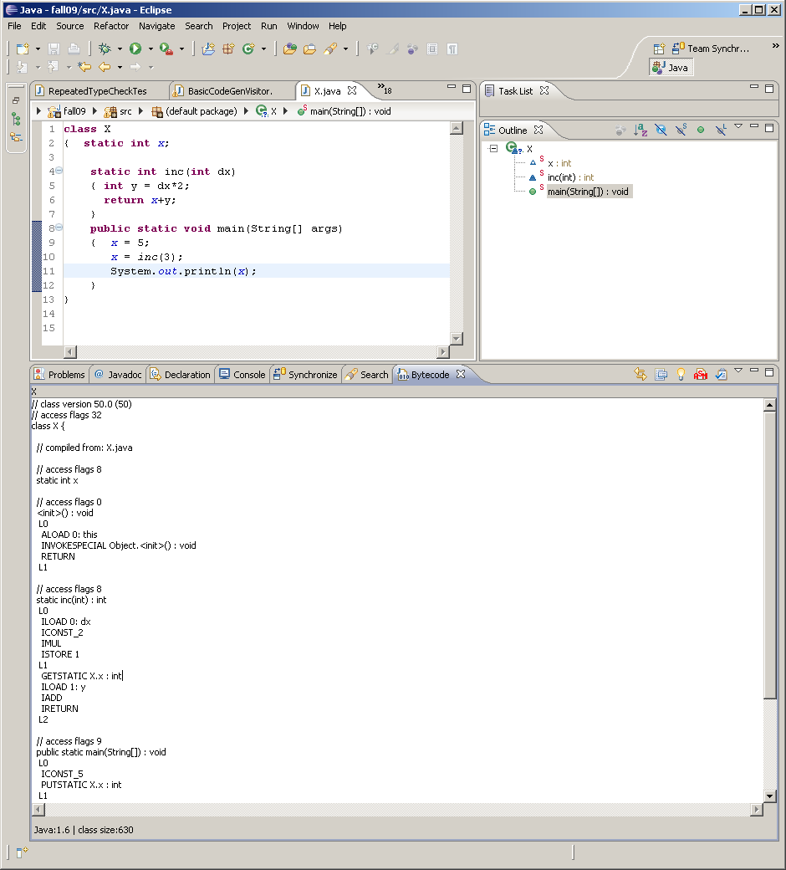

Slide 68
Example
class ThisClass
{ static int f(int a, int b)
{ return a+b; }
}

Slide 69
Example
class ThisClass
{ static int f(int a, int b)
{ return a+b; }
}
Generated code for f
iload 0;
iload 1;
iadd;
ireturn;

Slide 70
Example
class ThisClass
{ static int f(int a, int b)
{ return a+b; }
}
Generated code for f(3,4)
ldc 3;
ldc 4;
invokestatic (“ThisClass”, “f”,”(II)I”)
// 7 is now on top of the stack

Slide 71
Example
class S
{ static String s;
static String t;
…
}
What code would be generated for S.s.equals(S.t)
(where we just call the method already defined for the Java String class)

Slide 72
class S
{ static String s;
static String t;
…
}
S.s.equals(S.t)
getstatic(“MyClass”,”s”,”Ljava/lang/String;”)
getstatic(“MyClass”,”t”,”Ljava/lang/String;”)
invokevirtual(“Ljava/lang/String;”,”equals”,
”(Ljava/lang/String;)Z”)
//now, the boolean value with the result is left on top of the stack. Both values placed on the stack have been consumed

Slide 73
Example:
class X
{ static int x;
static int inc(int dx)
{ int y = dx*2;
return x+y;
}
public static void main(String[] args)
{ x = 5;
x = inc(3);
System.out.println(x);
}
}
is a java class that includes both static and local variables, and method calls.

Slide 74
Example:
class X
{ static int x;
static int inc(int dx)
{ int y = dx*2;
return x+y;
}
public static void main(String[] args)
{ x = 5;
x = inc(3);
System.out.println(x);
}
}
is a java class that includes both static and local variables, and method calls.
static inc(int) : int
ILOAD 0: dx
ICONST_2
IMUL
ISTORE 1
GETSTATIC X.x : int
ILOAD 1: y
IADD
IRETURN

Slide 75
Example:
class X
{ static int x;
static int inc(int dx)
{ int y = dx*2;
return x+y;
}
public static void
main(String[] args)
{ x = 5;
x = inc(3);
System.out.println(x);
}
}
is a java class that includes both static and local variables, and method calls.
ICONST_5
PUTSTATIC X.x : int
ICONST_3
INVOKESTATIC X.inc(int) : int
PUTSTATIC X.x : int
GETSTATIC System.out : PrintStream
GETSTATIC X.x : int
INVOKEVIRTUAL
PrintStream.println(int) : void
RETURN

Slide 76
ASM
Java bytecode manipulation framework
Designed to generate, transform, and analyze Java classes represented as byte arrays
Provides tools to read, write, and transform byte arrays using higher level concepts
Download from http://asm.objectweb.org

Slide 77
Can be used to statically
generate code
parse and analyze an existing class file
dynamically
read and transform class files at load time
aspect-oriented programming
instrument classes for debugging or performance measurements
generate (and load) new classes at runtime
stubs and proxies
Small and fast

Slide 78
Visitors
Defines a visitor interface for elements of the bytecode
ClassVisitor
FieldVisitor
MethodVisitor
etc.
Different visitor implementations perform different functions
ClassReader parses existing class files
ClassWriter generates a class file

Slide 79
General pattern
Get a visitor object for a construct
Visit its components
There are often constraints on order
invoke visitEnd() method

Slide 80
Example
class Demo
{ static int x;
static String s;
static ArrayList<Integer> a;
public static int f(int y, String t)
{ int z;
z = y + x;
a.add(z); //this call also requires wrapping
//the int parameter in an Integer class
return z;
}

Slide 81
public static void main(String[] args)
{ x = 22;
s = "test";
IO.writeString(s);
a = new ArrayList<int>();
x = (f(x,s));
IO.writeInt(x);
x = a.get(0); IO.writeInt(x);
}
}
We will give a program that uses asm to generate Java byte code for this class.

Slide 82
public class IO
{
public static void writeInt(int x)
{System.out.println(x);}
public static void writeString(String s)
{System.out.println(s);}
}
We will compile this with javac and call its methods in our class.
We will also use Java classes to implement certain functionality.

Slide 83
import java.io.FileOutputStream;
/* Download this package from http://asm.objectweb.org */
import org.objectweb.asm.*;
public class CodeGenDemo implements Opcodes
{
public static void main(String[] args)
{
generate and output class file
}
}
The Opcodes interface defines constants used by asm. These constants are available in this class by marking it to implementing the interface
Notes:
Defining constants using an enum rather than putting them in an interface and implementing the interface. ASM predates the addition of enums to Java.

Slide 84
/* Initialize the class to be built by creating and visiting a ClassWriter object */
String className = "Demo"; String superClassName = "java/lang/Object";
ClassWriter cw = new ClassWriter(ClassWriter.COMPUTE_FRAMES);
cw.visit(V1_6, ACC_PUBLIC | ACC_SUPER, className, null, superClassName, null);
Notes:
Parameters
int version - the class version. We will always use V1_6
int access - the class's access flags (see Opcodes).
This parameter also indicates if the class is deprecated.
String name - the internal name of the class (see getInternalName).
String signature - the signature of this class. May be null if the
class is not a generic one, and does not extend or implement
generic classes or interfaces.
String superName - the internal of name of the super
class (see getInternalName).
For interfaces, the super class is Object. May be null, but only
for the Object class.
String[] interfaces - the internal names of the class's interfaces
(see getInternalName). May be null.

Slide 85
//add fields and methods—we’ll come back to this
/*we're done adding things to the class */
cw.visitEnd();

Slide 86
/* Now write the classfile to a file named "Demo.class"
/*Convert ClassWriter's data structure to valid class file*/
byte[] bytes = cw.toByteArray();
/*Write the resulting bytes to a file*/
FileOutputStream f;
try
{
System.out.println("writing class " +
className + ".class");
f = new FileOutputStream(className + ".class");
f.write(bytes);
f.close();
}
catch (Exception e)
{
e.printStackTrace();
}

Slide 87
Or dymically load class and execute a method
/* Dynamically load the class file and execute the main method */
Class demoClass = loadClass("Demo", bytes);
/* get the method to be executed, give name and class objects for parameters */
Method mainMethod = demoClass.getMethod("main",String[].class);
/*invoke the method */
String[] st = new String[1];
mainMethod.invoke(null,st); //first param is target,
//null for static methods
Notes:
The following is copied verbatim out of the asm manual
Using generated classes
The previous byte array can be stored in a Comparable.class file for future
use. Alternatively it can be loaded dynamically with a ClassLoader. One
method is to define a ClassLoader subclass whose defineClass method is
public:
class MyClassLoader extends ClassLoader {
public Class defineClass(String name, byte[] b) {
17
2 Classes
return defineClass(name, b, 0, b.length);
}
}
Then the generated class can be loaded directly with:
Class c = myClassLoader.defineClass("pkg.Comparable", b);
Another method to load a generated class, which is probably cleaner, is to
define a ClassLoader subclass whose findClass method is overridden in order
to generate the requested class on the fly:
class StubClassLoader extends ClassLoader {
@Override
protected Class findClass(String name)
throws ClassNotFoundException {
if (name.endsWith("_Stub")) {
ClassWriter cw = new ClassWriter(0);
...
byte[] b = cw.toByteArray();
return defineClass(name, b, 0, b.length);
}
return super.findClass(name);
}
}
In fact the way of using your generated classes depends on the context, and
is out of scope of the ASM API. If you are writing a compiler, the class
generation process will be driven by an abstract syntax tree representing the
program to be compiled, and the generated classes will be stored on disk. If
you are writing a dynamic proxy class generator or aspect weaver you will use,
in one way or another, a ClassLoader.

Slide 88
So far
…
ClassWriter cw = new ClassWriter(…)
cw.visit(…)
add fields and methods
cw.visitEnd();
Byte[] bytes = cw.toByteArray();
… save or load byte array….

Slide 89
/* Add Fields */
String fieldName; //name of the field
String fieldType;
//type descriptor of field in JVM notation
Object initValue;
//Object containing initial value of field
FieldVisitor fv;
//Object returned by the ClassWriter
//to provide access to field

Slide 90
/*static int x*/
fieldName = "x";
fieldType = "I";
initValue = new Integer(0);
fv = cw.visitField(ACC_STATIC, fieldName, fieldType, null, initValue);
fv.visitEnd();
Notes:
/* Parameters
int access - the field's access flags (see Opcodes). This parameter also
indicates if the field is synthetic and/or deprecated.
String name - the field's name.
String desc - the field's descriptor (see Type).
String signature - the field's signature. May be null if the field's
type does not use generic types.
Object value - the field's initial value. This parameter,
which may be null if the field does not have an initial value,
must be an Integer, a Float, a Long,
a Double or a String (for int, float, long or String fields respectively).
This parameter is only used for static fields. Its value is ignored
for non static fields, which must be initialized through
bytecode instructions in constructors or methods.

Slide 91
/*static String s*/
fieldName = "s";
fieldType = "Ljava/lang/String;";
initValue = new String("");
fv = cw.visitField(ACC_STATIC, fieldName, fieldType, null, initValue);
fv.visitEnd();

Slide 92
/*static ArrayList<Integer> a;*/
fieldName = "a";
fieldType = "Ljava/util/ArrayList;";
String fieldSig = “Ljava/util/ArrayList<Ljava/lang/Integer;>;”;
initValue = null;
fv = cw.visitField(ACC_STATIC, fieldName, fieldType, fieldSig, initValue);
fv.visitEnd();
Notes:
This isn’t needed in PICO+

Slide 93
So far
…
ClassWriter cw = new ClassWriter(…)
cw.visit(…)
//add fields
FieldVisitor fv = cw.visitField(..)
….
add methods
cw.visitEnd();
Byte[] bytes = cw.toByteArray();
… f.write(bytes)….

Slide 94
/*Add Methods*/
String methodName; //name of the method
String methodDesc; //type descriptor of method in JVM format
MethodVisitor mv; //object returned by ClassWriter to allow method to be accessed
Label startLabel; //label used to indicate start of method
Label endLabel; //label used to indicate end of method

Slide 95
/* public static int f(int y, String t)... */
methodName = "f";
methodDesc = "(ILjava/lang/String;)I";
mv = cw.visitMethod(ACC_STATIC, methodName, methodDesc, null, null);
/* determine slots for parameters and local variables */
int y_slot = 0;
int t_slot = 1;
int z_slot = 2;
/* initialize addition of instructions */
mv.visitCode();

Slide 96
/* create and visit label at start of code. A label designates the instruction that will be visited just after the label is visited
*/
startLabel = new Label();
mv.visitLabel(startLabel);
add instructions to class (see later slides)
/*visit label to mark end of method's code*/
endLabel = new Label();
mv.visitLabel(endLabel);

Slide 97
/*visit local variables, including paramers*/
mv.visitLocalVariable(“y”,”I”,null,startLabel,endLable,y_slot);
mv.visitLocalVariable(“t”,”Ljava/lang/String;”,null,startLabel,endLabel,t_slot)
mv.visitLocalVariable("z","I",null,startLabel,
endLabel,z_slot);
/*visit maximum stack size and number of local variables . The COMPUTE_FRAMES option we used in the ClassWriter constructor causes this method to ignore the given parameters (for max stack size and number of local variables) and automatically determine the correct values */
mv.visitMaxs(1,1);
/*visit the end of the method*/
mv.visitEnd();

Slide 98
So far in adding a method
…
mv = cw.visitMethod(ACC_STATIC, methodName, methodDesc, null, null);
mv.visitCode();
startLabel = new Label();
mv.visitLabel(startLabel);
add instructions to class
endLabel = new Label();
mv.visitLabel(endLabel);
mv.visitLocalVariable("z","I",null,startLabel,
endLabel,z_slot);
mv.visitMaxs(1,1);
mv.visitEnd();
….
assignment of slot numbers not shown.

Slide 99
Recall method
public static int f(int y, String t)
{ int z;
z = y + x;
a.add(z);
return z;
}

Slide 100
/* Add instructions to the class. See the MethodVisitor documentation for which visit method to use for a particular opcode
*/
/*z = y + x*/
mv.visitVarInsn(ILOAD,y_slot); //load parameter y
mv.visitFieldInsn(GETSTATIC, className, "x", "I"); //read static variable x
mv.visitInsn(IADD); //add
mv.visitVarInsn(ISTORE,z_slot); //store top of stack to local variable z

Slide 101
/* a.add(z); */
mv.visitFieldInsn(GETSTATIC, className, "a","Ljava/util/ArrayList;" );
mv.visitVarInsn(ILOAD,z_slot);
mv.visitMethodInsn(INVOKESTATIC, "java/lang/Integer", "valueOf","(I)Ljava/lang/Integer;");
mv.visitMethodInsn(INVOKEVIRTUAL, "java/util/ArrayList","add",
"(Ljava/lang/Object;)Z");
mv.visitInsn(POP);

Slide 102
/* return z; */
mv.visitVarInsn(ILOAD,z_slot);
mv.visitInsn(IRETURN);

Slide 103
Now, generate the main method
public static void main(String[] args)
{ x = 22;
s = "test";
IO.writeString(s);
a = new ArrayList<int>();
x = (f(x,s));
IO.writeInt(x);
x = a.get(0);
IO.writeInt(x);
}

Slide 104
/* public static void main(String[] args) */
methodName = "main";
methodDesc = "([Ljava/lang/String;)V";
mv = cw.visitMethod(ACC_PUBLIC | ACC_STATIC, methodName, methodDesc, null, null);
/* only local var is arg parameter */
int arg_slot = 0;
mv.visitCode();
startLabel = new Label();
mv.visitLabel(startLabel);

Slide 105
/*x = 22;*/
mv.visitLdcInsn(new Integer(22));
mv.visitFieldInsn(PUTSTATIC, className, "x", "I");
/*s = "test";*/
mv.visitLdcInsn("test");
mv.visitFieldInsn(PUTSTATIC, className, "s", "Ljava/lang/String;");
visitLdcInsn takes an Object parameter

Slide 106
/*IO.writeString(s); */
mv.visitFieldInsn(GETSTATIC, className, "s", "Ljava/lang/String;");
mv.visitMethodInsn(INVOKESTATIC, "IO", "writeString", "(Ljava/lang/String;)V");

Slide 107
/*a = new ArrayList<int>();*/
mv.visitTypeInsn(NEW, "java/util/ArrayList");
mv.visitInsn(DUP);
mv.visitMethodInsn(INVOKESPECIAL, "java/util/ArrayList", "<init>", "()V");
mv.visitFieldInsn(PUTSTATIC, className, "a", "Ljava/util/ArrayList;");

Slide 108
/*x = f(x,s); */
mv.visitFieldInsn(GETSTATIC, className, "x", "I");
mv.visitFieldInsn(GETSTATIC, className, "s", "Ljava/lang/String;");
mv.visitMethodInsn(INVOKESTATIC, className, "f", "(ILjava/lang/String;)I");
mv.visitFieldInsn(PUTSTATIC, className, "x", "I");

Slide 109
/*IO.writeInt(x);*/
mv.visitFieldInsn(GETSTATIC, className, "x", "I");
mv.visitMethodInsn(INVOKESTATIC, "IO", "writeInt", "(I)V");

Slide 110
/*x = a.get(0);*/
mv.visitFieldInsn(GETSTATIC, className, "a", "Ljava/util/ArrayList;");
mv.visitLdcInsn(new Integer(0));
mv.visitMethodInsn(INVOKEVIRTUAL, "java/util/ArrayList", "get","(I)Ljava/lang/Object;");
mv.visitTypeInsn(CHECKCAST, "java/lang/Integer");

Slide 111
/*x = a.get(0); CONTINUED*/
mv.visitMethodInsn(INVOKEVIRTUAL, "java/lang/Integer","intValue","()I");
mv.visitFieldInsn(PUTSTATIC, className, "x", "I");

Slide 112
/*IO.writeInt(x);*/
mv.visitFieldInsn(GETSTATIC, className, "x", "I");
mv.visitMethodInsn(INVOKESTATIC, "IO", "writeInt", "(I)V");
/* return not in source, but need one anyway*/
mv.visitInsn(RETURN);

Slide 113
/*visit local variable (args)*/
endLabel = new Label();
mv.visitLabel(endLabel);
mv.visitMaxs(1,1);
mv.visitEnd();

Slide 114
See CodeGenDemo.java for this example (with more comments) in linear and executable format.
java CodeGenDemo → Demo.class
java Demo →
test
44
44

Slide 115
Troubleshooting
Name vs Descriptor
Name: “java/lang/String”
Descriptor “Ljava/lang/String;”
Exceptions in ASM code—check your names and descriptors (missing ;)

Slide 116
JVM verification errors
The JVM verifies the source code before executing it.
This includes type checking and ensuring that the code satisfies certain well-formed conditions.
It is possible that a compiler will generate code that does not pass verification (but conforming Java compilers only generate code that will pass verification)
In some cases, this will be due to programmer errors, in others it will indicate a problem with your code generation.
Example: method without a return statement

Slide 117
Typical verification errors:
“falling off the end of the code”.
problem is a missing return statement
“unequal stack sizes”
problem is that you have branching code where the alternative paths have different effects on the stack. This indicates a problem with code generation
it is likely to come up with if and while statements

Slide 118
eclipse plugin
shows bytecode for classes
shows “ASMified” code
a Java program that uses ASM to generate the given code

Slide 119
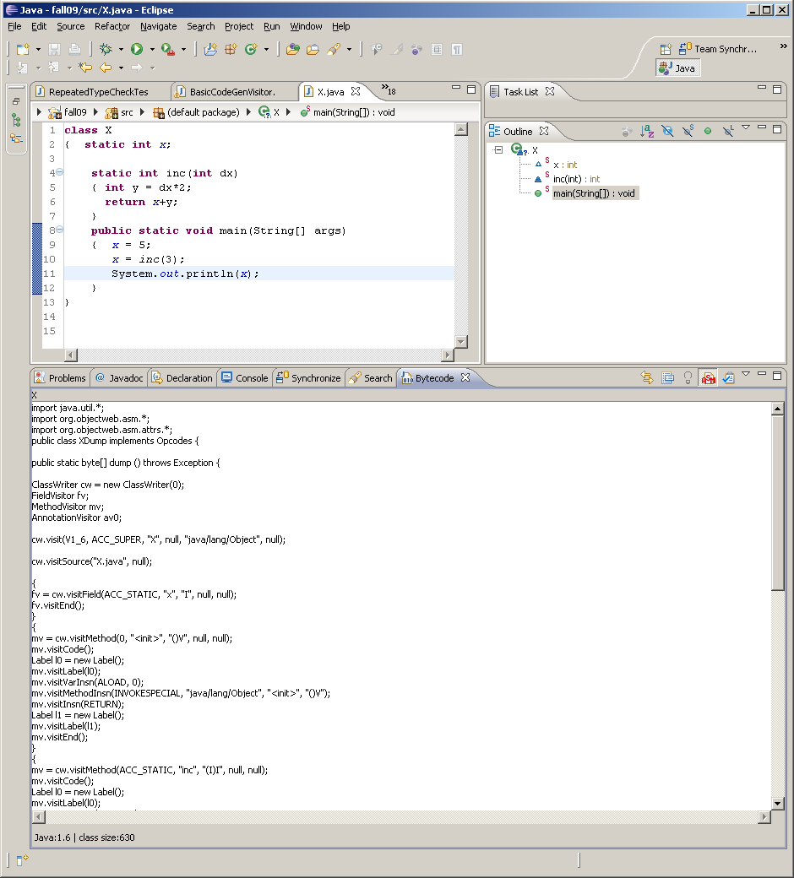

Slide 120
public static byte[] dump () throws Exception { ClassWriter cw = new ClassWriter(0); FieldVisitor fv; MethodVisitor mv; AnnotationVisitor av0; cw.visit(V1_6, ACC_SUPER, "X", null, "java/lang/Object", null); cw.visitSource("X.java", null); { fv = cw.visitField(ACC_STATIC, "x", "I", null, null); fv.visitEnd(); }

Slide 121
{ mv = cw.visitMethod(0, "<init>", "()V", null, null); mv.visitCode(); Label l0 = new Label(); mv.visitLabel(l0); mv.visitVarInsn(ALOAD, 0); mv.visitMethodInsn(INVOKESPECIAL, "java/lang/Object", "<init>", "()V"); mv.visitInsn(RETURN); Label l1 = new Label(); mv.visitLabel(l1); mv.visitEnd(); }

Slide 122
{ mv = cw.visitMethod(ACC_STATIC, "inc", "(I)I", null, null); mv.visitCode(); Label l0 = new Label(); mv.visitLabel(l0); mv.visitVarInsn(ILOAD, 0); mv.visitInsn(ICONST_2); mv.visitInsn(IMUL); mv.visitVarInsn(ISTORE, 1); Label l1 = new Label(); mv.visitLabel(l1); mv.visitFieldInsn(GETSTATIC, "X", "x", "I"); mv.visitVarInsn(ILOAD, 1); mv.visitInsn(IADD); mv.visitInsn(IRETURN); Label l2 = new Label(); mv.visitLabel(l2); mv.visitEnd(); }

Slide 123
{ mv = cw.visitMethod(ACC_PUBLIC + ACC_STATIC, "main", "([Ljava/lang/String;)V", null, null); mv.visitCode(); Label l0 = new Label(); mv.visitLabel(l0); mv.visitInsn(ICONST_5); mv.visitFieldInsn(PUTSTATIC, "X", "x", "I"); Label l1 = new Label(); mv.visitLabel(l1); mv.visitInsn(ICONST_3); mv.visitMethodInsn(INVOKESTATIC, "X", "inc", "(I)I"); mv.visitFieldInsn(PUTSTATIC, "X", "x", "I"); Label l2 = new Label(); mv.visitLabel(l2); mv.visitFieldInsn(GETSTATIC, "java/lang/System", "out", "Ljava/io/PrintStream;"); mv.visitFieldInsn(GETSTATIC, "X", "x", "I"); mv.visitMethodInsn(INVOKEVIRTUAL, "java/io/PrintStream", "println", "(I)V"); Label l3 = new Label(); mv.visitLabel(l3); mv.visitInsn(RETURN); Label l4 = new Label(); mv.visitLabel(l4); mv.visitEnd(); }

Slide 124
cw.visitEnd(); return cw.toByteArray(); } }

