Slide 1
COP5556 Programming Language Principles
Names, Scopes, and Bindings

Slide 2
Reading
Read Chapter 3 in Scott

Slide 3
Vocabulary
A name is exactly what you think it is
Most names are identifiers
symbols (like '+') can also be names
A binding is an association between two things, such as a name and the thing it names
The scope of a binding is the part of the program (textually) in which the binding is active

Slide 4
Vocabulary (2)
Binding Time
the point at which a binding is created
or, more generally, the point at which any implementation decision is made
The next slide
lists some possible binding times and typical examples

Slide 5
Binding time examples
language design time
program structure, primitive types
language implementation time
I/O, number of bits in primitive types, how arithmetic overflow is handled, type equality (if unspecified in manual)
Remarks:
Java attempts to define more at language design time than most languages for portability reasons.
Fixing decision at language design time may disallow architecture specific optimization.

Slide 6
Binding time examples (2)
program writing time
algorithms, names
compile time
plan for data layout
link time
layout of whole program in memory
load time
choice of physical addresses

Slide 7
Binding time examples (3)
run time
value/variable bindings, sizes of strings
run time subsumes
program start-up time
module entry time
elaboration time (point a which a declaration is first "seen")
procedure entry time
block entry time
statement execution time

Slide 8
Static refers to things bound before run time
Dynamic refers to things bound at run time
These are both coarse terms

Slide 9
Early binding times
usually associated with greater efficiency
compiled languages tend to have early binding times
Later binding times
associated with greater flexibility
Interpreted languages tend to have later binding times

Slide 10
Object lifetime and storage management
Distinguish between names and objects to which they refer
Key events
creation of objects
creation of bindings
references to objects using the bindings
(temporary) deactivation of bindings
reactivation of bindings
destruction of bindings
destruction of objects
Remark:
In this discussion, object just refers to anything that we want to bind to a name. This could be class, method, variable, type, etc.
It is not necessarily an object as the term is used in OOP

Slide 11
Object lifetime and storage management
Important: Distinguish between names and objects to which they refer
Key events
creation of objects
creation of bindings
references to objects using the bindings
(temporary) deactivation of bindings
reactivation of bindings
destruction of bindings
destruction of objects

Slide 12
Lifetime and Scope
The lifetime of a binding is the period of time from creation to destruction
If an object outlives binding it is garbage
If binding outlives object it is a dangling reference
The scope of a binding is the region of the program in which the binding is active

Slide 13
Storage Allocation
Object lifetimes associated with storage allocation mechanisms
static
an object is given an address that is maintained through program execution
stack
memory for objects allocated in last-in, first-out order, usually in conjunction with subroutine calls and returns
heap
memory for objects allocated in a region of memory where sub-blocks can be allocated and deallocated at arbitrary times.

Slide 14
Static allocation usage
Static allocation is typically used for:
code
globals
static or own variables
explicit constants (including strings, sets, etc)
scalars which are stored in the instructions

Slide 15
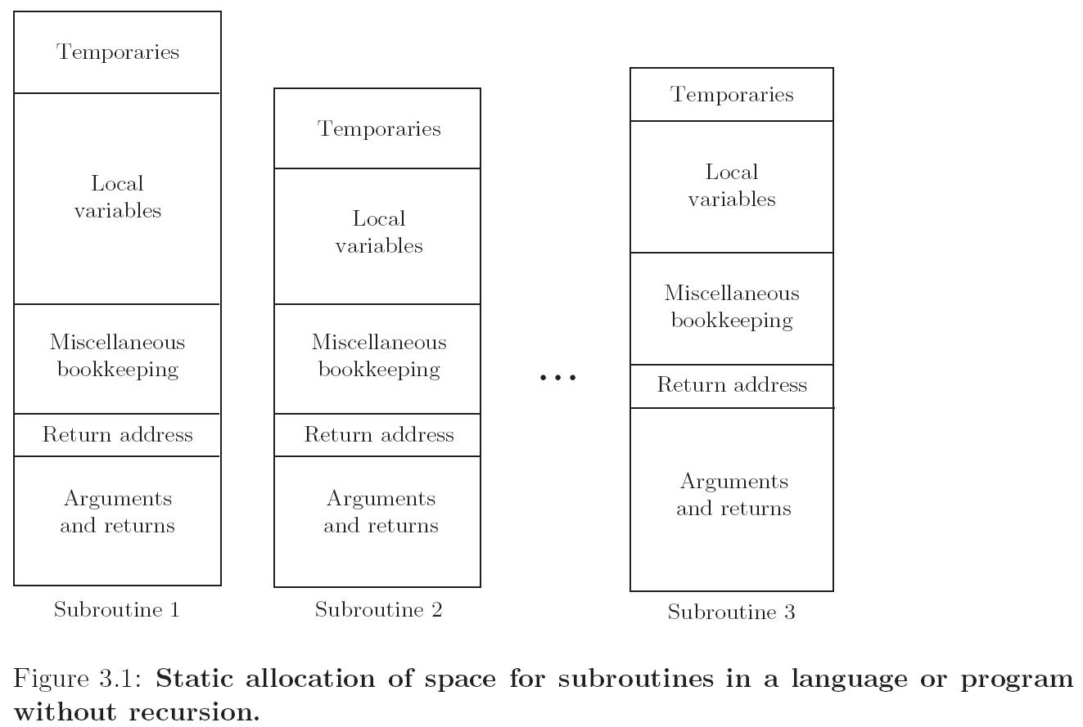
Static allocation for a language without recursion

Slide 16
Stack allocation
Stack allocation is typically used for
parameters of procedures
local variables
temporaries (e.g. intermediate values of expression)
Why a stack?
allocate space for recursive routines (not necessary in FORTRAN – no recursion)
reuse space (in all programming languages)
space for active routines usually much less than space for all routines
Although location of stack cannot be predicted at compile time, offsets of objects in stack relative to stack frame can be determined statically.

Slide 17
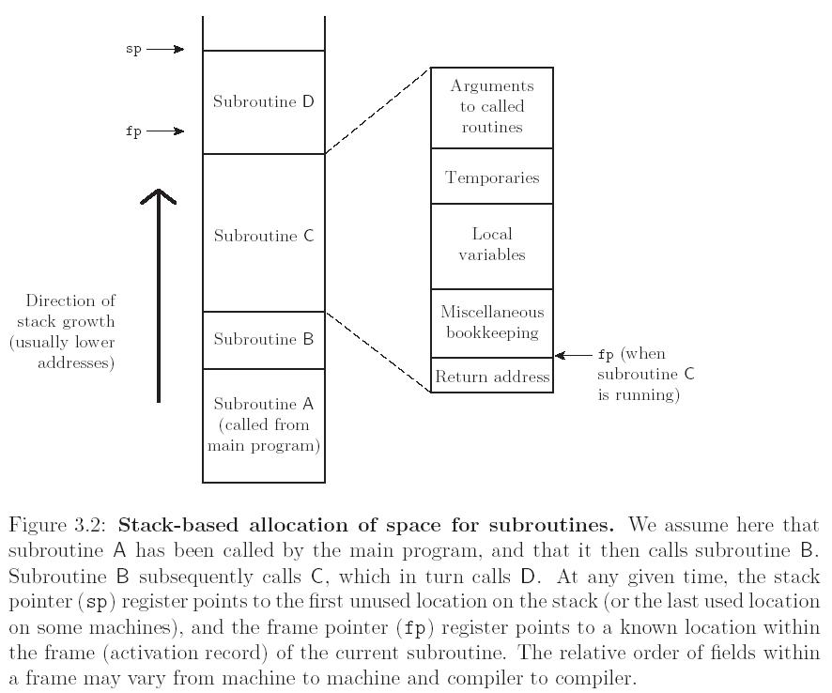

Slide 18
Heap-based allocation
Memory for an object is allocated in a region of memory where sub-blocks can be allocated and deallocated at arbitrary times.
Tradeoffs between:
Space
internal fragmentation. Memory blocks allocated that are larger than needed, unused space is allocated.
external fragmentation. Memory is available, but in small non-contiguous pieces.
Allocation Speed
With more computation, can reduce fragmentation
Various approaches (see Scott page 118-119) exist with various time-space tradeoffs.

Slide 19
Heap allocation and deallocation
Allocation occurs at specific point in program
new object instantiated,
long string assigned to previously shorter string, etc.
Deallocation
explicit
when indicated by programmer (Pascal, C)
implicit
garbage collection
occurs some time after no more references to object exist
on exiting scope

Slide 20
Tradeoffs
Explicit
simpler compiler implementation
better execution speed.
Subject to dangling references due to programmer error
deallocation bugs are common and serious in practice
Subject to memory leaks where unused memory is never deallocated.
This can cause programs to eventually run out of heap space.
Implicit:
simplifies programming task
with garbage collection, dangling references cannot occur
Fewer memory leaks
but these may still occur if the programmer keeps references to unneeded objects.
High quality garbage collection algorithms are available and technology is improving.

Slide 21
Scope
Recall:
The scope of a binding is the part of the program (textually) in which the binding is active
scope (more precisely)
a program section of maximal size in which no bindings change (or at least in which no re-declarations are permitted)

Slide 22
Scope (2)
referencing environment
set of active bindings at some point in program execution.
scope rules
define referencing environment
elaboration
the process of creating bindings when entering a scope
first used with Algol 60, Ada re-popularized the term
storage may be allocated, tasks started, even exceptions propagated as a result of the elaboration of declarations

Slide 23
Example: subroutines
In most languages with subroutines
On subroutine entry—enter a new scope:
create bindings for new local variables,
deactivate bindings for global variables that are re-declared (these variable are said to have a "hole" in their scope)
make references to variables
On subroutine exit:
destroy bindings for local variables
reactivate bindings for global variables that were deactivated

Slide 24
Static vs dynamic scoping
Statically scoped (lexically scoped) –scope of a binding is determined by lexical structure of the program
The determination of scopes can be made by the compiler
All bindings for identifiers can be resolved by examining the program
Typically, we choose the most recent, active binding made at compile time
Most compiled languages employ static scope rules
Dynamically scoped—scope of a binding is determined at runtime (and depends on flow of execution)

Slide 25
Classic example of static scope
used in block structured languages such as Algol 60 and Pascal
These languages allow nested subroutines
most closely nested rule
An identifier is known in the scope in which it is declared and in each enclosed scope, unless it is re-declared in an enclosed scope
To resolve a reference to an identifier, we examine the local scope and statically enclosing scopes until a binding is found

Slide 26
Example
program example;
var a,b: integer … procedure sub1; var x,y: integer begin {sub1} …… ←Ref Env = x,y of sub1, a,b of example, sub1
(maybe sub2 if variables not required to be declared before used) end{sub1} procedure sub2; var x: integer; … procedure sub3; var x: integer; begin {sub3} …. ← Ref evn: x of sub3, (x of sub2 is hidden) a,b of example, sub1,sub2,sub3 x := ….. end{sub3}
begin{sub2} … ← x of sub2, a,b of example, sub1,sub2,sub3 end{sub2}
begin{example} .. ← a,b of example, sub1,sub2
end{example}

Slide 27
Example
program example;
var a,b: integer … procedure sub1; var x,y: integer begin {sub1} …… ←Ref Env = x,y of sub1, a,b of example, sub1
(maybe sub2 if variables not required to be declared before used) end{sub1} procedure sub2; var x: integer; … procedure sub3; var x: integer; begin {sub3} …. ← Ref evn: x of sub3, (x of sub2 is hidden) a,b of example, sub1,sub2,sub3 x := ….. end{sub3}
begin{sub2} … ← x of sub2, a,b of example, sub1,sub2,sub3 end{sub2}
begin{example} .. ← a,b of example, sub1,sub2
end{example}

Slide 28
Example
program example;
var a,b: integer … procedure sub1; var x,y: integer begin {sub1} …… ←x,y of sub1, a,b of example, sub1
(maybe sub2 if variables not required to be declared before used) end{sub1} procedure sub2; var x: integer; … procedure sub3; var x: integer; begin {sub3} …. ← Ref evn: x of sub3, (x of sub2 is hidden) a,b of example, sub1,sub2,sub3 x := ….. end{sub3}
begin{sub2} … ← x of sub2, a,b of example, sub1,sub2,sub3 end{sub2}
begin{example} .. ← a,b of example, sub1,sub2
end{example}

Slide 29
Example
program example;
var a,b: integer … procedure sub1; var x,y: integer begin {sub1} …… ←x,y of sub1, a,b of example, sub1
(maybe sub2 if variables not required to be declared before used)) end{sub1} procedure sub2; var x: integer; … procedure sub3; var x: integer; begin {sub3} …. ← Ref evn: x of sub3, (x of sub2 is hidden) a,b of example, sub1,sub2,sub3 x := ….. end{sub3}
begin{sub2} … ← x of sub2, a,b of example, sub1,sub2,sub3 end{sub2}
begin{example} .. ← a,b of example, sub1,sub2
end{example}

Slide 30
Example
program example;
var a,b: integer … procedure sub1; var x,y: integer begin {sub1} …… ←x,y of sub1, a,b of example, sub1
(maybe sub2 if variables not required to be declared before used) end{sub1} procedure sub2; var x: integer; … procedure sub3; var x: integer; begin {sub3} …. ← x of sub3, (x of sub2 is hidden) a,b of example, sub1,sub2,sub3 x := ….. end{sub3}
begin{sub2} … ← x of sub2, a,b of example, sub1,sub2,sub3 end{sub2}
begin{example} .. ← a,b of example, sub1,sub2
end{example}

Slide 31
Implementation of variable access
With the most-closely nested rule
Use static links
Each frame points to the frame of the (correct instance of) the routine inside which it was declared
In the absence of subroutines passed as a parameter, correct means closest to the top of the stack
Access a variable in a scope k levels out by following k static links and then using the known offset within the frame thus found

Slide 32
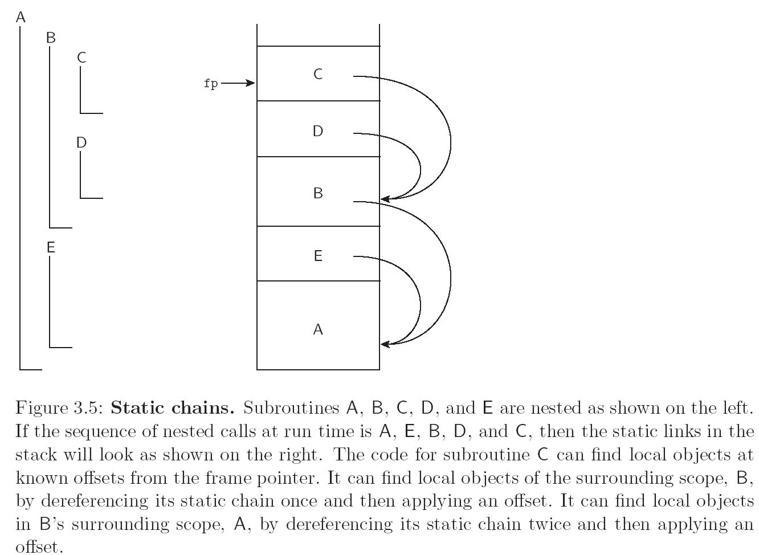
Scope Rules

Slide 33
More examples of static scope
Basic
One global scope
(traditional) Fortran
Global variable visible everywhere
Local variables are only visible in a subroutine where they appear.
By default, lifetime of local variables and their bindings is extent of subroutine execution.
Can override this using the save statement to make the lifetime of a variable is entire execution of program (thus the variable retains its value between calls), but the binding is only active inside subroutine.
(plus some other things)

Slide 34
Fortran-like example
f() prints 1
print i //error--i not visible here, but variable exists.
f() prints 2
f() prints 3
subroutine f()
save int i;
i = i+1;
print i;
end f
Notes:
Fortran’s static allocation for subroutines makes this easy to implement

Slide 35
Nested blocks
In some languages, blocks determine a scope and may be declared anywhere (not just subroutines)
Java, C:
{ } delineates a scope.
Scopes are nested, but not subroutines.

Slide 36
Declaration order
Is a declaration in a scope
valid in the entire scope?
or just in the text following the definition?
If a name must be declared before used, then how can we allow recursive types and subroutines.
Different languages deal with this in different ways

Slide 37
Pascal
Forward references for procedures.
Give the signature (Name parameters, return type) first.
This is enough information to compile a call to the procedure
Later, give entire definition.
Treat pointers as a special case in type definitions, only pointers can be used recursively in type definitions
ListPtr = POINTER TO ListNode ListNode = RECORD data: ... next: ListPtr; END
What is so special about pointers?.

Slide 38
Pascal
Pointers always same size regardless of what they point to—so can be handled as special case.
Forward refs for procedures plus limiting recursion in types to pointers enables one-pass compilation.

Slide 39
C,C++
Differentiate between
declaration—introduces name and defines scope
definition—introduces object to which name is bound
struct manager; //declare
struct employee{ struct manager *boss;
struct employee *next; }
struct manager{ //define struct employee *first; ..... } ...
Note that this is a pointer

Slide 40
Scopes and “Programming in the Large”
Large software projects require work to be done by multiple programmers who can work simultaneously.
Need language support for information hiding—making details invisible to parts of system that don’t need them.
Reduces “cognitive load” on programmers
Reduces risk of name conflicts
Helps protect integrity of data abstractions (can limit, with support from compiler, access to internals of abstraction)
Implies the need to decouple object lifetime from visibility.

Slide 41
Decoupling lifetime from visibility
Allow “local variables” of a subroutine to keep value between calls.
Examples:
static variables in C
“saved” variables in Fortran
Lifetime longer than subroutine invocation
Variables are visible only in subroutine
Disadvantage:
Only allows “single subroutine abstraction”
For example, can’t do the straightforward implementation of a stack with multiple operations implemented by different subroutines

Slide 42
Modules —(package, cluster,namespace)
Encapsulates collection of objects (variables, subroutines, types, etc.) so that
objects inside module are visible to each other
object inside module are NOT visible outside unless exported
(in many languages) objects outside are not visible inside the module unless explicitly imported.
Object lifetime is orthogonal to visibility
Example
Modula-2, a language designed by Niklaus Wirth to improve upon Pascal
Supports local modules and global modules

Slide 43
Local modules in Modula-2
VAR a,b: INTEGER;
MODULE M;
IMPORT a; EXPORT w,x;
VAR u,v,w: INTEGER;
MODULE N;
IMPORT u; EXPORT x,y;
VAR x,y,z: INTEGER
(* u,x,y,z, visible here *)
END N;
(* a,u,v,w,x,y visible here *)
END M;
(* a,b,w,x visible here *)
END

Slide 44
Local modules in Modula-2
VAR a,b: INTEGER;
MODULE M;
IMPORT a; EXPORT w,x;
VAR u,v,w: INTEGER;
MODULE N;
IMPORT u; EXPORT x,y;
VAR x,y,z: INTEGER
(* u,x,y,z, visible here *)
END N;
(* a,u,v,w,x,y visible here *)
END M;
BEGIN
(* a,b,w,x visible here *)
END

Slide 45
Local modules in Modula-2
VAR a,b: INTEGER;
MODULE M;
IMPORT a; EXPORT w,x;
VAR u,v,w: INTEGER;
MODULE N;
IMPORT u; EXPORT x,y;
VAR x,y,z: INTEGER
(* u,x,y,z, visible here *)
END N;
(* a,u,v,w,x,y visible here *)
END M; (* a,b,w,x visible here *)
(* a,b,w,x visible here *)
END

Slide 46
Local modules in Modula-2
VAR a,b: INTEGER;
MODULE M;
IMPORT a; EXPORT w,x;
VAR u,v,w: INTEGER;
MODULE N;
IMPORT u; EXPORT x,y;
VAR x,y,z: INTEGER
(* u,x,y,z, visible here *)
END N;
(* a,u,v,w,x,y visible here *)
END M;
(* a,b,w,x visible here *)
END
Remark: Local modules are an obvious next step from nested subroutines. In practice they didn’t turn out to be very useful and Wirth did not keep them in his later languages

Slide 47
Global Modules in Modula-2
Divide a module into two parts
DEFINITION MODULE
defines the module’s interface
contains all information needed to compile a module that uses it (exported names, types, etc.)
IMPLEMENTATION MODULE
defines internals.
The two modules are in separate files
A client module needs only the (compiled) definition module, module internals thus hidden.

Slide 48
DEFINITION MODULE Buffer; VAR nonempty, nonfull: BOOLEAN; PROCEDURE put(x: INTEGER); PROCEDURE get(VAR x: INTEGER);
END Buffer.
Everything in the definition module is exported

Slide 49
IMPLEMENTATION MODULE Buffer; (* nonempty and nonfull defined in definition module *)
CONST N = 100; VAR in, out [0..N-1]; n: [0..N]; buf: ARRAY[0..N-1] OF INTEGER;
PROCEDURE put(x: INTEGER); BEGIN IF n<N THEN buf[in] := x; in := (in +1)MOD N; n := n+1; nonfull := n<N; nonempty := TRUE; END; END put;
PROCEDURE get(VAR x: INTEGER) ....
END get;
BEGIN (*initialize*) n:=0; in := 0; out := 0; nonempty := FALSE; nonfull := TRUE;
END Buffer.

Slide 50
MODULE MainBufferClient IMPORT Buffer; .... BEGIN .... Buffer.put(item);
(*or if no name conflicts, just put(item)*) ... END MainBufferClient

Slide 51
Question: How many instances can there be of a module?
recall in previous slide, the Buffer was not explicitly instantiated
In Modula-2 (and often in languages with modules) only 1.
If program needs two Buffers then we need a module for each one.
For example, create, say, module Buffer2 and replicate the code.

Slide 52
A way to get around the limitation of only one instance per module
Use the module as a manager of a type rather than the type itself
The former module (i.e. Buffer) becomes a (record) type in the module.
Variables become fields of the record
Procedures accept the record as a parameter

Slide 53
DEFITION MODULE BufferManager;
CONST N = 100;
TYPE Buffer = RECORD VAR in, out [0..N-1]; n: [0..N]; buf: ARRAY[0..N-1] OF INTEGER; END
PROCEDURE put(VAR b: Buffer; x: INTEGER) PROCEDURE get(VAR b: Buffer; VAR x: INTEGER) PROCEDURE init(VAR b: Buffer)
END BufferManager.

Slide 54
It is also possible to hide the implementation of the Buffer by exporting an opaque POINTER to the buffer instead of the buffer itself
DEFITION MODULE BufferManager;
CONST N = 100;
TYPE Buffer = RECORD VAR in, out [0..N-1]; n: [0..N]; buf: ARRAY[0..N-1] OF INTEGER; END
PROCEDURE put(VAR b: Buffer; x: INTEGER) PROCEDURE get(VAR b: Buffer; VAR x: INTEGER) PROCEDURE init(VAR b: Buffer)
END BufferManager.

Slide 55
IMPLEMENTATION MODULE BufferManager;
PROCEDURE put(VAR b: Buffer; x: INTEGER)
BEGIN IF n<N THEN b.buf[in] := x; b.in := (b.in +1)MOD b.N; b.n := b.n+1; END;
END push;
PROCEDURE put(VAR b: Buffer; VAR x: INTEGER)
BEGIN
....
END put;
PROCEDURE init(VAR b: Buffer)
BEGIN
b.n:=0; b.in := 0; b.out := 0;
END init;
END BufferManager.

Slide 56
MODULE MainBufferClient; IMPORT BufferManager; .... b: BufferManager.Buffer;
BEGIN b = NEW(BufferManager.Buffer);
BufferManager.init(b); .... BufferManager.put(b,item); END

Slide 57
Classes
Similar to modules except they statically bind procedures to a type.
For example, imagine a new version of Modula+Classes (similar to Oberon 2)

Slide 58
(revised) DEFITION MODULE BufferManager;
TYPE Buffer = RECORD CONST N = 100; VAR in, out [0..N-1]; n: [0..N]; buf: ARRAY[0..N-1] OF INTEGER
PROCEDURE push(x: INTEGER) PROCEDURE get(VAR x: INTEGER) PROCEDURE init() END (*of type Buffer*)
END BufferManager
Now the methods are defined inside the record

Slide 59
Inside the implementation module, use a keyword to refer to this implicit argument
often self or this
In a client program that imports the modified BufferManager and declares a variable b of type Buffer:
say b.put(x)
rather than BufferManager.put(b,x);
Classes also include inheritance and other concepts to be discussed later when we talk about object-oriented programming

Slide 60
Additional support for programming in the large
Independent compilation
Can compile different parts of a program independently, but no type checking across the compilation units
Separate compilation
Can compile different parts of a program independently, with type checking across the compilation units
Extremely important in maintaining large systems

Slide 61
Example: Separate compilation in Modula-2
The definition module contains the information needed by clients.
During development, write the definition module first and compile it to get a symbol file.
With the symbol file, clients can compile their code to get an object file.
As long as the symbol file doesn’t change, the implementation module can change without requiring recompilation of clients.
The clients can work with a “stub” implementation.

Slide 63
Maintaining consistency
Each symbol file is given a key.
Each object file includes the keys of all symbol files for imported modules
Keys are matched by the linker.
Possible approaches for obtaining keys
timestamps
advantage: simple
disadvantage: merely recompiling definition module without changing it requires all clients to be recompiled)
Signature or checksum
depends only on content.
still fragile—reordering declarations changes key

Slide 64
Oberon
Another Niklaus Wirth language, the successor to Modula-2.
Most important new concept: type extensions (will discuss later)
Instead of programmer writing explicit definition module the programmer marks items to be exported.
The definition module is thus implicit
Symbol file are generated from marked items.
The symbol file only changes when exported items change.
but—there are a few traps for the unwary
For example, changing the declaration order changes the symbol file.

Slide 65
Java
Java has more sophisticated encapsulation concepts than Modula-2 and Oberon
Classes may belong to a package
public, visible everywhere imported,
protected visible within package or subclass
default, visible within a package,
private visible only within class
local variables are visible only in block where they are defined
Symbol file info is extracted from class files by the compiler
Class files contain symbolic names.
Compatibility checks are performed as part of byte code verification.
Notes:
Mention Java’s interfaces and abstract classes

Slide 66
Dynamic Scope
Current binding is one encountered most recently during program execution
A few languages with dynamic scope: APL, Lisp, Perl
An example is on the next slide

Slide 67
x: integer;
procedure sub1
{ print x;
}
procedure sub2
{ x: integer
x = 100;
call sub1;
}
read x;
if (x > 0) call sub1 else call sub2
}
Which x does this refer to???

Slide 68
x: integer;
procedure sub1
{ print x;
}
procedure sub2
{ x: integer
x = 100;
call sub1;
}
read x;
if (x > 0) call sub1 else call sub2
}
Dynamic scope: if input value <=0, print input value, otherwise print 100.

Slide 69
x: integer;
procedure sub1
{ print x;
}
procedure sub2
{ x: integer
x = 100;
call sub1;
}
read x;
if (x > 0) call sub1 else call sub2
}
Static scope: always print input value.

Slide 70
Modern languages are more likely to have static than dynamic scope
Disadvantages of dynamic scope
During time span that a subroutine executing, its locals are visible to any other executing subprogram. (breaks encapsulation, less reliable programs)
Can’t statically type check references to nonlocals
see next slide
Dynamic scope more difficult to understand—understanding a subroutine requires knowing the calling sequence
Implementation issue: access to non-locals is slower in dynamically typed languages (more on this later)
Empirical evidence: dynamically scoped languages have tended to evolve statically scoped versions (Lisp →Scheme, later versions of Perl)

Slide 71
x: integer;
procedure sub1
{ printint x;
}
procedure sub2
{ x: boolean
x = true;
call sub1;
}
read x;
if (x > 0) call sub1 else call sub2
}
Is this type safe? Can’t tell until runtime

Slide 72
Implementing Scope
We have talked about what the scope rules are
Now, we consider how to implement these rules in the compiler and run-time system.
We have already looked at how local variables can be found at runtime, but not how the compiler manages to set this up.

Slide 73
Implementing static scope in a compiler
Use a data structure called a symbol table which contains (name, attribute) pairs
Attributes include the various things that the compiler needs to know about the name: type, address or offset, value if a constant, etc.
Basic operations provided by a symbol table
create an empty symbol table
insert an entry (associates identifiers with attributes)
lookup an entry (returning attributes associated with a given identifier)
delete an entry
The organization of the symbol table depends on the structure of the language

Slide 74
Example: monolithic block structure
The only block is entire program
Use a hashtable
insert entries when variables are declared
lookup entries when variables are referenced
name | attributes
x | int,…
y | bool,…

Slide 75
Flat block structure
Two scope levels
global—names visible everywhere
local—visibility restricted to block where declared
When a variable is encountered in an expression, it must be matched with the appropriate declaration.
Symbol table changes during compilation

Slide 76
program A { int x; procedure B { int y; ..
x = y; }
procedure main { boolean y; int z; … if (!y) then x = z+1 … } }

Slide 77
program A { int x; procedure B { int y; ..
x = y; }
procedure main { boolean y; int z; … if (!y) then x = z+1 … } }
Symbol table when analyzing B
ident | level | attributes
x | global | int, …
y | local | int, …

Slide 78
program A { int x; procedure B { int y; ..
x = y; }
procedure main { boolean y; int z; … if (!y) then x = z+1 … } }
Symbol table when analyzing main
ident | level | attribute
x | global | int, …
y | local | bool, …
z | local | int, …

Slide 79
Modifications to simple interface
add enterScope() and leaveScope methods to SymbolTable
enterScope is called at the start of a block.
leaveScope is called at the end of a block.
after the a scope is entered, new declarations are local to that scope
when scope is exited, all local declarations are discarded
The most obvious data structure is a stack

Slide 80
Nested block structure
Blocks may be nested within one another.
There may be many scope levels (not just global and local)
class X
{ int x;
void f()
{ int y; int z;…..
while (x != 0){ int x = y + z;…}
}
}

Slide 81
Declarations at outermost level are global in scope. This level 1
Declarations inside an inner block are local to that block.
Every inner block is completely contained by another block.
The level of block is the level of the enclosing block +1.
Record level numbers in the level field in the symbol table

Slide 82
The symbol table keeps track of current scope level.
At start of block, enterScope is called.
increments current scope level.
At end of block, leaveScope is called.
leaveScope decrements current scope level
removes entries with higher scope level
When an entry for identifier i is requested, the matching entry for i with the highest scope level will be returned.

Slide 83
Symbol table implementation
Naïve implementation
use a stack.
linear search from top of stack.
return first match found
pop entries when leaving scope.
In serious compilers, efficiency is important.
Lookup identifier is a frequent operation, adding a new entry is not. Stack implementation has fast add and slow lookup.
To support debuggers, symbol table information should be maintained (not popped and discarded) even when no longer needed by the compiler

Slide 84
Leblanc-Cook symbol table
More efficient than a stack
See Scott, supplement, for more details
Main ideas
Each scope is assigned a unique serial number.
New scopes given new number as they are encountered. (These numbers do not reflect nesting)
All identifiers are entered into one hash table with their attributes and scope number.
The hash table chains entries with the same identifier.
A separate scope stack records the scopes that belong to the current referencing environment.

Slide 85
int current_scope, next_scope;
void enterScope()
{ current_scope = next_scope++; scope_stack.push(current_scope);
}
void closeScope()
{ current_scope = scope_stack.pop();
}
void lookup(String name)
{ gets matching entry in hash table;
scan chain and return attributes for entry with
scope number closest to the top of the scope stack;
}

Slide 86
Example
class X
{ int x;
void f()
{ int y; int z;…..
while (x != 0)
{ int x = y + z;…}
print(x);
}
}

Slide 87
Example
class X
{ int x;
void f()
{ int y; int z;…..
while (x != 0)
{ int x = y + z;…}
print(x);
}
}
identifier | scope number | attributes
X | 0 | program name
0

Slide 88
Example
class X
{ int x;
void f()
{ int y; int z;…..
while (x != 0)
{ int x = y + z;…}
print(x);
}
}
identifier | scope number | attributes
X | 0 | program name
x | 1 | int, ...
f | 1 | method, void,...
1
0

Slide 89
Example
class X
{ int x;
void f()
{ int y; int z;…..
while (x != 0)
{ int x = y + z;…}
print(x);
}
}
identifier | scope number | attributes
X | 0 | program name
x | 1 | int, ...
f | 1 | method, void,...
y | 2 | int, ...
z | 2 | int, ...
2
1
0

Slide 90
Example
identifier | scope number | attributes
X | 0 | program name
x | 3 | int, ...
f | 1 | method, void,...
y | 2 | int, ...
z | 2 | int, ...
class X
{ int x;
void f()
{ int y; int z;…..
while (x != 0)
{ int x = y + z;…}
print(x);
}
}
3
2
1
0
identifier | scope number | attributes _
x | 1 | int, ...

Slide 91
Example
identifier | scope number | attributes
X | 0 | program name
x | 3 | int, ...
f | 1 | method, void,...
y | 2 | int, ...
z | 2 | int, ...
class X
{ int x;
void f()
{ int y; int z;…..
while (x != 0)
{ int x = y + z;…}
print(x);
}
}
2
1
0
identifier | scope number | attributes _
x | 1 | int, ...

Slide 92
Implementation of dynamic scope
A symbol table-like data structure needs to be available at runtime.
Two common ones
Association List
Central reference table

Slide 93
Association list
Uses a stack
Entries are placed on stack when declarations are encountered.
Lookup by searching from the top of stack
Remark:
With dynamic scope, the stack is maintained at runtime and reflects calling structure.
A stack used to implement a symbol table for static scope is a compile time structure and reflects the lexical structure.

Slide 94
Central reference table
Uses a hashtable to hold name, attribute pairs
New entries are added at the front of a chain
Lookup retrieves the first entry in the chain
Entries no longer in scope are deleted when a scope is exited.

Slide 95
Passing subroutines as parameters
Some languages allow subroutines (procedures, methods) to be passed as parameters.
What should the reference environment be?
What scope rules apply??
Deep binding=when reference created
Shallow binding=when routine is called
Example illustrating the difference next--

Slide 96
Example
program var x: integer; procedure SUB2; begin write(x); end; procedure SUB3; var x: integer; begin x := 3; SUB4(SUB2)
end; procedure SUB4(SUBX); var x: integer; begin x := 4; SUBX;
end
begin x := 1; SUB3 end

Slide 97
Example with deep binding
program var x: integer; procedure SUB2; begin write(x); //writes 3
end; procedure SUB3; var x: integer; begin x := 3; SUB4(SUB2) // ref env for sub2 created here.
end; procedure SUB4(SUBX); var x: integer; begin x := 4; SUBX;
end
begin x := 1; SUB3 end

Slide 98
Example with shallow binding
program var x: integer; procedure SUB2; begin write(x); //writes 4 end; procedure SUB3; var x: integer; begin x := 3; SUB4(SUB2)
end; procedure SUB4(SUBX); var x: integer; begin x := 4; SUBX; //ref env for SUB2 created here
end
begin x := 1; SUB3 end

Slide 99
State of A-list after calling SUB4
(stack grows upwards)
Deep binding, may need to look arbitrarily “deep” into the stack
Shallow binding, starts at top of stack.
x_{SUB4} 4 | ref env for sub2 with shallow binding
x_{SUB3} 3 | ref env for sub2 with deep binding
x_{MAIN} 1

Slide 100
Typical design decisions
Most language with static scoping use deep binding
Difference only matters for recursive calls with variables that are neither global nor local
Some languages avoid the issue altogether
Modula-2 only allows outermost subroutines to be passed as parameters (thus all their variables are either local or global)
C, Java, etc. don’t have nested subroutines
PL/1, Ada 83 don’t allow subroutines to be passed as parameters
Most languages with dynamic scope use shallow binding.
There are situations where deep is more useful than shallow (See fig. 3.12 pg 123 in Scott.)
Some languages with one type of binding as default offer the other as an option

Slide 101
Definition: closure
Reference to subroutine together with a representation of the binding environment.
This is necessary with deep binding.
With an Association list, a closure can be represented by pointer to the location in the stack
x_{SUB4} 4 | ref env for sub2 with shallow binding
x_{SUB3} 3 | ref env for sub2 with deep binding
x_{MAIN} 1

Slide 102
First class object: can be passed as parameter, returned, and assigned to a variable
simple types
functions in functional languages (and some imperative languages with restrictions)
some authors also require the ability to create the object at runtime
Second class: passed but not returned or assigned
procedures in many imperative languages
Third class: cannot be passed, returned, or assigned.
labels in most languages

Slide 103
So far, we’ve looked at issues with second class subroutines
We have additional complication when subroutines are first class values
A reference to a subroutine may outlive the execution of scope in which it was declared.
Example in Scheme
(define plus_x (lambda (x) (lambda (y) (+ x y))))
this defines plus_x to be a function that takes a parameter x, and returns a new function that takes a parameter y and returns x + y.
(plus_x 2) is a function that adds 2 to its argument
(plus_x 3) is a function that adds 3 to its argument
((plus_x 2) 10) 12
Notes:
Same example in ML:
val plus_x = fn x => fn y => x + y;
val f = plus_x 2;
f 3;
gives result 5

Slide 104
(let ( f (plus_x 2) ) (f 3 ))
let means bind f to (plus_x 2), the function that adds 2 to its argument,
then evaluates the expression, here f with argument 3.
The result is 5.
To evaluate f, need to refer to local variable (the parameter) 2 plus_x, even though plus_x has already been evaluated and returned.
Cannot reclaim storage for plus_x’s local variables without risking creating a dangling reference.
In most functional languages, local vars have unlimited extent
They are garbage collected when garbage collector can prove they will no longer be called.
The desire to maintain stack based allocation is the reason that most imperative languages do not have first class subroutines.

Slide 105
Extended example :Perl
All variables are global by default.
The runtime environment contains a symbol table implemented using a hashtable that maps variable names to their values.
It is actually a bit more complicated, but the details are not important for our purposes.

Slide 106
Local variables in Perl
A variable can also be marked local in a block, using the local keyword.
When a variable is marked local, its current value in the symbol table is saved.
When the program leaves the block, the saved value is restored to the symbol table.
This approach gives dynamic binding of names, and shallow binding of reference environments for procedures passed as a parameter.

Slide 107
Lexical variables in Perl
A variable can also be marked as a lexical variable in a block using the my keyword.
A lexical variable is newly allocated in the block, and deallocated when the program leaves the block.
It is stored in stack-based structure separate from the symbol table.
This gives static binding for names, and deep binding of the reference environment for that variable.
The next slide illustrates lexical and local variables

Slide 108
Example 1: local and lexical vars
$a = 20; # $a is a global scalar var
{ # starts a new block
local ($a) # mark $a as a local var
# this saves the old value of $a, # the current value is undefined
$a = 10; # now $a has value 10
print $a; # prints 10, the current value
my (@b); # @b is a lexically scoped array
@b = ("go", "gators");
print "@b"; # prints "go gators“
} # end of block
# old value of $a restored, @b no longer defined
print $a; # prints "20", the old value
@b; # illegal

Slide 109
The next two examples illustrate how
local variables are dynamically bound in subroutine calls
lexical variables are lexically bound.
The only difference in the code is the treatment of $x inside sub first.

Slide 110
#Example 2: with (dynamically bound) local vars
$x = 10;
first();
sub first
{ local ($x) = "zen";
second();
}
sub second
{ print $x; # Prints "zen",
#the current value of $x
}

Slide 111
#Example 3: with lexical vars
$x = 10;
first();
sub first
{ my ($x) = "zen";
second();
}
sub second
{ print $x; # Prints 10,
#the lexical x defined in first
#not visible
}

Slide 112
Subroutines
are first class values
can be anonymous.
In the next example, an anonymous subroutine is returned from a subroutine call, then later executed.

Slide 113
Anonymous subroutine
$greeting = "hello world";
$rs = sub { print $greeting; };
&$rs(); #prints "hello world"

Slide 114
Next example
an anonymous subroutine is returned from a subroutine call, then later executed.
The examples illustrate shallow binding and deep binding, depending on whether the variable $greeting is local or lexical.

Slide 115
Shallow binding
sub generate_greeting
{ local($greeting) = “hello”;
print “$greeting from generate_greeting\n”;
#prints “hello from generate_greeting”
return sub {print “$greeting\n”};
}
$rs = generate_greeting();
#evaluates subroutine and
#assigns ref to returned subroutine to $rs
$greeting = “goodbye”;
#assigns value to global var $greeting
&$rs(); # invokes subroutine assigned to $rs, # shallow binding # prints “goodbye”, which is the # current val of global var $greeting

Slide 116
Deep binding
sub generate_greeting
{ my($greeting) = "hello";
print “$greeting from generate_greeting\n”; #prints “hello fromgenerate_greeting”
return sub {print “$greeting\n”};
}
$rs = generate_greeting();
$greeting = “goodbye”;
&$rs(); # Prints "hello” using a closure
# containing the value of $greeting when
# subroutine assigned to $rs was created
# This is deep binding.
# Value of lexical var $greeting has
# extent beyond subroutine where it was created

Slide 117
One more example with closures.
This time, the generated subroutine takes an argument.

Slide 118
Example-deep binding
$greeting = “howdy”
sub gen_greeting
{ my($greeting) = @_; # @_ is list of args for
#gen_greeting
return sub {
my($subject)= @_; # @_ here is the arg list for the # anonymous subroutine print "$greeting $subject \n";
};
}
$rs1 = gen_greeting("hello");
$rs2 = gen_greeting("my fair");
# $rs1 and $rs2 refer to the same code,
# but the closures contain different referencing
# environments with different values for $greeting.
&$rs1 ("world") ; # prints "hello world“
&$rs2 ("lady") ; # prints "my fair lady"

Slide 119
Example-shallow binding
$greeting = “howdy”
sub gen_greeting
{ local($greeting) = @_; # @_ is list of args for
#gen_greeting
return sub {
my($subject)= @_; # @_ here is the arg list for the # anonymous subroutine print "$greeting $subject \n";
};
}
$rs1 = gen_greeting("hello");
$rs2 = gen_greeting("my fair");
# $rs1 and $rs2 refer to the same code,
# but the value for greeting in both is taken from the
# global var .
&$rs1 ("world") ; # prints “howdy world“
&$rs2 ("lady") ; # prints “howdy lady"

Slide 120
So far, we’ve assumed that every name refers to a distinct object. This is not necessarily the case
A few definitions to finish off the topic of names:
Alias
multiple names bound to same object in a scope
pointer based data structures
Pass variable by reference to a subroutine that accesses variable directly
VAR totalCalls: INTEGER; PROCEDURE IncAndCount(VAR INTEGER x) BEGIN x := x+1; totalCalls := totalCalls+1; END IncAndCount; .... IncAndCount(totalCalls);.....
Aliases make it more difficult to reason about programs by both the programmer (leading to errors) and the compiler (making optimizations more difficult or impossible).

Slide 121
Overloading
multiple objects are bound to same name in a scope
Since multiple objects may be bound to a name, we need to be able to find the correct one from the context.
a+b
if a and b are ints, then + is integer addition,
if they are doubles, then double precision floating point addition.
int f(int x){.....} int f(int x, int y){....}
Multiple methods bound to name f, select using the number and type of arguments.

Slide 122
Polymorphism
from Greek—having multiple forms
In programming—can work with multiple types
Explicit polymorphism
Code takes type as a paramenter
Also called genericity
List<SyntaxException>
Subtype polymorphism
Subtype relation between types
Code designed to work with objects of a type can work with objects of subtypes as well
Method overriding—method defined in subtype, which method chosen at runtime
More on this later

Slide 123
Coercion
Compiler automatically converts a value from one type to another when second type is required by context
int x = 1;
….
System.out.println(“result=“ + x);

Slide 124
Difference between coercion and overloading
(very hypothetical) Language 1: ‘+’ only defined for int
2.3 + 3.4
convert 2.3 and 3.4 to int
result is 5
Language 2: ‘+’ plus overloaded, int or fp addition selected based on types of arguments
2.3 + 3.4
chooses fp addition
result is 5.7

