Slide 1
COP5556 Programming Language Principles
Data Abstraction and Object-oriented Programming

Slide 2
Reference
Scott Chapter 10
Design by Contract:
The best reference is the book
Bertrand Meyer: Object-Oriented Software Construction, Prentice Hall, 1997
Many resources available on the web, including
http://eiffel.com/developers/design_by_contract_in_detail.html

Slide 3
Why abstractions?
easier to think about - hide what doesn't matter
protection - prevent access to things you shouldn't see
plug compatibility
replacement of pieces, often without recompilation, definitely without rewriting libraries
division of labor in software projects

Slide 4
Background
Control or process abstraction is a very old idea (subroutines!), though few languages provide it in a truly general form (Scheme comes close)
Data abstraction is somewhat newer, though its roots can be found in Simula67
An Abstract Data Type is one that is defined in terms of the operations that it supports (i.e., that can be performed upon it) rather than in terms of its structure or implementation

Slide 5
We talked about data abstraction some back in the unit on naming and scoping
Recall that we traced the historical development of abstraction mechanisms

Slide 6
Static set of global variables | Basic
Local variables | Fortran, Algol 60, Pascal
Statics | Fortran, Algol 60
Modules | Mesa, Modula-2 Ada 83
Module types | Euclid
Objects | Simula, Smalltalk, C++, Eiffel, Oberon, Module-3, Ada95, C#,….

Slide 7
Definitions (review)
Global variable
lifetime spans program execution
Local variables and nested scopes
lifetime spans subroutine, and subroutines themselves can be local
Statics
allow a single subroutine to retain values from one invocation to the next, while hiding the name in-between

Slide 8
Definitions (2)
Modules
allow a collection of subroutines to share some statics, still with hiding
If you want to build an abstract data type, though, you have to make the module a manager
Module types
allow instantiation of multiple instances
Classes
allow definition of families of related abstractions

Slide 9
Module as Manager (review)
MODULE BufferManager
Buffer = POINTER to BufferDesc
BufferDesc = RECORD …..END
…
void init(Buffer: b) …. END init
void put(Buffer: b, itemType x)…. END put
itemType get(Buffer: b)….END get
…
END

Slide 10
Oberon*: modules + type extensions
maxBuffer = POINTER TO maxBuffeDesc;
maxBufferDesc = RECORD (BufferDesc)
int max
END
void init(maxBuffer: b);
BEGIN BufferManager.init(b); b^.max = 0 END init;
void put(maxBuffer: b, itemType x)
BufferManager.put(b,x); b^.max := .. END put
…
*Oberon was designed by Niklaus Wirth in the 80s as a successor to Modula 2

Slide 11
Type extension
Oberon: modules + type extensions
maxBuffer = POINTER TO maxBuffeDesc;
maxBufferDesc = RECORD (BufferDesc)
int max
END
void init(maxBuffer: b);
BEGIN BufferManager.init(b); b^.max = 0 END init;
void put(maxBuffer: b, itemType x)
BufferManager.put(b,x); b^.max := .. END put
…
This record extends BufferDesc by adding a new field, max

Slide 12
Type compatibility
Oberon: modules + type extensions
maxBuffer = POINTER TO maxBuffeDesc;
maxBufferDesc = RECORD (BufferDesc)
int max
END
void init(maxBuffer: b);
BEGIN BufferManager.init(b); b^.max = 0 END init;
void put(maxBuffer: b, itemType x)
BufferManager.put(b,x); b^.max := .. END put
…
Can use a maxBuffer anywhere a Buffer is expected

Slide 13
Oberon-2: Oberon+ procedures bound to records
MODULE MaxBufferManager
maxBuffer = POINTER to maxBufferDesc
maxBufferDesc = RECORD (BufferDesc),
int max
void init()
super.init(); b.max = 0 END init
void put( itemType x)
super.put(x); b.max := .. END put
itemType get(maxbuffer: b)
END
…
END
procedures (methods) defined inside the record
invoke with target.name(…) instead of name(target,…)
Also can override methods in extensions

Slide 14
Objects add inheritance and dynamic method binding
Simula 67 introduced these, but didn't have data hiding
Inheritance allows functionality of existing classes to be extended
The 3 key factors in OO programming
Encapsulation (data hiding)
Inheritance
Dynamic method binding

Slide 15
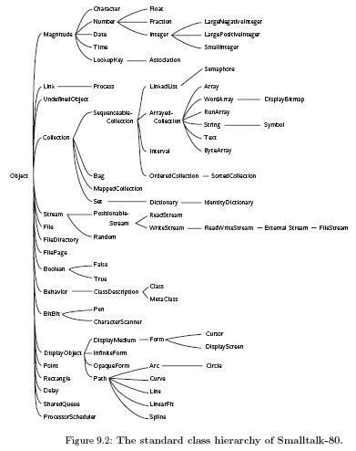
By deriving new classes from old ones, the programmer can create arbitrarily deep class hierarchies, with additional functionality at every level of the tree.
The Smalltalk class hierarchy for Smalltalk has as many as seven levels of derivation

Slide 16
Dynamic method binding
Don’t know at compile time exactly what type the object referred to will be
But we do know it will be the declared class or a subclass of the declared class.
class X{ void f(){print(“this is X”);}}
class Y extends X
{void f(){print (“this is Y”);}}
…
X x = new X; x.f();
x = new Y; x.f();

Slide 17
class X{ void f(){print(“this is X”);}}
class Y extends X
{void f(){print (“this is Y”);}}
…
X x = new X; x.f();
x = new Y; x.f();
Static type of x is X
Dynamic type of x is X

Slide 18
class X{ void f(){print(“this is X”);}}
class Y extends X
{void f(){print (“this is Y”);}}
…
X x = new X; x.f();
x = new Y; x.f();
Static type of x is X
Dynamic type of x is Y

Slide 19
Dynamic method binding
Don’t know at compile time what type the object referred to will be, which method is called depends on runtime type.
class X{ void f(){print(“this is X”);}}
class Y extends X
{void f(){print (“this is Y”);}}
…
X x = new X(); x.f();
x = new Y(); x.f();
prints “this is X”
dynamic binding:
prints “this is Y”
static binding:
prints “this is X”

Slide 20
Implementation
Data members of classes are implemented like records
With (single) inheritance, subclasses classes have extra fields at the end
A pointer to the parent and a pointer to the child contain the same address - the child just knows that the record goes farther than the parent does

Slide 21
class X
{ int a; ….}
class Y extends X
{ int b; ….}
X x = new X();
Y y = new Y();
… a
… a
b
x
y

Slide 22
class X
{ int a; }
class Y extends X
{ int b; }
X x = new X();
Y y = new Y();
x = y;
x.b =
… a
… a
b
x
y

Slide 23
Dynamically bound methods
Dynamically bound methods are called virtual in C++ (and some other languages)
C++: statically bound default, virtual when marked
Simula also had virtual functions
In Smalltalk, Eiffel, Modula-3, and Java all member functions are virtual
Non-virtual functions require no space at run time; the compiler just calls the appropriate version, based on the static type of the variable
Virtual functions are passed an extra, hidden, parameter: this (called current in Eiffel and self in Smalltalk)
(invokestatic vs. invokevirtual in Java bytecode)

Slide 24
Implementation of virtual functions in C++
Each class has dispatch table (vtable)
Each object has pointer to its class’s vtable.
Objects of a subclass have a different dispatch table
In the dispatch table, functions defined in the parent come first, though some of the pointers point to overridden versions

Slide 25
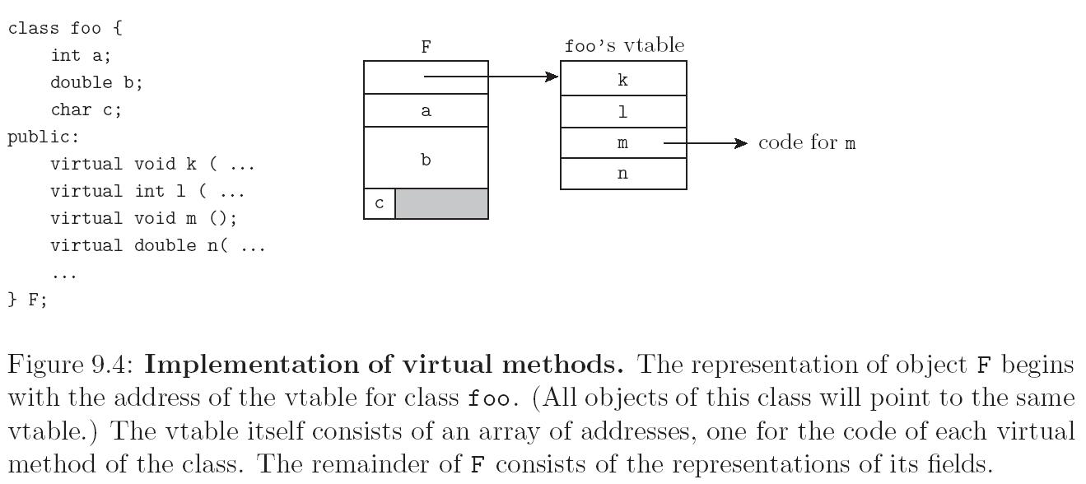

Slide 26
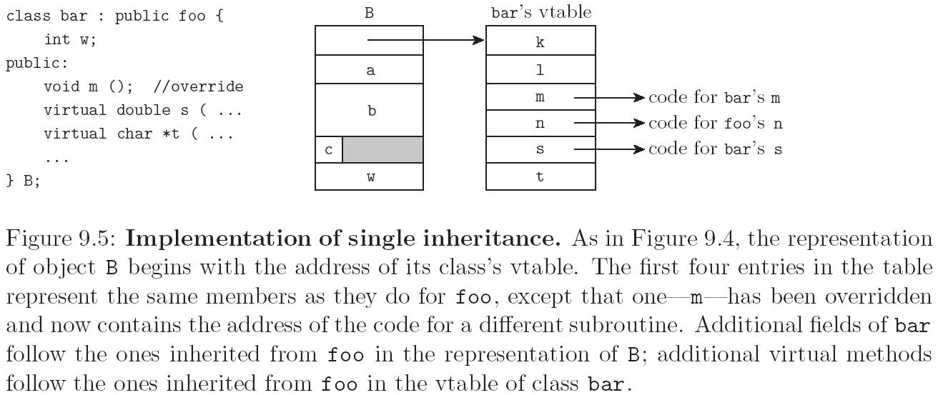

Slide 27
Runtime type information
If you can query the type of an object, then you need to be able to get from the object to run-time type info.
Typical implementation technique
Include a pointer to the type info at the beginning of the vtable
This was not shown in the figures

Slide 28
Fragile base class problem
To invoke a method on an object:
get address of object’s vtable,
calculate offset into vtable (can be done at compile time)
invoke method at that address.
Problem:
Given class A
class A{int x; void q(){…} void p(){…} }
Suppose we modify a class A by changing order of q and p and recompile
class A{int x; void p(){…} void q(){…} }
All clients will have to be recompiled too.

Slide 29
Java’s approach solved the fragile base class problem somewhat.
Methods are represented in class files by symbolic links.
These links are resolved after compile time to find offset into the method table.

Slide 30
Resolution in JVM
The JVM spec does not specify when resolution must be done as long as it happens in time.
Strict: all links are resolved when the class is first loaded.
This may require loading the referred to classes—these are verified, etc.
Loading original class will fail if a problem loading any class, even if not actually needed by the program.
Lazy: wait until method is called to resolve its link.
Avoids problems (and time wasted) resolving methods that are never actually called.
Errors due to loading problems may occur in the middle of the program execution.

Slide 31
Inheritence
Recall that inheritance allows reusability and extensibility
Generally, a subclass is a specialization of its superclass and may reuse some or all of its implementation
Type system allows an object of a subclass to be used wherever an element of a superclass is expected
The figure shows a class hierarchy for Figures
Notes:
Figures from Meyer OOSC2

Slide 32
In the previous figure, each class has at most one direct superclass
What about the situations where it makes sense to have more?
Example: define composite Figures using Elementary figure
a Composite Figure is a Figure
it is also a specialization of a data structure that can hold multiple other Figures—say a Linked List
elementary Figures
wheel: composite Figure

Slide 33
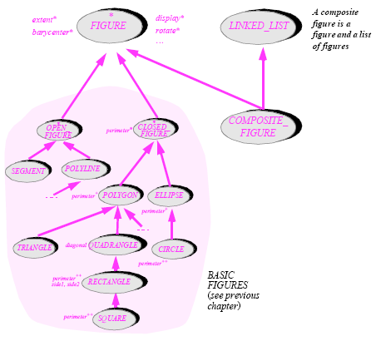

Slide 34
A plane owned by a company is both a plane and an asset
Repeated inheritance: a teaching assistant is both a teacher and a student. Teachers and students are university-persons.

Slide 35
Multiple inheritence: Repeated inheritance
Two parent classes share a single “grandparent” class.
Design issue? One copy of members of two?
shared inheritance
One copy
default in Eiffel
replicated inheritance
multiple copies
default in C++
Both languages provide a way to get the other type
Eiffel—rename to get replicated
C++--declare base class virtual to get shared

Slide 36
class Driver
age
address
violation_count
pass_birthday
pay_fee
In French_US_Driver
age and pass_birthday should be shared
address, violation_count, pay_fee should be replicated
In Eiffel—specify replication by renaming inherited attributes
Renaming also used for other name clashes (say two superclasses have attribute with the same name)

Slide 37
In previous description of vtables, the representation of parent class is prefix of representation of derived object.
Need more for for multiple inheritance
The next slide shows the simplest case (where there is no repeated inheritance)

Slide 38
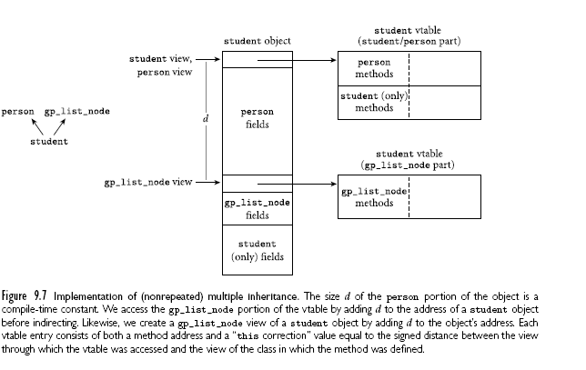

Slide 41
Mix-in inheritance
Single inheritance from one “real” base class, plus multiple inheritance from abstract classes (interfaces in java)
Since the multiply inherited objects have no data members, replicated vs. shared issues don’t arise.

Slide 42
Assertions and Inheritance
If B extends A, then the type system allows us to use a B anywhere an A can be used.
Extend this idea to pre and postconditions for methods—so that semantics, not just class declarations allow us to use a B anywhere and A can be used.

Slide 43
What relationship between preconditions α and γ allow an A’ to be used anywhere an A could be?
What about postconditions β and δ ??
superclass A
client
subclass A’
overrides method r

Slide 44
What relationship between preconditions α and γ allow an A’ to be used anywhere an A could be?
weaken precondition in subclass
What about postconditions β and δ ??
strengthen postcondition in subclass
superclass A
client
subclass A’
overrides method r

Slide 45
In Eiffel
class A
INV IA
{ method M require P ....ensures Q
}
class B extends A
INV IB
{ method M requires P’ ....ensures Q’ }
The compiler automatically generates code to check
in class B
{ IA and IB and (P or P’)}
....
{IA and IB and Q and Q’}
The invariant of a subclass contains the conjunction of the invariants of all superclasses.

Slide 46
This principle is also known as the Liskov substitution principle (LSP).
Some authors distinguish between subclasses and subtypes
subclasses inherit using facilities of programming language
subtypes satisfy the semantic constraints (LSP)
It is a good idea to try to do this in your own code.

Slide 47
Initialization and finalization
Earlier, we defined the lifetime of an object to be the interval during which it occupies space and can hold data
Most object-oriented languages provide some sort of special mechanism to initialize an object automatically at the beginning of its lifetime
When written in the form of a subroutine, this mechanism is known as a constructor
A constructor does not allocate space—just initializes it
A few languages provide a similar destructor mechanism to finalize an object automatically at the end of its lifetime

Slide 48
Issues for Initialization
Contructors and design by contract
the constructor must establish the invariant
languages that don’t allow constructors don’t support this important principle
Choosing a constructor
some languages allow multiple constructors to be specified
behave like overloaded subroutine (C++, Java, C#)
have different names (Eiffel, Smalltalk)

Slide 49
references and values
If variables are references to objects, then every object must be created explicitly - appropriate constructor is called
If variables can have a value that is an object (C++, Oberon, Modula-3, Ada 95), then object creation can happen implicitly as a result of elaboration.
Either objects begin life in uninitialized state (Oberon, Modula-3, Ada 95) or
There is some mechanism for implicitly selecting a constructor

Slide 50
Examples: C++
foo b;
calls foo: foo(), the parameterless constructor
foo b(10, ‘x’);
calls foo::foo(int,char), using the types of args to select the overloaded constructor

Slide 51
Common situation—arg list is single object
foo a; //calls foo:foo()
bar b; //calls bar::bar()
foo c(a) //calls foo::foo(foo&)
foo d(b) //calls foo::foo(bar&)
Special syntax for this
foo a; //calls foo:foo()
bar b: //calls bar::bar()
foo c = a //calls foo::foo(foo&)
foo d = b //calls foo::foo(bar&)
= indicates initialization, not assignment
single arg constructor is called a copy constructor

Slide 52
Copy constructors can lead to surprising behavior
foo a = b+c
compiler must create hidden temporary object
foo t
t = b.operator+(c)
foo a = t;
generated code calls non-zero arg constructor and destructor for t, plus copy constructor for a.
foo a=b; a += c;
calls copy constructor for a, followed by +=
Parameter passed by value may include implicit call to copy constructor
Evaluating tradeoff between pass-by-reference (additional indirection) and needing to call copy constructor can be difficult in practice.

Slide 53
execution order
When an object of a derived class is created in C++, the constructors for any base classes will be executed before the constructor for the derived class
In the context of multiple constructors and multiple inheritance, this can get tricky.
in concurrent programming (in Java)—it is important not to let a reference to a partially constructed object (i.e. this) escape the constructor.
This may conflict with establishing the invariant in the constructor.

Slide 54
Issues for finalization
In C++, objects have destructors.
Typically used to reclaim resources such as memory allocated to an object
Destructor for subclass called first, followed by destructor for superclasses
Languages with garbage collection have less need for destructors
Java, C# allow finalizers
Called before garbage collector reclaims object
Not very useful since garbage collection time is highly unpredictable.

Slide 55
Genericity (Scott Chapter 8) vs. Inheritance
Genericity = parametric polymorphism
type is explicitly parameterized
single copy of source code allows generation of versions that allow multiple types
Inheritance = subtype polymorphism
can use an instance of a subclass wherever a class is expected

Slide 56
Inheritance and genericity generalize a class in different dimensions
Genericity especially useful for containers

Slide 57
Semantic issues
unconstrained: any type allowed to replace the type parameter
constrained: type replacing type parameter must satisfy certain constraints
recall ML: a’’ = type with equality defined
ADA (almost correct syntax)
generic
type G is private;
with function “<=“(a,b:G) return BOOLEAN is <>;
function minimum(x,y:G) return G is
begin
if x<=y then return x else return y end fi;
end minimum

Slide 58
Implementing genericity
Static (C++, Ada)
compiler creates separate copy of code for each instance
type checks each separately
disadvantages
poor error messages
code bloat

Slide 59
Dynamic (Java 5)
compiler treats as instances of Object, except that programmer doesn’t have to do explicit type cast
to eliminate some deficiencies in practice
<? super T> OK to be a superclass of T
<? extends T> OK to be a subclass of T

Slide 60
Java before genericity
List l = new List();
l.add(“hello”);
…
String s = (String)(l.get(0));
Java with genericity
List<String> l = new List<String>()
l.add(“hello”);
…
String s = l.get(0);

Slide 61
iconst_0
invokeinterface
java/util/List/get,
(I)Ljava/langlObject;
checkcast java/lang/String
astore….
Java before genericity
List l = new List();
l.add(“hello”);
…
String s = (String)(l.get(0));
Java with genericity
List<String> l = new List<String>()
l.add(“hello”);
…
String s = l.get(0);

Slide 62
iconst_0
invokeinterface
java/util/List/get,
(I)Ljava/langlObject;
checkcast java/lang/String
astore….
Java before genericity
List l = new List();
l.add(“hello”);
…
String s = (String)(l.get(0));
Java with genericity
List<String> l = new List<String>()
l.add(“hello”);
…
String s = l.get(0);
iconst_0
invokeinterface
java/util/List/get,
(I)Ljava/langlObject;
checkcast java/lang/String
astore….

Slide 63
In Java 5, generic and non-generic generate same code
Generic easier for programmer because casts can be omitted from source (but are added by compiler)
Compiler can statically ensure that casts will never fail
Why aren’t casts omitted from byte code for efficiency???

Slide 64
Intermediate (C#)
compiler generates separate copy
but type checks generic code
designed in from beginning rather than added later as in Java. Works better with reflection.

