Slide 1
COP5556 Programming Language Principles
Parsing 2

Slide 2
Recap of parsing so far:
Specify phrase structure of programming language with context free grammar (CFG) using EBNF notation
CFGs generate sentences
Parsers recognize sentences
Several approaches to parsing
bottom up
top down
Can classify grammars according to the type of parsing algorithm that can be used to parse them.

Slide 3
We are primarily interested in LL(1) grammars which admit top-down parsing with one-step lookahead.
We defined
FIRST set
FOLLOW set
Predict set
Grammar is LL(1) if the Predict sets of all productions with the same left hand side are disjoint

Slide 4
Is this grammar LL(1)?
dec ::= modifier type ident ;
dec ::= procedure ident ( formals ) body ;
type ::= int | bool
modifier ::= public | ε
formals ::= ε | type ident ( , type ident )*

Slide 5
dec ::= modifier type ident ;
dec ::= procedure ident ( formals ) body ;
type ::= int | bool
modifier ::= public | ε
formals ::= ε | type ident ( , type ident )*
----------------------------
predict(dec ::= modifier type ident ;) = ????

Slide 6
dec ::= modifier type ident ;
dec ::= procedure ident ( formals ) body ;
type ::= int | bool
modifier ::= public | ε
formals ::= ε | type ident ( , type ident )*
----------------------------
predict(dec ::= modifier type ident ;) =
FIRST(modifier type ident ;) =
{ public, int, bool }

Slide 7
dec ::= modifier type ident ;
dec ::= procedure ident ( formals ) body ;
type ::= int | bool
modifier ::= public | ε
formals ::= ε | type ident ( , type ident )*
----------------------------
predict(dec ::= modifier type ident ;) =
{ public, int, bool }
predict(dec ::= procedure ident ( formals ) body ;)
={ procedure }

Slide 8
Same left hand side,
predict sets are disjoint,
so far so good
dec ::= modifier type ident ;
dec ::= procedure ident ( formals ) body ;
type ::= int | bool
modifier ::= public | ε
formals ::= ε | type ident ( , type ident )*
----------------------------
predict( dec ::= modifier type ident ;) =
{ public, int, bool }
predict(dec ::= procedure ident ( formals ) body ;)
={ procedure }

Slide 9
dec ::= modifier type ident ;
dec ::= procedure ident ( formals ) body ;
type ::= int | bool
modifier ::= public | ε
formals ::= ε | type ident ( , type ident )*
----------------------------
Predict ( type ::= int ) = { int }
Predict ( type ::= bool ) = { bool }
Predict ( modifier ::= public ) = { public }
Predict ( modifier ::= ε ) = FOLLOW(modifier) =
{ int, bool }

Slide 10
Same left hand side,
predict sets are disjoint,
still on track to be
LL(1)
dec ::= modifier type ident ;
dec ::= procedure ident ( formals ) body ;
type ::= int | bool
modifier ::= public | ε
formals ::= ε | type ident ( , type ident )*
----------------------------
Predict ( type ::= int ) = { int }
Predict ( type ::= bool ) = { bool }
Predict ( modifier ::= public ) = { public }
Predict ( modfier ::= ε ) = FOLLOW(modifier) =
{ int, bool }

Slide 11
dec ::= modifier type ident ;
dec ::= procedure ident ( formals ) body ;
type ::= int | bool
modifier ::= public | ε
formals ::= ε | type ident ( , type ident )*
----------------------------
Predict ( formals ::= type ident ( , type ident )* ) =
{ int, bool }
Predict (formals ::= ε ) = FOLLOW(formals) = { ) }

Slide 12
Same left hand side,
predict sets are disjoint.
Grammar is LL(1)
dec ::= modifier type ident ;
dec ::= procedure ident ( formals ) body ;
type ::= int | bool
modifier ::= public | ε
formals ::= ε | type ident ( , type ident )*
----------------------------
Predict ( formals ::= type ident ( , type ident )* ) =
{ int, bool }
Predict (formals ::= ε ) =FOLLOW(formals) ={ ) }

Slide 13
dec ::= modifier type ident ; { public, int, bool }
dec ::= procedure ident ( formals ) body ;
{ procedure }
type ::= int {int } | bool { bool }
modifier ::= public { public }
| ε {int, bool }
formals ::= ε { ) }
| type ident ( , type ident )* {int, bool }
--------------------------------------------
Top down parse of int ident ;
dec int ident ;

Slide 14
dec ::= modifier type ident ; { public, int, bool }
dec ::= procedure ident ( formals ) body ;
{ procedure }
type ::= int {int } | bool { bool }
modifier ::= public { public }
| ε {int, bool }
formals ::= ε { ) }
| type ident ( , type ident )* {int, bool }
--------------------------------------------
Top down parse of int ident ;
dec int ident ;
modifier type ident ;

Slide 15
dec ::= modifier type ident ; { public, int, bool }
dec ::= procedure ident ( formals ) body ;
{ procedure }
type ::= int {int } | bool { bool }
modifier ::= public { public }
| ε {int, bool }
formals ::= ε { ) }
| type ident ( , type ident )* {int, bool }
--------------------------------------------
Top down parse of int ident ;
dec int ident ;
modifier type ident ;
ε type ident ;

Slide 16
dec ::= modifier type ident ; { public, int, bool }
dec ::= procedure ident ( formals ) body ;
{ procedure }
type ::= int {int } | bool { bool }
modifier ::= public { public }
| ε {int, bool }
formals ::= ε { ) }
| type ident ( , type ident )* {int, bool }
--------------------------------------------
Top down parse of int ident ;
dec int ident ;
modifier type ident ;
ε type ident ;
int ident ; int ident ;

Slide 17
Summary
property of predict sets tells us that grammar is LL(1)
predict sets are also used during parsing to choose a production

Slide 18
Is this grammar LL(1)?
ident_list ::= ident | ident_list , ident

Slide 19
Is this grammar LL(1)?
ident_list ::= ident | ident_list , ident
FIRST(ident_list) =
ident U FIRST(ident_list)
Predict (ident_list ::= ident) = {ident}
Predict (ident_list ::= ident_list , ident)
= FIRST(ident_list) = {ident}

Slide 20
Is this grammar LL(1)?
ident_list ::= ident | ident_list , ident
FIRST(ident_list) =
ident U FIRST(ident_list)
Predict (ident_list ::= ident) = {ident}
Predict (ident_list ::= ident_list , ident)
= FIRST(ident_list) = {ident}
If you see left recursion,
the grammar is not LL

Slide 21
Left recursion
We saw that left recursion makes a grammar non-LL(1)
A grammar is left recursive if, for some nonterminal A,
A →+ A σ.
If there is a production of the form
A ::= A σ | β
then we immediately see that it is left recursive.
Left recursion may be indirect, involving several rules, but we will only worry about direct recursion

Slide 22
Left recursion removal
A production of the form
A ::= A σ | β
can be replaced in the grammar with
A ::= β B
B ::= σ B | ε
B is a new symbol

Slide 23
Left recursion removal (2)
More generally, productions of the form
A ::= A σ1 |....|A σn| β1 | ...| βm
can be replaced by
A ::= β1 B | ....| βm B
B ::= σ1 B | .... σn B | ε

Slide 24
Original grammar
ident_list ::= ident | ident_list , ident
Recall rule : replace A ::= A σ | β with
A ::= β B
B ::= σ B | ε
Let
A := ident_list,
σ := , ident,
β = ident,
introduce new symbol ident_list_tail instead of B
Equivalent grammar without left-recursion
ident_list ::= ident ident_list_tail
ident_list_tail ::= , ident ident_list_tail | ε

Slide 25
Transforming to EBNF
A ::= β B
B ::= σ B | ε
can be replaced with
A ::= β σ*
ident_list ::= ident (, ident)*
New grammar specifies the same language as the starting point, but the structure of the parse tree may change.

Slide 26
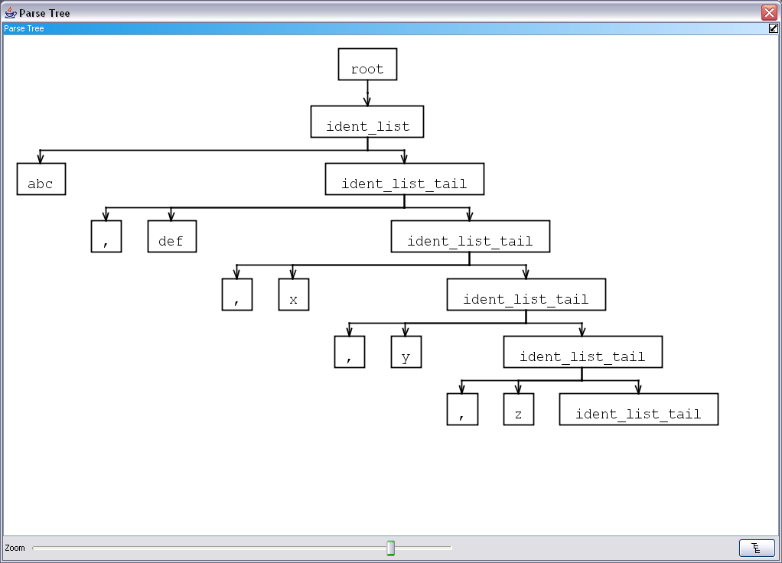

Slide 27
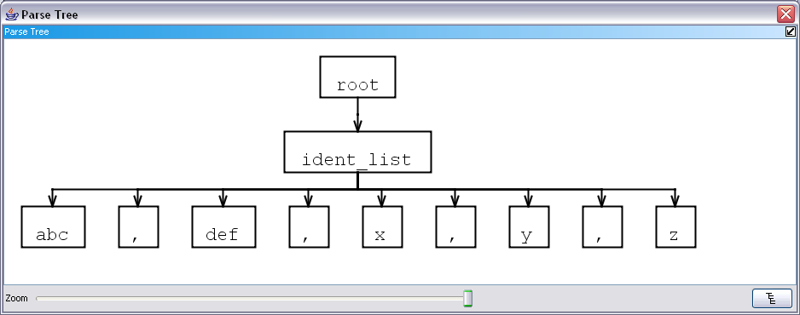

Slide 28
Example: expression grammar with precedence and associativity
expr ::= term | expr add_op term
term ::= factor | term mult_op factor
factor ::= ident | number | - factor | (expr)
add_op ::= + | -
mult_op ::= * | /
Operators are left associative:
10-4-3 = (10-4)-3
A mult_op has higher precedence than an add_op:
3+4*5 = 3+(4*5)
Notes:
Precedence and associatively are important aspects of expressions that are not captured by the phrase structure of the language. However, these things can be captured in the structure of the parse tree, so we need to be careful when we make transformations. In particular, left recursion is the most useful way to indicate left associativity, but makes the grammar not LL(1).

Slide 29
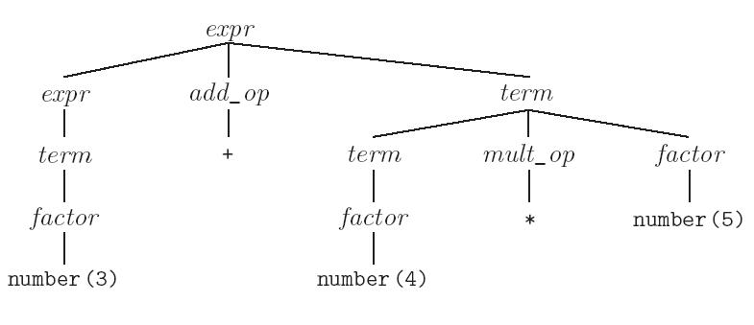
Parse tree for 3+4*5

Slide 30
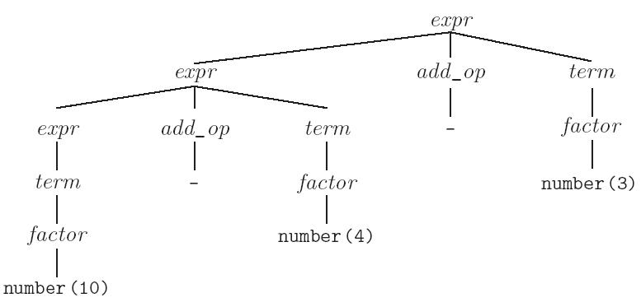
Parse tree for 10-4-3

Slide 31
Is this expression grammar LL(1)?
expr ::= term | expr add_op term
term ::= factor | term mult_op factor
factor ::= ident | number | - factor | (expr)
add_op ::= + | -
mult_op ::= * | /

Slide 32
Left recursive
expr ::= term
| expr add_op term
term ::= factor | term mult_op factor
factor ::= ident | number | - factor | (expr)
add_op ::= + | -
mult_op ::= * | /
FIRST(expr) = FIRST(term) U FIRST(expr)
Grammar not LL(1)
Notes:
In top-down parsing, left recursion can lead to non-termination of the parsing algorithm.

Slide 33
Example
Start with left recursive grammar for expressions
expr ::= number | expr add_op number
add_op := + | -
Left recursion gives left-associative operators.
Right recursion gives right-associative operators
expr ::= number
| number right_assoc_op expr

Slide 34
Parse tree for 4-3-5
expr
expr
number(5)
add_op
-
expr
add_op
number(4)
number(3)

Slide 35
Transformed example
expr ::= number expr_tail
expr_tail ::= add_op number expr_tail | ε
add_op ::= + | -

Slide 36
Parse tree for 3-4-5 (not left associative)
expr
number(3)
expr_tail
add_op
number(4)
expr_tail
-
add_op
number(5)
expr_tail
-
ε

Slide 37
Transformed again to EBNF
expr ::= number | expr add_op number
add_op := + | -
expr ::= number expr_tail
expr_tail ::= add_op number expr_tail | ε
add_op ::= + | -
expr ::= number (add_op number)*
add_op ::= + | -

Slide 38
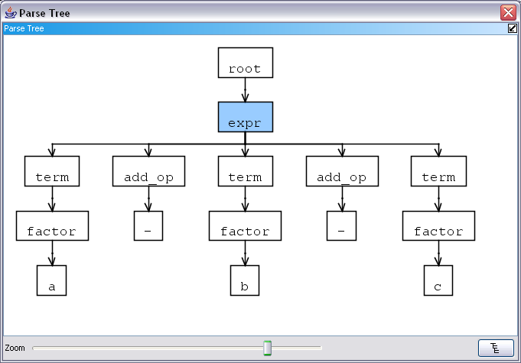
Parse tree for 3-4-5 (left associative)

Slide 39
Thus the left-recursion in the grammar provided structural information beyond just the set of legal strings. Need to be somewhat careful when applying transformations.
Note that bottom up parsers can handle left recursion.

Slide 40
Another cause of non-LL(1) ness
Grammar with production of shape
A ::= α β | α γ
is not LL(1)

Slide 41
Common initial part can be factored out
A ::= αβ | αγ
can be transformed using left factorization
A ::= α B
B ::= β | γ
where B is a new non-terminal
We need PREDICT(B ::= β ) and PREDICT B ::= γ) to be disjoint

Slide 42
It is often convenient to replace
A ::= α B
B ::= β | γ
with
A ::= α ( β | γ )
to avoid introducing a new symbol.
We still need the condition on the PREDICT sets as if new symbol were there.

Slide 43
Example
stmt ::= ident := expr | ident ( arg_list )
can be transformed to
stmt ::= ident ident_stmt_tail
ident_stmt_tail ::= := expr | ( arg_list )
or
stmt ::= ident (:= expr | ( arg_list ))

Slide 44
Example
stmt ::= ident ident_stmt_tail
ident_stmt_tail ::= := expr | ( arg_list )
OK!

Slide 45
Another example
expr ::= @expr . field_name
| @expr . field_name = expr
| @expr . method_name ( ε | expr (, expr)* )
| … .
field_name ::= ident
method_name ::= ident

Slide 46
Another example (2)
expr ::= @expr . field_name
| @expr . field_name = expr
| @expr . method_name ( ε | expr (, expr)* )
| … .
field_name ::= ident
method_name ::= ident

Slide 47
Another example (3)
expr ::= @expr . field_name
| @expr . field_name = expr
| @expr . method_name ( ε | expr (, expr)* )
| … .
Problem!
field_name ::= ident
method_name ::= ident

Slide 48
Another example (4)
substitute ident for field_name and method_name
expr ::= @expr . ident
| @expr . ident = expr
| @expr . ident ( ε | expr (, expr)* )
| … .

Slide 49
Another example (5)
expr ::= @expr . ident
| @expr . ident = expr
| @expr . ident ( ε | expr (, expr)* )
| … .

Slide 50
Another example (5)
expr ::= @expr . ident
| @expr . ident = expr
| @expr . ident ( ε | expr (, expr)* )
| … .
or
expr ::= @expr . ident
(ε | = expr | ( ε | expr (, expr)* ) )

Slide 51
Another example (6)
expr ::= @expr . ident
(ε | = expr | ( ε | expr (, expr)* ) )
Because of the ε we can’t be sure this will work without knowing FOLLOW(expr) in entire grammar

Slide 52
Transformations don’t always work
Note that eliminating left recursion and common prefixes does NOT necessarily make a grammar LL
there are infinitely many non-LL LANGUAGES, and the mechanical transformations work on most of them just fine
the few that arise in practice, however, can generally be handled with kludges

Slide 53
Systematic construction of parsers
Given an LL(1) grammar, we can systematically construct a recursive descent parser.
Tools exist that will do this automatically, we’ll do it by hand.
Our first parser will only recognize whether or not a sentence is legal.
Later we’ll extend the approach to construct a syntax tree

Slide 54
Parser construction
Compute the predict sets for each production
Rewrite the grammar so that each non-terminal is on the left side of exactly one production. (i.e. change
A::= B
A::= C
to
A::= B | C

Slide 55
For each non-terminal A, we will have a method void A().
For each possible shape of the rhs of a production
A ::= σ
we have a rule for constructing the code for the method A();

Slide 56
σ₁ | σ ₂ | ... σ_{n} (where none are ε)
becomes code fragment
if (token ∈ PREDICT(l.h.s.::= σ₁ )) parse σ₁ ;
else if (token ∈ PREDICT(l.h.s::= σ ₂ ))
parse σ ₂;
...
else if (token ∈ PREDICT(l.h.s. ::= σ_{n} ))
parse σ_{n}
else error()

Slide 57
σ₁ | σ ₂ | ... σ_{n} | ε
becomes
if (token ∈ PREDICT(l.h.s.::= σ₁ )) parse σ₁ ;
else if (token ∈ PREDICT(l.h.s::= σ₂ ))
parse σ₂;
...
else if (token ∈ PREDICT(l.h.s. ::= σ_{n} ))
parse σ_{n} ;
else just return //this branch matches ε

Slide 58
σ₁ σ ₂ ... σ_{n}
becomes
parse σ₁;
parse σ₂;
…
parse σ_{n}

Slide 59
σ*
becomes
while(token ∈ FIRST(σ)) { parse σ; }

Slide 60
A (where A is a non-terminal)
becomes
A();
(i.e. just invoke the method for A)

Slide 61
c (where a is a terminal symbol)
becomes
match(c);
where
match(c) { if ( current token is c )
{ get next token from scanner;}
else error;
}

Slide 62
It may be worthwhile to simplify the grammar before starting.
For example,
A ::= B| xC
C::= D
could be simplified to
A ::= B | xD.
Also, code can be simplified after the fact to eliminate redundant tests, etc.

Slide 63
Example: Simple expression grammar
expr ::= term ( ( + | - ) term )*
term ::= factor ( ( * | / ) factor )*
factor ::= int_lit | ( expr )
We are given a Scanner and Token class similar to that in Assignment 1

Slide 64
Class SimpleParser
public class SimpleParser
{
Scanner scanner; //Token producer
Token t; //next token
Parser(Scanner scanner) {
this.scanner = scanner;
t = scanner.nextToken();
}

Slide 65
Token consume()
{
t = scanner.getNext();
}
void match(Kind kind){
if( t.isKind(kind)){
consume();
} else handle error
}

Slide 66
// expr ::= term ( ( + | - ) term )*
public void expr()
{
term();
while (t.isKind(PLUS) || t.isKind(MINUS))
{
if (t.isKind(PLUS))
{ match(PLUS);
}
else if (t.isKind(MINUS))
{
match(MINUS);
}
term();
}
}

Slide 67
// term ::= factor ( ( * | / ) factor )*
// same shape as expr()—here we use switch statement for fun
void term()
{
factor();
while (t.isKind(TIMES) || t.isKind(DIV))
{
switch (t.kind)
{
case TIMES:
match(TIMES);
break;
case DIV:
match(DIV);
break;
}
factor();
}
}

Slide 68
// term ::= factor ( ( * | / ) factor )*
// same shape as expr()
void term()
{
factor();
while (t.isKind(TIMES) || t.isKind(DIV))
{
switch (t.kind)
{
case TIMES:
consume(); // match(TIMES);
break;
case DIV:
consume (); //match(DIV);
break;
}
factor();
}
}

Slide 69
// term ::= factor ( ( * | / ) factor )*
void term()
{
factor();
while (t.isKind(TIMES) || t.isKind(DIV))
{
switch (t.kind)
{
case TIMES: case DIV:
consume();
break;
// case DIV:
// consume ();
// break;
}
factor();
}
}

Slide 70
// term ::= factor ( ( * | / ) factor )*
void term()
{
factor();
while (t.isKind(TIMES) || t.isKind(DIV))
{
// switch (t.kind)
// {
// case TIMES: case DIV
consume();
// break;
// }
factor();
}
}

Slide 71
void factor() {
if (t.isKind(INT_LIT)) {
match(INT_LIT);
} else if (t.isKind(LPAREN)) {
match(LPAREN);
expr();
match(RPAREN);
}
else handle error
}
}

Slide 72
Showed how to systematically construct a recursive descent parser for a language specified by an LL(1) grammar.
Next step
example to show that the parser really does implement the top down parsing algorithm
error handling in recursive descent parsers

Slide 73
Recall grammar
expr ::= term ( ( + | - ) term )* term ::= factor ( ( * | / ) factor )* factor ::= int_lit | ( expr )

Slide 74
public void expr() // expr ::= term ( ( + | - ) term )*
{
term();
while (t.isKind(PLUS) || t.isKind(MINUS)) { consume(); term(); }
return;
}
void term() // term ::= factor ( ( * | / ) factor )*
{
factor();
while (t.isKind(TIMES) || t.isKind(DIV)){ consume(); factor(); }
return;
}
void factor() //factor ::= int_lit | ( expr )
{
if (t.isKind(INT_LIT)) { consume(); }
else if (t.isKind(LPAREN))
{ consume(); expr(); match(RPAREN); }
else error();
return
}

Slide 75
Sentence to parse:
3 - ( 4 * 5 )
Tokens:
num_lit(3), minus, lparen,
num_lit(4), times, numlit(5),
rparen

Slide 76
expr | 3 – ( 4 * 5 ) | expr
term ( ( + | - ) term )* | 3 – ( 4 * 5 ) | term
factor ( ( * | / ) factor )* ( ( + | - ) term )* | 3 – ( 4 * 5 ) | factor
int_lit ( ( * | / ) factor )* ( ( + | - ) term )* | 3 – ( 4 * 5 ) | if (intlit) consume() return from factor
( ( * | / ) factor )* ( ( + | - ) term )* | – ( 4 * 5 ) | return from term
( ( + | - ) term )* | – ( 4 * 5 ) | if + or - consume
( + | - ) term ( ( + | - ) term )* | – ( 4 * 5 )
term ( ( + | - ) term )* | ( 4 * 5 ) | term
factor ( ( * | / ) factor )* ( ( + | - ) term )* | ( 4 * 5 ) | factor
( expr ) ( ( * | / ) factor )* ( ( + | - ) term )* | ( 4 * 5 ) | if ( consume

Slide 77
expr ) ( ( * | / ) factor )* ( ( + | - ) term )* | 4 * 5 ) | expr
term ( ( + | - ) term )* ) ( ( * | / ) factor )* ( ( + | - ) term )* | 4 * 5 ) | term
factor ( ( * | / ) factor )* ( ( + | - ) term )* ) ( ( * | / ) factor )* ( ( + | - ) term )* | 4 * 5 ) | factor
int_lit ( ( * | / ) factor )* ( ( + | - ) term )* ) ( ( * | / ) factor )* ( ( + | - ) term )* | 4 * 5 ) | if intlit consume return from factor
( ( * | / ) factor )* ( ( + | - ) term )* ) ( ( * | / ) factor )* ( ( + | - ) term )* | * 5 ) | while * or /
* factor ( ( * | / ) factor )* ( ( + | - ) term )* ) ( ( * | / ) factor )* ( ( + | - ) term )* | * 5 ) | consume

Slide 78
factor ( ( * | / ) factor )* ( ( + | - ) term )* ) ( ( * | / ) factor )*( ( + | - ) term )*factor ( ( * | / ) factor )* ( ( + | - ) term )* ) ( ( * | / ) factor )* ( ( + | - ) term )* | 5 ) | factor
int_lit ( ( * | / ) factor )* ( ( + | - ) term )* ) ( ( * | / ) factor )* ( ( + | - ) term )* | 5 ) | if (intlit) consume return from factor
( ( * | / ) factor )* ( ( + | - ) term )* ) ( ( * | / ) factor )* ( ( + | - ) term )* | ) | not * or / , terminate while loop and return from term
( ( + | - ) term )* ) ( ( * | / ) factor )* ( ( + | - ) term )* | ) | not + or – terminate whileloop and return from expr
) ( ( * | / ) factor )* ( ( + | - ) term )* | ) | match ) return from factor
( ( * | / ) factor )* ( ( + | - ) term )* | eof | not * or / , end while return from term
( ( + | - ) term )* |  | not + or – , terminate while loop and return from expr

Slide 79
Syntax Errors
Read Scott section 2.3.5 (in the online supplement) through Exception based errors
We will discuss several approaches
Halting
Syntax error recovery
Panic mode recovery
Phrase level recovery
Context specific
Exception based
http://Scott 4e Online Supplement

Slide 80
Halting
When an error is detected, just stop and print message
This is easy for the compiler implementer, but inconvenient for the programmer using the compiler
Syntax error recovery
compiler continues looking for errors
high quality error recovery essential for production compilers
Problem: how to avoid cascading errors

Slide 81
Panic mode recovery
Define small set of safe symbols that delimit “clean” points in the input
When an error occurs, delete input tokens until a safe symbol is encountered
Return from subroutines until the parser is in a context where the new symbol might occur
Tends to generate lots of spurious errors in most languages

Slide 82
Phrase level recovery
Use different sets of safe symbols in different contexts
When a parsing routine for non-terminal A discovers an error at its beginning, it deletes tokens until it find one that is in FIRST(A) and proceeds, or a member of FOLLOW(A) and returns

Slide 83
void factor() //factor ::= int_lit | ( expr )
{ if (! (t.isKind(INT_LIT) || t.isKind(LPAREN))
{ report error
do { t = s.next();}
while ( t not in FIRST(factor) && t not in
FOLLOW(factor)
}
if (t.isKind(INT_LIT)) { consume(); }
else if (t.isKind(LPAREN))
{ consume(); expr(); match(RPAREN); }
//else error();
return();
}

Slide 84
if not the expected token, match just reports the error and returns, effectively inserting the expected token
void factor() //factor ::= int_lit | ( expr )
{ if (! (t.isKind(INT_LIT) || t.isKind(LPAREN))
{ report error
do { t = s.next();}
while ( t not in FIRST(factor) && t not in
FOLLOW(factor)
}
if (t.isKind(INT_LIT)) { consume(); }
else if (t.isKind(LPAREN))
{ consume(); expr(); match(RPAREN); }
//else error();
return();
}

Slide 85
void factor() //factor ::= int_lit | ( expr )
{ if (! (t.isKind(INT_LIT) || t.isKind(LPAREN))
{ report error
do { t = s.next();}
while ( t not in FIRST(factor) && t not in
FOLLOW(factor)
}
if (t.isKind(INT_LIT)) { consume(); }
else if (t.isKind(LPAREN))
{ consume(); expr(); match(RPAREN); }
//else error();
else return();
}
This example isn’t very interesting—all tokens except ( are in FOLLOW(factor)

Slide 86
More general description of phrase level recovery from Scott
If foo →ε, this approach tends to predict ε and return when it should detect an error—
Notes:
$$ is eof

Slide 87
More general description of phrase level recovery from Scott
A symbol may be in FOLLOW set because it can follow foo somewhere, but not in the particular context

Slide 88
Context-specific look-ahead (Wirth ’76)
Tokens may follow A somewhere in a valid program (and thus be in FOLLOW(A)) but are not necessarily allowed at a particular place.
Let the follow set be context-dependent
Pass in FOLLOW set in recursive calls
Otherwise, the same as phrase-level recovery
Example
stmt ::= ident := expr ;
would pass SEMI when calling expr here,
factor ::= ( expr )
would pass RPAREN when calling expr here,
Additional heuristic—don’t delete tokens that start major constructs that require matching tokens later (BEGIN, WHILE, etc)

Slide 89
Exception-based error recovery
Choose small set of contexts to back-out to when an error occurs (for example the beginning of code to handle a declaration, or a statement)
Attach exception handler to blocks of code that should implement recovery
When error is detected—raise an exception (throw in Java)
The system unwinds the stack to find most recent block of code with a handler.
The handler can continue, or re-throw the exception.

Slide 90
Aside: Exceptions in Java
class SyntaxException extends Exception{}
Can add fields for additional information, constructors, etc.
When an exception occurs
the block is exited.
If there is no handler, the exception is propagated to enclosing block.
Propagation continues until the exception is caught.
If the exception reaches the outermost block without being caught, the program terminates.

Slide 91
void factor() throws SyntaxException
{
if (t.isKind(INT_LIT)) { consume(); }
else if (t.isKind(LPAREN))
{ consume();
expr();
match(RPAREN); }
//else error();
else throw new SyntaxException();
}

Slide 92
public void expr()
{ try{
term();
while (t.isKind(PLUS) || t.isKind(MINUS))
{ consume();
term();
}
}
catch (SyntaxException e)
{ while (t not EOF)
{ if (t in FIRST(expr) expr(); return;}
else if (t in FOLLOW(expr); return;}
else t = s.next();
}
}
}

Slide 93
Tools for parser generation
Lex and Yacc
ANTLR
LL(*)
LPG
LR(k), backtracking possible
Xtext
based on ANTRL
creates simple eclipse IDE
many, many more

Slide 94
ANTLR
ANTLR (ANother Tool for Language Recognition)
Reads a grammar file and generates a
lexer
parser
Can generate the lexer and parser in several languages (maybe)
java, c/c++, c#, python, ruby, …
Can include target language fragments in the grammar file that will be included in the generated parser.
More info at www.antlr.org
Accepts LL grammars, including LL(*) (unbounded lookahead)
Holds the entire input string in memory.
Approach only feasible recently, but necessary for IDEs such as eclipse.

