Slide 1
COP5556 Programming Language Principles
Type Systems

Slide 2
Reading
Scott, Chapter 7 and Chapter 8

Slide 3
Types
Purposes of types in a language
Provide implicit context for operations
meaning of + depends on type
result of new p depend on type
overloading
Limits the set of operations that can be performed on a semantically valid program
Can’t add a boolean to a char, for example
Eliminates many programming errors.
If types specified explicitly, they can make the program easier to read and understand.
Stylized documentation whose correctness is checked by the compiler
But….this may make programs more difficult to write
If types are known at compiler time, they can drive important performance optimizations
either explicitly given, or inferred by the compiler
Example: assignment through pointer—if known that objects of different types are not affected, they can be left in register.

Slide 4
Type system
mechanism to define types
a way to associate types with objects in language
a set of rules for
type equivalence
when are type of two values considered to be the same? (name vs. structure)
type compatibility
when can a value of a given type be used in a particular context?
type inference
How is the type of an expression determined?

Slide 5
Overview of type systems
Computer hardware can interpret bits in several ways
instructions
addresses
characters, integers, floating point numbers of various lengths
Hardware and assembly languages do not keep track of types
High level languages associate types with values to provide context and error checking

Slide 6
(Informal) definition of a type system
A type system is
Mechanism to define types and associate them with certain language constructs
Set of rules for
type equivalence
when the types of two values are the same
type compatibility
when a value of a given type can be used in a given context
type inference
rules define type of expression based on types of its subexpressions and (sometimes) the surrounding context
Which constructs need types?
those that have values or refer to objects that have values
Examples: named constants, variables, record fields, parameters, (in some languages) subroutines, literal constants and expressions containing these

Slide 7
Subroutine types
Subroutines have types in languages where
they are first or second class values
thus, there is a construct in the language whose value is a dynamically determined subroutine
Type information allows the language to restrict the set of subroutines to those with a particular interface
Subroutines do not need types in languages where
language is statically scoped
subroutines are third class values
thus compiler can always identify to which subroutine a name refers, thus can check correct usage without needing a formal notion of subroutine types.
Notes:
first or second class value: can be passed as a parameter, returned by functions, stored in variables.

Slide 8
Type checking
The process of ensuring that a program satisfies languages type compatibility rules.
Some terminology
Type clash:
violation of the language’s typing rules
Strongly typed:
language implementation prohibits application of operation to object not intended to support operation
Statically typed:
strongly typed + type checking (mostly) performed before run-time.
Dynamically typed:
type checking performed at run-time.

Slide 9
Design choices in practice
Since mid 70s
Most new languages are strongly, but not necessarily statically, typed
C has become more strongly typed with each new version
Remaining loopholes
unions
nonconverting type casts
subroutines with variable number of parameters
interoperability of pointers and arrays
C implementations rarely check anything at runtime
Loopholes needed for systems programming
malloc, free: must interpret same bytes at different times as unallocated space, metadata, or parts of user defined data structures
More modern languages tend to allow loopholes only in clearly marked sections of code.
Example: C# unsafe

Slide 10
Design choices in practice (2)
Dynamic type checking
late binding
tends to be found in languages that delay other issues to runtime
more common in languages intended for ease or programming
Examples of languages with dynamic typing: Lisp, Smalltalk, most scripting languages
Examples of languages with dynamic typing that are also strongly typed: Lisp, Smalltalk, Python, Ruby
Languages with dynamic scoping are generally dynamically typed
if the compiler doesn’t know what object the name refers to, it can’t check its type

Slide 11
Design choices in practice (3)
Static typing is norm for languages designed for performance
Dynamic vs. static typing?
Popularity of scripting languages has led to recent questioning of value of static typing
Type systems becoming increasingly complex
Easier to write code without all the declarations
dynamic typing incurs runtime overhead and delays bug finding, but increase in human productivity may be worth the price
Intermediate position
Type inference
Types must be statically known, but the compiler infers them without the need for explicit declarations.
First example: ML

Slide 12
Three ways to think about types
Denotational
Constructive
Abstraction-based

Slide 13
Denotional types
a type is a set of values called a domain.
A value has a type if it belongs to the set
An object has a type if its value is guaranteed to be in the set.
Can often describe user-defined composite types in terms of mathematical operations on sets

Slide 14
Examples of denotational types
boolean {true, false}
int {…. –1,0,1,… } = Z
remark: we usually ignore limited precision and deal with it outside of type system
Record types correspond to Cartesian product of component types
TYPE point = RECORD x:integer, y:integer END
{(x,y) | x Є Z and y Є Z } or Cartesian product Z X Z
TYPE person = RECORD name: string, age: integer END
{(name, age) | name Є string, age Є Z } = string X Z
Enumerated type:
TYPE hue = (red,green,blue)

Slide 15
Constructive types
A type is either
a primitive (built-in) type
int,
char,
boolean,
etc.
or a composite formed by applying a type constructor to simpler types

Slide 16
Examples from Modula-2
TYPE t = ARRAY [0..31] OF CHAR;
TYPE b = [0..1]
subrange type (values 0,1)
TYPE s =SET OF b
values associated with s are {}, {0}, {1}, {0,1})

Slide 17
Examples from ML
datatype intList = nil
| Cons of int * intList
datatype tree = Leaf of int
| Node of tree * tree
These types
are recursive
Remark: In practice would just use the predefined (polymorphic) list rather than define a new type

Slide 18
Abstraction-based types
a type is an interface consisting of a set of operations with well-defined semantics
Examples:
int operations +,-,*,/, %
abstract data types
stack: push, pop, top, size
remark: Algebraic specifications for types define a type without explicitly talking about the values.
integers: Peano axioms
stack: a set of equations including pop(push(x)) = x for all x
classes in OO programming languages

Slide 19
Orthogonality
A useful goal in the design of a language, particularly its type system
A collection of features is orthogonal if there are no restrictions on the ways in which the features can be combined (analogy to vectors in math)
For example
Pascal is more orthogonal than Fortran, (because it allows arrays of anything, for instance)
Pascal is not completely orthogonal because it does not permit variant records as arbitrary fields of other records (for instance)
Orthogonality contributes to making a language easy to understand, easy to use, and easy to reason about

Slide 20
Trivial types
Type with only one value
C, Java, etc. : void
ML: unit
Motivation
Algol and C blur distinction between expression and statements
introduce a type with single value to characterize statement useful only for side effect but doesn’t produce a value
In C, if subroutine returns a value that isn’t needed, can cast subroutine to void. (This is done implicitly)
In Pascal, which does not have a trivial type, would need to assign return value to a variable

Slide 21
Classification of types
Varies between languages
Most provide built-in types that are similar to those supported by hardware
integer
char
boolean
floating point

Slide 22
Primitive types
Built-in types typically corresponding to those supported by hardware
boolean
(but not C, represented with one byte, 0 = false, 1 = true)
integers
characters (in many chars are 1-byte ascii, Java 2-byte unicode)
real (floating point)
unsigned integers (called Cardinals in Modula-2)
complex
fixed point
contains an implicit decimal point at programmer specified location
internally represented as an integer
Useful for compact representation of non-integral values in specific range, e.g. dollars and cents.
….

Slide 23
Numeric Types
Some properties:
length
defined by language or left as compiler implementation decision?
efficiency on all processors vs. portability
unsigned and signed integers?
complex types
pair of floating point numbers representing real and imaginary parts
built-in, standard library or unsupported?
rational?
pair of integers representing numerator and denominator
integers with arbitrary precision?
fixed point types?
represented internally by an integer with implied decimal point at programmer specified position
decimal types?
base 10 encoding to avoid round-off anonolies in financial calculation

Slide 24
Common terms
discrete types (ordinal)
countable: have one-to-one correspondence with a subset of integers
have a well-defined notion of predecessor and successor (except first and last)
Examples:
integer
boolean
char
enumeration
subrange
scalar types
discrete
real
rational
complex

Slide 25
Enumeration types
First introduced by Wirth in Pascal
facilitate readable programs
reduce some errors
Examples from Modula-2
TYPE color = (red, yellow, green)
boolean = (true,false)
operations on enumerated types
ORD(green) returns 2, ORD(yellow) returns 1 , etc.
(red < yellow) is a well defined expression
VAR trafficLight: color
IF trafficLight < green THEN stop()
ELSE enter_intersection()…

Slide 26
Internal representation of enumerated types may use integers
red=0, yellow = 1, green = 2.
But, enumerated types are not compatible with integers
VAR x: INTEGER;
x = red;
Type error!

Slide 27
Enums in C
Just a syntactic convenience for declaring a set of constants, but not really a type
enum color {red,yellow,green}
is shorthand for
typedef int color const color red=0, yellow=1,green=2;
red, yellow, green, can be used interchangeably with ints
Convenient, efficient, and integrates with other language features, but not type safe.

Slide 28
Design goals for enums
Type safety.
Compact, efficient declaration of enumerated values.
Seamless integration with other language features
Runtime efficiency.

Slide 29
Enums in OO languages
In the transition from Modula2 (modules) to Oberon (inheritance) enumerated types were removed because of difficulties in dealing with them in the presence of inheritance.
No enums in the early versions of Java either.
Enums added to Java 1.5.
An enum in Java is actually a class
Can add arbitrary methods and fields
Provides high quality implementations of Object methods (toString, etc.)
implements Comparable and Serializable interfaces
new enum support added to C++11

Slide 30
public enum Operation
{ PLUS { double eval(double x, double y) { return x + y; } },
MINUS { double eval(double x, double y) { return x - y; } },
TIMES { double eval(double x, double y) { return x * y; } },
DIVIDE { double eval(double x, double y) { return x / y; } };
// Perform arithmetic operation represented by this constant
abstract double eval(double x, double y);
}
---------------------------
….
double x = …;
double y = …;
for (Operation op : Operation.values())
print (op.eval(x, y));
}
for loop iterates over all the values of the enum

Slide 31
Example: recall expression evaluator from “Semantic Analysis”
public Object visitBinaryOpExpr(
BinaryOpExpr e, Object arg)
{ int val0;
int val1 = (Integer) e.e0.visit(this,null);
int val2 = (Integer) e.e1.visit(this,null);
switch( e.op.Kind )
{ case PLUS: val0 = val1 + val2; break;
case MINUS: val0 = val1 – val2; break;
case TIMES: val0 = val1 * val2; break;
case DIV: val0 = val1 / val2: break
}
e.val = new Integer(val0);
return e.val;
}
}

Slide 32
Introduce eval function for kind
public static enum Kind {
INT_LIT(""),
PLUS("+"){@Override int eval(int a, int b){return a+b;}},
MINUS("-"){@Override int eval(int a, int b){return a-b;}},
TIMES("*"){@Override int eval(int a, int b){return a*b;}},
DIV("/"){@Override int eval(int a, int b){return a/b;}},
EOF("eof");
Kind(String text) {
this.text = text;
}
final String text;
String getText() {
return text;
}
int eval(int a, int b) {
assert false: "illegal application of eval";
return 0;
}
}

Slide 33
Example: replace switch
public Object visitBinaryOpExpr(
BinaryOpExpr e, Object arg)
{ int val0;
int val1 = (Integer) e.e0.visit(this,null);
int val2 = (Integer) e.e1.visit(this,null);
switch( e.op.Kind )
{ case PLUS: val0 = val1 + val2; break;
case MINUS: val0 = val1 – val2; break;
case TIMES: val0 = val1 * val2; break;
case DIV: val0 = val1 / val2: break
}
e.val = new Integer(val0);
e.val = e.op.eval(val1,val2);
return e.val;
}
}
We replaced explicit switch with implicit dynamic dispatch

Slide 34
Subrange types
First introduced in Pascal
Values are contiguous subset of value of a discrete base type
Pascal examples
type test_score = 0..100;
type weekday = (sun, mon, tue, wed, thu, fri, sat);
type workday = (mon..fri);
Ada examples
type test_score is new integer range 0..100
derived type, incompatible with integers
type weekday {sun, mon, tue, wed, thu, fri, sat};
subtype workday is weekday range mon..fri;
constrained subtype, workdays and weekdays can be intermixed

Slide 35
Composite types
nonscalar types
Created by applying type constructor to one or more simple types
Examples
options: add “none of the above” value to base type
records (structs)
variant records (unions)
arrays
sets
pointers
lists
files

Slide 36
Type checking
Recall the def of a type system
1. Mechanism for defining types and associating them with certain language constructs
2. A set of rules for
type equivalence—when are the types of two values the same?
type compatibility—when can a value of a given type can be used in a given context?
type inference—how can we determine the type of an expression based on the types of its parts and the context

Slide 37
Type Equivalence
Structural equivalence
Name equivalence
with alias types
strict
loose

Slide 38
Structural equivalence:
two types are equivalent if they consist of the same components put together in the same way.
Example
TYPE t1 = RECORD x,y: INTEGER END
TYPE t2 = RECORD x,y: INTEGER END
TYPE t3 = RECORD p,q: INTEGER END
All are equivalent under structural equivalence

Slide 39
Name equivalence
Based on lexical occurrence.
Each definition introduces a new type.
The same example
TYPE t1 = RECORD x,y: INTEGER END
TYPE t2 = RECORD x,y: INTEGER END
TYPE t3 = RECORD p,q: INTEGER END
these types are not equivalent under name equivalence
Most modern imperative languages use name equivalence

Slide 40
Alias types
TYPE new_type = old_type;
Loose name equivalence:
aliases are equivalent in an otherwise name equivalent language
Strict name equivalence:
aliased types are not equivalent

Slide 41
MODULE pair;
IMPORT elemType;
EXPORT first, second;
...
PROCEDURE first(Pair p):elemType; //returns first item in pair
....
PROCEDURE second(Pair p):elemType //returns second item in pair
To use
precede with a type definition to define elemType.
for example TYPE elemType = INTEGER;
INTEGER is then considered to be the same type as elemType provided the language has loose name equivalence

Slide 42
TYPE person = STRING;
TYPE automobile = STRING;
person and automobile should probably not be considered equivalent—strict name equivalence would be more appropriate.
Ada allows the programmer to specify which
subtype elemType is integer; //loose name equiv
type person is new string; //strict name equiv
type automobile is new string; //gives desired behavior

Slide 43
Type conversions (casts)
Allow programmer to use object of one type in a context where another type is expected.
3 cases:
types are structurally equivalent but language is name equivalent.
types have different sets of values, but intersection is represented in the same way.
types have different low-level representations, but there is some sensible correspondence between them.

Slide 44
types are structurally equivalent but language is name equivalent.
Conversion is conceptual since types have same low-level representation and set of values.
TYPE t2 = RECORD x,y: INTEGER END
TYPE t3 = RECORD p,q: INTEGER END
t3 x;
…
t2 y := (t2)x;
The cast just tells the compiler to allow this assignment.

Slide 45
types have different sets of values, but intersection is represented in the same way.
Example: Subrange types
Need runtime code to ensure value is valid for the expected type.
TYPE digit = [0..9]
INTEGER x := ….;
digit d := (digit)x;
Cast requires runtime check.

Slide 46
Types have different low-level representations, but there is some sensible correspondence between them.
Examples:
convert integer to float,
truncate float to integer
etc.

Slide 47
Example in C
int n; float r; r = (float) n;
/*generates code for runtime conversion */ n = (int) r;
/*generates code for runtime conversion (no overflow,checks—c doesn’t do overflow checks) */

Slide 48
Non-converting type cast
Does not alter underlying bits, merely reinterprets them.
Nonconverting type casts break the language’s type system!
Some languages require these casts to be clearly marked.
Ada has a built-in generic routine unchecked_conversion

Slide 49
Example in C: interpret n as float
r = *((float *) &n);
Take address of object n
convert the type of the resulting pointer,
then dereference result.
Usually works, but only because of common implementation decisions that may not always hold
use same representation for pointers to ints and pointers to floats
floats and ints are the same size.

Slide 50
Type coercion
implicit type conversion
Example:
Pascal allows an integer to be used in places where a real is expected.
int x = …
real y = y + x;
representation implicitly converted to real

Slide 51
Java
Both explicit (cast) and implicit conversion
cast
cases where the type can only be determined at run-time
conversion of a primitive type to another type where range is lost (assign double to float)
coercions: Implicit conversions (coercions)
any numeric value can be assigned to any numeric variable whose type supports a larger range of values.
char where int expected
float where double expected
int to floating-point type (remark: may lose precision)

Slide 52
Example:
long 64 bits, float 32 bits
long orig = 0x7effffffL;
float fval = orig;
long lose = (long)fval;
orig is 7ffffff
lose is 8000000

Slide 53
//Example of coercion from C
short int s;
unsigned long int l;
char c; /*signed or unsigned, implementation dependent*/
float f;
double d;
s = l; /*l’s low order bits interpreted as a signed number*/
l = s; /*s is sign extended to the longer length, then bits interpreted as unsigned number*/
s=c; /*c is either sign extended or zero-extended to s’s length; the result is interpreted as a signed number */
f = l; /* l converted to floating point, since f has fewer significant bits, precision may be lost */
d=f; /*f converted to longer format, no precision lost*/
f=d; /*d is converted to shorter format; precision may be lost, if d’s value cannot be represented in single precision, the result is undefined, but NOT a dynamic semantic error*/

Slide 54
Reference conversion
In an OO language, an object reference of one type is allowed wherever a reference of any supertype is expected.
This works since each instance of a class includes an instance of each superclass.

Slide 55
Universal reference types
Useful for systems programming and general purpose containers (lists, stacks, etc.)
Examples
C,C++: void*
CLU: any
Modula2: address
(Java: Object)
c#: object

Slide 56
Universal reference types (2)
Can assign (almost) anything to object of universal reference type
No operations allowed on values of universal reference type
What about assignments from universal to specific????
Common approach in OO languages:
make object self-descriptive by including type tag
Java, C# require type cast, C++ uses <dynamic_cast>

Slide 57
class X extends Y{…..}
….
X x;
Y y;
…
y = x; //OK
x= y; //compiler error
x = (X)y //compiles, generates run-time type test.
null object reference assignable to any object reference type.

Slide 58
Type inference
Even when language requires declaration of all variables, types of expressions must still be inferred.
Some non-trivial cases
Subranges and sets
type Atype = 0..20
type Btype = 10..20
var a Atype;
var b Btype;
What is type of a + b?
Not Atype or Btype
New anonymous type 0..40 ????
integer ??????
a = a + a may require dynamic semantic check
Similar issues arise with sets, if we consider ops on sets with same base type compatible.

Slide 59
Declarations
Reducing burden on programmer
Ada: index variable in for loop is new local variable only visible in loop, implicitly assigned type of expressions providing bounds
Scala, C# 3.0, Go, C++11, Swift:
allow certain declarations to be omitted if type can be inferred from context
C# var i = 123; instead of int i = 123;
var map = new Dictionary<string, int>();
instead of
Dictionary<string, int> map =
new Dictionary<string, int>();

Slide 60
Declarations
C++ auto
tells compiler to infer type
C++ decltype
matches type of given expression
template <typename A, typename B>
A a; B b:
decltype(a+b) sum;

Slide 61
Hindley-Milner type inference
Hindley-Milner type inference determines types of names without explicitly giving the types.
The translator looks at uses of name, and infers the type (or indicate error if uses are incompatible).
Some variation of Hindley-Milner type checking is found in most strongly typed functional languages such as ML, Haskell (Hope, Miranda....), OCaml
We will look at ML and OCaml in detail during the semester

Slide 62
Consider expression
a[i] + i
In a languages such as Java, types of both a and i must have been explicitly declared.
int[] a;
int i;
The compiler would use properties of + to infer that the type of the expression is also an int.

Slide 63
Type inference
The type of expressions can be inferred, even if types of variables are not explicitly declared.
Recall
a[i] + i
+ / \ [] i / \
a i

Slide 64
Assign type variables to subexpressions that don’t have types
+ / \ γ [] i / \ β a i α β

Slide 65
Can infer that
α= array of γ
+ / \ γ [] i / \ β a i α β

Slide 66
Can infer that β = int (since it is used as the index of an array)
+ / \ γ [] i / \ β a i α β

Slide 67
Can infer that γ = int (since it is added to an int)
+ / \ γ [] i / \ β a i α β

Slide 68
Entire expression has type int
+ / \ γ [] i / \ β a i
α β

Slide 69
Type inference implemented with an algorithm that performs unification
Unification rules
Any type variable unifies with any type expression
Any two type constants (int, double, etc) unify only if they are the same.
Any two type constructors (array, record, etc) unify only if they are applications of same type constructor and all of their component types also unify.
Will see unification again when we talk about logic programming

Slide 70
H-M type checking allows types to be “as general as possible”
a[i] = b[i];
H-M type checking assigns
type of i is int.
a is array of α,
b is array of β,
and α = β.
This captures what is needed for type consistency, but α could be any type.
This expression is polymorphic
We’ll look at type inference in context of ML

Slide 71
Records (structures)
Introduced in Cobol.
Each record is a collection of fields, each of which belongs to a potentially simpler type
PersonRec = RECORD firstName,lastName: ARRAY[0..31] OF CHAR; SSN: INTEGER END
p1,p2: PersonRec; (*declare*)
… := p1.firstName; (*reference*)

Slide 72
Domain of a record
Tuple corresponding to Cartesian product of types of fields.
U x V = {(u,v) : u in U and v in V}

Slide 73
Records usually laid out contiguously
possible holes for alignment reasons
smart compilers may re-arrange fields to minimize holes
C, C++ compilers don’t rearrange fields
rearranging fields bad for systems programming
programmer may want to arrange fields to keep certain values in the same cache line

Slide 74
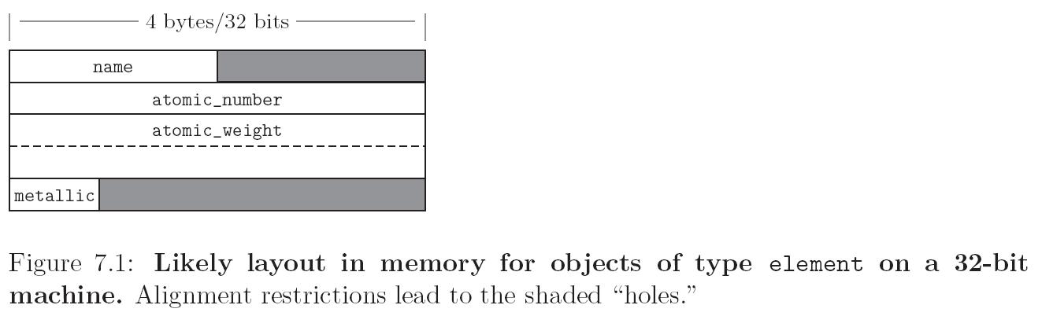
struct element{
char name[2];
int atomic_number;
double atomic_weight;
_Bool metalic;
}

Slide 75
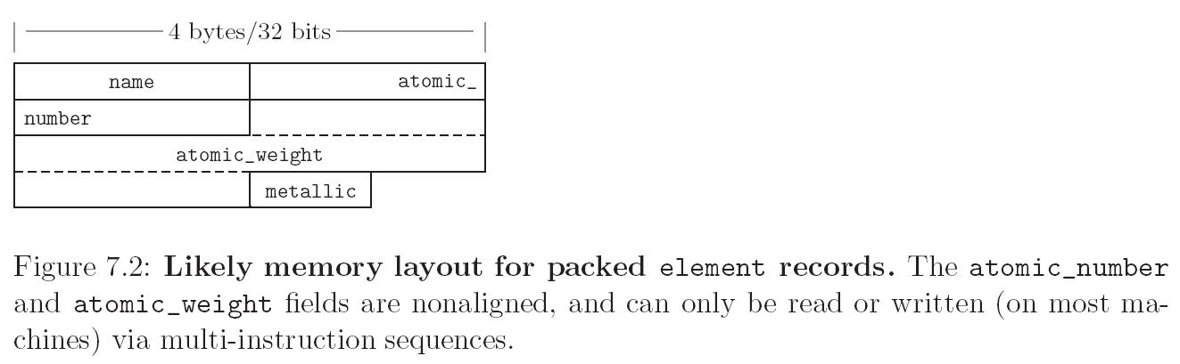
Some languages (Pascal) allows records to be packed
optimized for space instead of speed
access requires multiple instructions
type element = packed record
name: two_chars;
atomic_number: integer;
atomic_weight: real;
metalic: Boolean;
end;

Slide 76
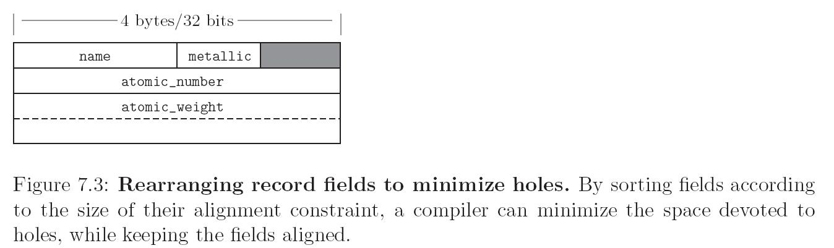
After rearranging record fields

Slide 77
Variant records (union)
There are several possible collections of fields: only one “variant” is valid at a given time.
Type Person = POINTER TO PersonRec PersonRec = RECORD firstName,lastName: ARRAY[0..31] OF CHAR; CASE student: BOOLEAN OF TRUE: advisor: Person; majorCode: INTEGER | FALSE: supervisor: Person; END END
Domain: Disjoint union of field types

Slide 78
type element = record
name: two_chars;
atomic_number: integer;
atomic_weight: real;
metalic: Boolean;
case naturally_occuring: Boolean of
true: (source: string_ptr;
prevalence: real;
);
false: (
lifetime: real
)
end;

Slide 79
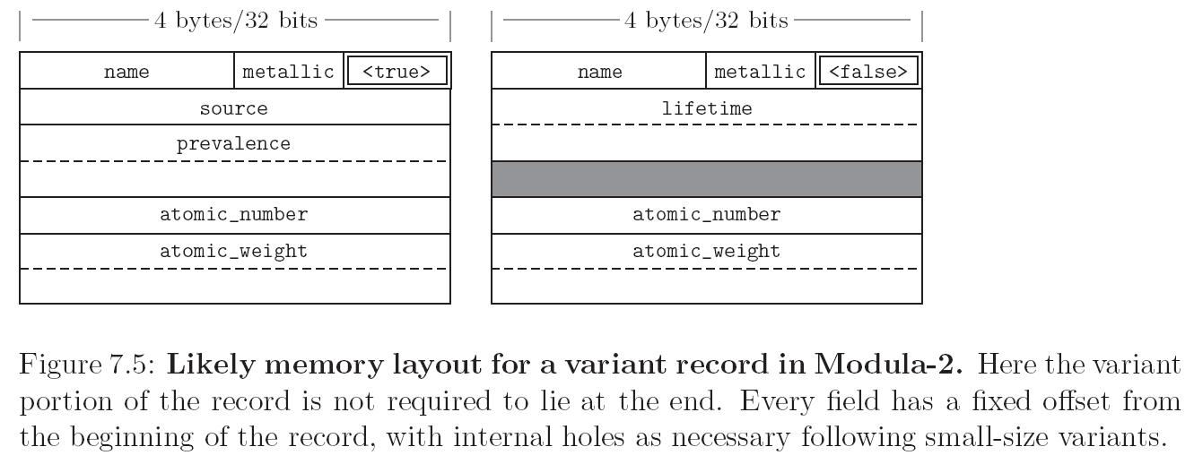

Slide 80
Variants in Pascal create holes in type system.
Can change tag like any other field
In example, could change naturally_occurring to true, then access memory for filed prevalence, which is not defined.
Union types in C similarly unsafe
Programmers of modern OO languages usually get same effect, more safely, with subtypes.
Variants not included in Modula-3, Java, or C#.

Slide 81
Arrays
Arrays are the most common and important composite data type
Unlike records, which group related fields of disparate types, arrays are usually homogeneous
Semantically, they can be thought of as a mapping from an index type to a component or element type
Domain: function from index type to component type
f: U → V.

Slide 82
Associative arrays
A few languages allow nondiscrete index types
Implemented with hash tables or search trees
Resemble dictionary or map types supported by standard libraries of many OO languages
For now, we assume dense arrays with discrete index types.

Slide 83
Syntax
Most languages refer to element of an array by appending the index value to the name of the array, usually delimited with [] or ().
A[3] or A(3)
Declarations
append subscript to scalar declaration
In C
char upper[26];
In Fortran
character, dimension (1:26) :: upper
or
character (26) upper
In Java
char[] upper
Ada
upper : array (character range ‘a’..’z’) of character
Other than syntax, how do these declarations differ?

Slide 84
Multidimensional arrays
Examples:
C
double mat[10][10]
Modula3
VAR mat: ARRAY [1..10],[1..10] OF REAL;
which is syntactic sugar for
VAR mat : ARRAY [1..10] OF ARRAY [1..10] OF REAL;
Fortran
real, dimension (10,10) :: mat
Ada
mat1: array (1..10, 1..10) of long_float;
In Ada, this is not the same as an array of arrays, which would be declared
type vector is array (integer range <>) of long_float;
type matrix is array (integer range <>) of vector (1..10)
mat2 : matrix (1..10);

Slide 85
Slicing
A slice or section is a rectangular portion of an array
Many languages provide support for slicing
Example: Fortran
a:b:c as a subscript means positions
a+c, a+2c, a+3c,…through b
c can be omitted (default is 1) or be negative to select positions backwards

Slide 86
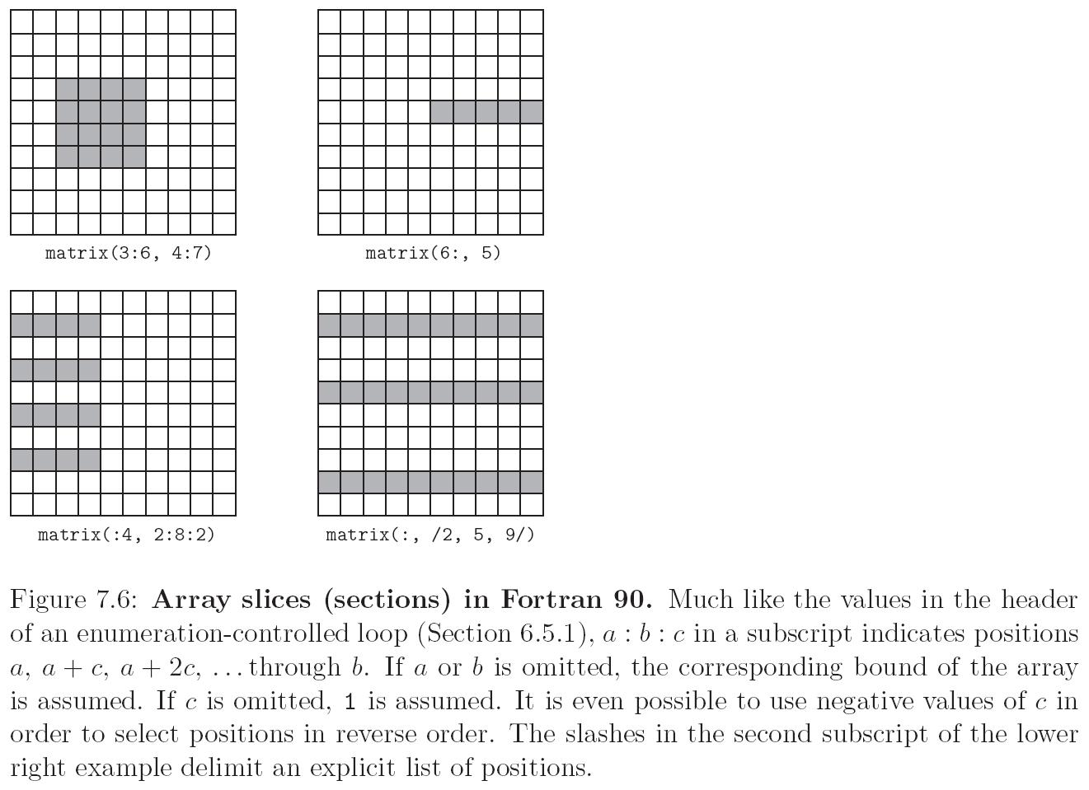
Slices
matrix (3:6, 4:7)

Slide 87
Slices
matrix (6: ,5)
when a range is omitted, bound assumed

Slide 88
Slices
matrix (:4,2:8:2)

Slide 89
Slices
matrix (:, (/2,5,9/)
slashes delimit explicit list

Slide 90
Dimensions, Bounds, and Allocation
Lifetime
global
local (extend of subroutine)
Bound
static
dynamic
Allocation mechanism
static
stack
heap

Slide 91
global lifetime, static shape
if shape of an array is known at compile time,
and if lifetime is entire execution of the program
then the compiler can allocate space for the array in static global memory

Slide 92
local lifetime, static shape
If the shape of the array is known at compile time,
but the array should only exist throughout the execution of a subroutine
then space can be allocated in the subroutine’s stack frame at run time.

Slide 93
local lifetime, shape bound at elaboration time
if shape is known at elaboration time (when declared)
object can be allocated on stack routine, but requires another level of indirection

Slide 94
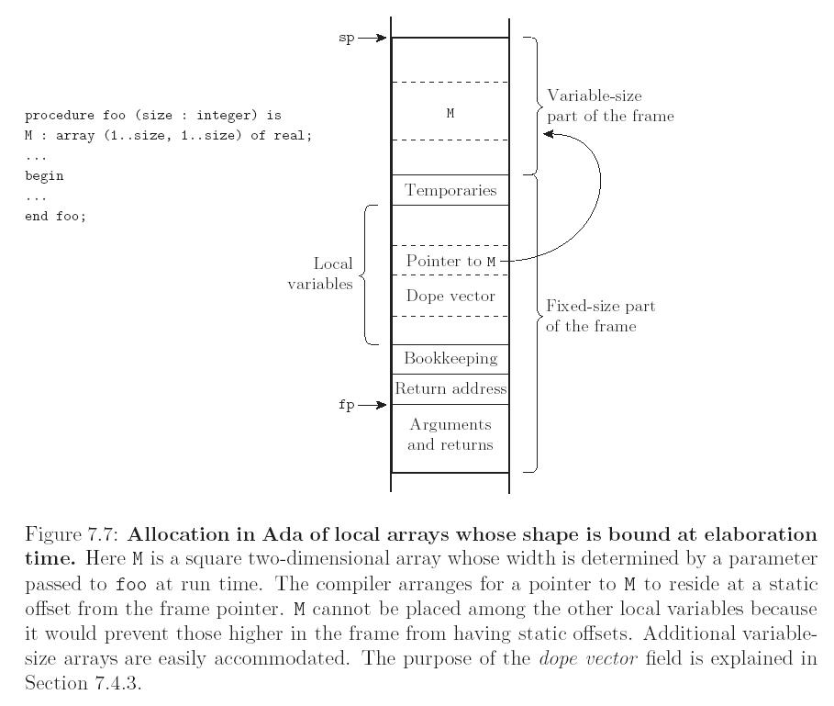
Bounds passed in as parameter
The dope vector is a runtime descriptor containing information about the shape of the array

Slide 95
arbitrary lifetime, shape bound at elaboration time
In Java and C#, an array variable is reference to an object
declaration only creates reference
int[] X;
space allocation on heap under explicit control of programmer
X = new int[size];
size of array does not change after allocation

Slide 96
arbitrary lifetime, dynamic shape
Shape changes during runtime
Cannot be allocated on stack
Increasing size usually requires allocating new array, copying contents, deallocating old array
Some languages allow Strings to dynamically change size, but not arbitrary arrays: Snobol, Icon, Perl. Sort of in Java and C#.
Some languages allow other arrays to dynamically change size: APL, Perl, Common Lisp.
Some support this in libraries (rather than language itself): Java (Vector, ArrayList), C++, C#,

Slide 97
Memory layout for arrays
Two layout strategies:
Contiguous elements
Elements are stored next to each other
Arrays of records may have holes for alignment reasons
Row-pointer layouts

Slide 98
Contiguous elements
column major - only in Fortran (and Matlab)
A[2,4] is followed by A[3,4]
row major
A[2,4] is followed by A[2,5]
used by everybody else
makes array [a..b, c..d] the same as array [a..b] of array [c..d]
Row major vs. column major important for programs that iterate over all elements in multidimensional array
need to minimize cache misses.
Notes:
Corfirm statement about Matlab

Slide 99
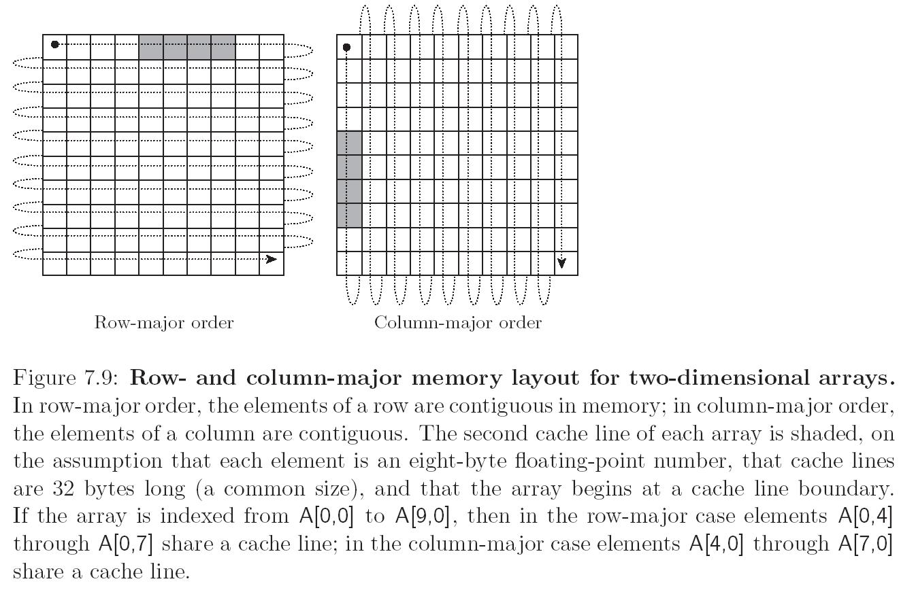
Memory layout
Row Major
Elements A[0,4] through A[0,7] share a cache line

Slide 100
Memory layout
Column Major
Elements A[0,4] through A[7,0] share a cache line

Slide 101
Traversing 2d arrays
In Fortran
do j= 1, N !columns
do i = 1,N !rows
…A(i,j)
end do
end do
In C
for (i=0; i<N; i++){ //rows
for (j=0; j< N’ j++){ //columns
…A[i][j]…
}
}

Slide 102
Row pointers
technically—array of arrays rather than true multidimensional array
an option (along with contiguous) in C, C++, C#, the only option in Java

Slide 103
advantages of row pointers
allows rows to be put anywhere - nice for big arrays on machines with segmentation problems
avoids multiplication
nice for matrices whose rows are of different lengths
e.g. an array of strings
allows a program to construct an array from existing rows without copying
fits better with OO paradigm
disadvantages
requires extra space for the pointers
possible performance penalty for scientific code

Slide 104
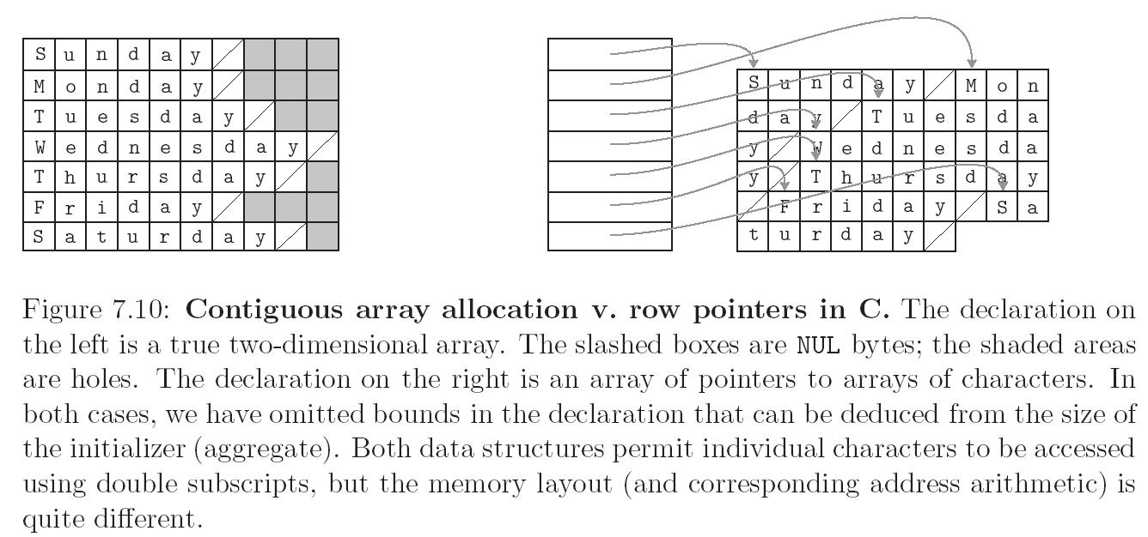
char *days[] = {
“Sunday”, “Monday”, “Tuesday”, “Wednesday”, “Thursday”, Friday””, “Saturday”
};
…
days[2][3] == ‘s’;
Row pointer allocation

Slide 105
char days[][10] = {
“Sunday”, “Monday”, “Tuesday”, “Wednesday”, “Thursday”, Friday””, “Saturday”
};
…
days[2][3] == ‘s’;
Contiguous allocation Shaded boxes are holes

Slide 106
Address Calculations
solid: array of planes
A: array [L₁..U₁] of
array [L₂..U₂] of
array [L₃..U₃] of elem_type
What is the address of A[i,j,k]?
with contiguous allocation
plane: array of arrays of elem types
array of elem_type

Slide 107
A: array [L₁..U₁] of
array [L₂..U₂] of
array [L₃..U₃] of elem_type
Define constants
S₃ = size of elem_type
S₂ = (U₃ – L₃ + 1) x S₃ (size of row )
S₁ = (U₂ – L₂ + 1) x S₂ (size of plane)
size of element times number of elements in row
size of row times number of rows in a plane

Slide 108
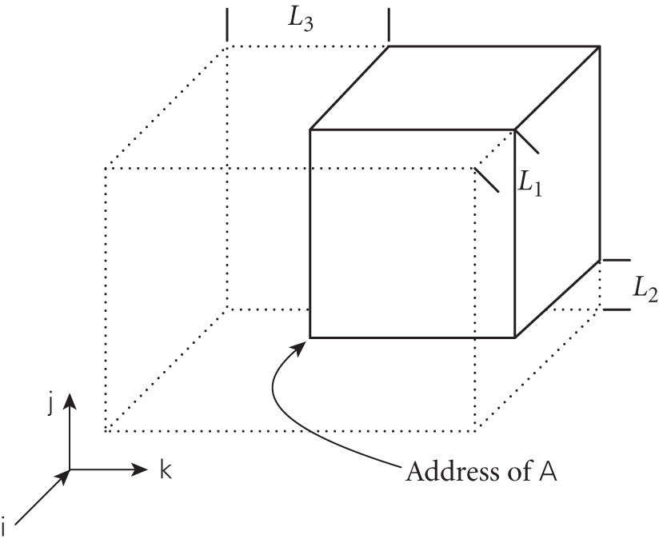
A[i,j,k] =
address of A
+ (i-L1) x S1
+ (j-L2) x S2
+ (k-L3) x S3

Slide 109
A[i,j,k] =
address of A
+ (i-L₁) x S₁
+ (j-L₂) x S₂
+ (k-L₃) x S₃
A[i,j,k] =
address of A
+ i x S₁
+ j x S₂
+ k x S₃
- L₁ x S₁
- L₂ x S₂
- L₃ x S₃
Depending on what is static, may be able to compute parts of the address at compile time:
General idea: Divide address calculation into static and dynamic parts

Slide 110
Strings
Often just arrays of characters
May be special-cased to give them flexibility not available for arrays in general
syntactic sugar: “this is a string”, escape sequences
possibly dynamic sizing
easier to provide for strings than for arrays in general because strings are one-dimensional and don’t contain references to anything else

Slide 111
Representation of strings
address + length
address + magic_marker
See The Most Expensive One-Byte Mistake

Slide 112
Sets
First introduced in Pascal
Unordered collection of an arbitrary number of distinct values of a common type.
Base type (or universe type) is the type from which elements in set are taken
Pascal implementation: characteristic array
bit vector with one bit for each element of base type.
value of bit is one indicates corresponding element in set
Can use fast logical instructions
union = bitwise or
intersection = bitwise and

Slide 113
Implementation of Sets
Size of bit vectors for a few base types
Set of ASCII chars: 128 bits (16 bytes)
Set of 32 bit integers: 500 MB
Set of 64 bit integers: more memory than on all computers in the world
Bit vectors only work for base types with a small number of values
Language design solutions?

Slide 114
Language design issues for sets
Option 1
Limit the size of base types that can be used to form sets to arbitrary value
Option 2
Provide an alternative implementation for larger base types
Size is proportional to number of elements in set, not number of elements in base type
Most implementations provide iterators to iterate over elements in set
Sorted
base type supports some ordering, elements returned in this order
implemented with skip list or some sort of tree
Unordered
elements returned in arbitrary order
implemented with a hash table

Slide 115
Sets in Modula-2
TYPE b = [0..1]
subrange type (values 0,1)
TYPE s =SET OF b
values associated with s are {}, {0}, {1}, {0,1} with bit vectors [00], [01], [10], and [11]

Slide 116
How sets may be supported
Built-in type constructor
Pascal, Modula2, Python
Standard library
Java, C++
No support for sets, but do support associative arrays
Can be used to emulate unordered sets by mapping elements in set to a dummy value

Slide 117
Pointers and recursive types
Recursive type: objects may contain one or more references to other objects of the same type
Most recursive types are records
They need to contain something other than the reference, thus have heterogeneous fields
Used to build linked data structures
Domain: abstraction of memory addresses, plus a special value, nil (null).

Slide 118
Pointers are not addresses
Pointer is high-level concept: reference to object
Address is low-level concept: location of word in memory
Pointers may be implemented as addresses
Pointers may also be implemented in other ways
segment + offset (in machine with segmented architecture(
address + access key (in languages that attempt to catch dangling references)

Slide 119
Creating pointers
Some languages only allow pointers to refer to object on heap
pointer obtained by calling “new” or equivalent
Some languages provide “address of” operator to return pointer to arbitrary variable

Slide 120
Operations on pointers:
allocation and deallocation of object in heap
assignment
sets pointer’s value to refer to a valid object
dereference
get the value of the object referred to by the pointer
dereferencing can be explicit or implicit.
In C it is explicit (use * operator)
Behavior depends on whether language is functional or imperative, and whether it uses reference of value model for variables

Slide 121
Aside: Value model of variables (Scott 6.1.2)
a variable is a named container for a value
a variable yields two interpretations—location or value
l-values are expressions that denote locations
r-values are expressions that denote values
whether an expression is an l-value or r-value depends on context

Slide 122
Examples: which are l-value and which are r-values???
x = y
y = z
x = x + y

Slide 123
Examples: which are l-value and which are r-values???
x = y
y = z
x = x + y
l-values

Slide 124
Examples: which are l-value and which are r-values???
x = y
y = z
x = x + y
r-values

Slide 125
Reference model of variables
A variable is a named reference to a value
Languages: Algol 68, Clu, Lisp/Scheme, ML, Smalltalk
every variable is an l-value
when value is needed, the variable must be dereferenced.
Often, dereferencing is implicit

Slide 126
Example
b := 2;
c := b;
a := b + c;
Value model: Put value of 2 into b, then copy it into c. Read the value in b and c, add then together and put the result, 4, in a
Reference model: Let b refer to 2 and let c refer to 2 also. Pass these references to the + operator and let a refer to the result, 4.

Slide 127
Functional languages usually employ a reference model for names
Variables in imperative languages may use either a value or reference model, or combination
Java uses value model for primitive types and reference model for objects

Slide 128
Back to references and pointers
Java contains reference types but only assignments and comparision allowed.
Java references always refer to class instances (arithmetic on them doesn’t make sense)
C# contains both Java-style references and C,C++ style pointers,
methods using pointers must be marked as unsafe
Pointers were included for interoperability with C, C++ code.

Slide 129
int *ptr; int count, init; ptr = &init;
/* ptr now points to init */
count = *ptr;
/* count now contains the value referred to by ptr */ *ptr = 10
/* ptr now refers to a location that contains 10, init=10. */

Slide 130
Arithmetic on pointers:
ptr + 1;
refers to next memory cell containing the type of the pointer.
For example if a pointer is implemented as an address, and say ptr has value 1024, and ints are 4 bytes, then ptr+1 is address 1028.
In C,C++, usually used in context of arrays

Slide 131
int list [10]; int *ptr; ptr = list; /* assigns address of list[0] to ptr*/
*(ptr+index)
/* equivalent to list[index] */

Slide 132
In C, C++, pointers of type (void *) can point to anything.
But pointers of that type cannot be dereferenced.
Must be cast to a specific type first
C++ also contains a reference type, a constant pointer that is implicitly dereferenced.
int result = 0;
int &ref_result = result; ...
ref_result = 100;
Used for formal parameters in function definitions.

Slide 133
Recursive types in Modula-2
Type Person = POINTER TO PersonRec
PersonRec = RECORD
firstName,lastName: ARRAY[0..31] OF CHAR;
mother, father: Person;
END
END
Why use POINTER instead of PersonRec?

Slide 134
Dangling pointers
Problems with dangling pointers are due to
explicit deallocation of heap objects
only in languages that have explicit deallocation
implicit deallocation of elaborated objects
object is local to a subroutine, thus allocated on stack
some reference has longer lifetime than subroutine
Two implementation mechanisms to catch dangling pointers
Tombstones
Locks and Keys

Slide 135
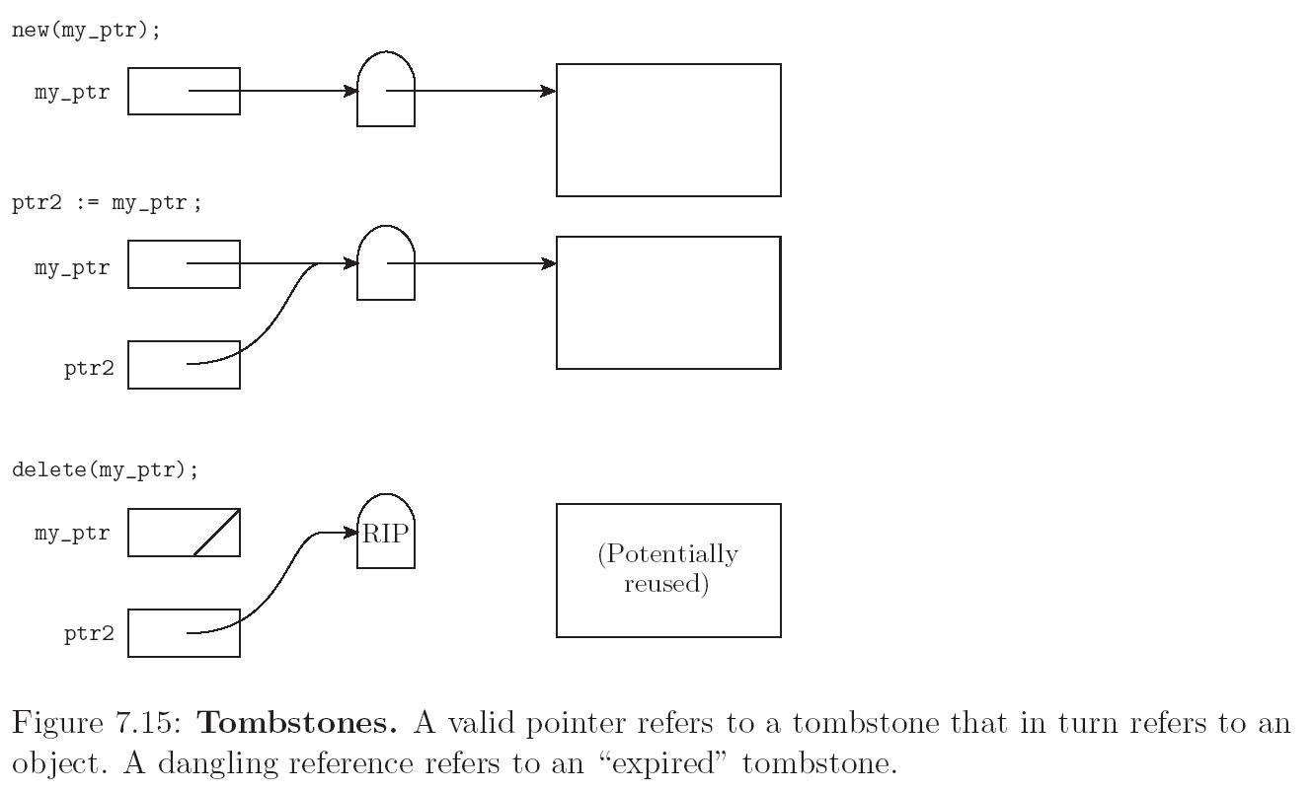

Slide 136
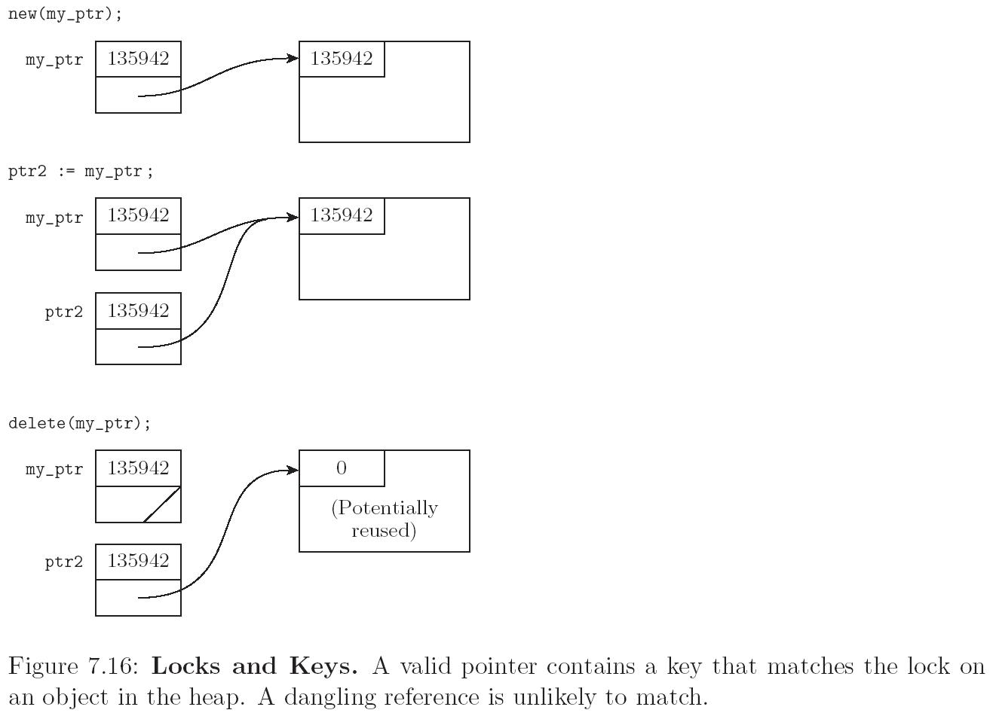

Slide 137
Tony Hoare’s billion-dollar mistake
I call it my billion-dollar mistake. It was the invention of the null reference in 1965. At that time, I was designing the first comprehensive type system for references in an object oriented language (ALGOL W). My goal was to ensure that all use of references should be absolutely safe, with checking performed automatically by the compiler. But I couldn't resist the temptation to put in a null reference, simply because it was so easy to implement. This has led to innumerable errors, vulnerabilities, and system crashes, which have probably caused a billion dollars of pain and damage in the last forty years. [2007]

Slide 138
Lists
Recursively defined by pair consisting of
head element and
reference to rest of list.
Variable length.
Operations:
get head
get tail
add element to front of list, etc.
Fundamental in functional programming languages—so we will come back to this!
In lisp, a program is a list. Can create a list representing a program at runtime and execute it

Slide 139
More on reference model vs value model
Ocaml
type chr_tree = Empty
| Node of char * chr_tree * chr_tree;
C
struct CharTree {
char ch;
CharTree* left;
CharTree* right;
};
Java
abstract class CharTree{}
class Empty extends CharTree{}
class Node extends CharTree{
char ch;
CharTree left;
CharTree right;
}

Slide 140
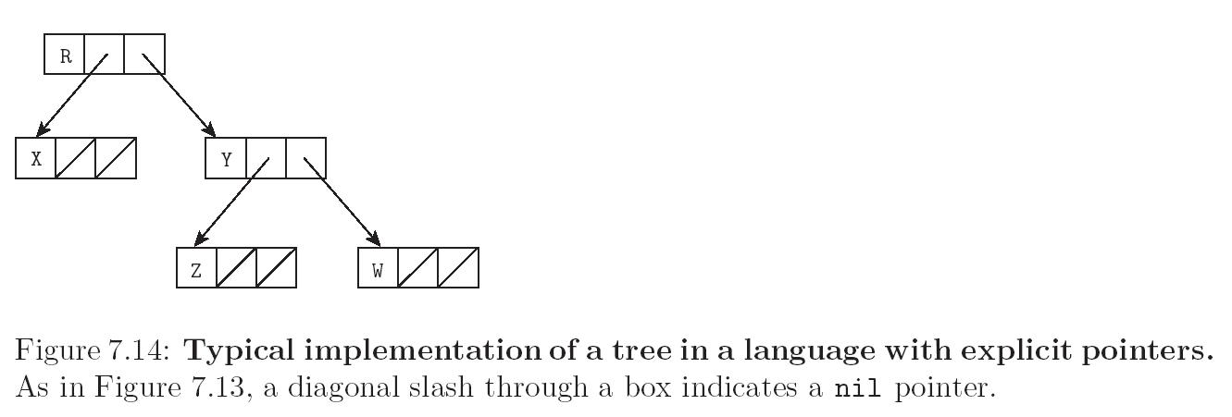
Tree in language with explicit pointers
nil

Slide 141
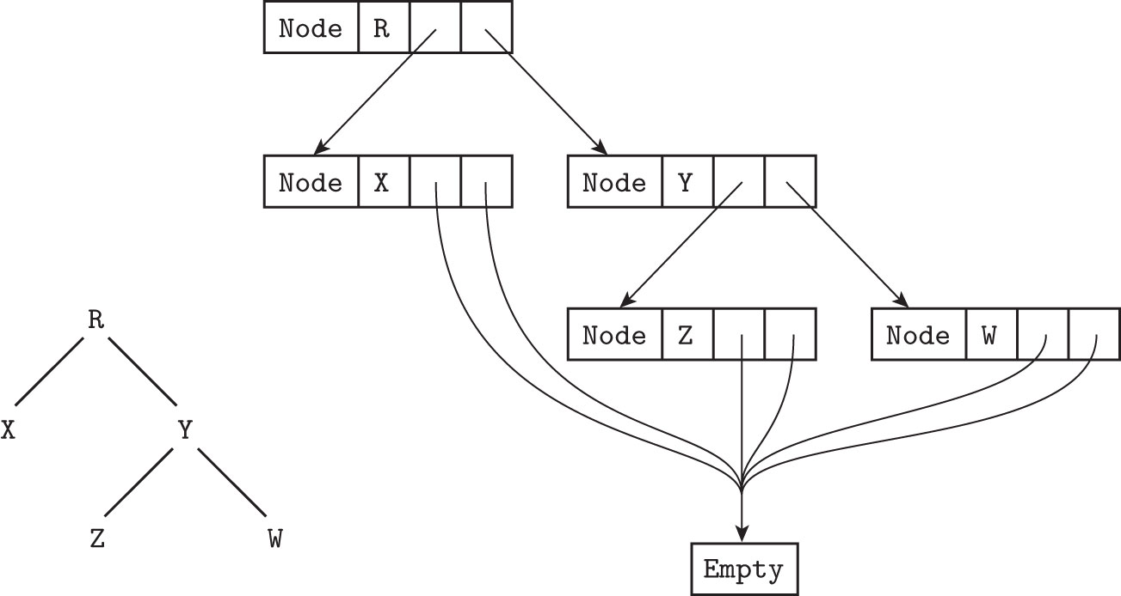

Slide 142
Tree in Lisp
( #\R (#\X () () ) (#\Y (#\Z () ()) (#\W () ()) ) )
#\R = ‘R’ in other languages
Lisp is dynamically typed—so no type declaration as in previous examples
Everything is list
These lists are empty () or have 3 elements, a char, and two more lists.
Behind the scenes, each list is made up of a cons cell with pointers to head, and pointers to rest of list.
Atoms are objects that are not cons cells (built in types)
Each memory block is tagged to indicate whether it is a cons cell or an atom

Slide 143
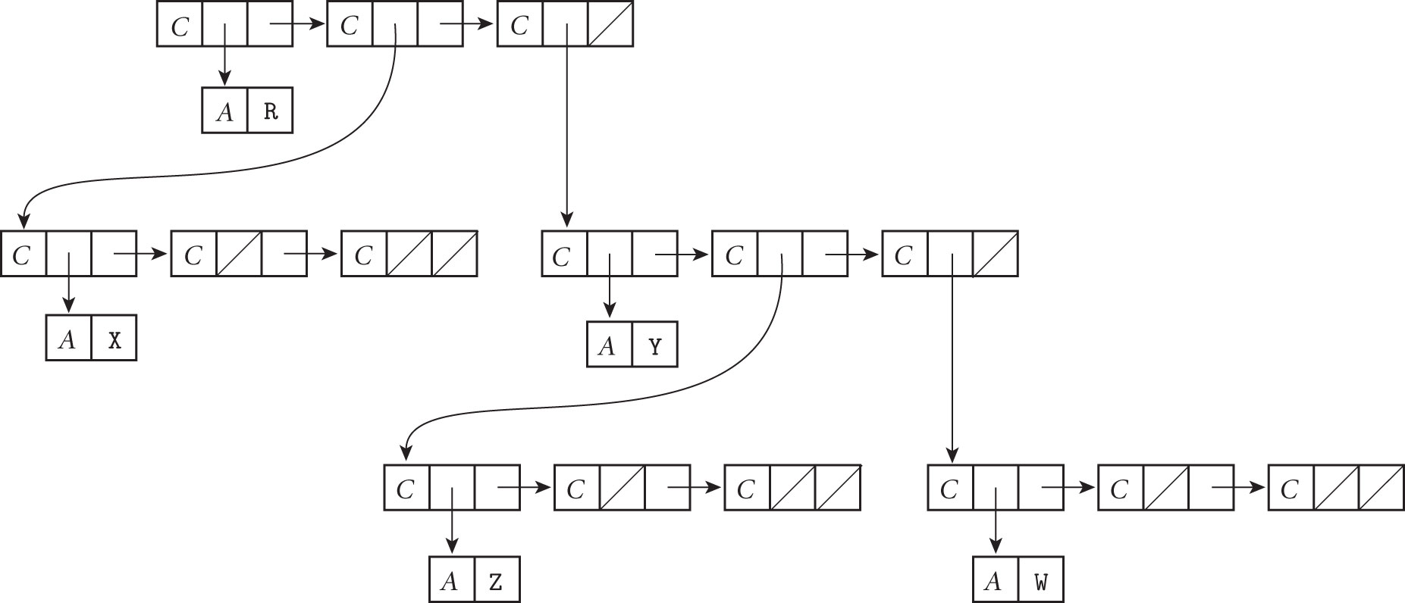

Slide 144
Files and I/O
One of the most difficult parts of language design
some have built-in data types and syntax for I/O
some leave it to libraries
Interactive I/O
communication with human users or physical devices working in parallel with running program
input from human or device may depend on earlier output from program
Files
offline storage implemented by OS
files may be
temporary
exist for duration or single program run
store info too large to fit in memory
persistent
allow reading data that existed before program
writing data that will exists after program exits

