Slide 1

Support Live Music Project
Group 4
Team Members – Jody, Javier, Marc, Rae Ann

Slide 2



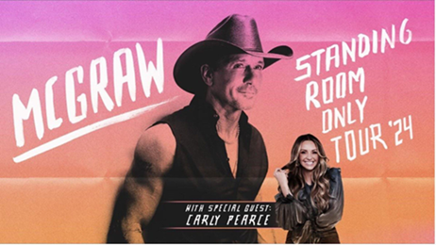
Artists
4 Bands selected from different genres who are currently touring
Depeche Mode Foo Fighters Green Day Tim McGraw

Slide 3




Markets
4 Markets selected where our 4 selected bands are playing
Denver Los Angeles/Inglewood Seattle Minneapolis/St. Paul Colorado California Washington Minnesota
Depeche Mode Depeche Mode Depeche Mode Foo Fighters Foo Fighters Foo Fighters Foo Fighters Green Day Green Day Green Day Green Day Tim McGraw Tim McGraw Tim McGraw Tim McGraw

Slide 4
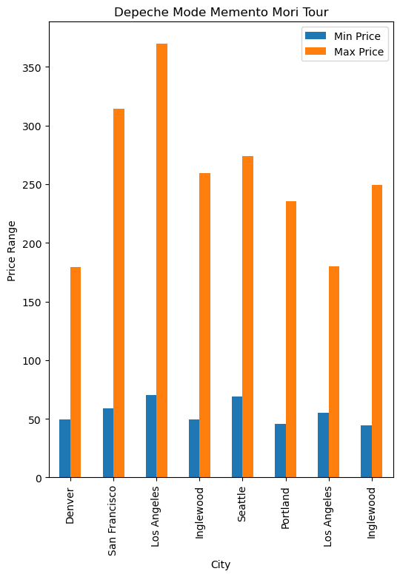

Depeche Mode Memento Mori Tour
Date | City | State | Min Price | Max Price
2023-11-16 | Denver | CO | $49.50 | $179.50
2023-11-26 | Seattle | WA | $69.00 | $274.00
2023-11-28 | Portland | OR | $45.50 | $235.50
2023-12-03 | San Francisco | CA | $59.00 | $314.00
2023-12-10 | Inglewood | CA | $49.50 | $259.50
2023-12-12 | Inglewood | CA | $44.50 | $249.50
2023-12-15 | Los Angeles | CA | $70.00 | $370.00
2023-12-17 | Los Angeles | CA | $55.00 | $180.00
Observations
We looked at prices over multiple markets
Price ranges are mostly consistent across markets
Denver is the most affordable market
California is the most expensive markets
Source : https://developer.ticketmaster.com/

Slide 5
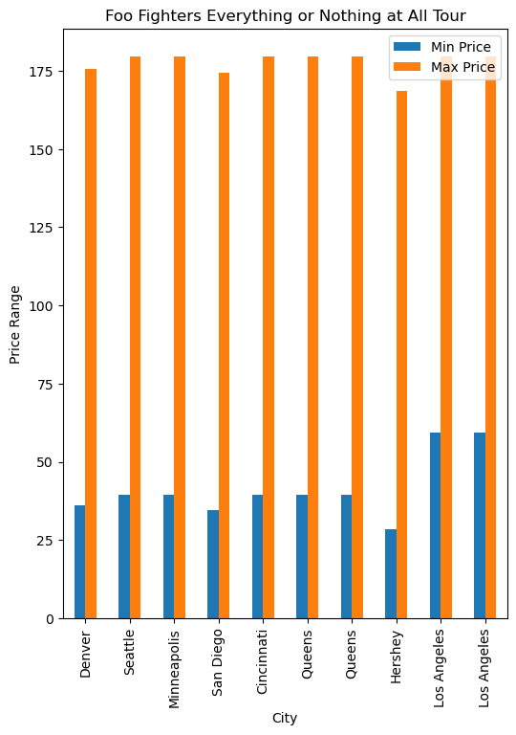
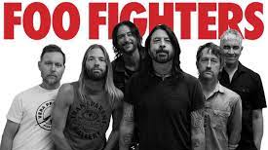
Foo Fighters Everything or Nothing At All Tour
Date | City | State | Min Price | Max Price
2024-07-17 | Queens | NY | $39.50 | $179.50
2024-07-19 | Queens | NY | $39.50 | $179.50
2024-07-23 | Hershey | PA | $28.50 | $168.50
2024-07-25 | Cincinnati | OH | $39.50 | $179.50
2024-07-28 | Minneapolis | MN | $39.50 | $179.50
2024-08-03 | Denver | CO | $36.00 | $175.50
2024-08-07 | San Diego | CA | $34.50 | $174.50
2024-08-09 | Los Angeles | CA | $59.50 | $179.50
2024-08-11 | Los Angeles | CA | $59.50 | $179.50
2024-08-18 | Seattle | WA | $39.50 | $179.50
Observations
We looked at prices over multiple markets
Price ranges are mostly consistent across markets
Hershey is the most affordable market
The top prices are consistent across markets
Source : https://developer.ticketmaster.com/

Slide 6
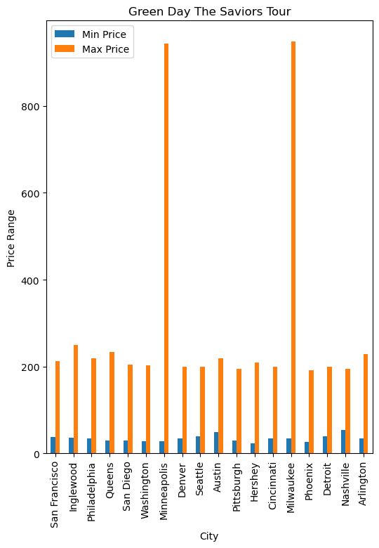

Green Day The Saviors Tour
Date | City | State | Min Price | Max Price
2024-07-29 | Washington | DC | $28.00 | $203.00
2024-08-05 | Queens | NY | $30.00 | $234.00
2024-08-09 | Philadelphia | PA | $35.00 | $219.00
2024-08-10 | Hershey | PA | $24.00 | $209.00
2024-08-17 | Minneapolis | MN | $29.00 | $943.00
2024-08-22 | Cincinnati | OH | $34.50 | $199.00
2024-08-24 | Milwaukee | WI | $35.00 | $949.00
2024-08-30 | Nashville | TN | $54.50 | $194.50
2024-09-01 | Pittsburgh | PA | $29.50 | $194.00
2024-09-04 | Detroit | MI | $39.50 | $199.00
2024-09-07 | Denver | CO | $35.00 | $199.00
2024-09-10 | Austin | TX | $49.50 | $219.50
2024-09-11 | Arlington | TX | $35.00 | $229.00
2024-09-14 | Inglewood | CA | $35.50 | $249.00
2024-09-18 | Phoenix | AZ | $26.50 | $191.50
2024-09-20 | San Francisco | CA | $37.75 | $211.75
2024-09-23 | Seattle | WA | $59.00 | $199.00
2024-09-28 | San Diego | CA | $30.00 | $205.00
Observations
We looked at prices over multiple markets
Price ranges are mostly consistent across markets
Minneapolis and Milwaukee are the most expensive markets
Source : https://developer.ticketmaster.com/

Slide 7
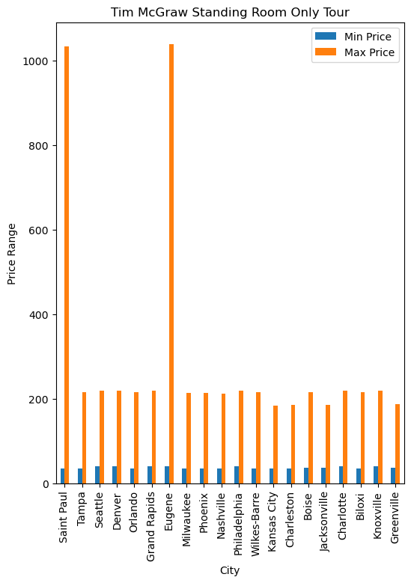

Tim McGraw Standing Room Only Tour
Date | City | State | Min Price | Max Price
2024-03-14 | Jacksonville | FL | $36.41 | $186.42
2024-03-15 | Tampa | FL | $35.75 | $215.75
2024-03-16 | Orlando | FL | $35.50 | $215.00
2024-03-29 | Seattle | WA | $39.50 | $219.50
2024-03-30 | Eugene | OR | $39.50 | $1,039.50
2024-04-04 | Denver | CO | $39.50 | $219.50
2024-04-06 | Boise | ID | $36.50 | $215.00
2024-04-19 | Milwaukee | WI | $34.50 | $214.50
2024-04-20 | Saint Paul | MN | $34.50 | $1,034.50
2024-04-25 | Nashville | TN | $34.15 | $212.50
2024-04-26 | Knoxville | TN | $39.50 | $219.50
2024-05-11 | Wilkes-Barre | PA | $35.00 | $215.00
2024-05-16 | Greenville | SC | $36.50 | $186.50
2024-05-17 | Charlotte | NC | $39.50 | $219.50
2024-05-18 | Charleston | WV | $35.50 | $185.50
2024-06-01 | Grand Rapids | MI | $39.50 | $219.50
2024-06-08 | Kansas City | MO | $34.50 | $184.50
2024-06-13 | Biloxi | MS | $35.50 | $215.50
2024-06-20 | Philadelphia | PA | $39.50 | $219.50
2024-06-27 | Phoenix | AZ | $34.50 | $214.50
Observations
We looked at prices over multiple markets
Price ranges are mostly consistent across markets
Saint Paul and Eugene are the most expensive markets
Source : https://developer.ticketmaster.com/

Slide 8
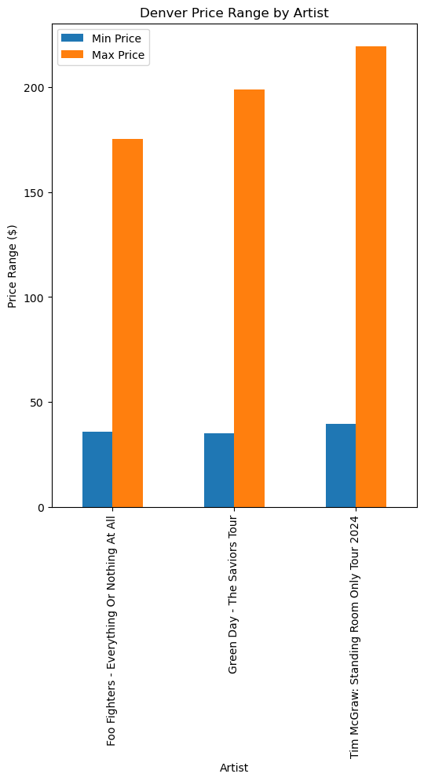
Denver, Colorado
Source : https://developer.ticketmaster.com/

Slide 9
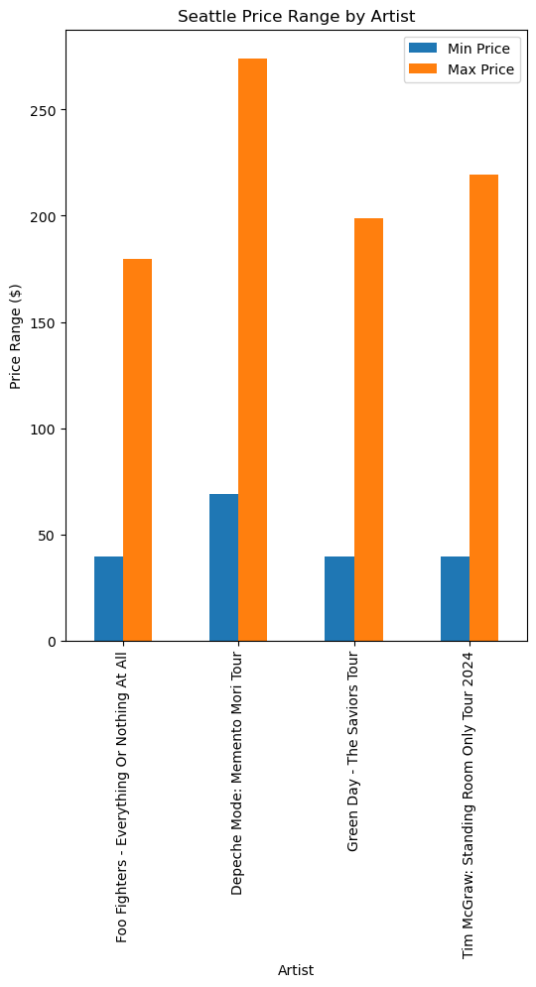
Los Angeles / Inglewood, California
Source : https://developer.ticketmaster.com/

Slide 10
Seattle, Washington
Source : https://developer.ticketmaster.com/

Slide 11
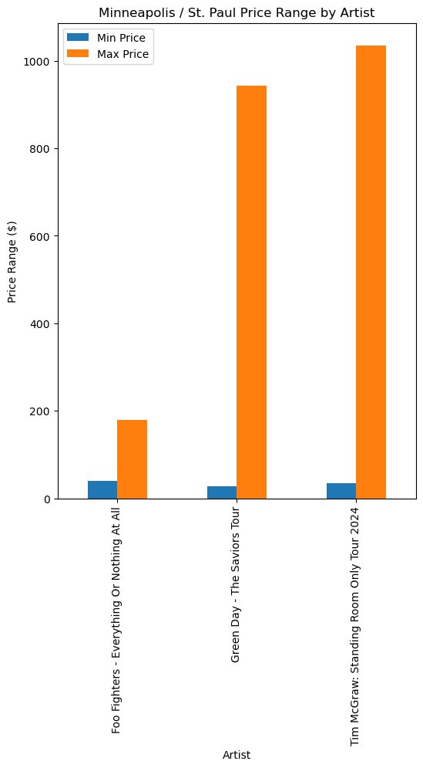
Minneapolis/St. Paul, Minnesota
Source : https://developer.ticketmaster.com/

Slide 12
Summary / Observations

