Slide 1

Support Live Music Project
Group 4
Team Members – Jody, Javier, Marc, Rae Ann

Slide 2



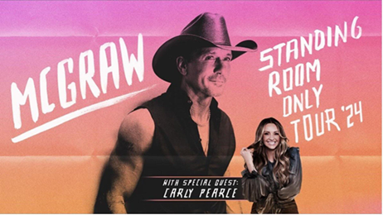
Artists
4 Bands selected from different genres who are currently touring
Depeche Mode Foo Fighters Green Day Tim McGraw

Slide 3




Markets
4 Markets selected where our 4 selected bands are playing
Denver Los Angeles/Inglewood Seattle Minneapolis/St. Paul Colorado California Washington Minnesota
Depeche Mode Depeche Mode Depeche Mode Foo Fighters Foo Fighters Foo Fighters Foo Fighters Green Day Green Day Green Day Green Day Tim McGraw Tim McGraw Tim McGraw Tim McGraw

Slide 4
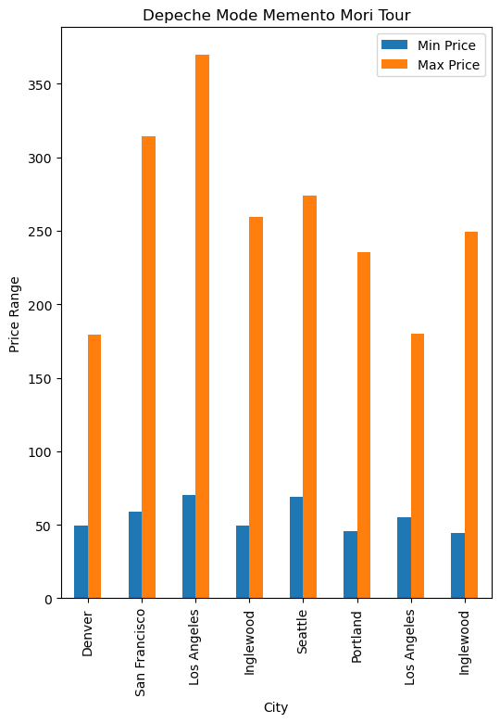

Depeche Mode Memento Mori Tour
Date | City | State | Min Price | Max Price
2023-11-16 | Denver | CO | $49.50 | $179.50
2023-11-26 | Seattle | WA | $69.00 | $274.00
2023-11-28 | Portland | OR | $45.50 | $235.50
2023-12-03 | San Francisco | CA | $59.00 | $314.00
2023-12-10 | Inglewood | CA | $49.50 | $259.50
2023-12-12 | Inglewood | CA | $44.50 | $249.50
2023-12-15 | Los Angeles | CA | $70.00 | $370.00
2023-12-17 | Los Angeles | CA | $55.00 | $180.00
Observations
We looked at prices over multiple markets
The Depeche Mode price ranges vary more than the other artists
Denver is the most affordable market
California is the most expensive markets
Source : https://developer.ticketmaster.com/

Slide 5
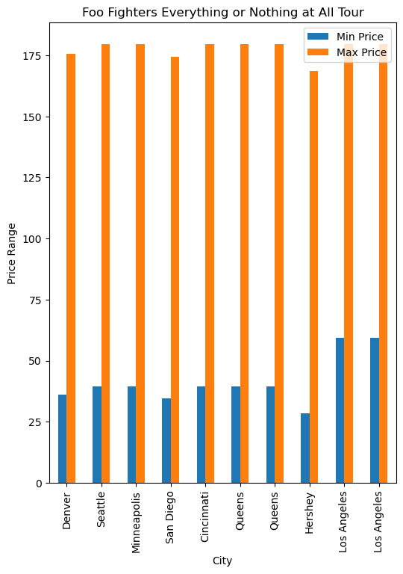

Foo Fighters Everything or Nothing At All Tour
Date | City | State | Min Price | Max Price
2024-07-17 | Queens | NY | $39.50 | $179.50
2024-07-19 | Queens | NY | $39.50 | $179.50
2024-07-23 | Hershey | PA | $28.50 | $168.50
2024-07-25 | Cincinnati | OH | $39.50 | $179.50
2024-07-28 | Minneapolis | MN | $39.50 | $179.50
2024-08-03 | Denver | CO | $36.00 | $175.50
2024-08-07 | San Diego | CA | $34.50 | $174.50
2024-08-09 | Los Angeles | CA | $59.50 | $179.50
2024-08-11 | Los Angeles | CA | $59.50 | $179.50
2024-08-18 | Seattle | WA | $39.50 | $179.50
Observations
We looked at prices over multiple markets
Price ranges are mostly consistent across the markets
Foo Fighters has the most reasonably priced tickets
Hershey is the most affordable market
The top prices are consistent across markets
Source : https://developer.ticketmaster.com/

Slide 6
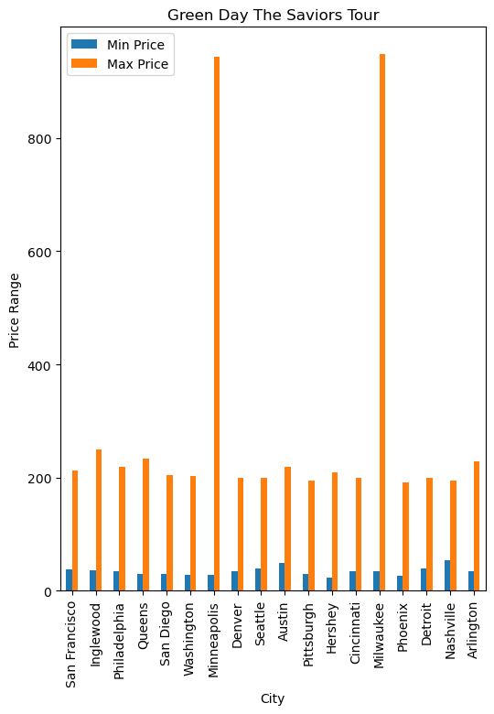

Green Day The Saviors Tour
Date | City | State | Min Price | Max Price
2024-07-29 | Washington | DC | $28.00 | $203.00
2024-08-05 | Queens | NY | $30.00 | $234.00
2024-08-09 | Philadelphia | PA | $35.00 | $219.00
2024-08-10 | Hershey | PA | $24.00 | $209.00
2024-08-17 | Minneapolis | MN | $29.00 | $943.00
2024-08-22 | Cincinnati | OH | $34.50 | $199.00
2024-08-24 | Milwaukee | WI | $35.00 | $949.00
2024-08-30 | Nashville | TN | $54.50 | $194.50
2024-09-01 | Pittsburgh | PA | $29.50 | $194.00
2024-09-04 | Detroit | MI | $39.50 | $199.00
2024-09-07 | Denver | CO | $35.00 | $199.00
2024-09-10 | Austin | TX | $49.50 | $219.50
2024-09-11 | Arlington | TX | $35.00 | $229.00
2024-09-14 | Inglewood | CA | $35.50 | $249.00
2024-09-18 | Phoenix | AZ | $26.50 | $191.50
2024-09-20 | San Francisco | CA | $37.75 | $211.75
2024-09-23 | Seattle | WA | $59.00 | $199.00
2024-09-28 | San Diego | CA | $30.00 | $205.00
Observations
We looked at prices over multiple markets
Price ranges are mostly consistent across markets
Minneapolis and Milwaukee are the most expensive markets due to VIP packages
Source : https://developer.ticketmaster.com/

Slide 7
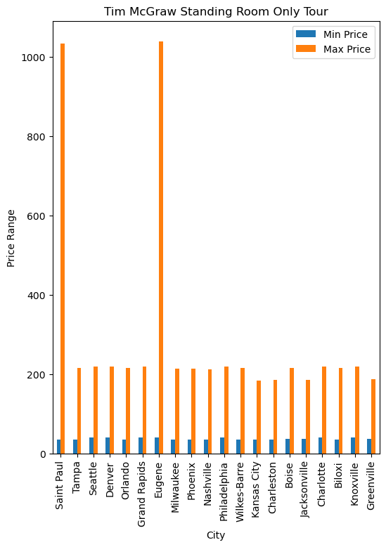

Tim McGraw Standing Room Only Tour
Date | City | State | Min Price | Max Price
2024-03-14 | Jacksonville | FL | $36.41 | $186.42
2024-03-15 | Tampa | FL | $35.75 | $215.75
2024-03-16 | Orlando | FL | $35.50 | $215.00
2024-03-29 | Seattle | WA | $39.50 | $219.50
2024-03-30 | Eugene | OR | $39.50 | $1,039.50
2024-04-04 | Denver | CO | $39.50 | $219.50
2024-04-06 | Boise | ID | $36.50 | $215.00
2024-04-19 | Milwaukee | WI | $34.50 | $214.50
2024-04-20 | Saint Paul | MN | $34.50 | $1,034.50
2024-04-25 | Nashville | TN | $34.15 | $212.50
2024-04-26 | Knoxville | TN | $39.50 | $219.50
2024-05-11 | Wilkes-Barre | PA | $35.00 | $215.00
2024-05-16 | Greenville | SC | $36.50 | $186.50
2024-05-17 | Charlotte | NC | $39.50 | $219.50
2024-05-18 | Charleston | WV | $35.50 | $185.50
2024-06-01 | Grand Rapids | MI | $39.50 | $219.50
2024-06-08 | Kansas City | MO | $34.50 | $184.50
2024-06-13 | Biloxi | MS | $35.50 | $215.50
2024-06-20 | Philadelphia | PA | $39.50 | $219.50
2024-06-27 | Phoenix | AZ | $34.50 | $214.50
Observations
We looked at prices over multiple markets
Price ranges are mostly consistent across markets
Saint Paul and Eugene are the most expensive markets due to VIP packages
Source : https://developer.ticketmaster.com/

Slide 8
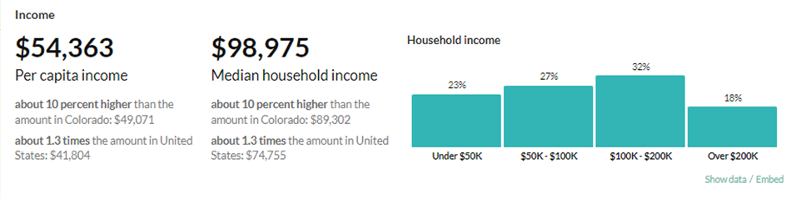
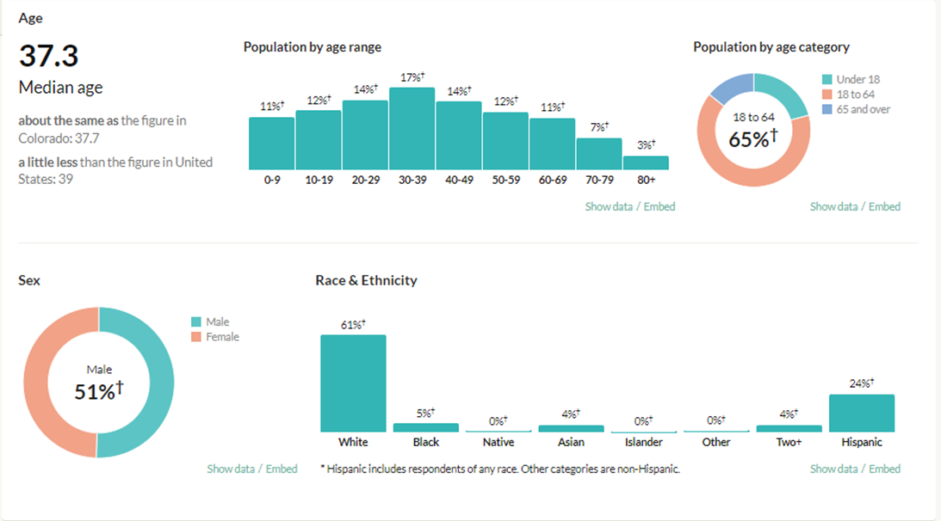
Denver, Colorado Demographics
Denver-Aurora-Lakewood, CO
Metro Area
Population - 2,985,871
Observations
Median Income is $98,975
32% make $100K-200K
50% make less than $100K
65% of population is 18-24
85% of population is white and Hispanic
Source : https://censusreporter.org/

Slide 9
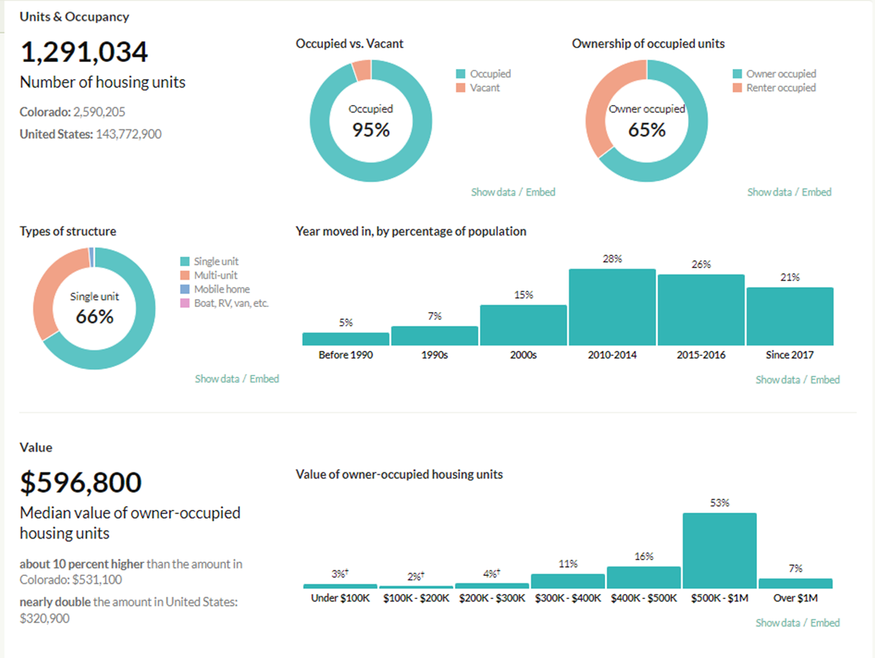
Denver, Colorado Demographics
Observations
65% of housing is owner-occupied
66% are single-unit structures
The median value is $596,800
53% of homes are valued at $500K - $1M
Source : https://censusreporter.org/

Slide 10
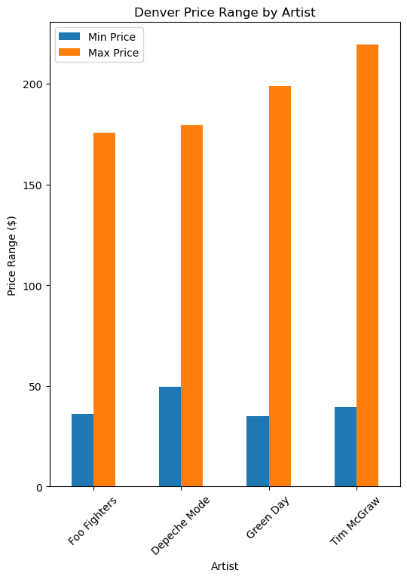

Denver, Colorado
Observations
The minimum price is similar for all artists.
The maximum price is the most expensive for Tim McGraw.
The minimum price is reasonable for most of the population
The max price would be cost-prohibitive for most of the population
Source : https://developer.ticketmaster.com and censusreporter.org

Slide 11
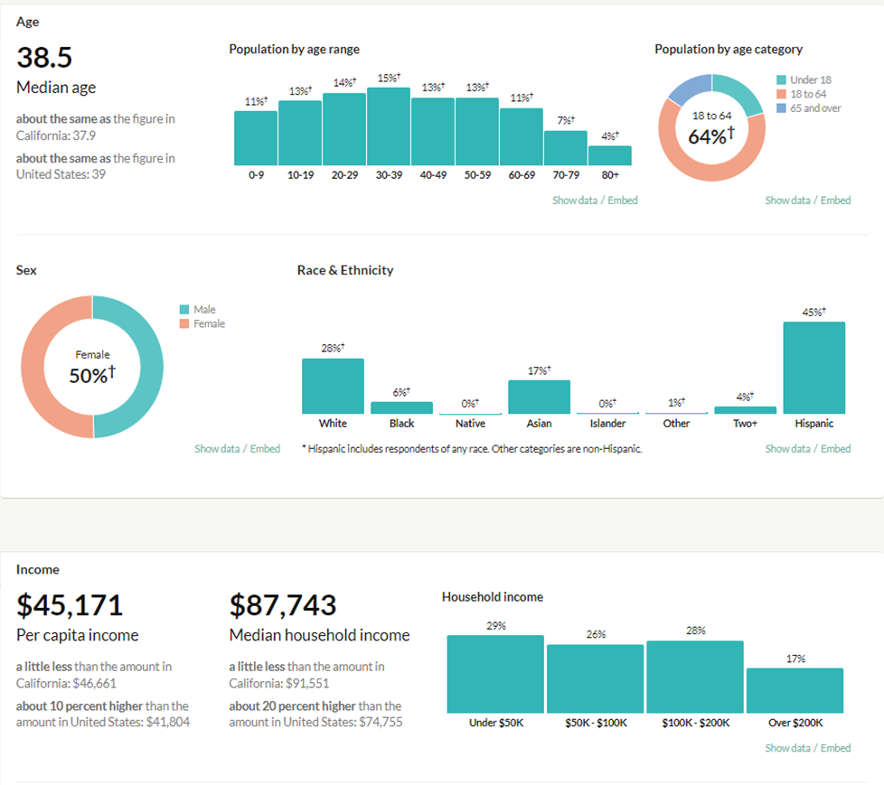
Los Angeles / Inglewood, California Demographics
Los Angeles-Long Beach-Anaheim,
CA Metro Area
Population – 12,872,322
Observations
Median Income is $87,743
29% make under $50K
64% of the population is 18-24
73% of the population is white and Hispanic
Source : https://censusreporter.org/

Slide 12
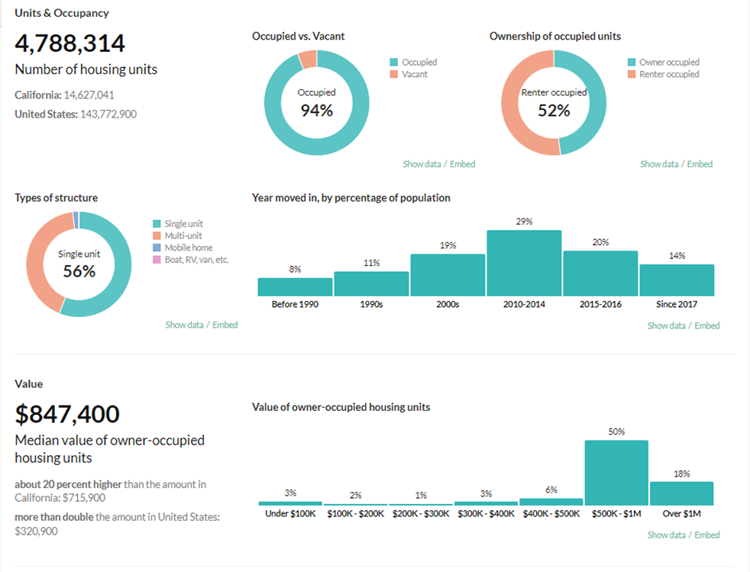
Los Angeles / Inglewood, California Demographics
Observations
52% of housing is renter-occupied
56% are single-unit structures
The median value is $847,400
50% of homes are valued at $500K - $1M
Source : https://censusreporter.org/

Slide 13
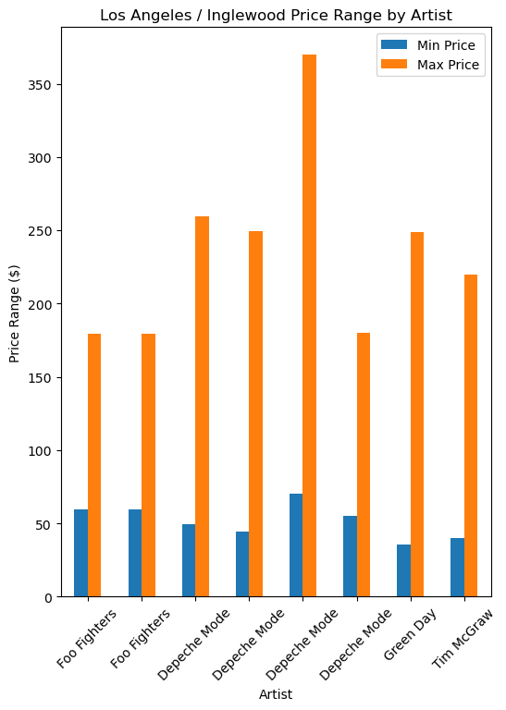

Los Angeles / Inglewood, California
Observations
The minimum price is similar for all artists.
The maximum price is the most expensive for Depeche Mode.
The minimum price is reasonable for a smaller portion of the population than other markets
The max price would be cost-prohibitive for most of the population
Source : https://developer.ticketmaster.com and censusreporter.org

Slide 14
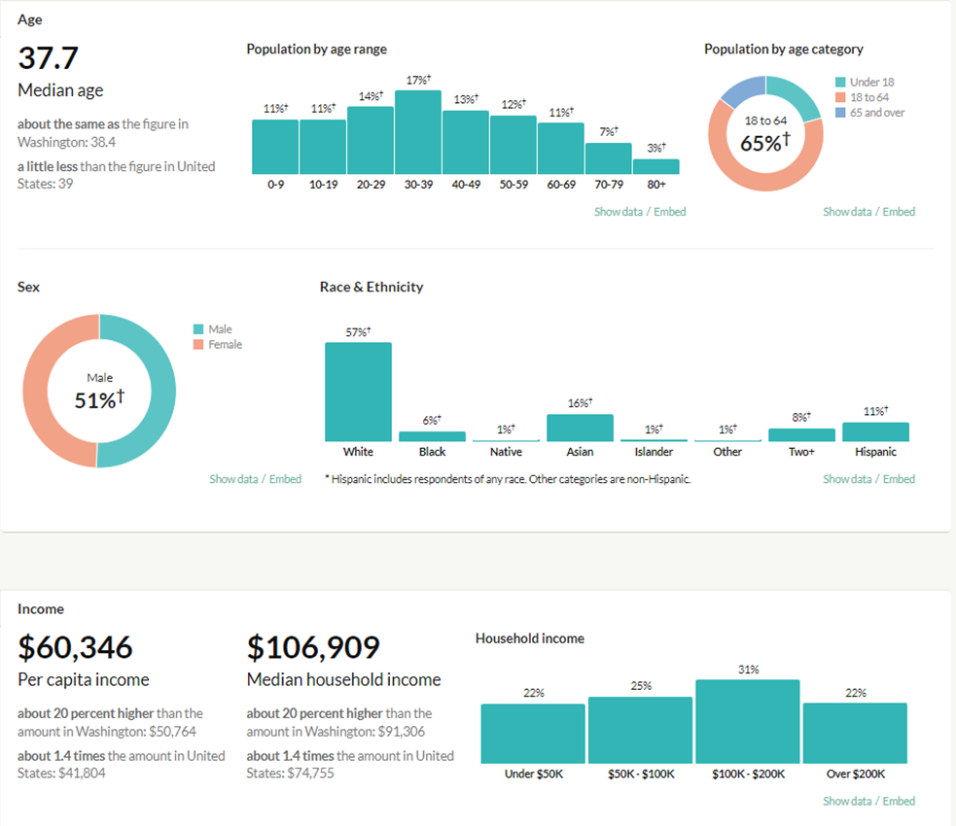
Seattle, Washington Demographics
Seattle-Tacoma-Bellevue, WA
Metro Area
Population – 4,034,248
Observations
Median Income is $106,909
31% make between $100-200K
47% make under $100K
65% of population is 18-24
68% of the population is white and Hispanic
Source : https://censusreporter.org/

Slide 15
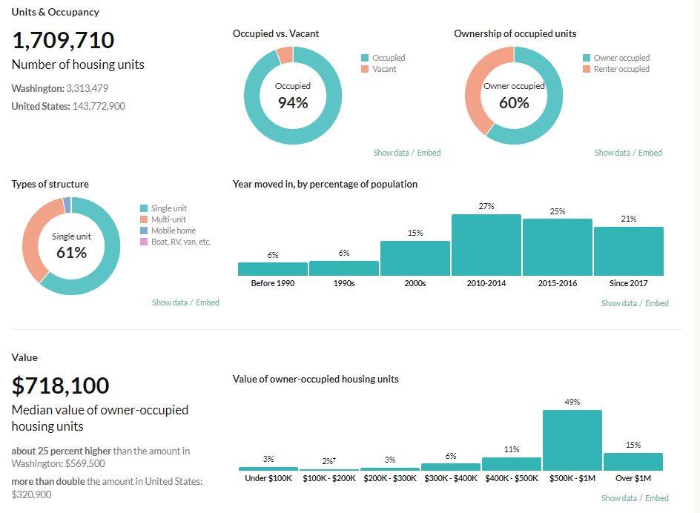
Seattle, Washington Demographics
Observations
60% of housing is owner-occupied
61% are single-unit structures
The median value is $718,100
49% of homes are valued at $500K - $1M
Source : https://censusreporter.org/

Slide 16
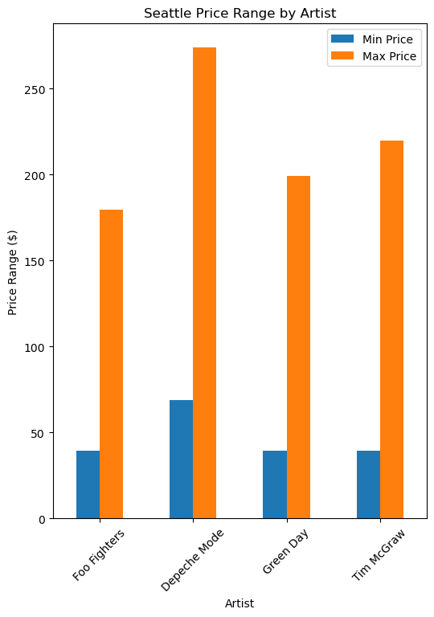

Seattle, Washington
Observations
The minimum price is similar for all artists except Depeche Mode
The maximum price is the most expensive for Depeche Mode.
The minimum price is reasonable for most of the population.
The max price would be cost-prohibitive for most of the population.
Source : https://developer.ticketmaster.com and censusreporter.org

Slide 17
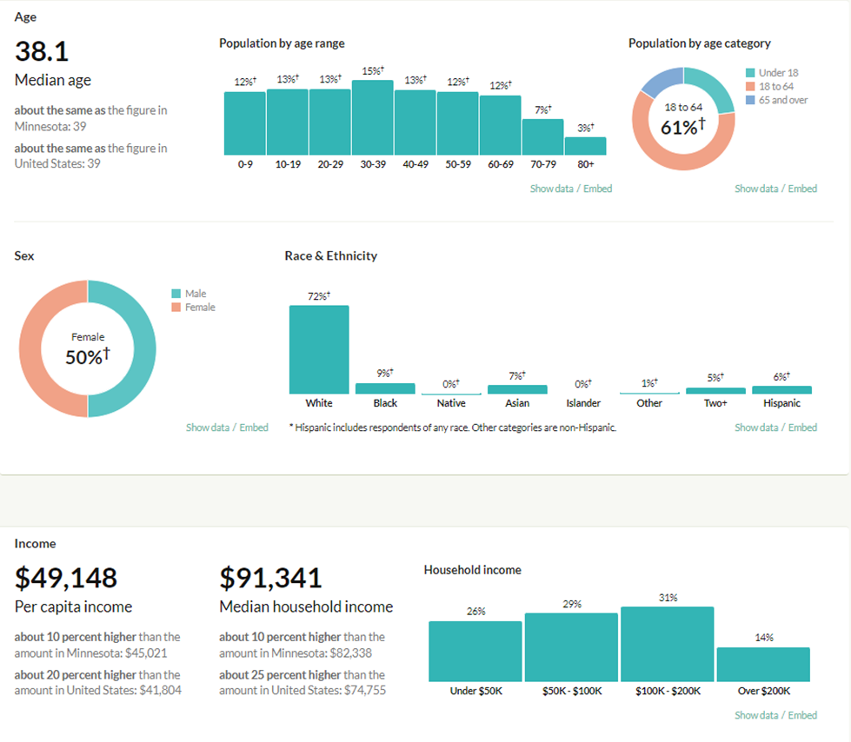
Minneapolis/St. Paul, Minnesota
Minneapolis-St. Paul-Bloomington, MN-WI Metro Area
Population – 3,693,729
Observations
Median Income is $91,341
31% make between $100-200K
55% make under $100K
61% of population is 18-24
72% of the population is white
Source : https://censusreporter.org/

Slide 18
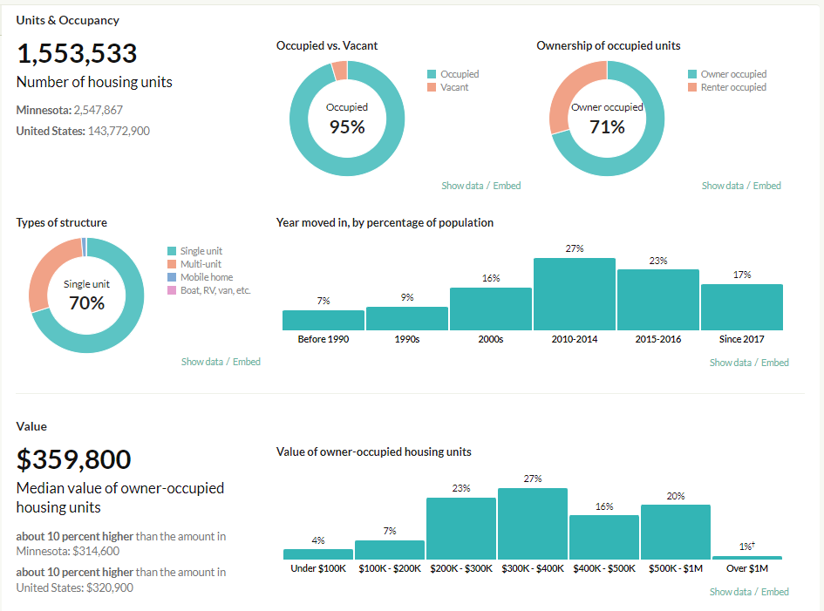
Minneapolis/St. Paul, Minnesota
Observations
71% of housing is owner-occupied
70% are single-unit structures
The median value is $359,800
The home values are more evenly spread across multiple price ranges than the other markets
Source : https://censusreporter.org/

Slide 19
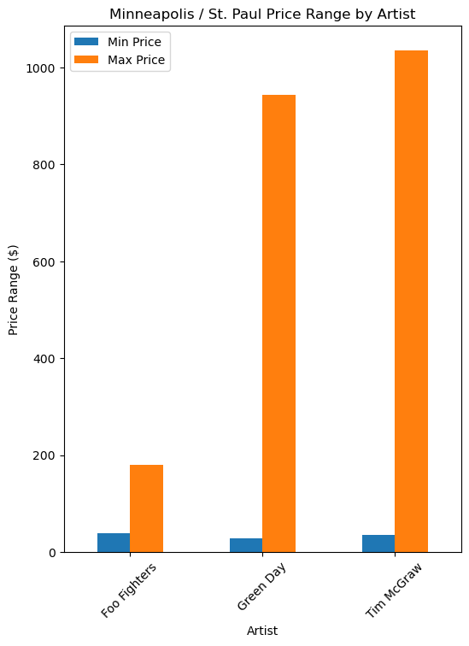

Minneapolis/St. Paul, Minnesota
Observations
The minimum price is similar for all artists.
The maximum price is the most expensive in this metro area due to VIP packages.
The minimum price is reasonable for most of the population.
The max price would be cost-prohibitive for most of the population
Source : https://developer.ticketmaster.com and censusreporter.org

Slide 20
Summary / Observations
The Minneapolis / St. Paul area is the most affordable market based on cost of living. But it had the highest ticket prices for Green Day and Tim McGraw due to VIP packages.
The Los Angeles metro area had the highest housing cost and the lowest income, but the ticket prices were still high and would be cost-prohibitive for most of the population.
Overall, the minimum ticket prices are affordable for most of the population in the markets we studied. But the highest ticket prices would be cost-prohibitive for most of the population.

