Slide 1
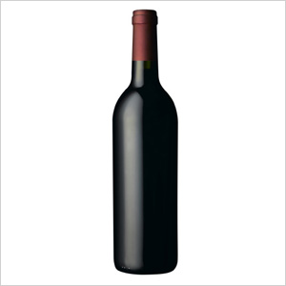
Fl@vor F@ve
Have a hankering for caramel, strawberry, or butter flavors in your wine?
Notes:
Good evening ladies and gentlemen…my name is Joe Dziados and tonight I am excited to talk to you about… FLAVOR FAVE; an interactive wine search tool that uses crowd-sourced customer reviews to find wines booming with flavors you want to taste.

Slide 2

Review Snippet
Retained a mossy quality, with distinct pencil shavings.
Notes:
We have all seen some wording in wine reviews that have been, at the very least, confusing. I wanted to create something in which you don’t need an advanced degree in wine speak in order to find wines that match what flavors you are in the mood for. I don’t want to find a wine with one review mentioning grapefruit….I want to find a wine that has many reviews mentioning the presence of grapefruit so I can have more confidence in what I’ll be tasting.

Slide 3

Where to begin: Mongo DB
Dataset of 28,000 wines that have 15 or more reviews
“Bag-of-words” model, TF-IDF
Large Dimensions
Notes:
To start, I created a Mongo database of 2,000,000 reviews on 500,000 wines. I then shrunk the dataset down to 28,000 wines each having 15 reviews or more. Using sci-kit learn, I converted the reviews to a bag of words model and used tf-idf to weight important terms. This resulted in a large dimensionality problem.

Slide 4
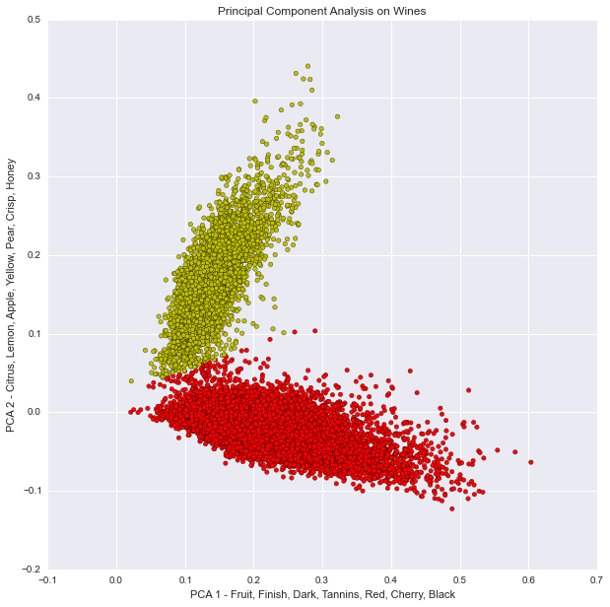
Principal Component Analysis - Visually
Notes:
To address this dimensionality issue, I used sci-kit learn’s truncated svd to perform principal component analysis on the reviews. I began by breaking the reviews down to their two principal components as you can see in the diagram above. Principal component 1 on the x-axis contains words like fruit, dark, and red while principal component 2 on the y-axis contains words like citrus, lemon, and yellow. The data can be separated linearly quite well.

Slide 5

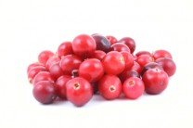
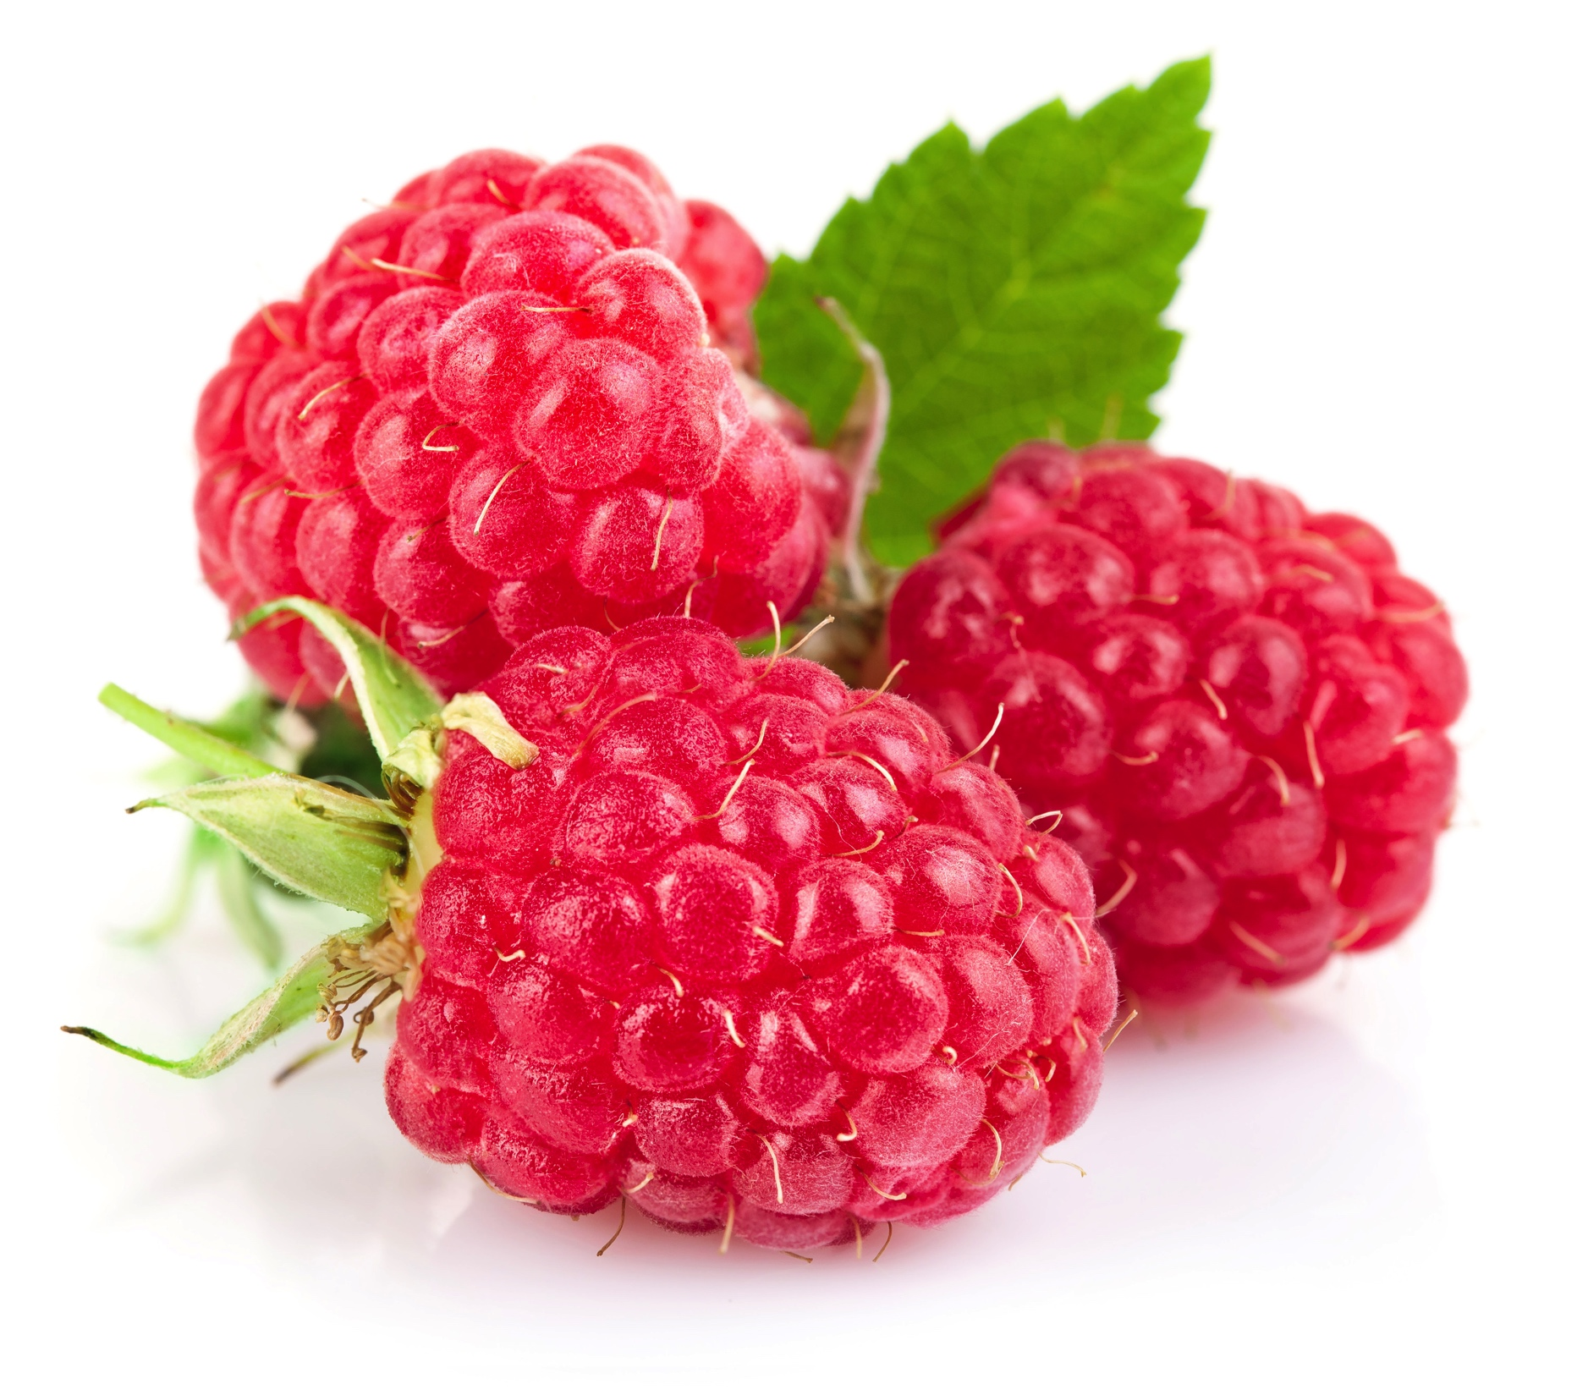
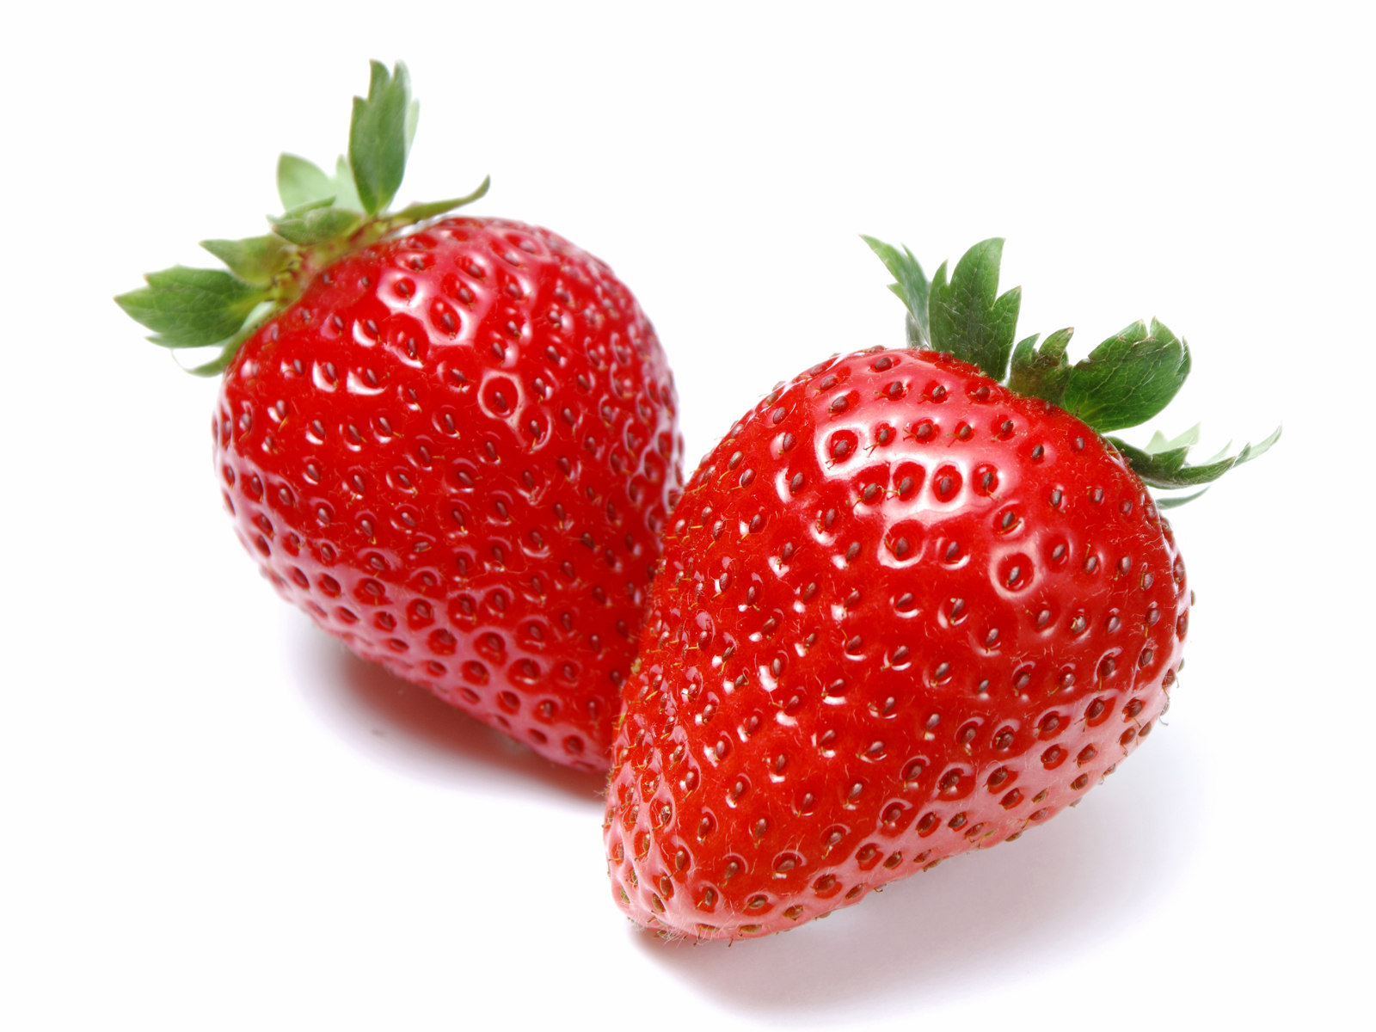
Topic Modeling – L.D.A.
raspberry + strawberry + pinot + tart + bright + cola + floral + fresh + cranberry + beautiful
Notes:
The next step wss to figure out what kind of flavors were prevalent in the review corpus.. Using Latent Dirichlet Allocation from gensim, I ran topic modeling on the reviews to try to extract important keywords or topics for different kinds of wines to offer the user.

Slide 6
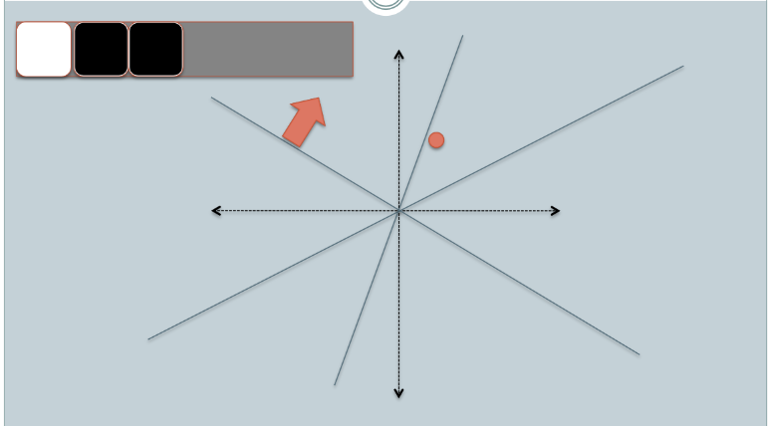
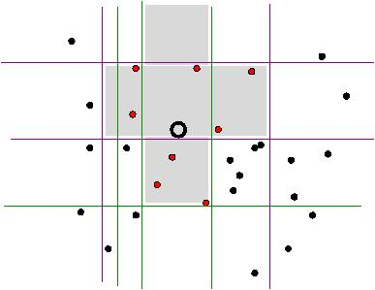
Locality Sensitive Hashing
Break down review text to 25 principal components
Find similar reviews based on flavor input
Notes:
Finally, I use sci-kit learn’s locality sensitive hashing forest to create a space of all wine reviews. Once I receive flavor words from the user, I am able to find the most similar wines and their reviews to the flavors mentioned.

