Slide 1
Wine Time
An exploration of flavors through crowd-sourced customer reviews.

Slide 2
Review Snippets
Tobacco and tar flavours are supported by a an expressive mineality of forest soil and graphite.
Retained a mossy quality, with distinct pencil shavings.
On the palate, medium weight, medium length, but sweet and seductive for about an hour.

Slide 3
Where to begin:
Over 2 million wine reviews on almost 500,000 wines
Dataset reduced to almost 30,000 wines that have 15 or more reviews
Convert reviews to a bag or words model
Results in a matrix of approximately 28,800 x 4,200,000
Curse of Dimensionality!!!

Slide 4
Principal Component Analysis to the Rescue
Principal Component 1:
'fruit’, 'finish', 'good', 'dark', 'nice', 'palate’, 'tannins', 'red', 'cherry’, 'black’)
Principal Component 2:
'citrus', 'lemon', 'apple', 'yellow', 'pear', 'crisp', 'honey', 'tropical', ‘champagne', 'acidity’

Slide 5
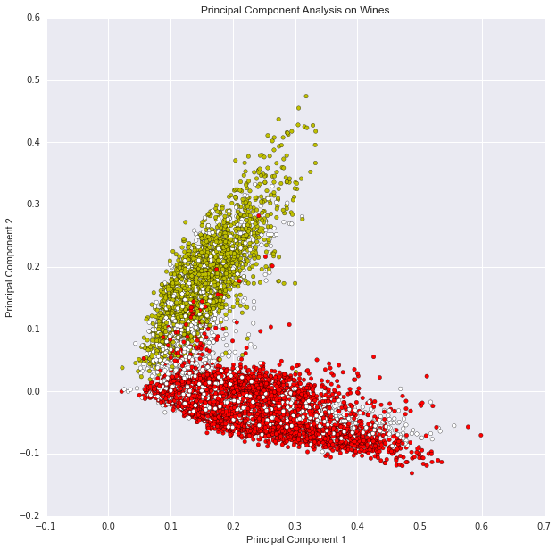
Principal Component Analysis - Visually

Slide 6
Topic Modeling – Red Wines
0.014*syrah + 0.009*heat + 0.007*night + 0.007*smoke + 0.007*blueberry + 0.006*hot + 0.005*licorice + 0.005*decant + 0.005*note + 0.005*raspberry
0.013*cab + 0.010*cassis + 0.008*merlot + 0.008*beautiful + 0.007*decant + 0.007*cabernet + 0.007*currant + 0.006*silky + 0.006*mocha + 0.006*wonderful
0.155*zin + 0.039*zinfandel + 0.018*raspberry + 0.018*jammy + 0.016*ridge + 0.015*carlisle + 0.010*bramble + 0.009*fruity + 0.008*peppery + 0.007*heat
0.016*raspberry + 0.015*strawberry + 0.013*pinot + 0.012*tart + 0.011*bright + 0.011*cola + 0.008*floral + 0.007*fresh + 0.007*cranberry + 0.006*beautiful
0.015*bordeaux + 0.012*vintage + 0.010*cassis + 0.010*fresh + 0.010*tobacco + 0.009*cedar + 0.009*elegant + 0.008*coffee + 0.007*floral + 0.007*fine
0.023*chianti + 0.015*sangiovese + 0.015*italian + 0.013*food + 0.010*leather + 0.009*pasta + 0.008*barbera + 0.007*dry + 0.007*tobacco + 0.007*tuscan

Slide 7
Topic Modeling – White Wines
0.021*orange + 0.015*caramel + 0.013*apricot + 0.011*oak + 0.011*sugar + 0.011*sweetness + 0.010*dessert + 0.009*spice + 0.008*vanilla + 0.007*alcohol
0.033*grapefruit + 0.015*summer + 0.009*stone + 0.009*blanc + 0.009*sb + 0.008*lime + 0.008*qpr + 0.007*grass + 0.007*previous + 0.007*consistent
0.015*sweetness + 0.009*petrol + 0.008*lime + 0.006*young + 0.006*pineapple + 0.006*beautiful + 0.006*wonderful + 0.005*length + 0.005*orange + 0.005*muscadet
0.025*oak + 0.015*chardonnay + 0.009*vanilla + 0.008*pineapple + 0.008*buttery + 0.008*butter + 0.008*qpr + 0.007*smooth + 0.007*chard + 0.007*style
0.016*sweetness + 0.012*lime + 0.009*petrol + 0.008*stone + 0.006*kabinett + 0.006*slate + 0.006*beautiful + 0.006*spicy + 0.005*simple + 0.005*riesling
0.046*strawberry + 0.020*champagne + 0.019*cherry + 0.012*orange + 0.011*rosé + 0.011*raspberry + 0.011*pink + 0.010*rose + 0.009*beautiful + 0.009*berry

Slide 8
Locality Sensitive Hashing
Get various flavor input from users.
Use that text to find the similar text in our crowd-sourced review data.
Reduce review text to 25 principal components.

