Slide 1
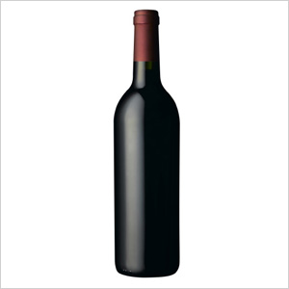
Fl@vor F@ve
Have a hankering for caramel, strawberry, or butter flavors in your wine?
Notes:
Good evening ladies and gentlemen…my name is Joe Dziados and tonight I am excited to talk to you about… FLAVOR FAVE; an interactive wine search tool that uses crowd-sourced customer reviews to find wines booming with flavors you’d like to experience.

Slide 2

Review Snippet
'Very good fruity and good finish Nose of honeysuckle. Thick on the palate, with a pretty heavy dose of oak.. Good floral and citrus, but heavy, heavy oak masked an abundant alcoholic burn. Too overbearing. This wine tastes alot like Conundrum-- tropical/melon on the nose, golden in color, creamy. A buttery chardonnay of medium body, though tongue coating. Honeyed-peach and tropical fruit notes and toasted oak. Quite enjoyable. sweet fruit, great with ham, one of my favorite chards. Medium-to-full bodied with a healthy dose of tropical fruits, butter and oak on the palate
Notes:
For this project, I wanted to explore wines and their reviews for a couple of reasons. 1.) I love drinking and learning about wine. 2.) Wine reviews have always fascinated me with their attention to detail and almost poetic descriptions. I ultimately decided to focus on the descriptions of flavors in the reviews, whether it is in the aroma or taste. I have had wines where the flavors have been intense and enjoyable and increased the experience of drinking it especially with the right kind of food. I decided to create a tool that people can use to pick flavors they’d like to experience and return great wines that can match that experience.

Slide 3

Where to begin: Mongo DB
Start with 2,000,000 wine reviews
End with 28,000 wines that have 15 or more reviews
“Bag-of-words” model, TF-IDF
Large Dimensions
Notes:
To start, I created a Mongo database from a text file of 2,000,000 reviews on 500,000 wines from CellarTracker.com. I then curated the dataset down to 28,000 wines each having 15 reviews or more. Using sci-kit learn, I converted the reviews to a bag of words model and used tf-idf to weight important terms. This created a dimensionality issue.

Slide 4
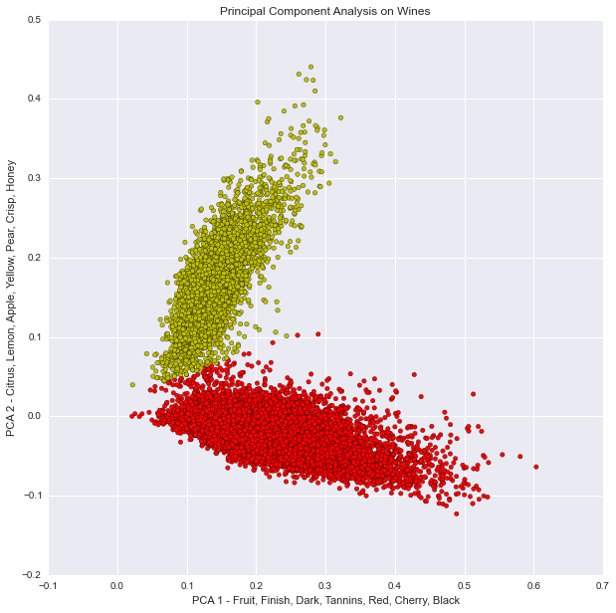
Principal Component Analysis - Visually
Notes:
To address this issue, I used sci-kit learn’s truncated svd, which is very similar to principal component analysis, to reduce the dimensions to feature components that contain the most variation. I broke the reviews down to their two principal components as you can see in the diagram.
I began by breaking the reviews down to their two principal components as you can see in the diagram above. The x-axis has features like fruit, dark, and red while the y-axis has features like citrus, lemon, and yellow. The data can be separated linearly quite well.

Slide 5

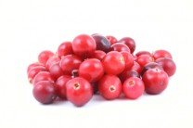
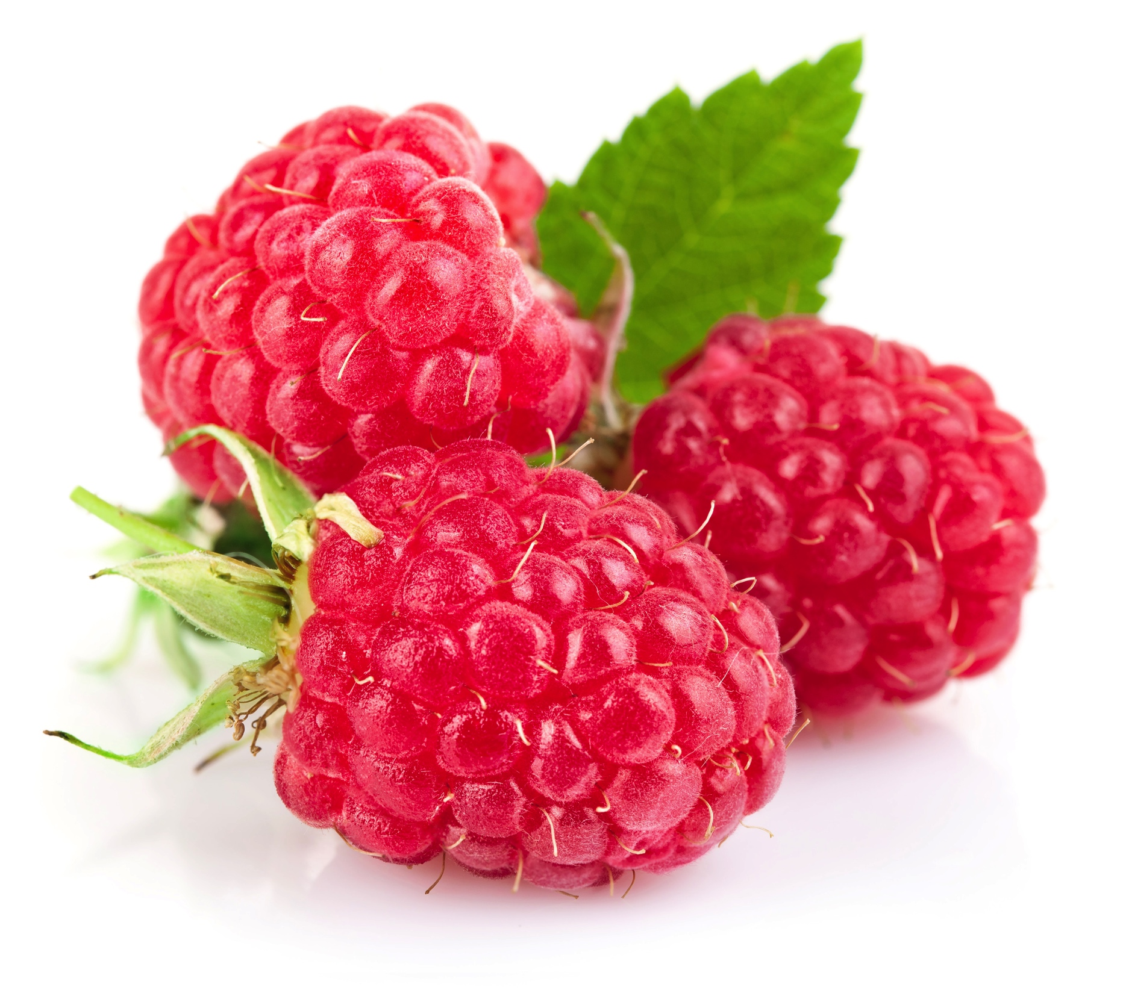
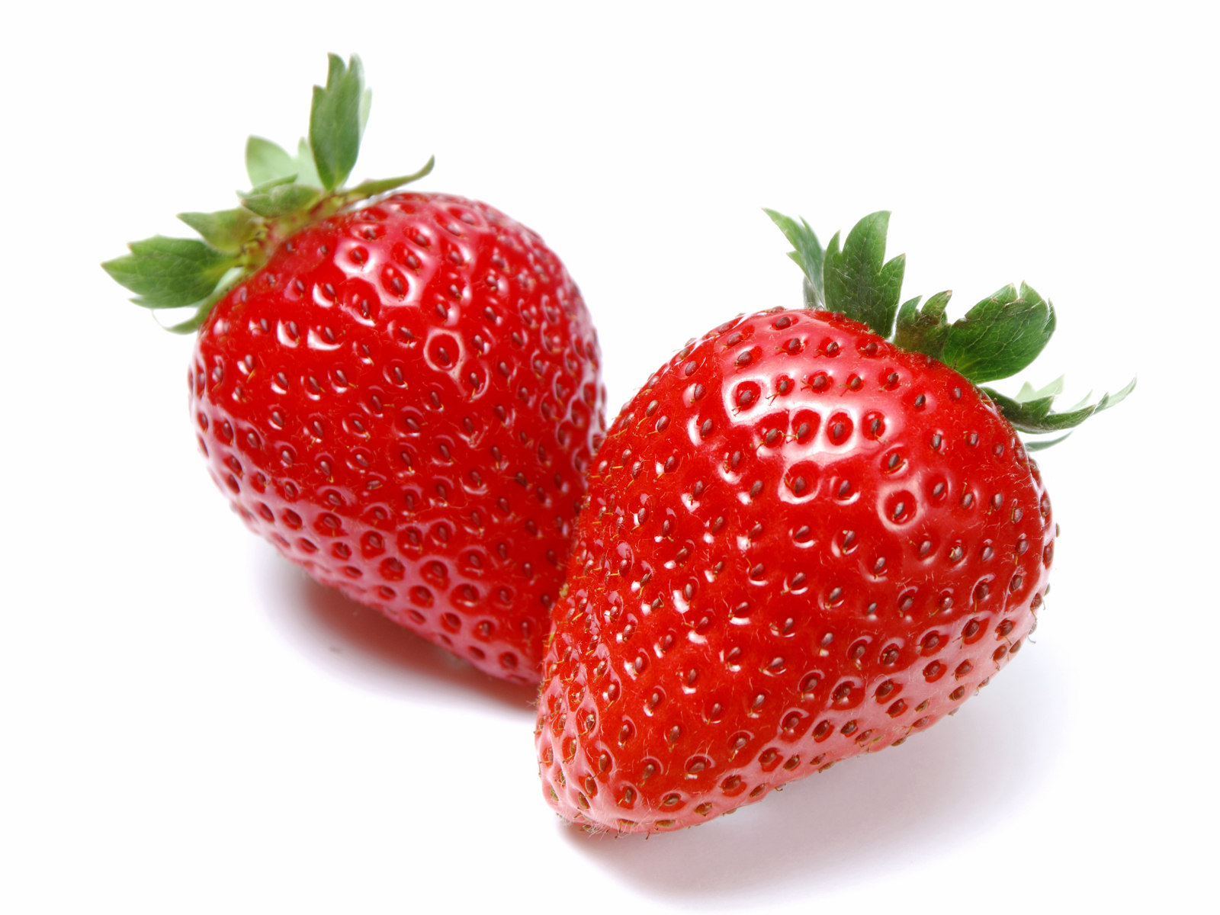
Topic Modeling – L.D.A.
raspberry + strawberry + pinot + tart + bright + cola + floral + fresh + cranberry + beautiful
Notes:
The next step was to figure out what kind of flavors were prevalent in the review corpus.. Using Latent Dirichlet Allocation from gensim, I ran topic modeling on the reviews to try to extract common flavors for different kinds of wines as well as see which flavors tend to show up together.

Slide 6
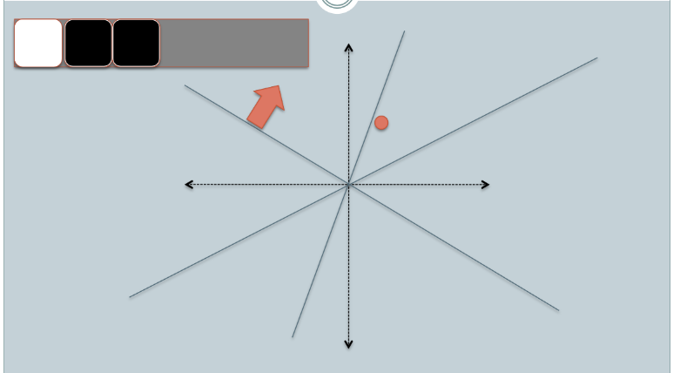
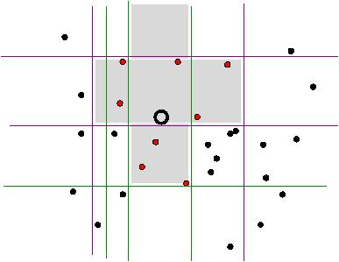
Locality Sensitive Hashing
Break down review text to 25 principal components
Find similar reviews based on flavor input
Notes:
Finally, I used sci-kit learn’s locality sensitive hashing forest to create a space of all wine reviews. Once I receive flavor preferences from the user, I am able to find the most similar wines and their reviews to the flavors mentioned.

Slide 7



Contact Info.
joedziados@gmail.com
jodzi.github.io
github.com/jodzi

