Slide 1




The British Effect
Aragon Soma Entertainment
VS.

Slide 2
Problem
U.K. gross for our movies has been stagnant for the past few years.
We want to establish a larger audience.
Goal is to maximize foreign revenue in the U.K.
Can we do anything to realize this goal?

Slide 3
The Data
Source: Box Office Mojo, Wikipedia
Dataset: 1300 U.S. Movies, 1600 British actors/actresses
Attributes: Title, U.S. Domestic Gross, Budget, Genre, British/Not British
Predict: U.K. Total Gross

Slide 4
The Data
U.K. Aggregate Gross for all movies without a British actor:
$7.3 Billion
Approx. 800 movies
U.K. Aggregate Gross for all movies with a British actor:
$6.2 Billion
Approx. 500 movies

Slide 5
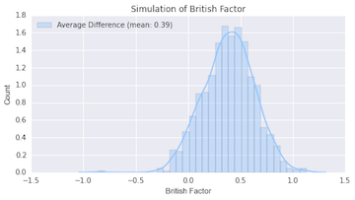
Analysis
Prediction Variables:
Budget
Genre
British/Not British
Analyze 1000 Simulations

Slide 6


Results
British Actor = 50% more U.K. rev
Which should we choose?

