Slide 1
Paisley
Final Report
April 14th, 2020

Slide 2

Physical Access Control
+
Can a blockchain network handle real-time access control authorization?
Is the security improved?
Can it handle long-term storage requirements?

Slide 3





Security Model
PRINCIPALS:
- ID
- NAME
-ROLES[]
RESOURCES:
- ID
- NAME
- TAGS[]
ACCESS CONTROL POLICIES:
- DEFAULT DENY
- PRINCIPAL → RESOURCE
- PRINCIPAL → TAG[]
- ROLE[] → RESOURCE
- ROLE[] → TAG[]

Slide 4
Security Model
Features:
- Generalized Security Model + Decentralized Contracts allows for
extensible security functions. Able to manage physical and digital access in
one system
- Client functionality is split into two services: Admin and Access Point. Admin
applications can manage principals, resources, and policies. Access Points
can only issue access transactions
- Mutual TLS Authentication ensures only trusted peers, orderers, and clients
can perform actions on the network. All access point clients have a unique
identity that associates them with resources that they can provide access to
- Hyperledger provides a total ledger history which can be audited:
- Complete location history for a principal
- Current resource allocation state
- History of all policy creation, updates, and removals
- etc.

Slide 5
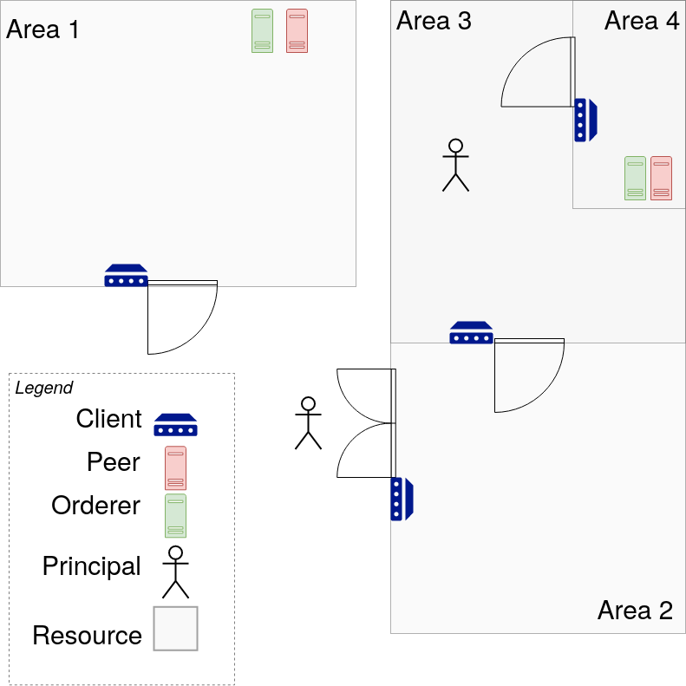
How it Works
Scenario:
An Employee (principal)
wants to access a
restricted area (resource)

Slide 6
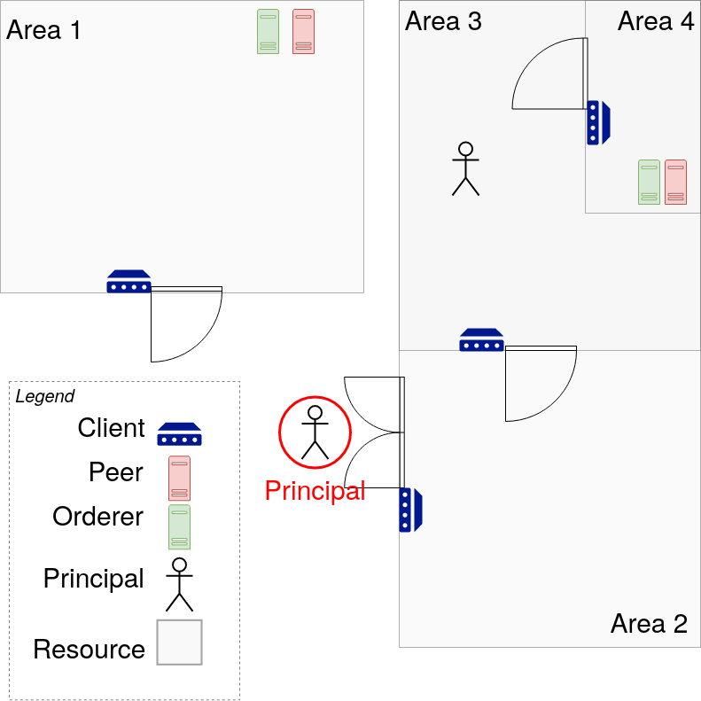
How it Works
Scenario:
An employee (principal)
wants to access a
restricted area (resource)

Slide 7
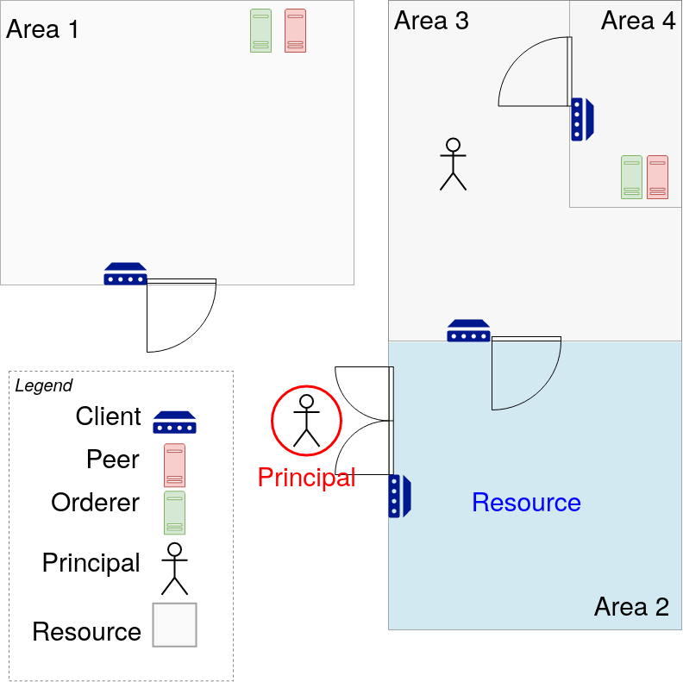
How it Works
Scenario:
An employee (principal)
wants to access a
restricted area (resource)

Slide 8
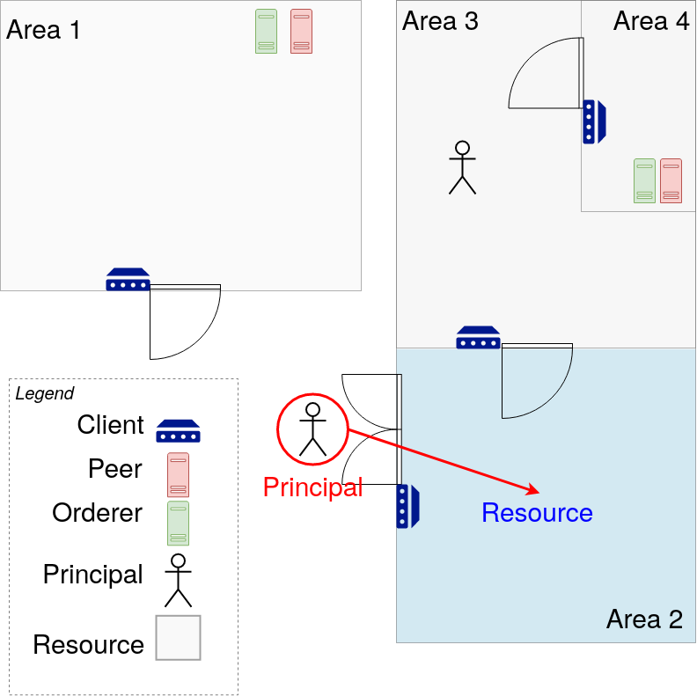
How it Works
Scenario:
An employee (principal)
wants to access a
restricted area (resource)

Slide 9
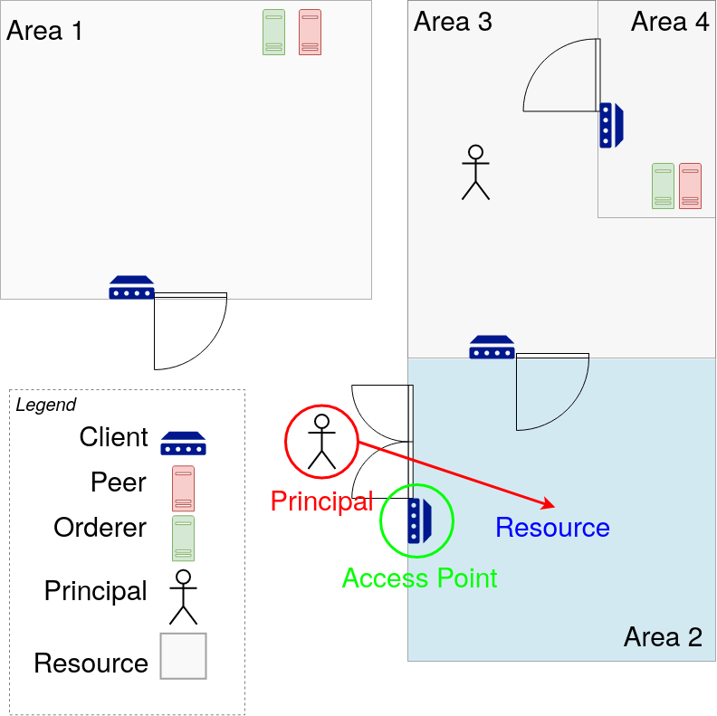
How it Works
Step 1:
Employee presents
authentication (card, phone,
ID number etc.) to the access
point device

Slide 10
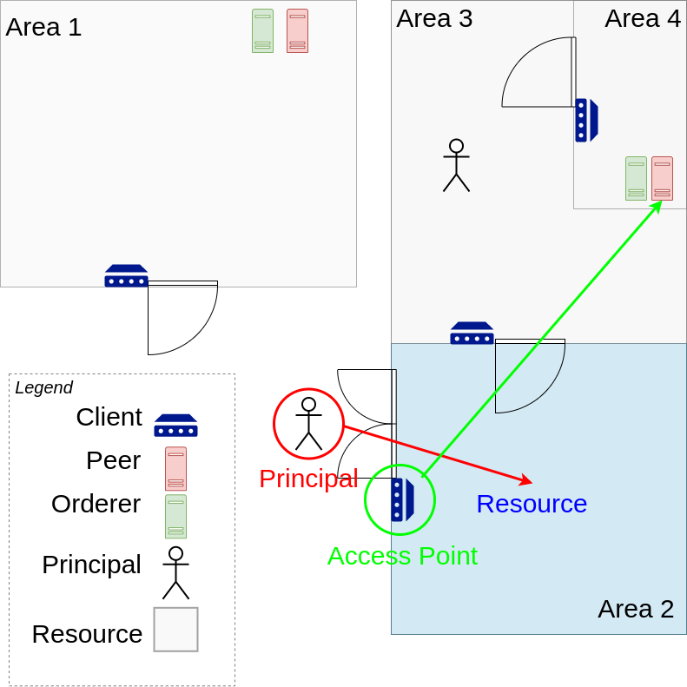
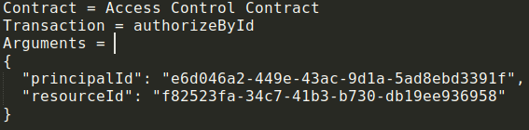
How it Works
Step 2:
Access point issues a
transaction proposal to a
peer node running the
Paisley chaincode

Slide 11
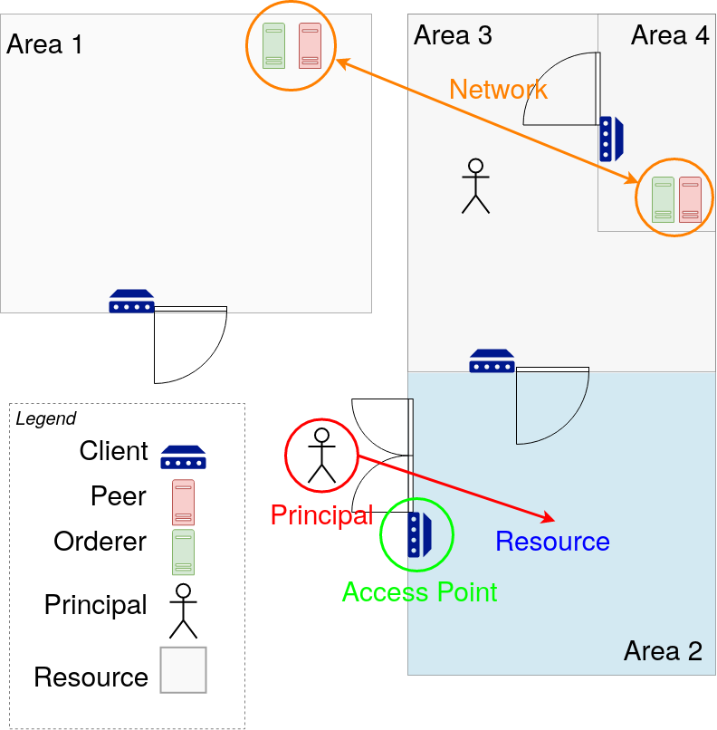
How it Works
Step 3:
Hyperledger Fabric processes
the transaction, verifies any
peer endorsements, and
achieves orderer consensus
before committing the
transaction to the ledger

Slide 12
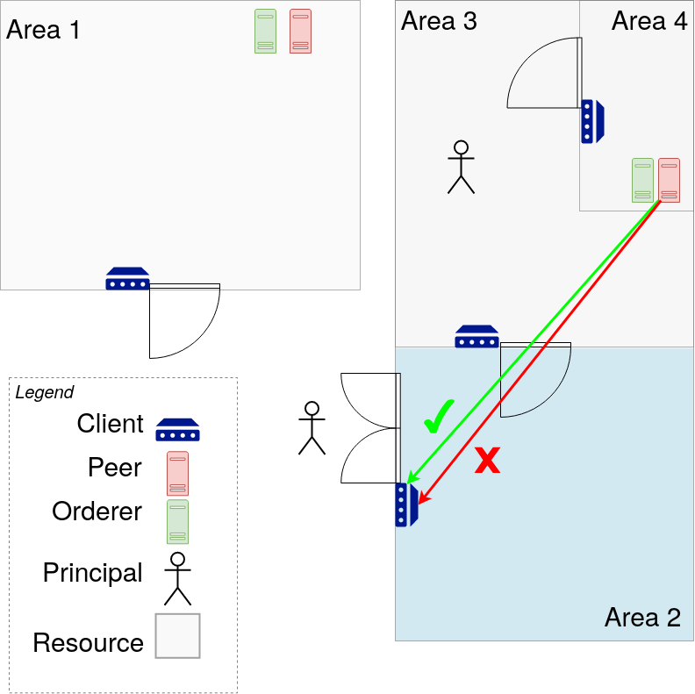
How it Works
Step 4:
The result of the transaction
is sent back to the access
point client (approve or deny)

Slide 13
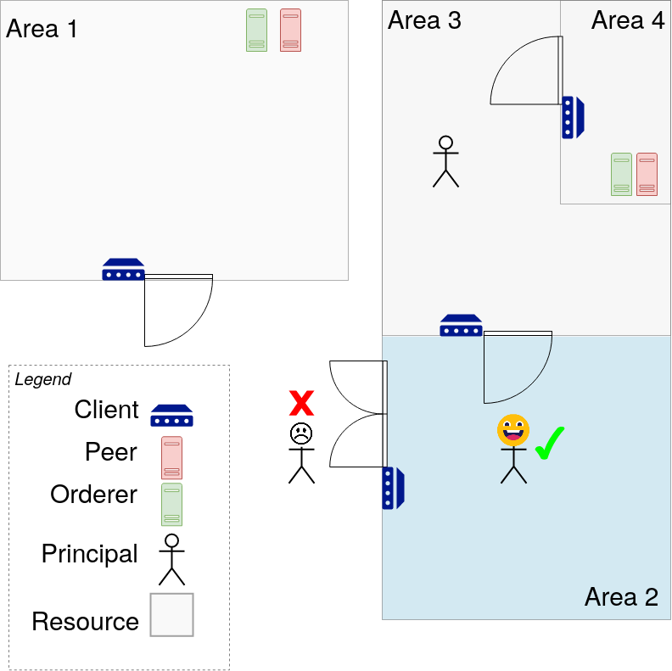
How it Works
The employee can enter the
area if the set of policies
permit it, and is denied
access if they don’t.

Slide 14
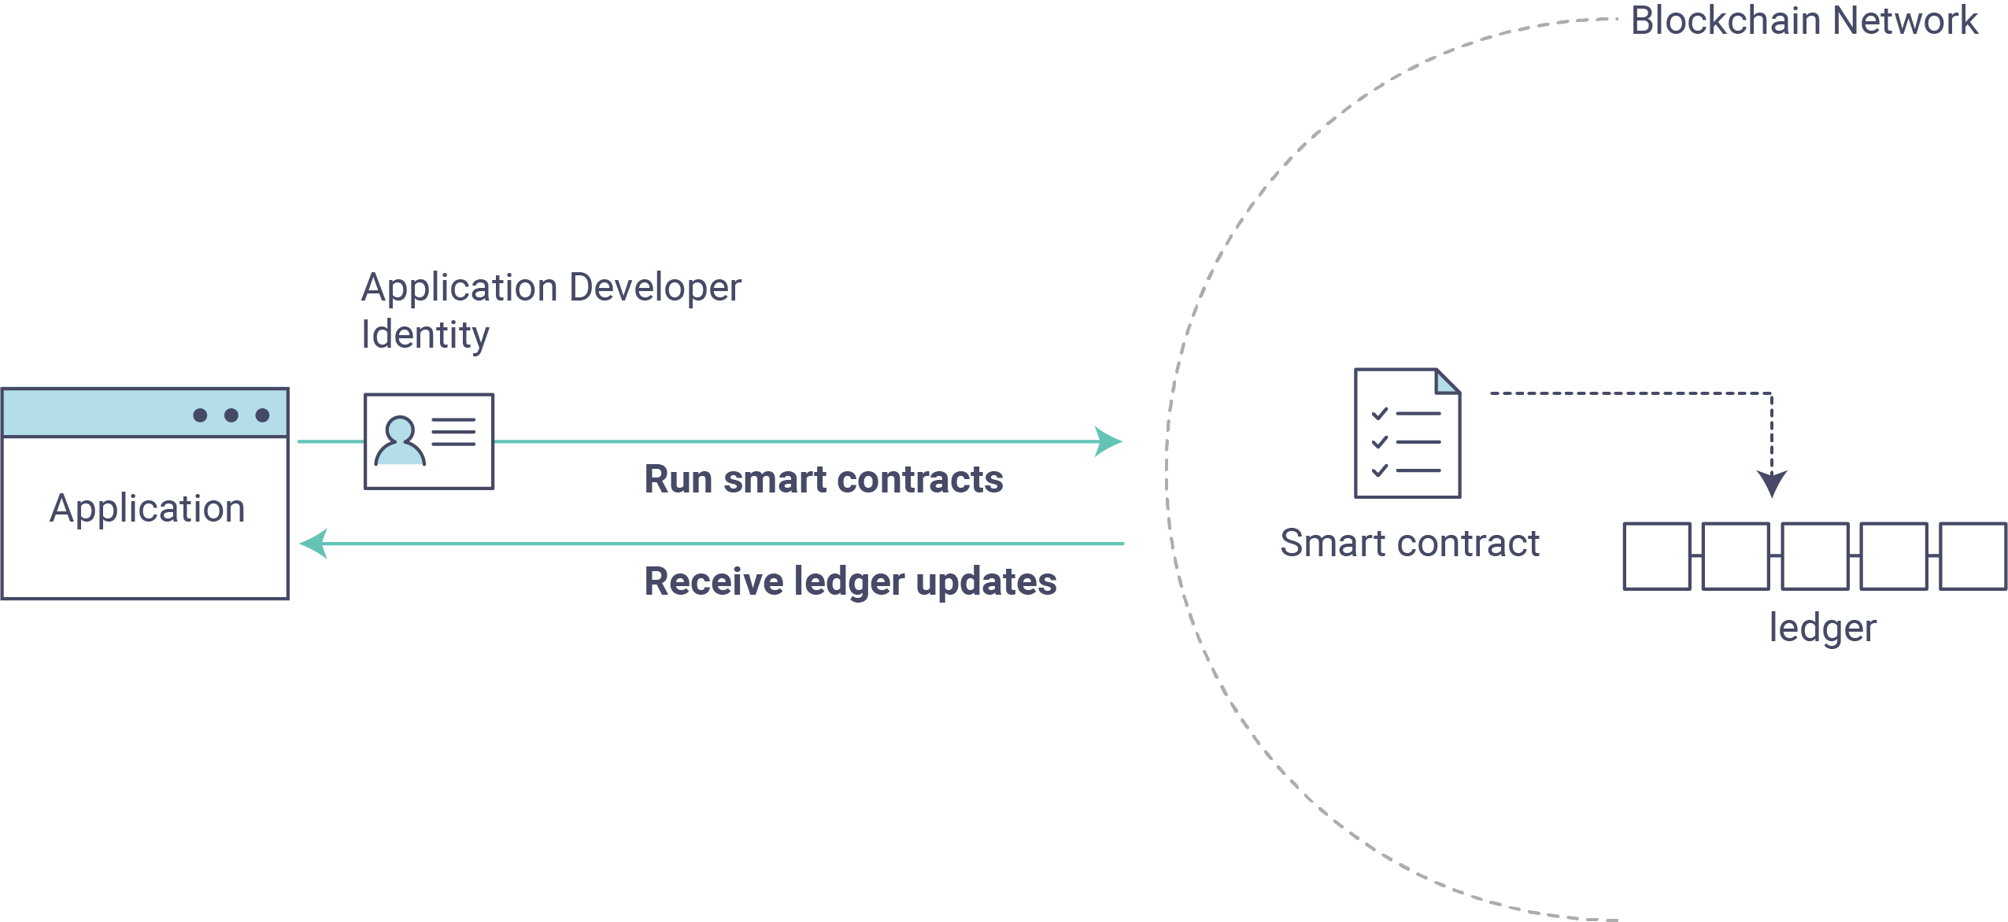

What is Paisley?
Clients:
- Access Point
- Admin
Chaincode:
- Principal contract
- Resource contract
- Policy contract
- Access control contract

Slide 15
Results: Performance
Time for client authorization event
Setup:
  Local deployment (Docker)
  1 Peer Endorsement
  1 Orderer
Client Verify Commit? | Avg. Submit Time (s) | Avg. Commit Time (s) | Avg. Response Time (s)
Yes | 2.1 | 2.1 | 2.1
No | 0.07 | 2.1 | 0.2

Slide 16
Results: Performance
Time for client authorization event
Setup:
  Local deployment (Docker)
  1 Peer Endorsement
  5 Orderers
Client Verify Commit? | Avg. Submit Time (s) | Avg. Commit Time (s) | Avg. Response Time (s)
Yes | 2.1 | 2.1 | 2.1
No | 0.03 | 2.0 | 0.16

Slide 17
Results: Security
Advantages | Disadvantages
Strong confidentiality and integrity integrated into the system through the use of Hyperledger Fabric | Very complicated to develop, deploy, and maintain. Hyperledger Fabric has a lot of required configuration
Accountability achieved through complete tracking of all actions on the network through use of a distributed ledger | Long running applications will require large storage requirements
Can be tuned to perform real-time access authorization in a reasonable amount of time. | The high security of Paisley is unnecessary for most business applications
Network is decentralized and uses zero-trust mutual TLS communication. Strong fault-tolerance, resistance to insider threats.
Can split up network into multiple organizations and channels in a multi-enterprise environment

Slide 18
Questions?

