Slide 1
Data 780 - NFL Draft Strategy and Trends
Joe Bryant

Slide 2
Problem Statement
Evaluating long-term success of NFL draft picks can be difficult by just looking at statistics alone
Analysts or fans need a more simple way to explore draft strategies and career performance
This project provides an interactive tool to discover those patterns

Slide 3
Project Design
Streamlit Dashboard
Interactive app using Streamlit with custom team logos and color and a clean, responsive interface. Includes year and team-based filtering options in the sidebar.
Draft Overview
League-wide overview of drafting patterns and position selections round by round, enabling the user to discover high-level trends in historical draft data.
Team Specific Analytics
Uses a Weighted Approximate Value indicator to highlight team-specific player performance and assign an overall draft grade to each team for a particular year.

Slide 4
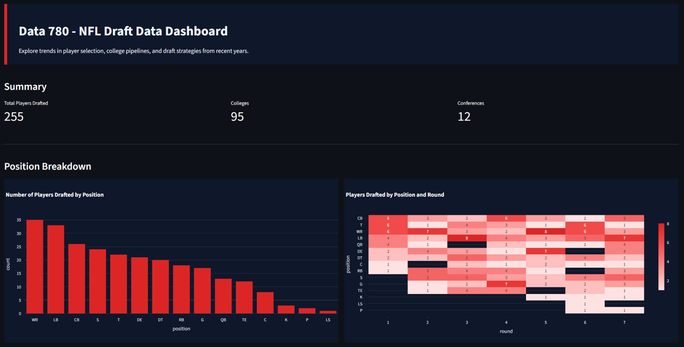
Live Demo
https://github.com/joe-bryant8/760-Draft-Picks

Slide 5
Q/A
Joe Bryant

