Slide 1

NACAP 2022 Figure Frenzy Graphs
NACAP Data Committee
Significant =

Slide 2
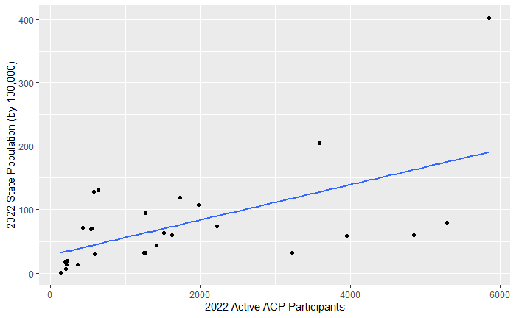
2022 ACP Active Participants vs. 2022 State Population (by 100,000)
Correlation = 0.582

Slide 3
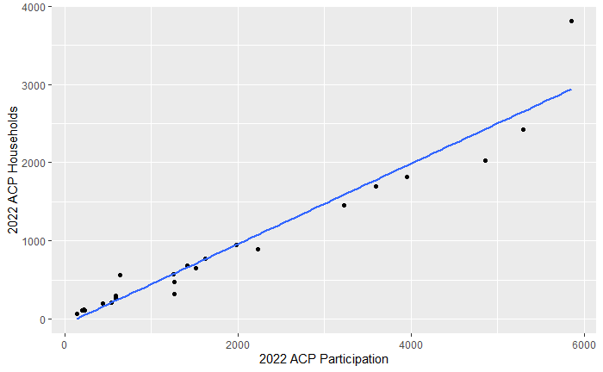
2022 ACP Active Participants vs. 2022 ACP Households
Correlation = .9663

Slide 4
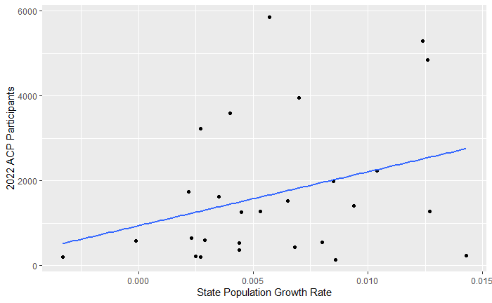
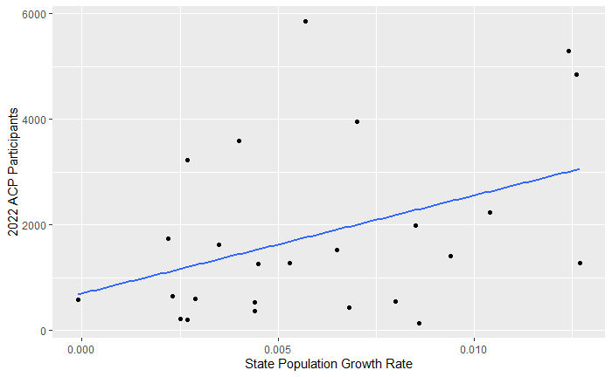

2022 ACP Active Participants vs. State Population Growth Rate
Correlation = 0.3200
Correlation = 0.3942
*without outliers

Slide 5
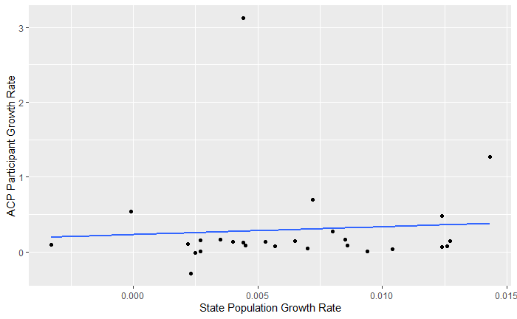
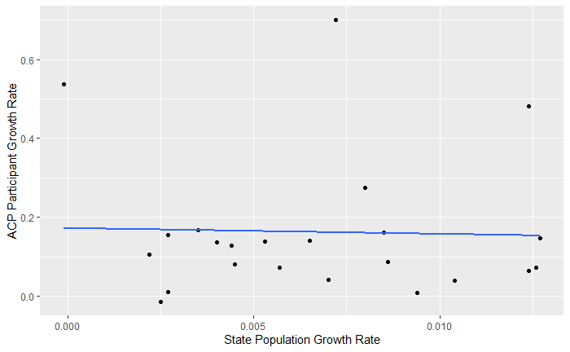
2022 State Growth Rate vs. ACP Participant Growth Rate
Correlation = 0.0715
Correlation = -0.0313
*without outliers

Slide 6
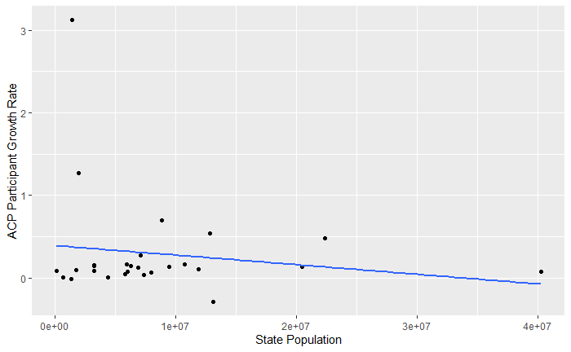
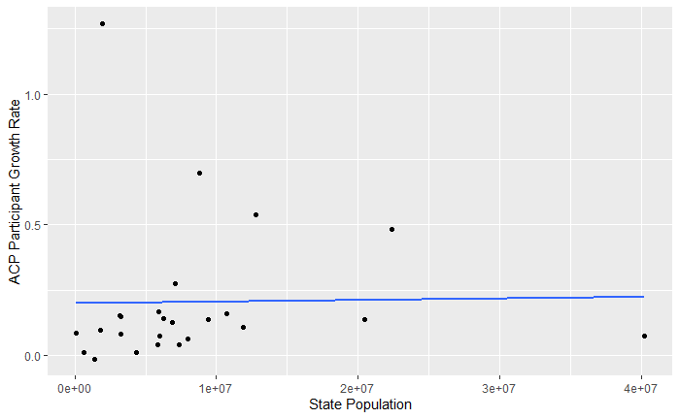
2022 State Population vs. ACP Participant Growth Rate
Correlation = -0.1545
Correlation = 0.01859
*without outliers

Slide 7
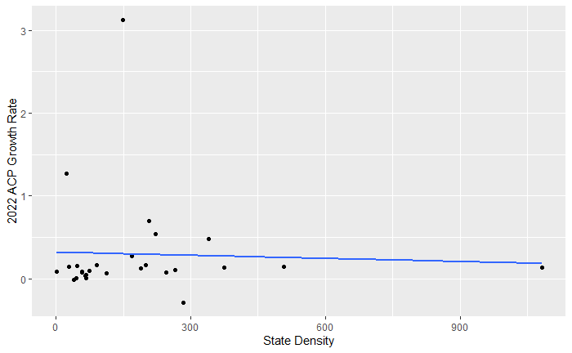
State Population Density vs. ACP Household Density
Correlation = -0.04035

Slide 8
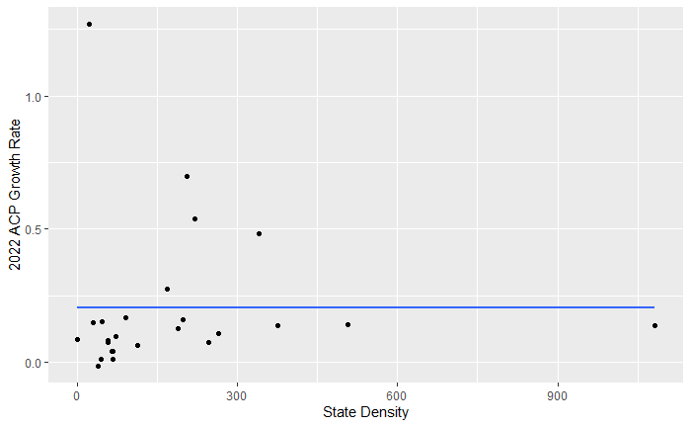
State Population Density vs. 2022 ACP Growth Rate
Correlation = -0.0430
Correlation = -0.0003737
*without outliers

