Slide 1
NACAP 2022 Figure Frenzy Graphs
NACAP Data Committee

Slide 2
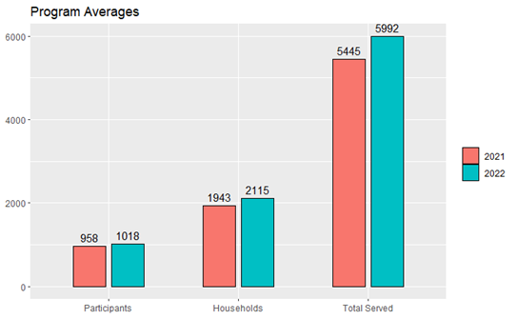
Figure 1: This figure depicts the collective NACAP averages for Participants, Households, and Total Served to date. The bars in red represent the averages from the 2021 Figure Frenzy while the bars in blue represent those from the 2022 Figure Frenzy.
**if you need something additional to write about, last year we had a decrease in average participants and households due to adding new programs that brought the collective averages down, but this year it is shown that now they are a part of helping bring them back up.

Slide 3
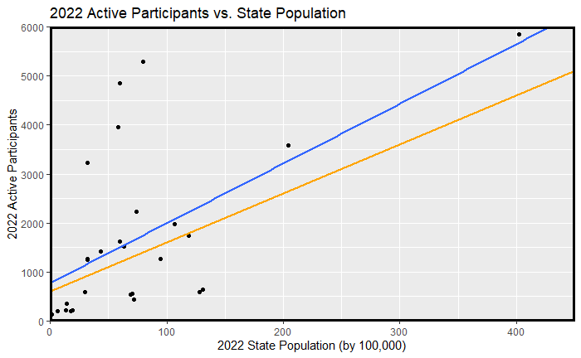
y = 0.0278x + 28.287 R² = 0.3384
y = 0.0311x + 29.786 R² = 0.368
Figure 2: This scatterplot represents the 2022 Active Participants per Capita for each state. The blue line represents the 2022 average trend for Participants based on a state’s population, while the orange line represents the same thing, but for 2021. As you can see the trend has increased this year, most likely due to the newer programs starting to break out of the first stages of growth that all new states go through. We did see a slight decrease in overall correlation; however, we had 1 more state reporting in this year compared to last as well as 4 states who reported last year, not report this year.
**I am going to be flipping the axes to better represent the trend. It will not change the correlations or significance, but it does look better, IMO.

Slide 4
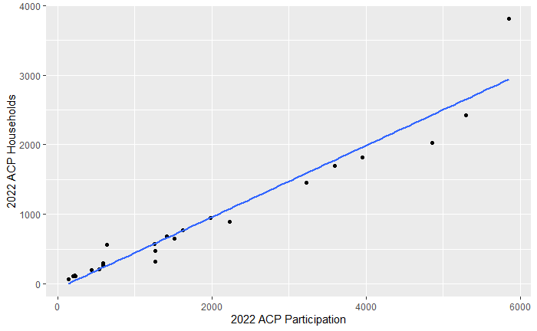
2022 ACP Active Participants vs. 2022 ACP Households
Correlation = .9663
Figure 3: This scatterplot represents the 2022 Active Participants vs. Active Households. More simply, the average number of participants living in a household per state. The takeaway from this graph is that despite a wide variety of state populations, densities, and program constrictions, almost all states experience the same amount of participants per household, with the exception of California all the way at the top.
**let me know if this one needs further explanation, it has by far the highest correlation and significance so I would like to keep it. This graph will also be getting a touch up.

Slide 5
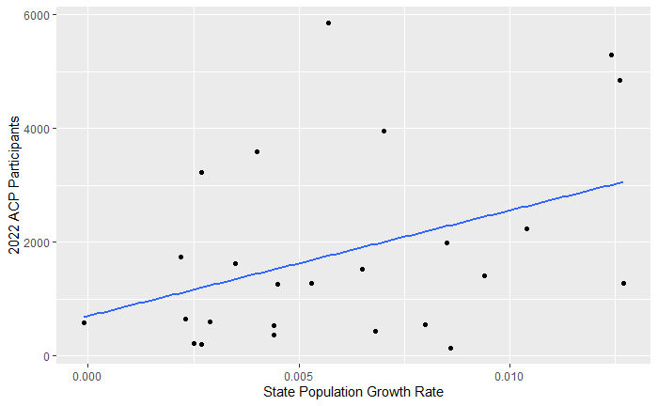
2022 ACP Active Participants vs. State Population Growth Rate
Correlation = 0.3942
Washington
Colorado
Nevada
Figure 4: This scatterplot represents the 2022 Active Participants vs. State Population Growth Rates. The significance of this graph is that while overall population size of a state is an indicator of ACP participation, the growth rate of the state is also an influencing factor. For those states that are seeing high rates of growth in the coming years, such as Nevada, Washington, and Colorado, there could be a commensurate increase in ACP participation.
**I understand that this is the shakiest of the explanations and graphs. I would only keep this one in the report if you are considering doing a food for thought addendum to the article. If that is your intent, please let me know. I have some serious touching up to do on this one, and I would like to try it as a multiple regression, potentially in 3 dimensions if I am able to.

