Slide 1
Pycrash Guide
Joe Cormier

Slide 2
Introduction

Slide 3
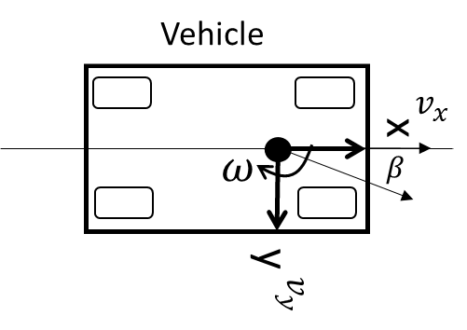
Coordinate Systems – SAE J211
Global
X
θ
+ heading angle
Y

Slide 4
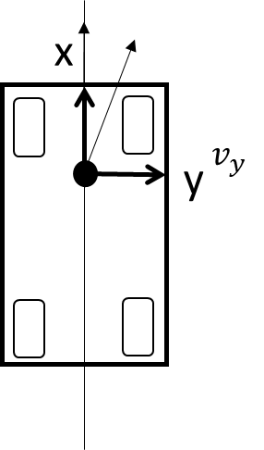

Path Calculations – Global Reference Frame
X
θ
- heading angle
$$v_{x}$$
x
y
Y

Slide 5

Δt
Impact
Kinetics
Vehicle Inputs
Kinetics
Vehicle Motion
Impact Model
Impact force
Tire forces
ax, ay, az
α
Velocity (mph)
Steering angle (deg)
Omega z (deg/s)
Braking (g)
Acceleration (g)
Tire forces
ax, ay, az
α
Road Slope + Bank
No Impact Forces
Vehicle Motion
Initial Conditions
Δt
Velocity (mph)
Location (X,Y)
Heading Angle (θ)
Plot Vehicle
$$t_{0}$$
X, Y, θ
steering angle
velocity
slip angle

Slide 6
Driver Inputs
EDR Data
The EDR data will be used to directly control measured inputs:
Steering wheel angle
Braking – with ABS activated?
The initial velocity of the vehicle will be modeled using the EDR data
Velocity
Yaw Rate
Following t=0, velocity and vehicle motion will be calculated based on the runout of the initial conditions and any other inputs.
The vehicle velocity and yaw rate will be plotted for comparison to the calculated response.

Slide 7


Modules
Driver Inputs
Vehicle
Global
Impact
Velocity (mph)
Steering angle (deg)
Omega z (deg/s)
Braking (g)
Acceleration (g)
Position data at t <= 0
Pre-impact
EDR Data
$$t={−t}_{start}:t=0$$
Tire
Surface
Post impact
$$t=0:t=stop$$

Slide 8


Initial Driver Inputs: No Impact
Δt
Vehicle Inputs
Kinetics
Tire Model
Velocity (mph)
Steering angle (deg)
Omega z (deg/s)
Braking (g)
Acceleration (g)
Tire forces
ax, ay, az
α
Braking (4 wheels)
Acceleration (2 vs 4)
Surface slope + bank
EDR Data
No Impact Forces
Initial Conditions
Δt
$$∆x, ∆y, ∆θ$$
Velocity (mph)
Side slip angle (β)
Angular rate (ω)
Location (X,Y)
Heading Angle (θ)
Plot Vehicle
$$t_{0}$$
X, Y, θ
steering angle
velocity
slip angle

Slide 9
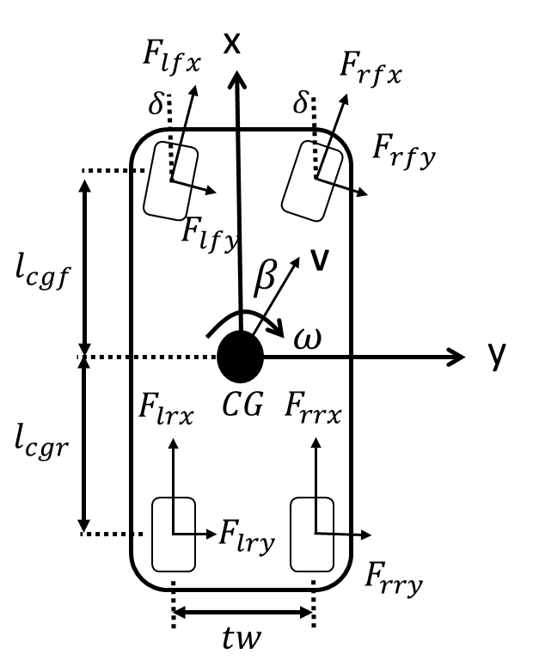



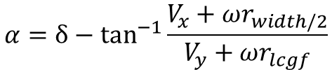





Tire Model
Initial Conditions
Tire
Velocity (mph)
Side slip angle (β)
Angular rate (ω)
Throttle (%)
Braking (%)
Location (X,Y)
Heading Angle (θ)
Steering Wheel Angle (γ)
Braking(%):
$$F_{tbraking}=\%_{input}μ_{available}F_{tz}$$
Throttle(%):
$$F_{accleration}=\%_{input}μ_{available}F_{tz}$$
Lateral Forces at Tire
Slip Angle at Tire (LF)
$$F_{ty}=\frac{α_{t}}{α_{tmax}}μ_{t}F_{tz}$$
Roll moments – vertical force
$$α≤α_{max}$$
$$α={δ−tan}^{−1}{\frac{V_{x}+ωr_{width/2}}{V_{y}+ωr_{lcgf}}}$$
wheel rolling
$$F_{tz}$$
$$α>α_{max}$$
$$F_{ty}=−sin{α_{t}}μ_{t}F_{tz}$$
$$F_{tx}=−cos{α_{t}}μ_{t}F_{tz}$$
wheel locked

Slide 10

Model Progression
User input
$$t_{0}$$
Initial Conditions
Initial Calculations
Velocity (mph)
Side slip angle (β)
Angular rate (ω)
Throttle (%)
Braking (%)
Location (X,Y)
Heading Angle (θ)
ax, ay

Slide 11
















x
$$F_{lfx}$$
$$F_{rfx}$$
$$δ$$
$$δ$$
$$F_{rfy}$$
$$F_{lfy}$$
$$l_{cgf}$$
$$β$$
V
$$ω$$
y
$$F_{lrx}$$
$$CG$$
$$F_{rrx}$$
$$l_{cgr}$$
$$F_{lry}$$
$$F_{rry}$$
$$tw$$

Slide 12
Notes

Slide 13





Path Calculations – Vehicle Reference Frame
$$φ_{v}$$
Velocity angle
Vehicle Velocity (V)
$$v_{x}$$
x
$$v_{R}$$
x
y
$$v_{y}$$
$$v_{y}$$
y

Slide 15




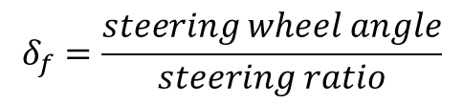


EDR Data Analysis
$$δ_{f}=\frac{steering wheel angle}{steering ratio}$$
Turning Radius no slip:
$wb$=wheel base
$$r=\frac{wb}{δ_{f}−δ_{r}}$$
$δ_{f}$=front steering angle
$δ_{r}$=rear steering angle
Turning Radius with slip:
$$r=\frac{wb}{(δ_{f}−λ_{f}{−δ}_{r}+λ_{r})}$$
$λ$= slip angle (front, rear)

Slide 16

$$+δ$$

Slide 17
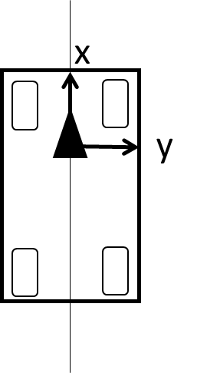
Y
θ
- heading angle
X

Slide 18
x
x
δ
y
y

Slide 19
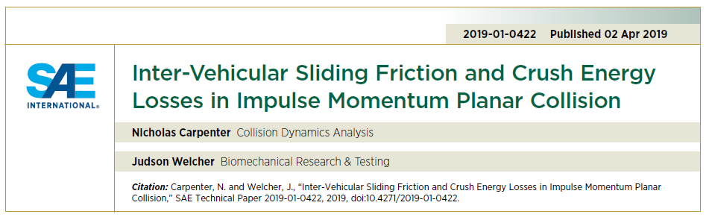
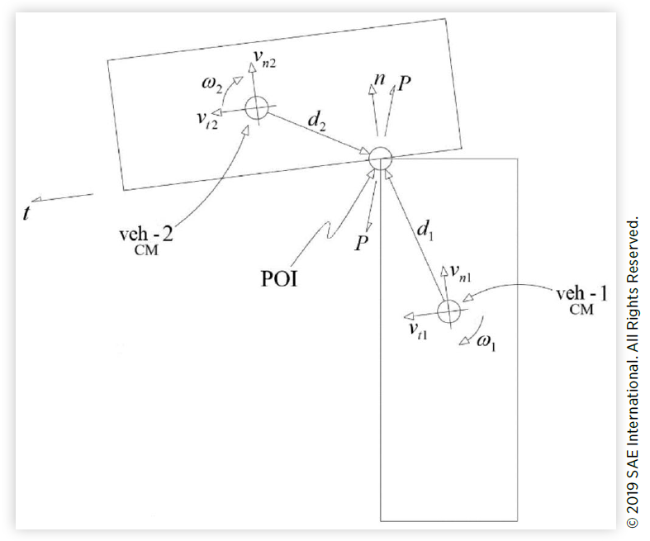
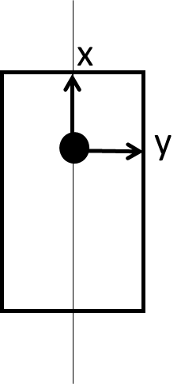






Impact Model
X
θ
- heading angle
POI
$$v_{2}$$
x
$$d_{2}$$
$$d_{1}$$
y
$$v_{1}$$
$$n$$
$$t$$
Y

Slide 20

Impact Model
X
θ
- heading angle
POI
$$v_{2}$$
x
$$d_{2}$$
$$d_{1}$$
y
$$v_{1}$$
$$θ_{t}=θ_{n}+90$$
Y

Slide 21
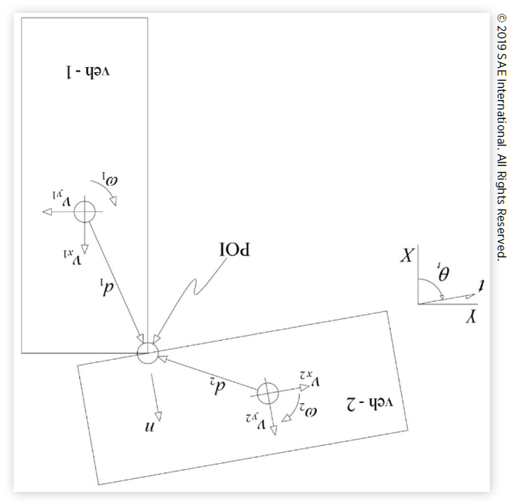






Carpenter & Welcher Method
Inputs:
Vehicle heading angle, dist (cg to POI), mass, Izz, vx, vy, oz
Theta-tangent plane, COF, COR
$$t$$
X
θ
- heading angle
POI
$$n$$
$$v_{2}$$
$$d_{2}$$
$$d_{1}$$
$$v_{1}$$
Y

Slide 23
Impact Detection

Slide 24
Closing velocity vectors

Slide 25
Activation Points on Edge

Slide 26
Reference

Slide 27
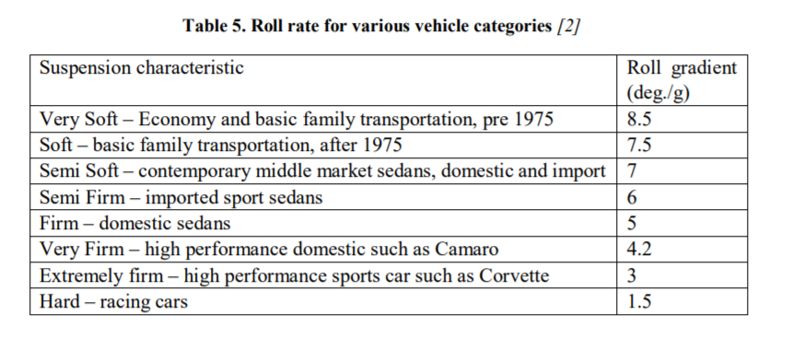
W. F. Milliken och D. L. Milliken, Race Car Vehicle Dynamics, Warrendale, PA: SAE, 1995.

Slide 28
Spring-Mass Model

Slide 29
Force Model
Based on combination of springs in series – K
Based on A, B and L values – generates a K value

Slide 30




X
$$v_{1}$$
POI
$$v_{2}$$
$$n$$
θ
- heading angle
$$t$$
Y

Slide 31
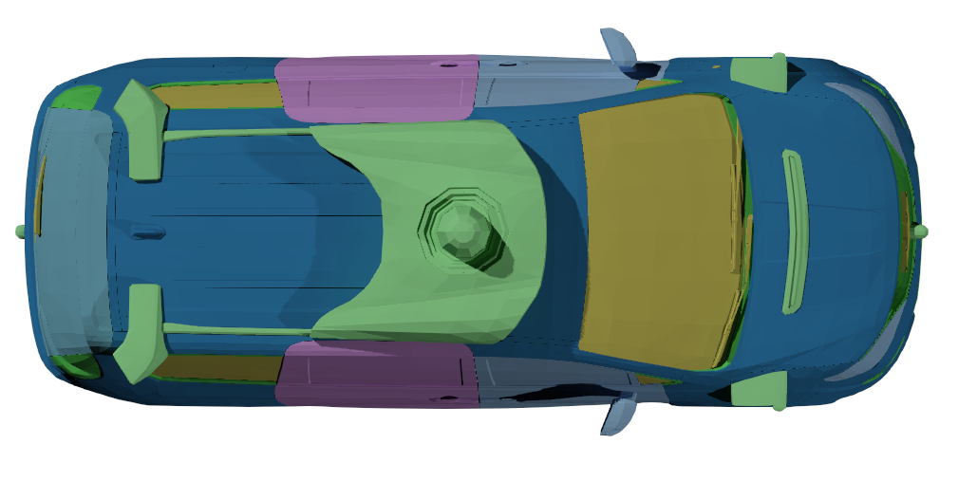


$$v_{1}$$
Brake applied as a percentage of available friction (max = 1)
$$v_{2}$$
Initial Velocity
Crush force from effective mutual stiffness
Initial Velocity

Slide 32
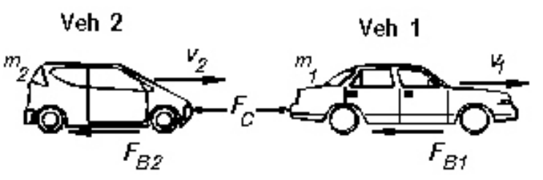

Slide 33



Coordinate Systems – SAE J211
Vehicle
Global
$$v_{x}$$
X
θ
$$ω$$
$$β$$
+ heading angle
Y

