Slide 1
Pycrash Guide
Joe Cormier

Slide 2
Basics
Two main types of analyses
Vehicle Motion (with and without impact)
Environment
Impact model:
SDOF – no vehicle kinematics
Sideswipe, impulse-momentum – includes vehicle kinematics

Slide 3
Structure
Classes
Project – general info, used for saving project
Vehicle – all vehicle level data
Models –
SDOF
Sideswipe
Momentum
Single vehicle motion

Slide 4
Questions
Saving / retrieving class objects – fine for now
Assign data types to variables before assigning values -
Import modules based on condition
What to do with “helper” functions – create class

Slide 5
Future Work
Clean-up files on Github – share with Alex
Video of vehicle motion
Dynamic input – automatically rerun model when any input is changed
Validation
Kineticorp – vehicle motion
Impact model - me
Environmental
Friction / slope / bank

Slide 6
Define Environment

Slide 7
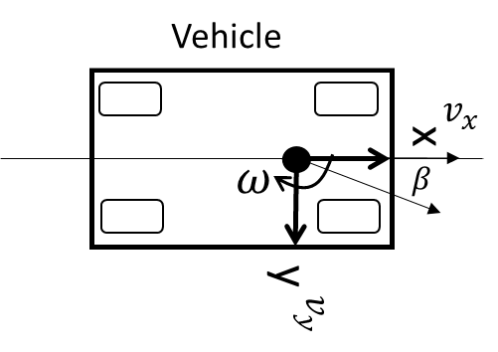
Coordinate Systems – SAE J211
Global
X
θ
+ heading angle
Y

Slide 8
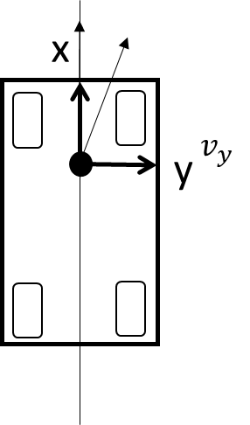

Path Calculations – Global Reference Frame
X
θ
- heading angle
$$v_{x}$$
x
y
Y

Slide 9

Δt
Impact
Kinetics
Vehicle Inputs
Kinetics
Vehicle Motion
Impact Model
Impact force
Tire forces
ax, ay, az
α
Velocity (mph)
Steering angle (deg)
Omega z (deg/s)
Braking (g)
Acceleration (g)
Tire forces
ax, ay, az
α
Road Slope + Bank
No Impact Forces
Vehicle Motion
Initial Conditions
Δt
Velocity (mph)
Location (X,Y)
Heading Angle (θ)
Plot Vehicle
$$t_{0}$$
X, Y, θ
steering angle
velocity
slip angle

Slide 10
Driver Inputs
EDR Data
The EDR data will be used to directly control measured inputs:
Steering wheel angle
Braking – with ABS activated?
The initial velocity of the vehicle will be modeled using the EDR data
Velocity
Yaw Rate
Following t=0, velocity and vehicle motion will be calculated based on the runout of the initial conditions and any other inputs.
The vehicle velocity and yaw rate will be plotted for comparison to the calculated response.

Slide 11


Modules
Driver Inputs
Vehicle
Global
Impact
Velocity (mph)
Steering angle (deg)
Omega z (deg/s)
Braking (g)
Acceleration (g)
Position data at t <= 0
Pre-impact
EDR Data
$$t={−t}_{start}:t=0$$
Tire
Surface
Post impact
$$t=0:t=stop$$

Slide 12


Initial Driver Inputs: No Impact
Δt
Vehicle Inputs
Kinetics
Tire Model
Velocity (mph)
Steering angle (deg)
Omega z (deg/s)
Braking (g)
Acceleration (g)
Tire forces
ax, ay, az
α
Braking (4 wheels)
Acceleration (2 vs 4)
Surface slope + bank
EDR Data
No Impact Forces
Initial Conditions
Δt
$$∆x, ∆y, ∆θ$$
Velocity (mph)
Side slip angle (β)
Angular rate (ω)
Location (X,Y)
Heading Angle (θ)
Plot Vehicle
$$t_{0}$$
X, Y, θ
steering angle
velocity
slip angle

Slide 13
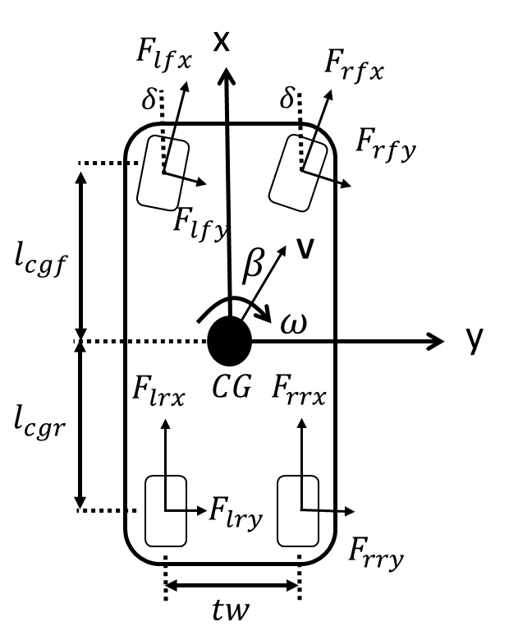



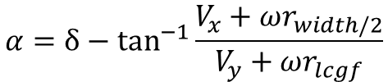





Tire Model
Initial Conditions
Tire
Velocity (mph)
Side slip angle (β)
Angular rate (ω)
Throttle (%)
Braking (%)
Location (X,Y)
Heading Angle (θ)
Steering Wheel Angle (γ)
Braking(%):
$$F_{tbraking}=\%_{input}μ_{available}F_{tz}$$
Throttle(%):
$$F_{accleration}=\%_{input}μ_{available}F_{tz}$$
Lateral Forces at Tire
Slip Angle at Tire (LF)
$$F_{ty}=\frac{α_{t}}{α_{tmax}}μ_{t}F_{tz}$$
Roll moments – vertical force
$$α≤α_{max}$$
$$α={δ−tan}^{−1}{\frac{V_{x}+ωr_{width/2}}{V_{y}+ωr_{lcgf}}}$$
wheel rolling
$$F_{tz}$$
$$α>α_{max}$$
$$F_{ty}=−sin{α_{t}}μ_{t}F_{tz}$$
$$F_{tx}=−cos{α_{t}}μ_{t}F_{tz}$$
wheel locked

Slide 14

Model Progression
User input
$$t_{0}$$
Initial Conditions
Initial Calculations
Velocity (mph)
Side slip angle (β)
Angular rate (ω)
Throttle (%)
Braking (%)
Location (X,Y)
Heading Angle (θ)
ax, ay

Slide 15
















x
$$F_{lfx}$$
$$F_{rfx}$$
$$δ$$
$$δ$$
$$F_{rfy}$$
$$F_{lfy}$$
$$l_{cgf}$$
$$β$$
V
$$ω$$
y
$$F_{lrx}$$
$$CG$$
$$F_{rrx}$$
$$l_{cgr}$$
$$F_{lry}$$
$$F_{rry}$$
$$tw$$

Slide 16
Notes

Slide 17





Path Calculations – Vehicle Reference Frame
$$φ_{v}$$
Velocity angle
Vehicle Velocity (V)
$$v_{x}$$
x
$$v_{R}$$
x
y
$$v_{y}$$
$$v_{y}$$
y

Slide 19




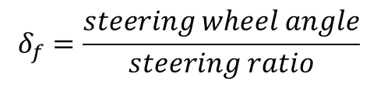


EDR Data Analysis
$$δ_{f}=\frac{steering wheel angle}{steering ratio}$$
Turning Radius no slip:
$wb$=wheel base
$$r=\frac{wb}{δ_{f}−δ_{r}}$$
$δ_{f}$=front steering angle
$δ_{r}$=rear steering angle
Turning Radius with slip:
$$r=\frac{wb}{(δ_{f}−λ_{f}{−δ}_{r}+λ_{r})}$$
$λ$= slip angle (front, rear)

Slide 20

$$+δ$$

Slide 21
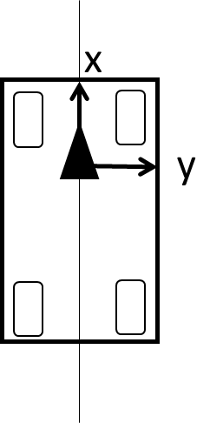
Y
θ
- heading angle
X

Slide 22
x
x
δ
y
y

Slide 23
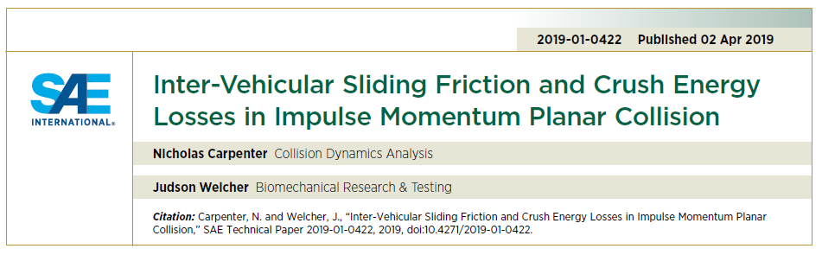
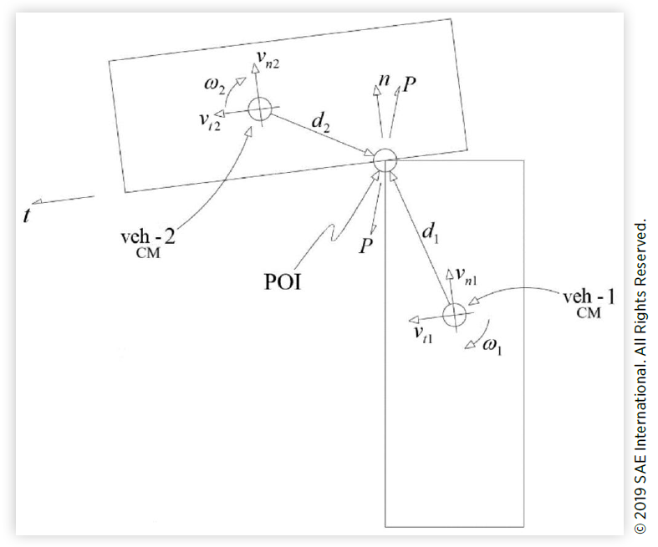
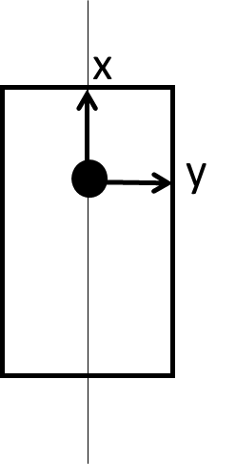






Impact Model
X
θ
- heading angle
POI
$$v_{2}$$
x
$$d_{2}$$
$$d_{1}$$
y
$$v_{1}$$
$$n$$
$$t$$
Y

Slide 24

Impact Model
X
θ
- heading angle
POI
$$v_{2}$$
x
$$d_{2}$$
$$d_{1}$$
y
$$v_{1}$$
$$θ_{t}=θ_{n}+90$$
Y

Slide 25
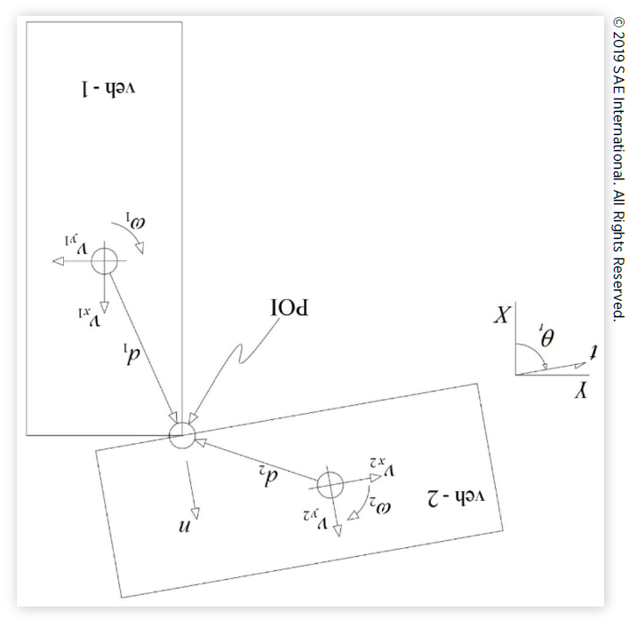






Carpenter & Welcher Method
Inputs:
Vehicle heading angle, dist (cg to POI), mass, Izz, vx, vy, oz
Theta-tangent plane, COF, COR
$$t$$
X
θ
- heading angle
POI
$$n$$
$$v_{2}$$
$$d_{2}$$
$$d_{1}$$
$$v_{1}$$
Y

Slide 27
Impact Detection

Slide 28
Closing velocity vectors

Slide 29
Activation Points on Edge

Slide 30
Reference

Slide 31
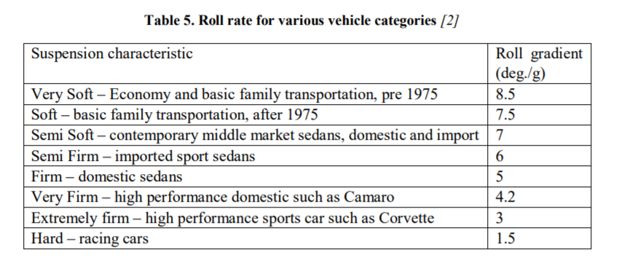
W. F. Milliken och D. L. Milliken, Race Car Vehicle Dynamics, Warrendale, PA: SAE, 1995.

Slide 32
Spring-Mass Model

Slide 33
Force Model
Based on combination of springs in series – K
Based on A, B and L values – generates a K value

Slide 34




X
$$v_{1}$$
POI
$$v_{2}$$
$$n$$
θ
- heading angle
$$t$$
Y

Slide 35
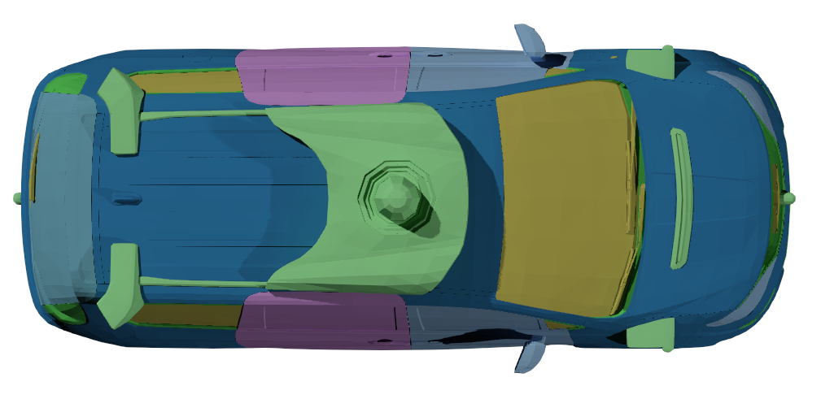


$$v_{1}$$
Brake applied as a percentage of available friction (max = 1)
$$v_{2}$$
Initial Velocity
Crush force from effective mutual stiffness
Initial Velocity

Slide 36
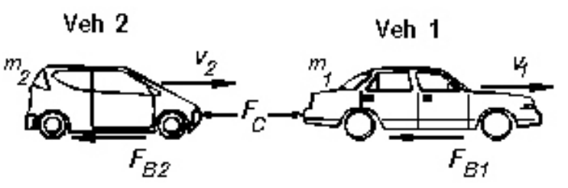

Slide 37



Coordinate Systems – SAE J211
Vehicle
Global
$$v_{x}$$
X
θ
$$ω$$
$$β$$
+ heading angle
Y

