Slide 1
Database and Web Development
Gary McNeill – 10187871
Joe Lloyd - 10177148

Slide 2
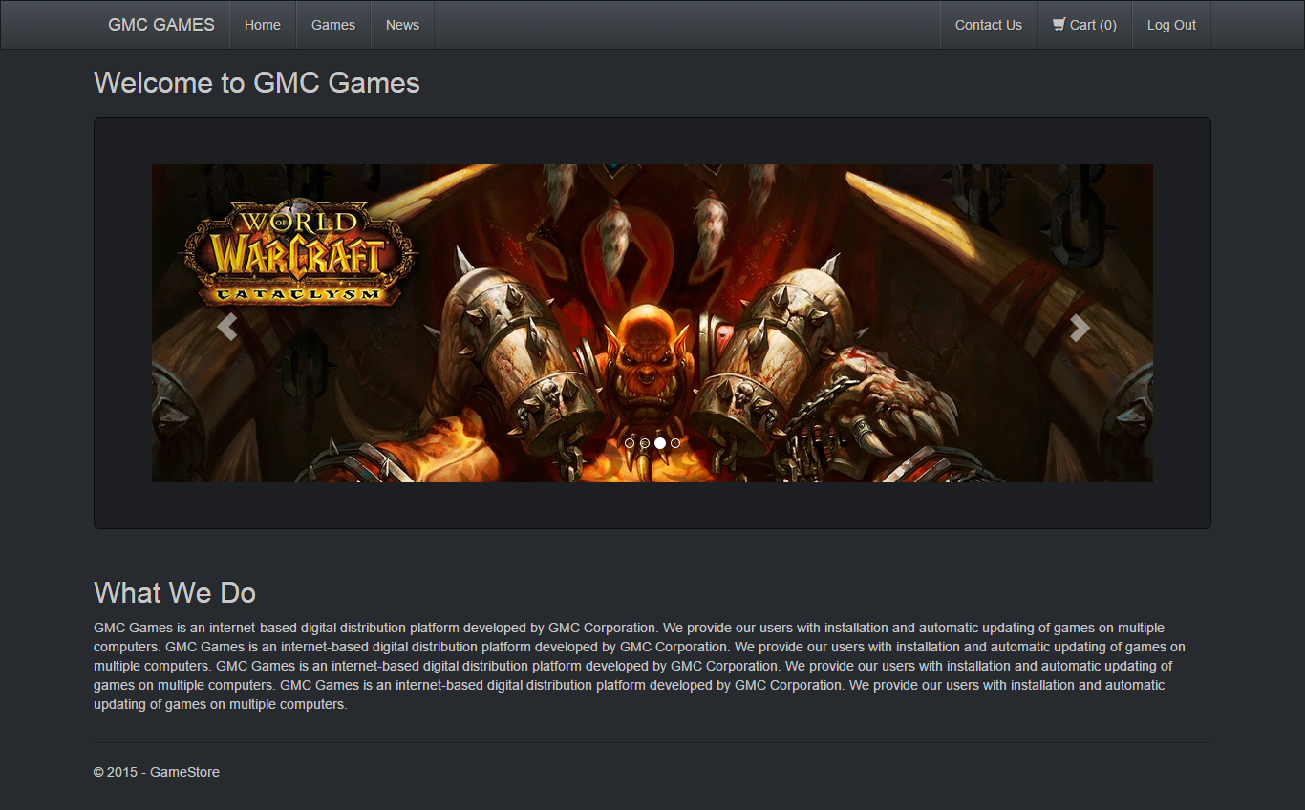
Topic - Online Game Store

Slide 3
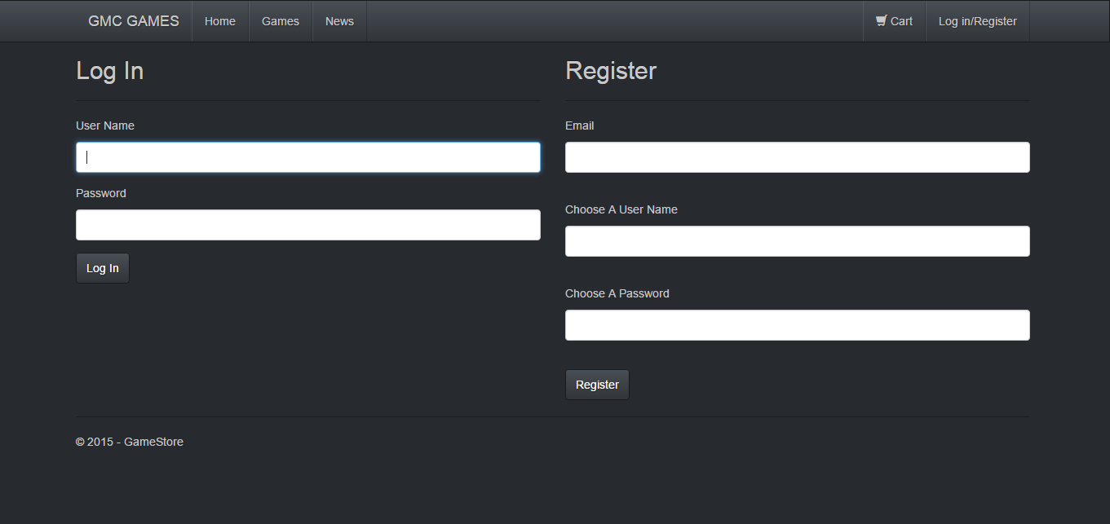
Hierarchical Structure
Two Sessions (Admin & User)
Main site inaccessible to non logged in users
Admin Controls only accessible by Admins

Slide 4
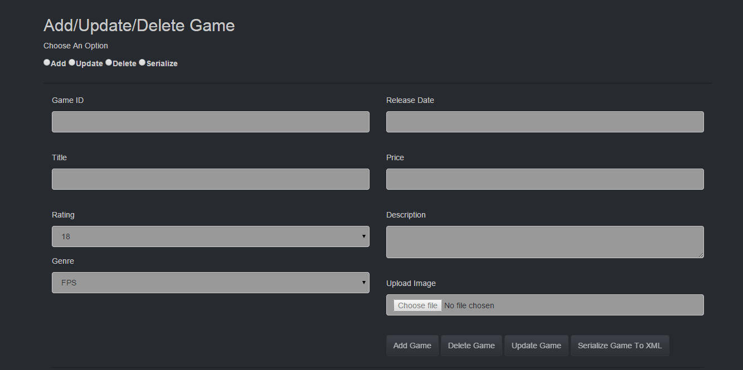
Admin Page – Content Controls

Slide 5
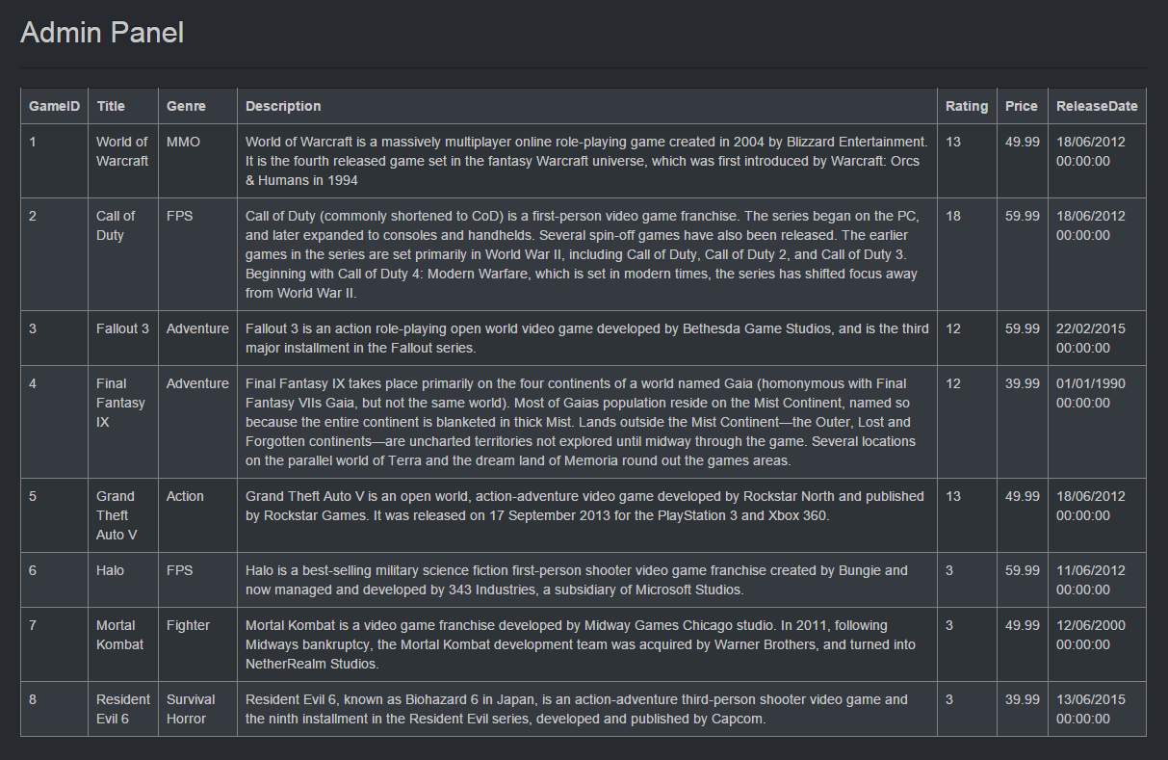
Admin Page – Game Grid

Slide 6
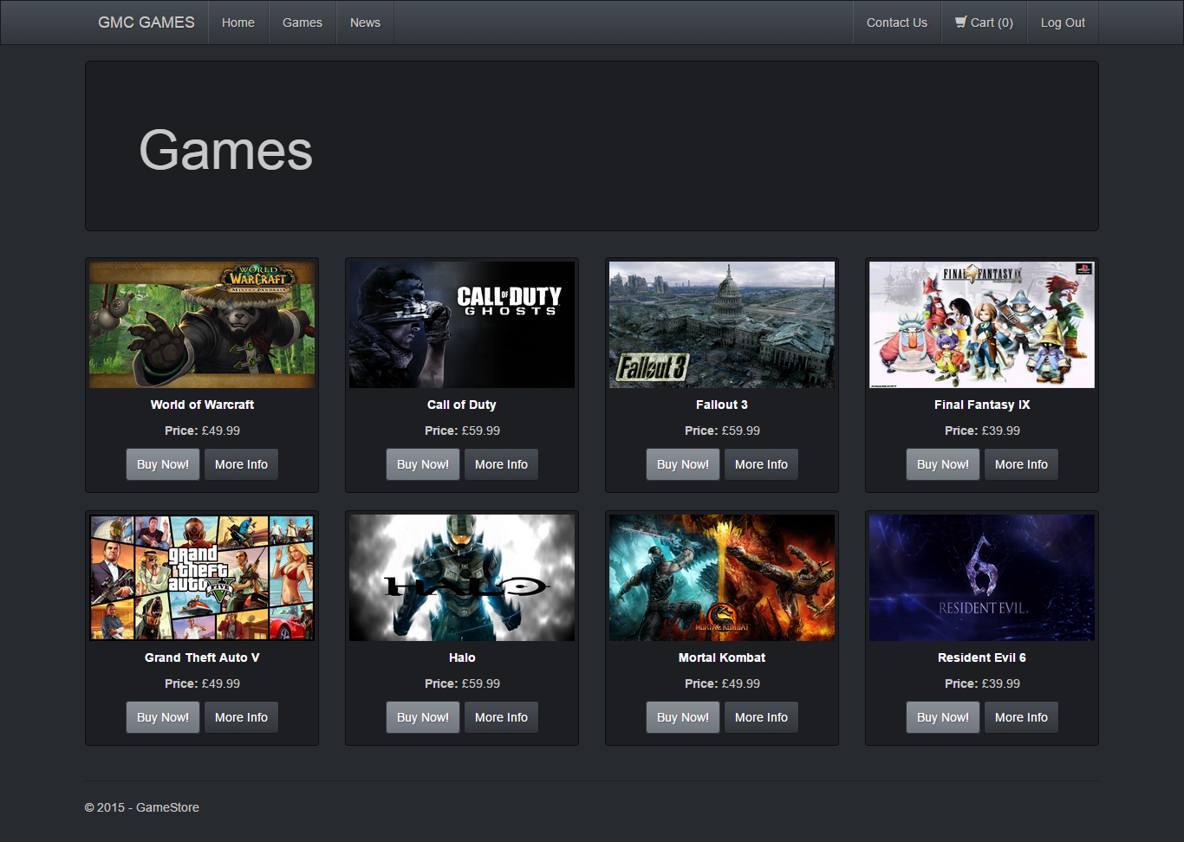

Slide 7

Game Details

Slide 8
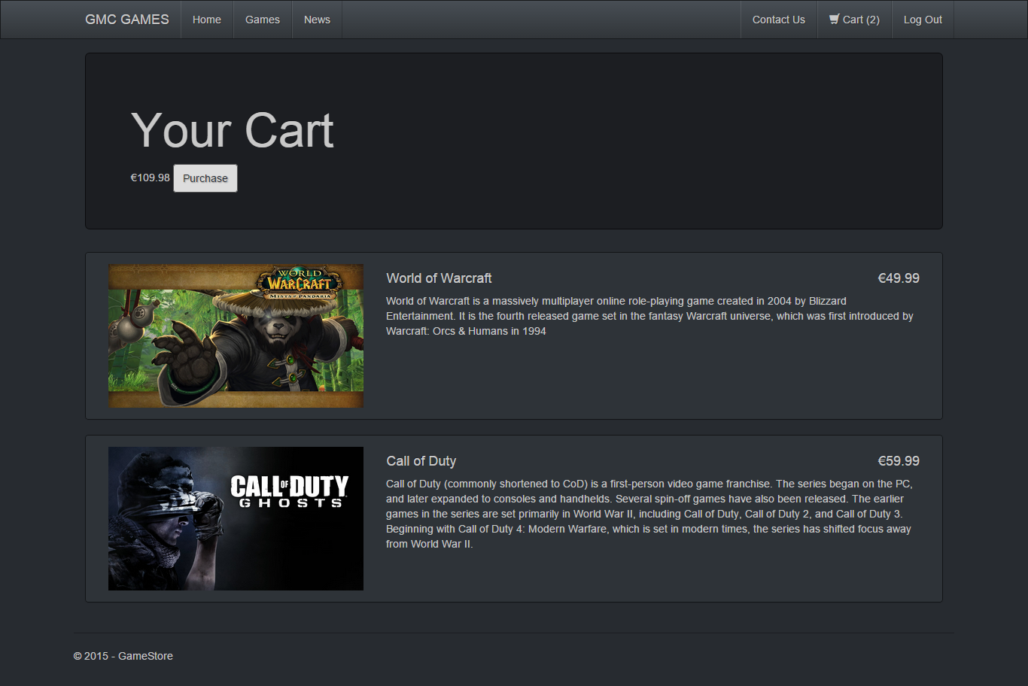

Slide 9

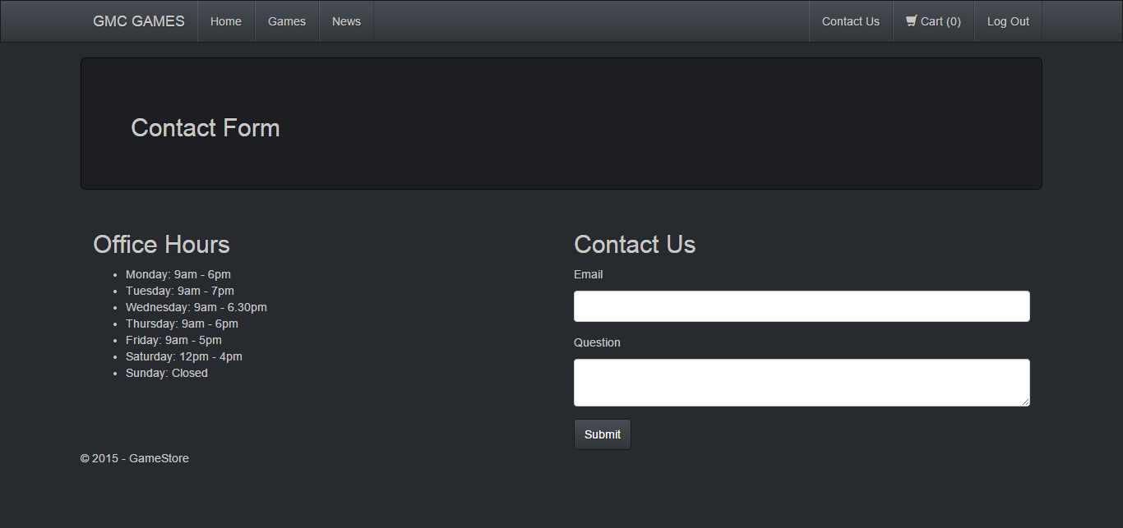
Other Pages
Static Pages – Can be updated in the future to pull news information from Database

