Slide 1
Assessment of patient feedback using Natural Language Processing (NLP) and textual data analysis in R
Ana Singh | ana.singh@esneft.nhs.uk
RPYSOC 24 (Nov 2024)
1

Slide 2
Introduction
What is Natural Language Processing? Why R?
Natural Language Processing (NLP) is an exciting area of artificial intelligence that focuses on interaction between computers and humans through natural language. The goal is to interpret, decode, and derive meaningful insights from language in a way that’s both practical and valuable.
R offers a wide range of tools and packages for NLP. From sentiment analysis to topic modelling, R provides numerous functionalities that address various aspects of natural language processing.
2

Slide 3
R Libraries
# Text Mining and Natural Language Processing
library(tidytext) # Tidy approach to NLP, for tokenising and sentiment analysis
library(tm) # General text mining, creating document-term matrices
library(textclean) # Cleaning and pre-processing text
library(text2vec) # Vectorization for text analysis
library(topicmodels) # Topic modeling (LDA, etc.)
library(SnowballC) # Text stemming
library(sentimentr) # For sentiment analysis
# Data Wrangling and Transformation
library(tidyverse) # General data wrangling, includes dplyr, ggplot2, and readr
library(scales) # Scaling functions for visualization
library(lubridate) # Date/time wrangling
library(tidyr) # For data tidying (spread, gather, etc.)
# Dashboard and Visualization Libraries
library(flexdashboard) # Automatically called when creating a dashboard file
library(plotly) # Interactive visualisations
library(highcharter) # Interactive charts for time series, etc.
library(DT) # Interactive tables
# Table Formatting
library(kableExtra) # Enhanced tables in Markdown/HTML
library(pivottabler) # Pivot tables, similar to Excel's pivot functionality
# Network Analysis and Visualisation
library(igraph) # Network analysis and graph theory
library(ggraph) # Grammar of graphics for networks, built on ggplot2
library(visNetwork) # Interactive network visualisations
library(networkD3) # D3 JavaScript-based network visualisation
library(threejs) # 3D JavaScript-based visualisations for networks
# Excel File Handling
library(readxl) # Reading Excel files
library(openxlsx) # Writing and modifying Excel files without dependencies
# Specialized Utilities
library(splitstackshape) # Reshaping and stacking data, useful for data munging
library(textmineR) # Additional text mining tools
library(ITNr) # International Trade Network analysis tools
3
Notes:
R’s large suite of packages makes it a useful tool for NLP tasks. Here are some of the standout packages:
tm: Often regarded as a fundamental tool for text mining in R, the tm package offers essential functions like removing punctuation, stemming, and creating term-document matrices. It’s indispensable for anyone getting started with text analysis in R.
textclean: As the name suggests, textclean is perfect for tidying and preparing your text data.
tidytext: If you're into text analysis with R, the tidytext package is a game-changer. It applies the tidyverse approach to text mining, making it easy to handle text data like any other tidy data frame. Ideal for cleaning, analyzing, and visualizing text in a structured way.
sentimentr: This package goes beyond simply counting positive or negative words by considering the context, making its sentiment analysis more accurate. If you want to truly understand the emotional tone of your text, whether it's happy, sad, or anything else, sentimentr offers deeper insights.

Slide 4
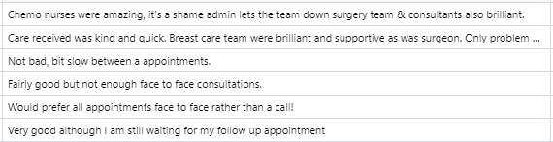

Cancer Patient Experience Survey
Comments Examples
Text/CSV/Excel/…
Consider these as examples of free text comments.
Natural Language Processing modelling
Main topics found in the document about:
Cancer Treatment and Care
Support and Oncology Team
Hospital Services
Cancer Diagnosis and Stages
Nursing
GP and Diagnoses
Staff and Professionalism
Surgery and Waiting Times
Patient Communication
NHS Units
4
Notes:
In the National Cancer Patient Experience Survey 2022, patients were given the opportunity to write free text comments answering several questions.
A sample of ~3k comments were provided for this analysis. While comments were already assigned to certain topics, they were not so easy to interpret and categorize as they contained between 6 and 30 words and in some cases, over 30 words making the comments complex in nature often mentioning 2 or 3 sub-topics in the same comment.
Due to the latter, we used machine learning algorithms to analyse the free text to obtain insights about what kind of general themes and problems were covered and observe how the comments were structured.
It is important to mention that although the algorithm found 10 main topics, it does not come with the following headings as those will come from the interpretation that the person is doing the analysis find based on the words grouped in each topic.

Slide 5
Topic Modelling and Words Networks
All Comments
Patient survey examples:
At present my cancer is being monitored by psa blood tests.
My care and treatment were excellent.
Breast cancer staff have been wonderful.
Survey Vocabulary
Word | Frequency
present | 1
cancer | 2
monitor | 1
psa | 1
blood | 1
test | 1
breast | 1
staff | 1
wonderful | 1
care | 1
treatment | 1
excellent | 1
Cleaning
Tokenisation
Cleaning ,Tokenisation and Stemming/Lemmatisation :
present, cancer, monitor, psa, blood, test
care, treatment, excellent
breast, cancer, staff, wonderful
Stemming/Lemmatisation
Comment Vectorisation
Word
Frequency
(Document
Vocabulary)
Vectorisation of Comment C)
breast | cancer | staff
Document Network
Topic
Modelling
1 word neighbourhood
How often those pair of words come together in the survey
Group of meaningful words often mentioned together creating different topics.
Words without value are not considered
Leads to:
Survey network of words
Leads to:
Topic Modelling
5
Notes:
CLEANING: Every comment is cleaned by lower casing all words, removing any punctuation and number as well as removing all extra spaces.
TOKENIZATION: Comments are split into smaller units called tokens (in this case, words) and then as a subsequent part of the cleaning stage, stop words (words that do not add meaningful value to the comments such as “a”, “to”, “above”, etc) are also removed.
Stemming/Lemmatization: At this stage, now that we have identified all words used, it is possible to obtain the stems of the words to obtain a more accurate count of words based on its roots. It is not so easy to identify patterns when words came in all forms, for example, people will talk not only about care, but also caring, being cared. Another option (as seen here) is to group words based on their lemma (or base word)
Document network: After vectorising each comment, we may be interested in visualizing all of the relationships among words simultaneously, rather than just the top few at a time, and for that, it is possible to arrange words into a network where it easier to observe what words are more likely to be seen together.
TOPIC MODELLING: Latent Dirichlet Allocation (LDA) is a technique to extract topics from a given document (in this case, the survey) by evaluating the frequency of the words in the comments considering context.

Slide 6
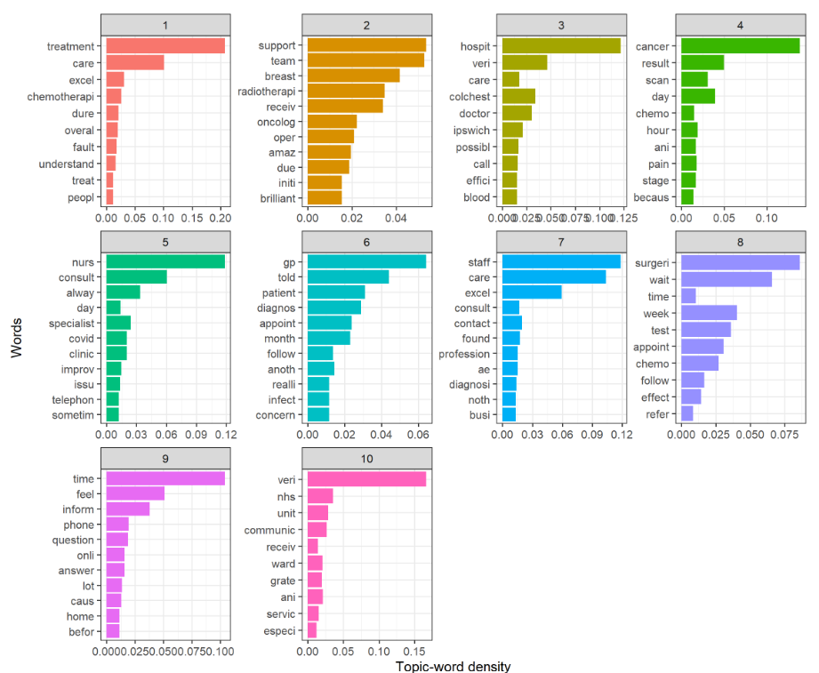
Topic Modelling
Topics Vocabulary
(Examples)
Suggested Topics
Cancer Treatment and Care
Support and Oncology Team
Hospital Services
Cancer Diagnosis and Stages
Nursing
GP and Diagnoses
Staff and Professionalism
Surgery and Waiting Times
Patient Communication
NHS Units
6
Notes:
Topic: Cancer Treatment and Care
Explanation: The most frequent words, such as "treatment," "care," and "chemotherapy," suggest the topic focuses on medical care and treatment experiences, particularly cancer-related procedures.

Slide 7
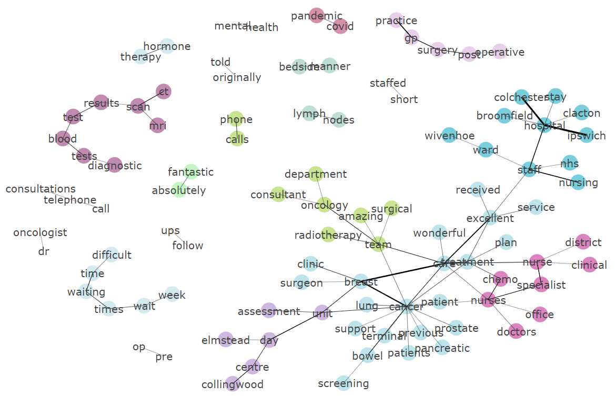
Survey Comments Network
Once comments have been disintegrated into individual words (tokens), they can be now put into context with neighbour words.
By connecting all contextualised words, it is possible to visualise a network of words.
Example: Isolated line of words
breast
cancer
nurses
specialist
Words from Topic about Cancer Treatment and Care
Words from Topic about Nursing
Comment that mentioned most likely 2 main topics.
Comments Network
7
Notes:
The network shows the link between pair of words commonly mentioned together in a neighbourhood of 2 words (for example, breast-cancer or nursing-staff).
In the network it is possible to observe in different colours the main topics the patients talked about in their comments and the connection between them. For example, if a person mentioned breast -> cancer -> nurses, most likely, that comment talked about Cancer Care (blue) and/or Nursing Staff (pink).
Another example is the Mental Health where is seen to be more isolated than others, meaning that most likely comments will talk about this topic without connecting it with other topics.

Slide 8
What is sentiment?
Sentiment refers to the emotional tone or attitude expressed within a piece of text, speech, or communication. It reflects how the writer or speaker feels about a particular subject, event, or situation. Sentiment can be categorised into several types, such as:
Positive sentiment: Expresses feelings of happiness, approval, or satisfaction (e.g., "I love this product!").
Negative sentiment: Reflects feelings of dislike, disapproval, or dissatisfaction (e.g., "This service is terrible!").
Neutral sentiment: Lacks strong emotional expression, often factual or unemotional (e.g., "The meeting starts at 9 a.m.").
In the context of Natural Language Processing (NLP), sentiment analysis is the process of determining and classifying these emotional tones within text to understand the overall mood or opinion expressed.
Sentiment analysis relies on algorithms and may occasionally produce inaccurate results – therefore the work should be treated as ‘directional’ / ‘indicative’ and users should seek to review underlying information or raw data.
8

Slide 9
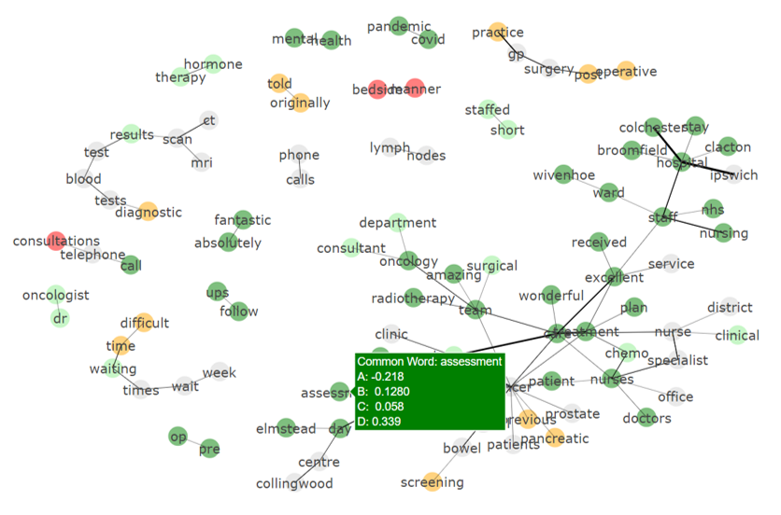
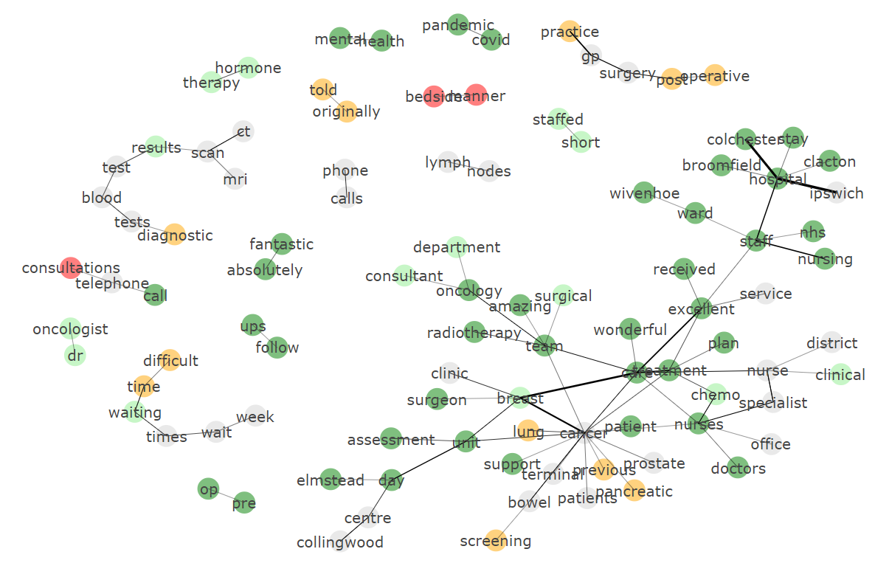
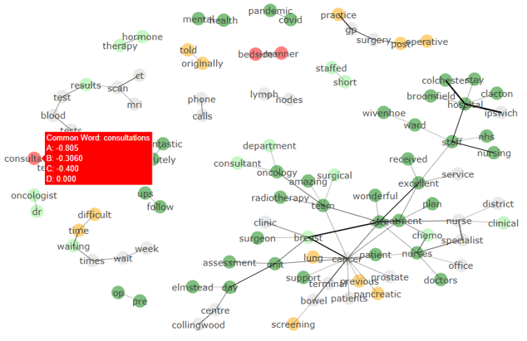
Survey Comments Network
The following sentiment metrics are calculated by considering all sentences within every comment that includes the presence of the “Common Word: xxxx”:
• (A) - Most Negative Sentiment
• (B) - Median Sentiment
• (C) - Mean Sentiment
• (D) - Most Positive Sentiment
Comments Network
9

Slide 10
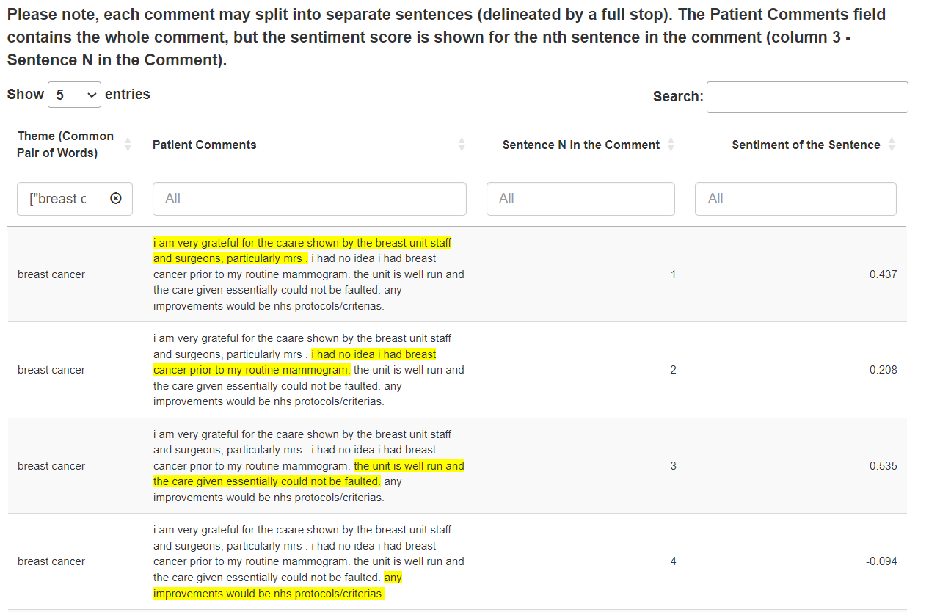
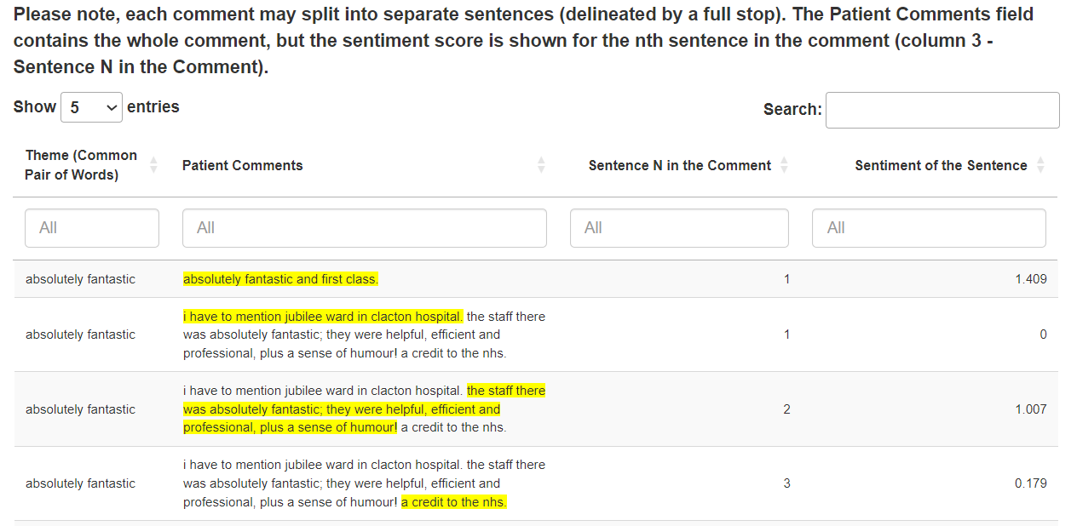
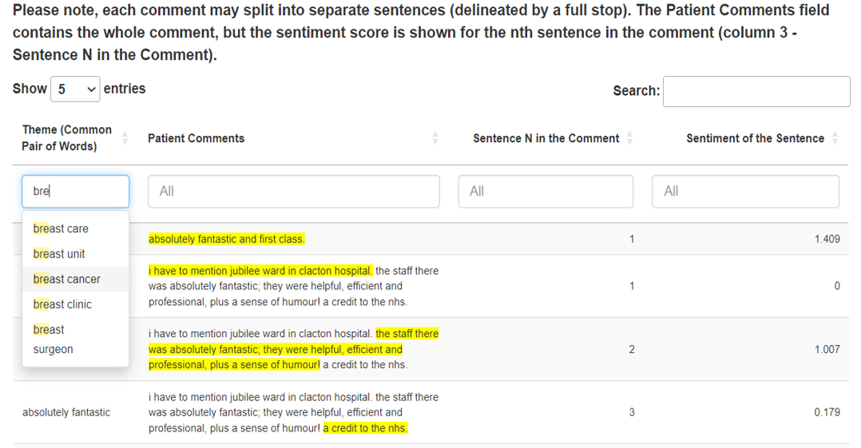
Patient Feedback
Bigram – Comment (Sentence) - Sentiment
Comments Network
10
Notes:
A patient’s comment can be composed of several sentences, each portraying their experience in various ways. Consequently, a negative sentiment within a sentence highlights areas of concern, a positive sentiment signifies contentment with hospital services or staff, and a sentiment score of 0 denotes neutrality in the context of the sentence.

Slide 11
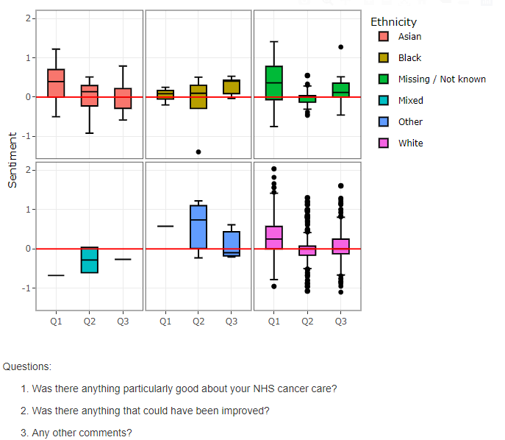
Sentiment Analysis
This visual depicts patients’ experiences, providing a way to identify any differences within a particular patient groups.
It is important to observe that across the figure, the horizontal axis (x-axis) represents survey questions, while the vertical axis (y-axis) presents a numerical representation of sentiment in patients’ written comments.
Values above 0 indicate positivity, whereas values below 0 indicate negativity.
11

Slide 12
Conclusion
NLP efficiently analyses large volumes of patient feedback, such as from the National Cancer Patient Experience Survey, to identify key themes, sentiment, and areas for improvement in care.
By automating this process, NLP reduces manual effort and enables faster extraction of actionable insights.
It also helps healthcare providers identify common concerns, facilitating targeted improvements in services and the patient experience.
NLP tools are widely available as free or low-cost resources, can be implemented in-house, and customised to suit specific requirements, making them an affordable and flexible solution for organisations.
12

Slide 13
References
[Julia Silge and David Robinson]
Welcome to Text Mining with R | Text Mining with R (https://www.tidytextmining.com/)
[Omar Hassoun]
R for Natural Language Processing: The Best Packages and Functions for NLP | Natural Language Processing - all about NLP (https://naturallanguageprocessing.com/programming-r-nlp-packages-functions/)

Slide 14
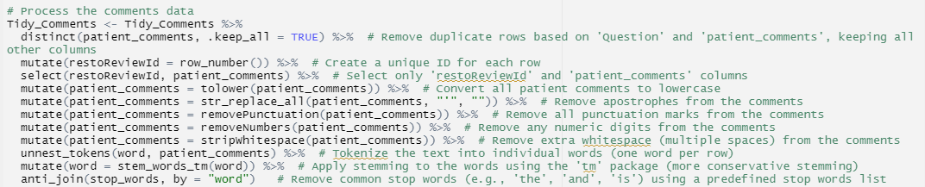
Code: cleaning, tokenization, stemming

Slide 15
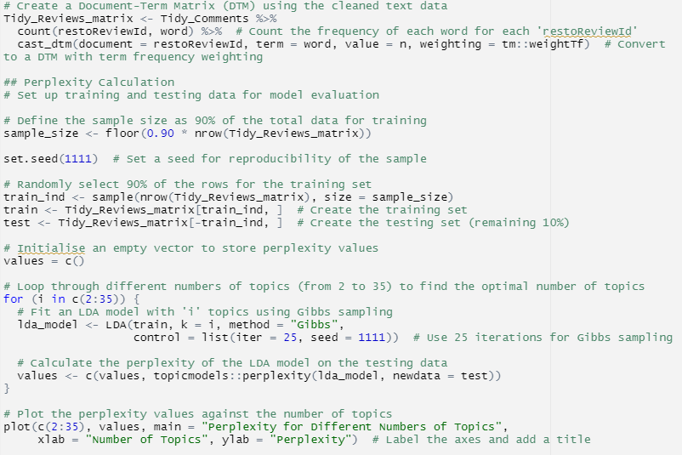
Code: identifying the optimal number of topics for the LDA model

Slide 16
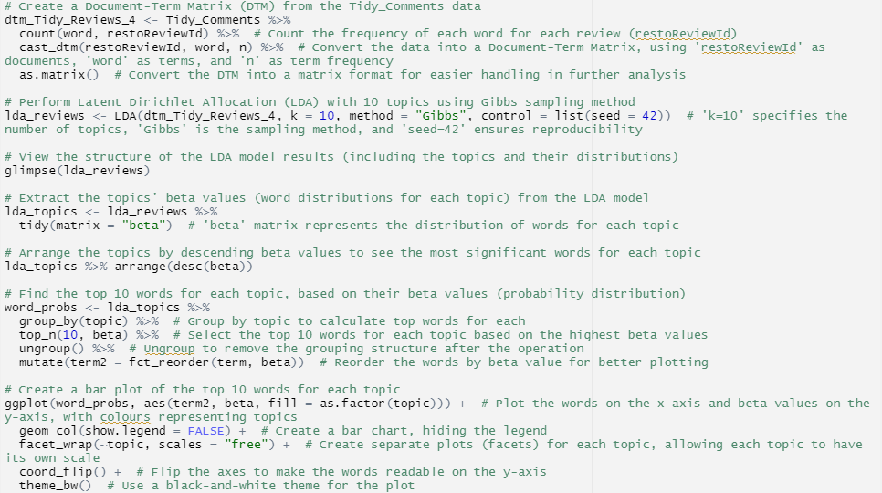
Code: Topic Modelling

Slide 17
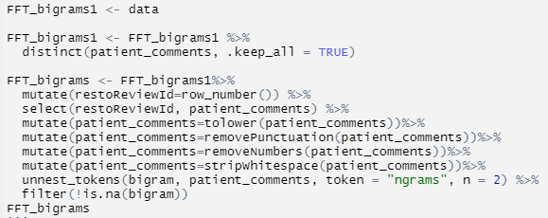
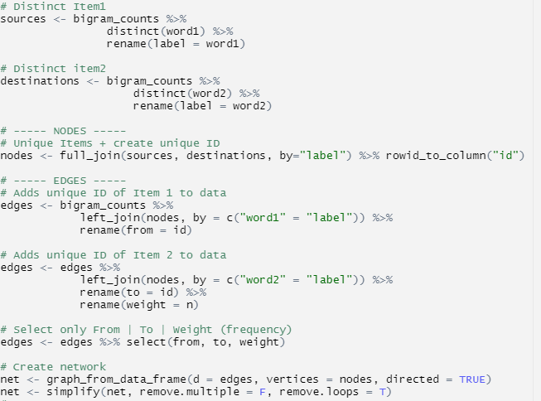
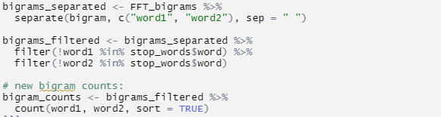
Code: Creating Network

Slide 18
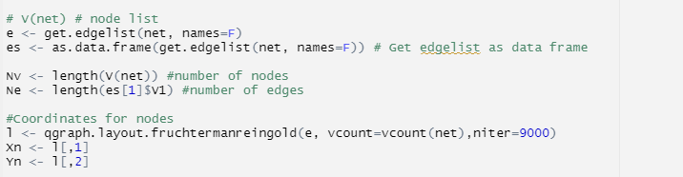
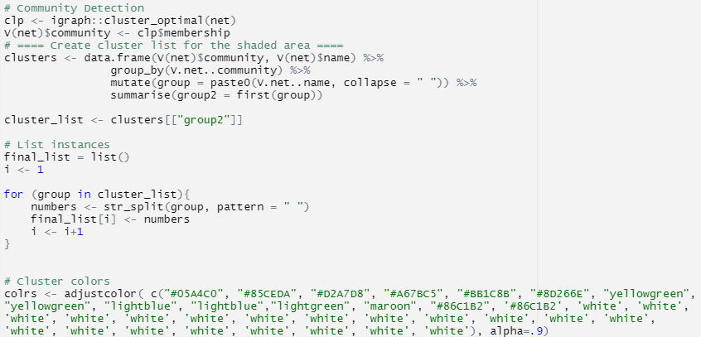
Code: Mapping Interactive Network I

Slide 19
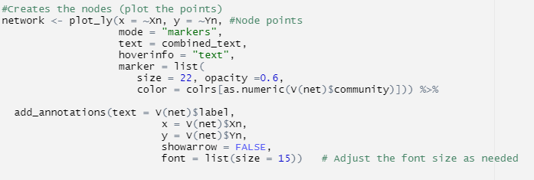
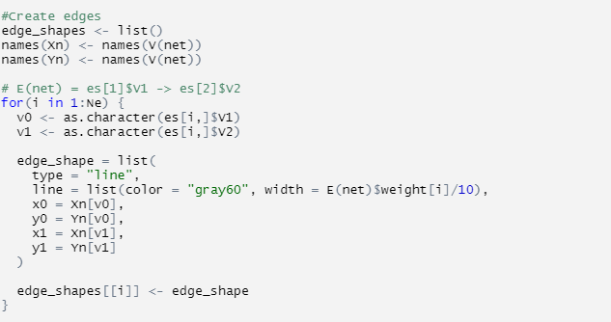
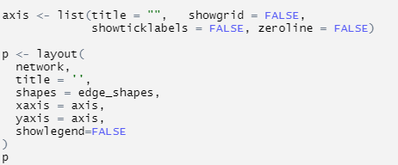
Code: Mapping Interactive Network II
Comments Network (example)

Slide 20

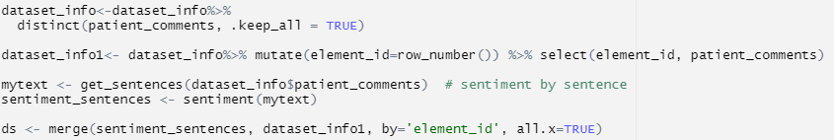
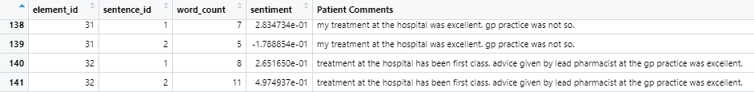
Code: Sentiment of Sentences
*If necessary, additional steps can be included to remove punctuation, numbers, and extra whitespace.
Data -> ds
Sentiment could be integrated into the network map, with adjustments made to meet custom project requirements.

Slide 21
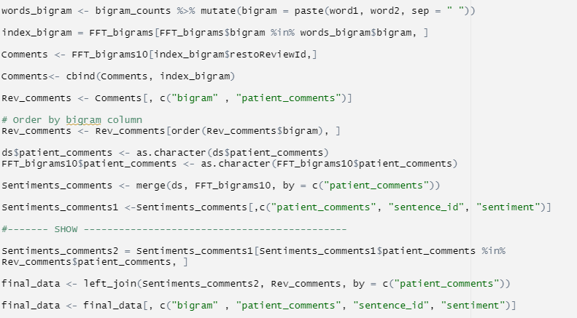
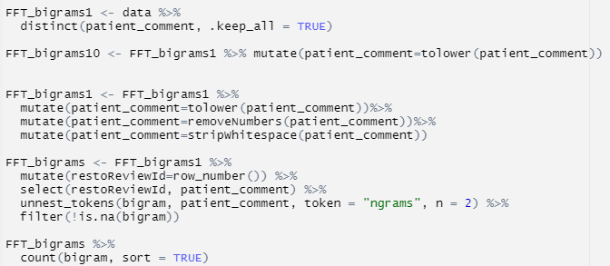
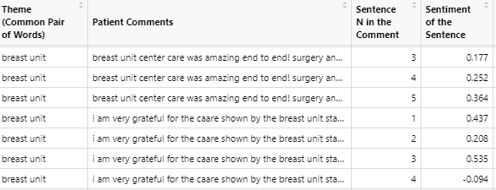
Code: Sentiment & Bigrams
Data -> final_data

Slide 22
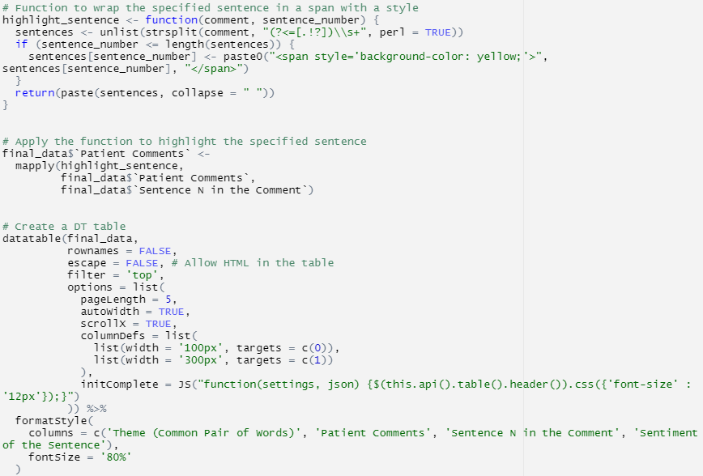
Code: Interactive DT table
DT datatable (example)

