Slide 1

Predictive Modelling for health and social care capacity planning using open data
Seb Fox
SW Decision Support Network

Slide 2
Talk objectives
Publicise a planning tool that has been developed in the SW Decision Support Network
Share learnings for areas were new to me

Slide 3
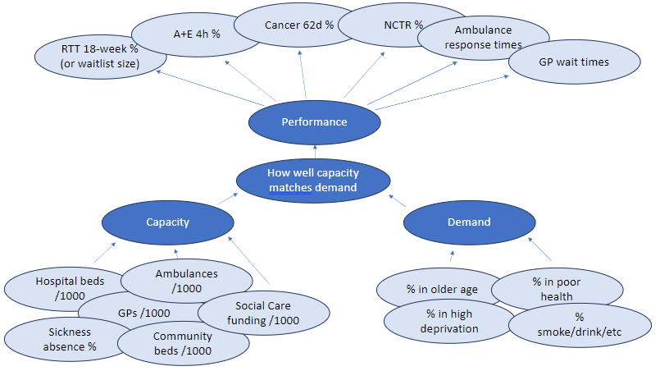
Project brief
‘Performance’
Predict NHS performance metrics from demand and capacity metrics at ICS geography
Provide a tool for decision makers in the SW can interact with and develop future scenarios
‘Inputs’

Slide 4


Project breakdown
Reproducibility
Data
Methods
Implementation
Image source: Flaticon.com

Slide 5
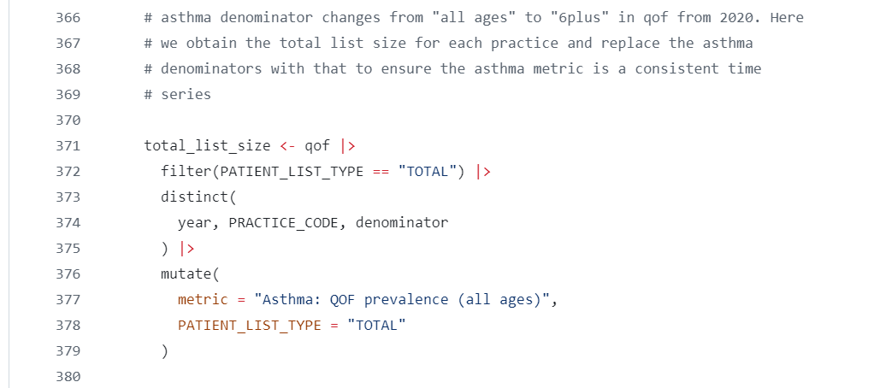
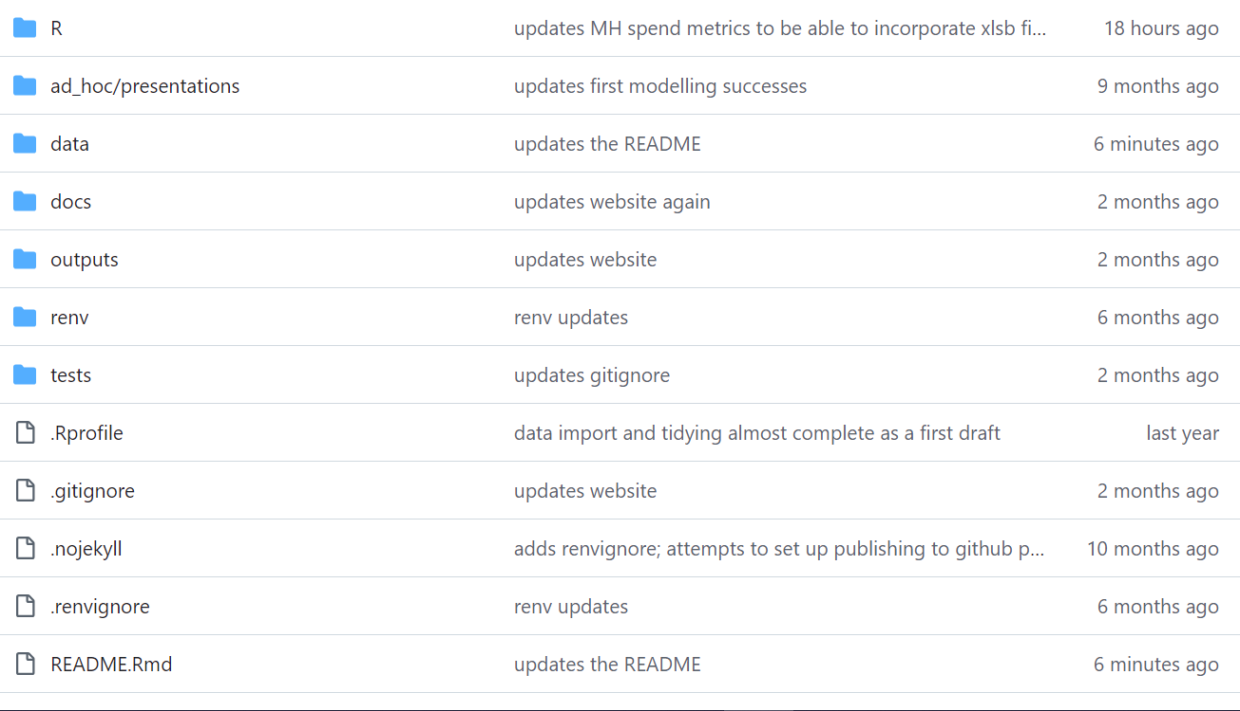
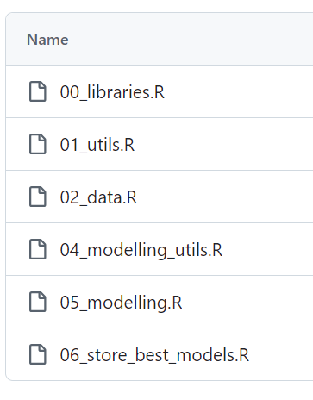
Reproducibility
Reproducibility
Open source programming software
Coding in the open (using Git/GitHub)
Documented code
Standard project structures
Controlling the analytical/package environment {renv}
All of this adds time, but it is important!
Data
Methods
Implementation

Slide 6
Data
Reproducibility
All public data (on the web)
Challenges
Unit of time in published data (daily, monthly, quarterly, annual calendar, annual financial)
Time periods (metrics start and stop at different times)
Inconsistent geographies (ICB, Acute, Primary Care, Local Authority)
COVID-19
Data
Methods
Implementation

Slide 7
Data considerations
Reproducibility
Need to get into consistent “tidy” format
Programmatically obtaining data (httr, XML, jsonlite)
Tidy the messy data (tidyxl and unpivotr)
Overcoming the data challenges (PostcodesioR, geosphere)
Organisation Data Service API
Year | Org code | Metric | Numerator | Denominator | Value
Data
Methods
Implementation

Slide 8
Final dataset - inputs
Reproducibility
Demand metrics:
Population by age
Deprivation
Smoking/obesity prevalence (including child obesity)
Condition prevalence from QOF (atrial fibrillation, hypertension, asthma, cancer, CHD, CKD, COPD, dementia, diabetes mellitus, epilepsy, heart failure, osteoporosis, PAD, palliative care, rheumatoid arthritis, STIA)
Capacity metrics:
Bed availability (day/night – General & Acute, LD/Maternity/Mental Illness)
Number of beds (General & Acute/LD/Maternity/Mental Illness)
Staff absence and availability (acute and mental health)
Expenditure on mental health
Workforce full time equivalents (acute, A&E, and primary care for different staff categories)
Data
Methods
Implementation

Slide 9
Final dataset - outputs
Reproducibility
Performance metrics (the “outcome”):
Wait of 62 or greater days from suspected cancer or referral to first definitive treatment
Accident & Emergency attendances greater than four hours at Type 1 Departments, major A&E
Attended primary care appointments with over a four-week waiting time
Incomplete referral to treatment pathways with a greater than 18 weeks since referral
Data
Methods
Implementation

Slide 10
The data driven approach to modelling
Reproducibility
Three “sophisticated” modelling approaches:
Logistic regression using elastic net regularisation (to predict a proportion outcome)
Random forest (to predict a proportion outcome)
Random forest (to predict the change in proportion for the outcome from the previous year)
Compared results with:
Performance next year = performance this year
Performance next year = linear extrapolation for performance from previous 3 years
Varying:
Number of years of data
Lagging predictor variables
Using lagged outcome as predictor
Data
Methods
Implementation

Slide 11

Model development
Reproducibility
Leave-group-out cross-validation
Data
Methods
Implementation

Slide 12
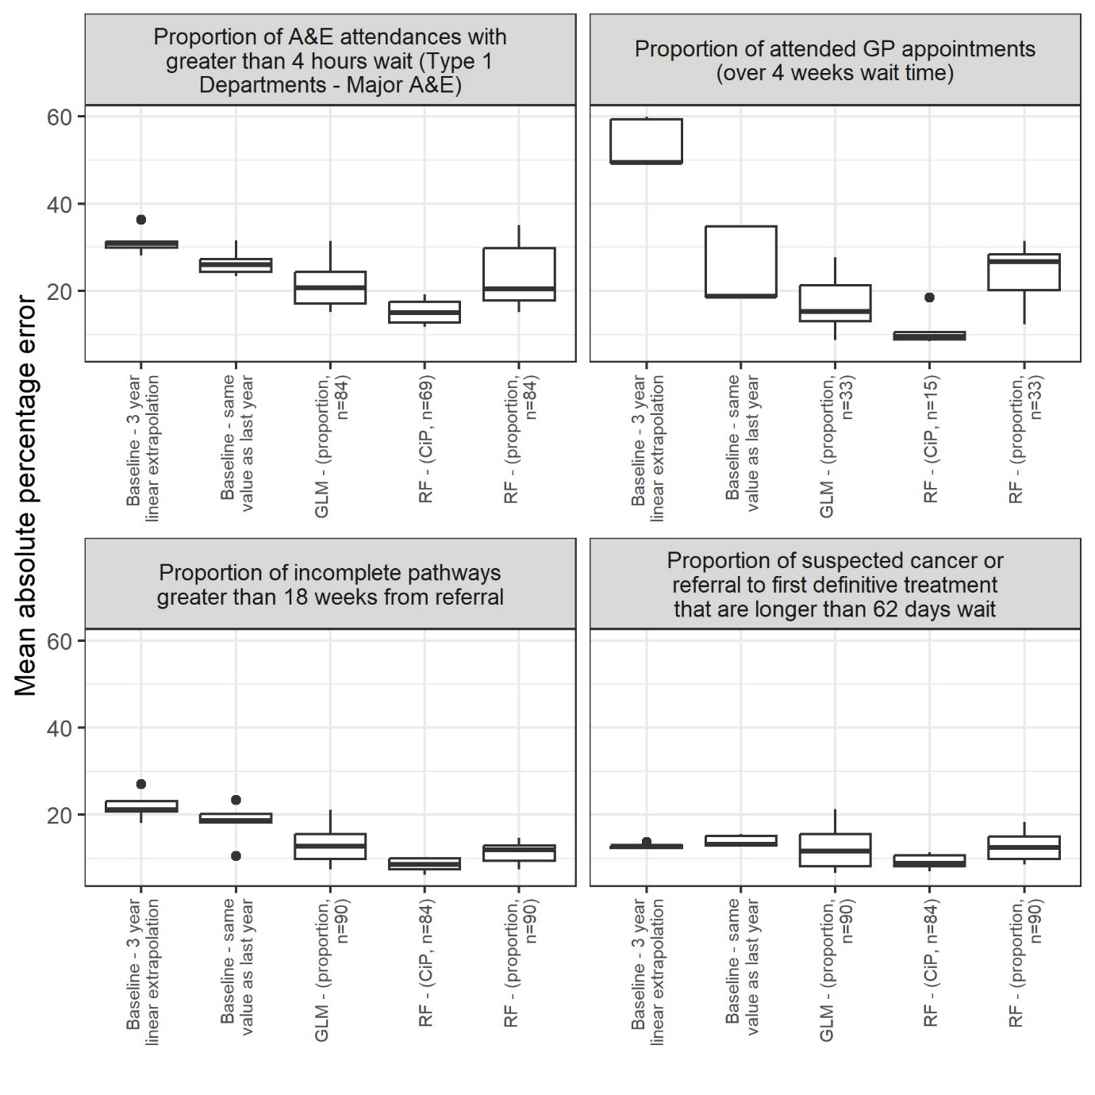
Model evaluation
Reproducibility
Sophisticated models generally outperformed naïve models
Random forest model, that modelled the change in outcome from one year to the next, generally performed best
A&E 4 hr waits had the highest mean absolute percentage error
Data
Methods
Implementation

Slide 13
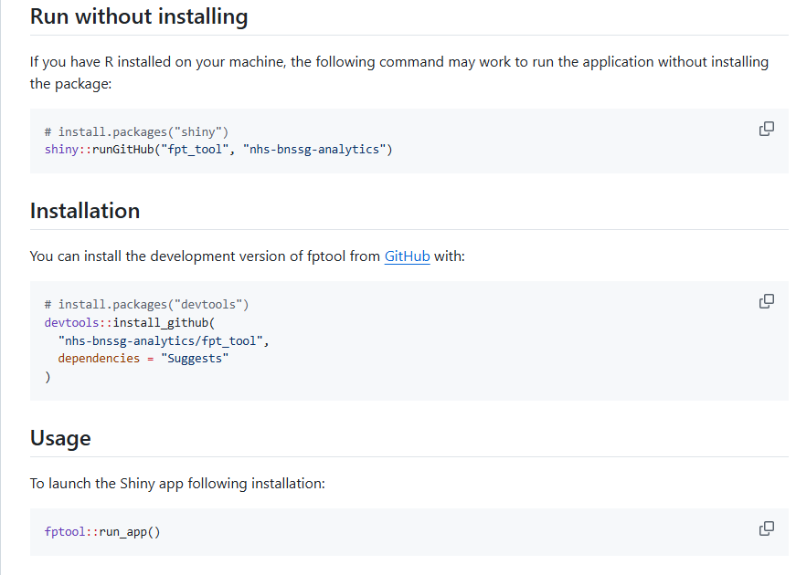
Accessing the Future Performance Tool
Reproducibility
Shinyapps.io
Free (with big limitations)
Publically available (this is ok because it uses public data)
Easy to set up
Locally
Data
Methods
Implementation

Slide 14
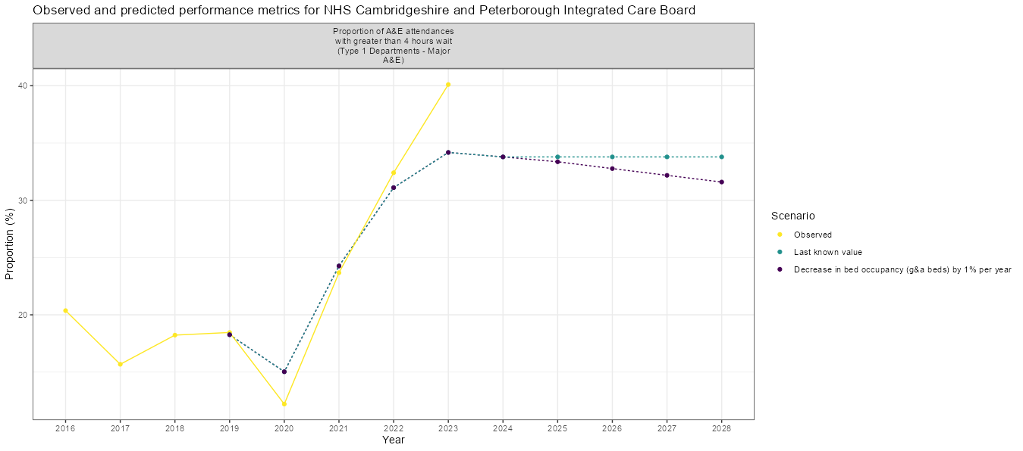
What does the tool look like?
Reproducibility
Data
Methods
Implementation

Slide 15
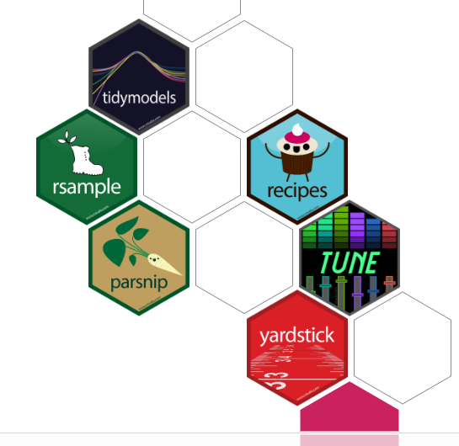
Learnings - {tidymodels}
Reproducibility
Brings order to the chaotic modelling landscape in R
Connects to the common statistical packages
Common language
Lots of examples and documentation
Safeguards against common errors and guides you to ensure best practice
Data
Methods
Implementation

Slide 16
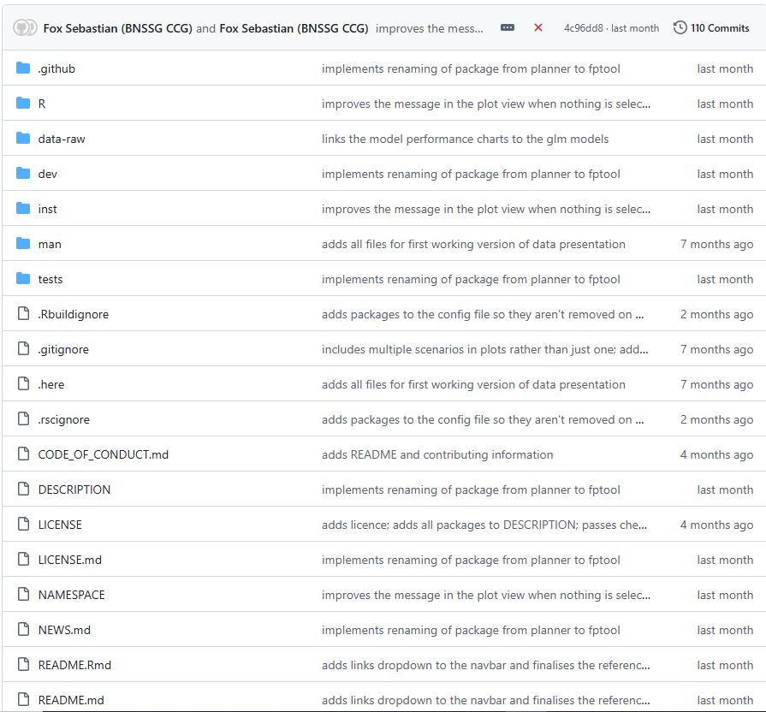
Learnings – {golem}
Reproducibility
Modular
Standard project structure
Unit testing
Easily installable
Continuous integration
Data
Methods
Implementation

Slide 17
Thank you
Reproducibility
Data
Methods
Links:
GitHub for analysis: https://github.com/nhs-bnssg-analytics/fpt_analysis
Project documentation: https://nhs-bnssg-analytics.github.io/fpt_analysis/outputs/01_index.html
GitHub for tool: https://github.com/nhs-bnssg-analytics/fpt_tool
Tool : https://sw-dsn.shinyapps.io/future-performance-tool/
Implementation

