Slide 1


What insights did Scottish Ambulance Service (SAS) gain from combining multiple data sources about all chest pain patients from 2023? Presentation about the process and findings of a 1-year long MSc dissertation project
Katalin Koszegi, MSc
MSc Data Science for Health and Social Care, University of Edinburgh
Dr Pawel Orzechowski, PhD
Lecturer in Programming for Data Science, MS Project Supervisor, University of Edinburgh
Dr Adam Lloyd, PhD
Clinical Supervisor, Scottish Ambulance Service

Slide 2
Background of the project
Final year MSc Dissertation work-placement project with Scottish Ambulance Service
Descriptive analysis using historical chest pain patient data collected
over a 12-month period in 2023
“First of its kind” analysis (no analysis done before on chest pain within SAS)
Service evaluation based on 6 clinical research questions
999 call
Past medical history
Vital signs, symptoms
Heart attack
Treatment given
Transported to hospital

Slide 3
Background of chest pain – literature data
Over 10% of patients contact emergency services with chest pain
Category | Diagnosis
Cardiovascular | Myocardial infarction
 | Angina pectoris
 | Heart failure
Respiratory | Pulmonary embolism
 | Pneumothorax
 | Airway infection
Gastrointestinal | Reflux, peptic ulcer
 | Acute pancreatitis
 | Tumour
Psychiatric | Substance dependence/misuse
 | Depression/affective disorder
 | Anxiety/panic disorder
Musculoskeletal | Inflammation
 | Contusion
20% of chest pain patients are diagnosed with a cardiac condition
But over 50% of patients with chest pain are be discharged without any serious findings
Still, call handlers tend to send ambulance since it can be life-threatening (overtriage)

Slide 4
Scottish Ambulance Service (SAS) data
14 datasets - 250 variables - 54,842 Incident IDs
call & incident details
patient demographics (age, gender, postcode)
monitoring and management of patient vital signs
allergies and past medical history
pre-hospital medication
management acute coronary syndrome (heart attack)
ambulance crew notes
discussion with call handler

Slide 5
Data Cleaning Challenges SAS data quality
Understanding what was behind the variable names
Inconsistences in the CSV data files
Split columns
Same variables in different datasets with different values
Mixed up variable column names
More than 2 values for binary variables (e.g. Yes, No, N/A, number, free text)
Limited text mining for free text variables
Time limit
No pattern
Variables with 100s options
Few variables with less options (e.g. unifying drug names)

Slide 6

Data analysis in R
Data
11 csv files
approx. 60 variables
54,842 Incident IDs
changing data types
renaming variables
creating new categorical variables
age groups, seasons, type of medication
recode the levels of factors for easier interpretation
modifying free text values
Cleaning
library(tidyverse)
library(dplyr)
library(janitor)
library(magrittr)
library(lubridate)
library(naniar)
Analysis
library(ggplot2)
library(RColorBrewer)
library(sf)
library(descriptr)
library(epitools)
library(finalfit)
library(knitr)
library(broom)
library(BSDA)
tables
plots
bar plots, heatmaps
statistical analysis

Slide 7
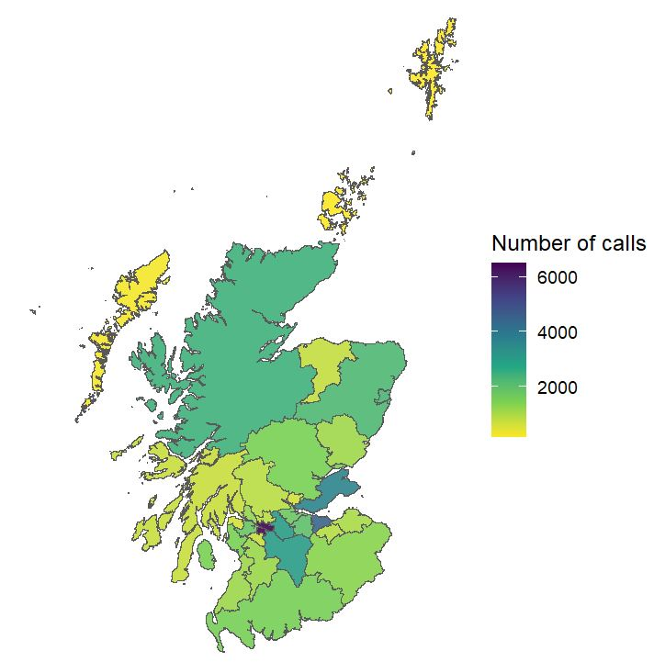
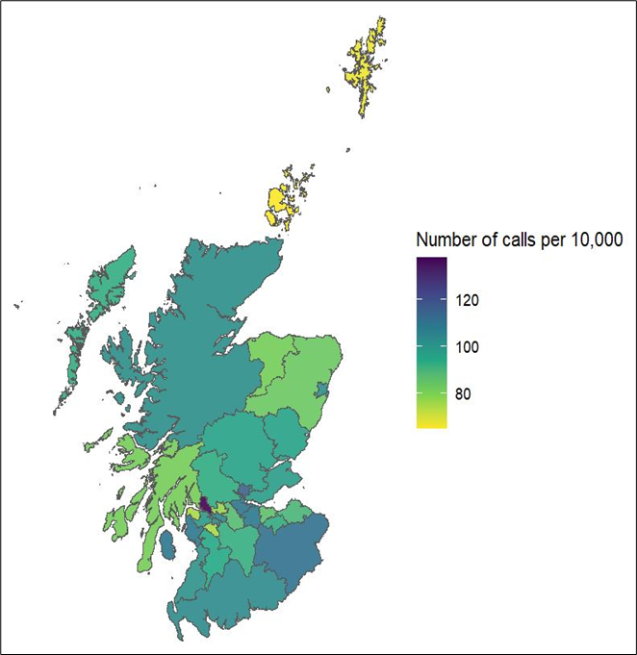
Number of calls by geographic regions
Blank map
GeoJSON file with coordinates of UK boundaries
Filtered to Scotland
library(sf)
Dataset for map
Downloaded file UK postcodes & coordinates
Merged with SAS dataset based on postcode
CouncilArea2019Code
Final map
Library (ggplot)
Number of calls
Number of calls per 10,000 people

Slide 8
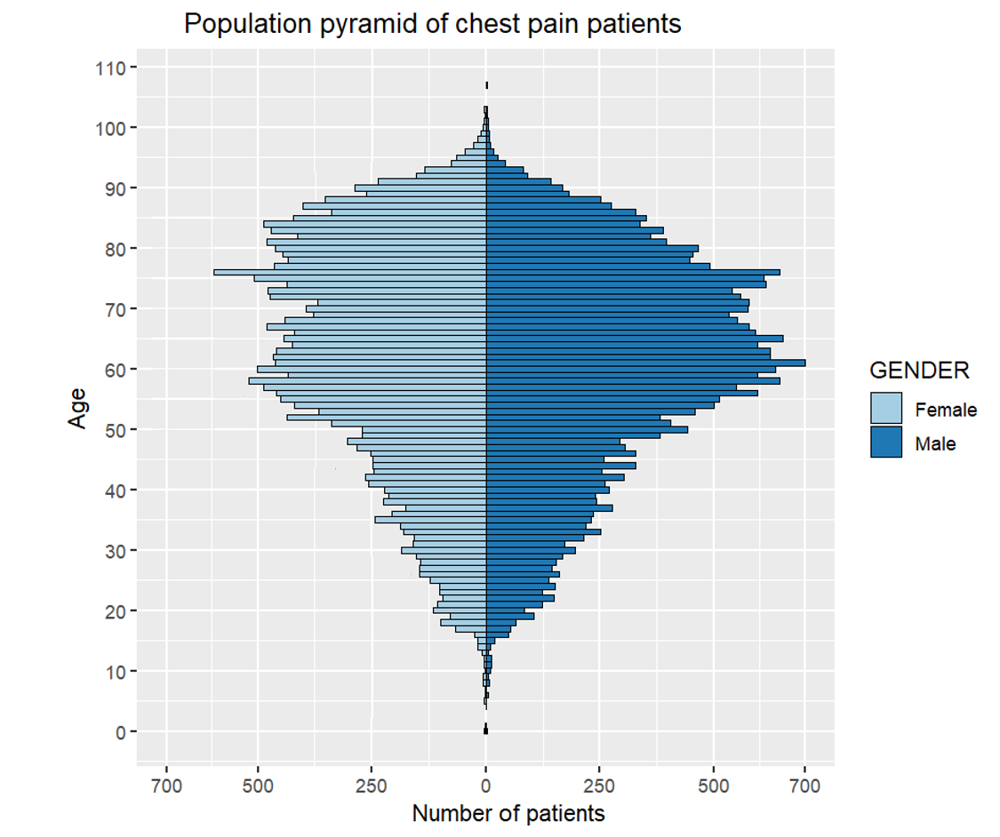
Population pyramid
FEMALE
MALE
Population pyramid
Library (tidyverse)
Library (ggplot)
Results
More men (51%) than women (45%)
Most aged over 70 yrs (36%)
More women over the age of 70
N = 54,834

Slide 9
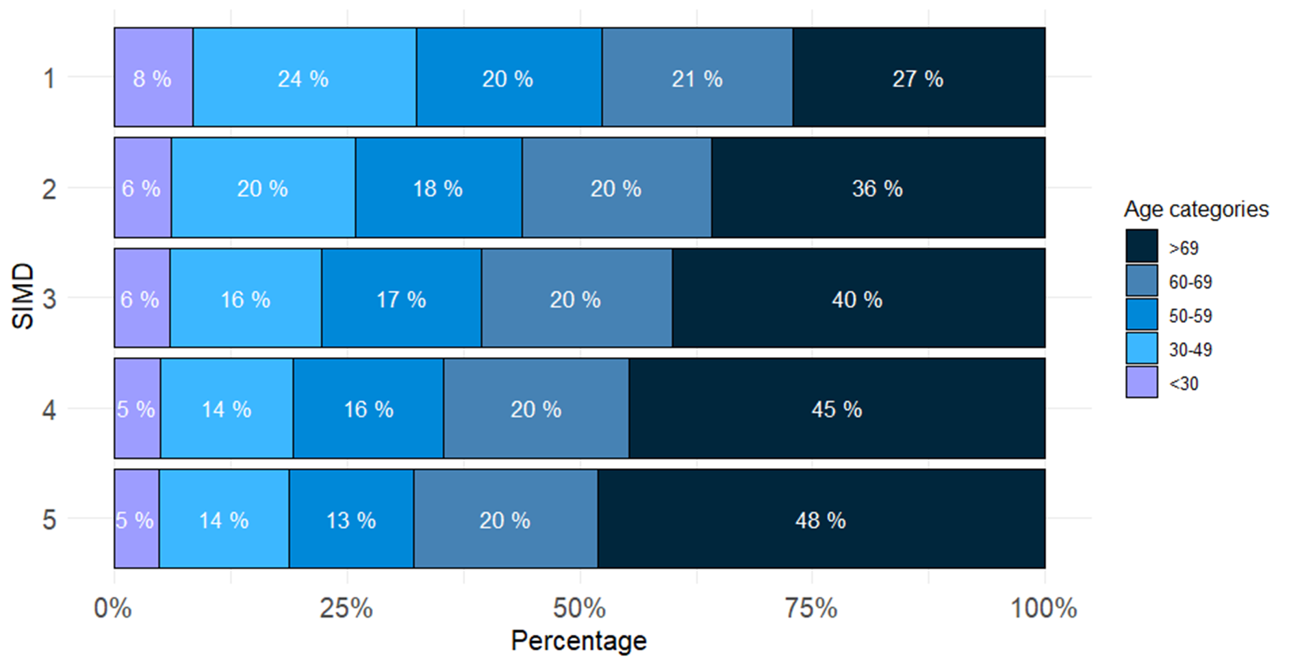
Number of calls by deprivation zone
MOST
DEPRIVED
LEAST
DEPRIVED
YOUNGEST
OLDEST

Slide 10
Conclusion
provided an insight how the Scottish Ambulance Service manages patients
and records data in relation to chest pain
provided a useful baseline data for future research (e.g linking patients’ ambulance data with hospital treatment and outcomes)
prediction model also can be developed to identify high risk chest pain patients

Slide 11
Thank you for your attention

