Slide 1
Development Team Update
The Dev Team

Slide 2
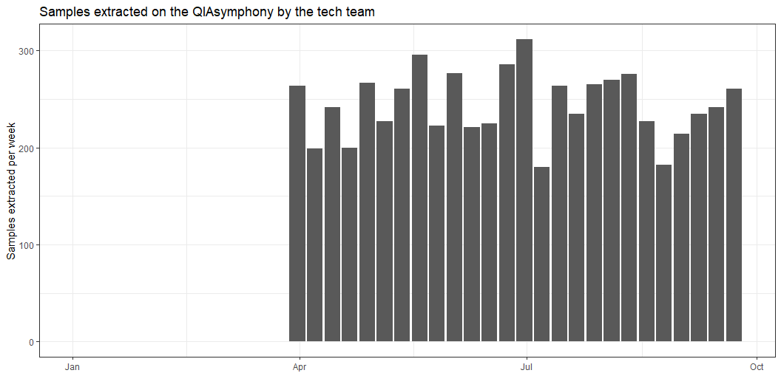
QIAsymphony extractions
Louise validated the QIAsymphony robot in April 2024.
Since then, 6351 samples have been extracted.

