Slide 1
Research Guided Work: Women Corner Example
SHU-Rouen Winter School

Slide 2
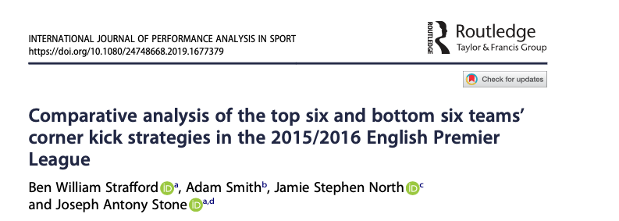
Effect of set play tactics
Set plays account for 30% to 40% of goals scored in elite men’s soccer
Corner kicks are largely ineffective (2.1% to 2.9% goals scored), but are influential in the final result of the match (68% of goals scored affect the result)

Slide 3


Background
Limited research examining set plays within women’s soccer
The aims were to determine the effectiveness of different types of corner kicks and identify key variables associated with attempts on target and goal scoring

Slide 4
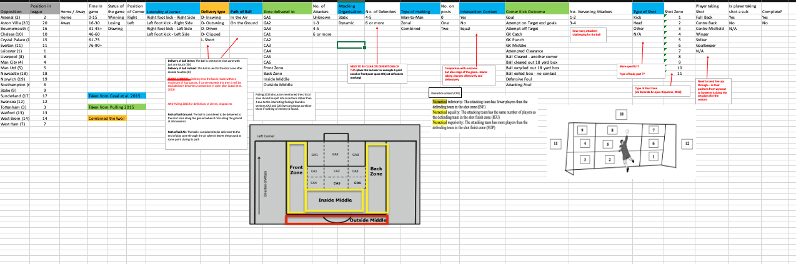
Method
17-18 Season (89 matches): 824 corner kicks

Slide 5
Method
17-18 Season (89 matches): 824 corner kicks
Delivery type
Left sided corner
Goal
Attacking direction
Outswinging
Inswinging
Direct
Worked
Indirect

Slide 6
Method
17-18 Season (90 matches): 824 corner kicks
Delivery type
Delivery area
Left sided corner
Goal
GA1
GA2
GA3
Front zone
Back zone
CA1
CA2
CA3
Attacking direction
Edge
Based on Casal et al. 2017

Slide 7
Method
17-18 Season (90 matches): 824 corner kicks
Delivery type
Delivery area
Corner kick outcomes
Goal
Attempt on Target
Attempt off Target
Free Kick or Penalty
Defensive Block
Goalkeeper catch/punch
Loss Possession

Slide 8
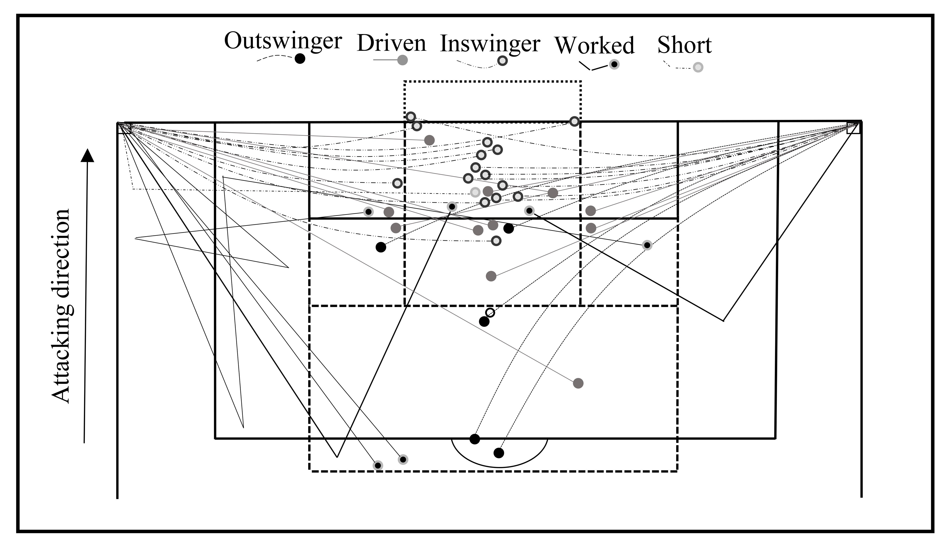
Results: Goal
38 goals scored (13.5% of the total 282 goals scored)
4.6% of corners taken resulted in a goal
Delivery Type had No Effect on outcome

Slide 9
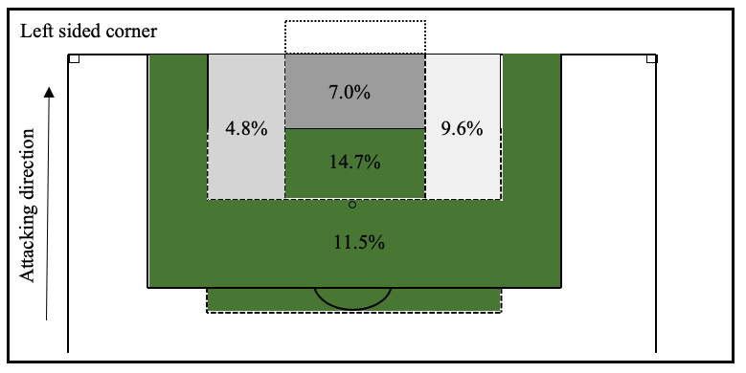
Results: Delivery Area
Attempt On Target
Delivery zone effected the likelihood of an attempt on target (P = 0.018)

Slide 10
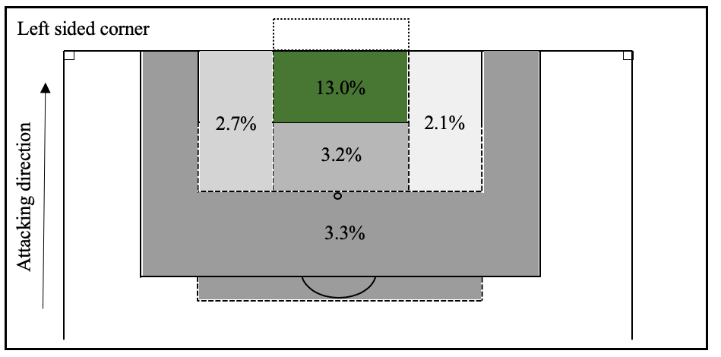
Results: Delivery Area
Goals were most likely to be scored when the ball was delivered into the central zone close to the goal line

Slide 11
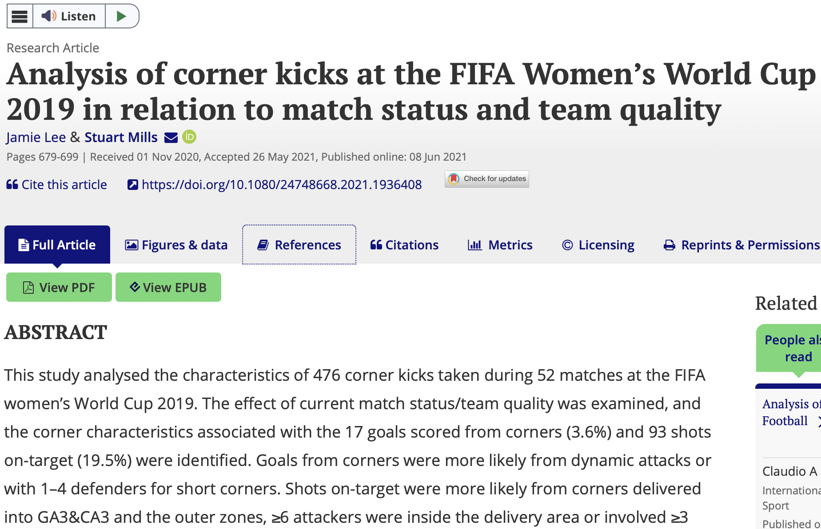
Other Papers on Corners…

Slide 12
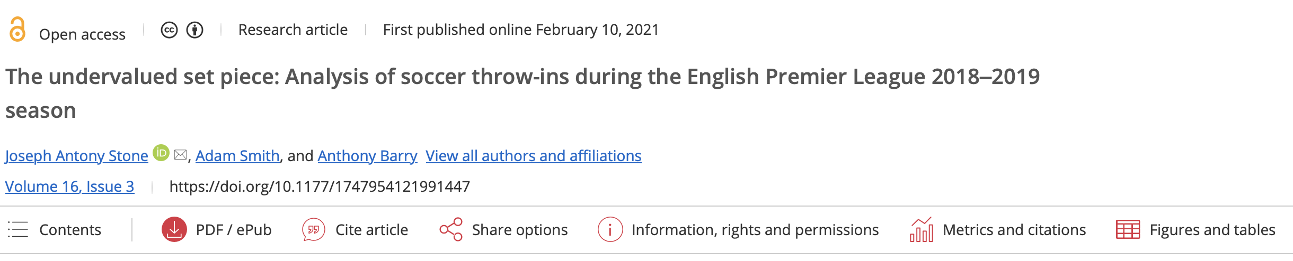
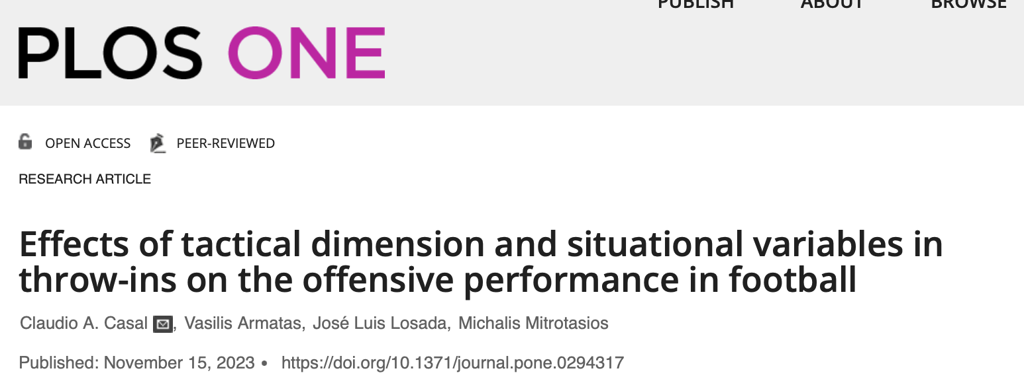
Throw-In Examples

Slide 13
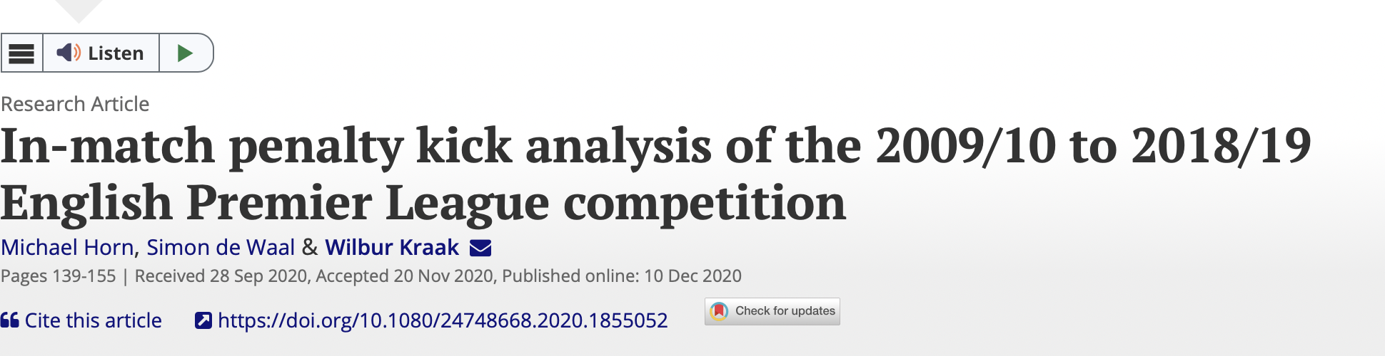
Penalty Kicks

