Slide 1
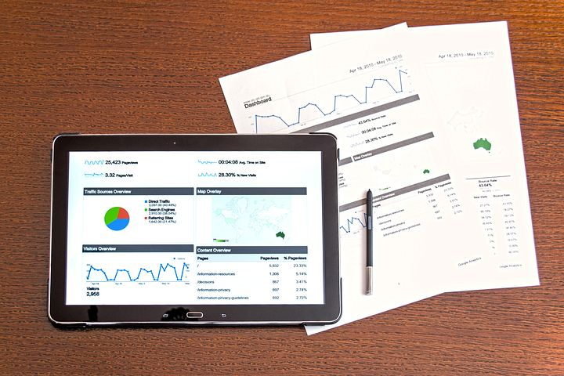

Welcome to Python Pandas Merge Sort Filter
Dave Dalsveen

Slide 2
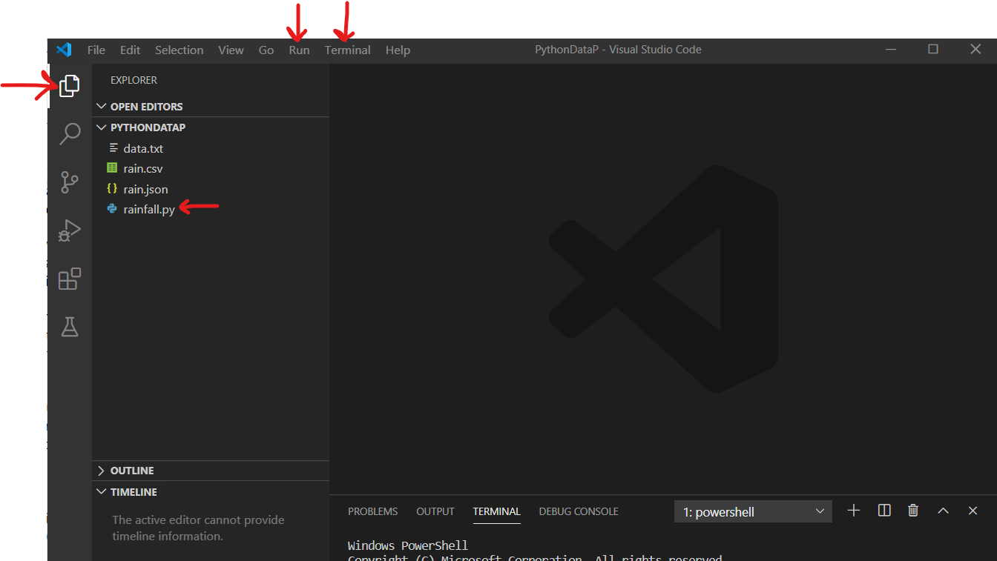
Visual Studio Code
The main Visual Studio Icons we are using are:
Explorer
Run->run without debugging
Code editor Window

Slide 3
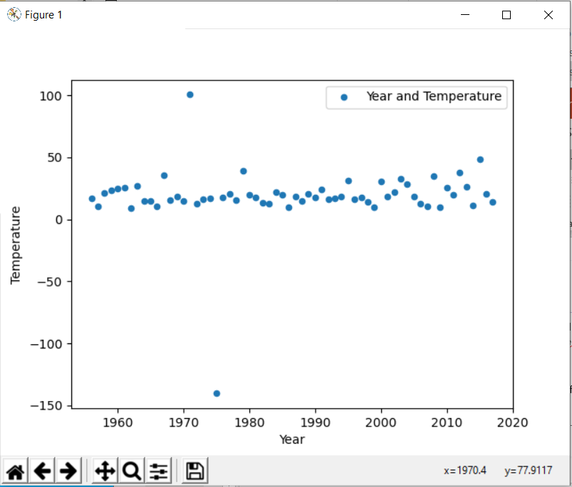
Task1: Read the data into a Pandas DataFrame
Create Temperature and Rainfall Tables using Pandas DataFrame and print..
Make a scatter plot graph of temperature data as well as rainfall data.
Observe outliers for each graph.

Slide 4
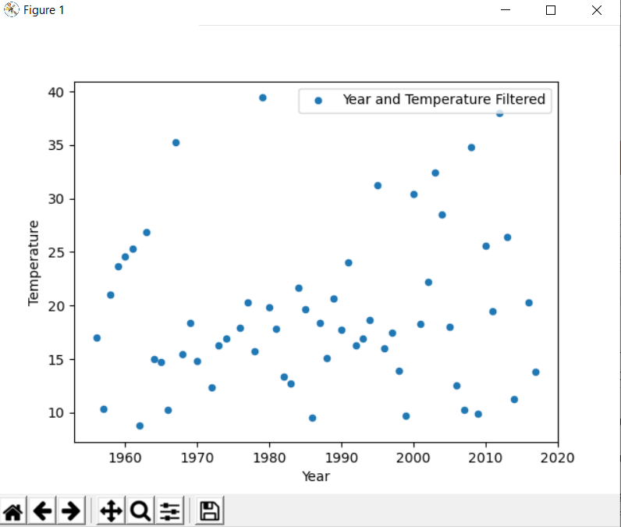
Task2: Use a Filter to remove outliers in the data
Use a query to eliminate outliers in temperature.
Use a query to eliminate outliers in rainfall
Graph the filtered temperature.
Graph the filtered rainfall.

Slide 5
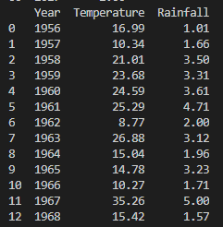
Task3: Combine the data using Pandas Merge
Merge two DataFrames together.
Use pandas merge with an outer join
Observe the merged data.
Use pandas merge with an inner join.
Print the merged DataFrame.

Slide 6
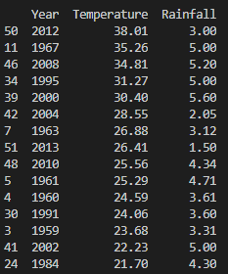
Task4: Sort the data by rainfall and temperature
Sort by temperature using the merged data set.
Observe any possible patterns in temperature vs. rainfall.
Sort by rainfall using the merged data set.
Sort in descending order.

Slide 7
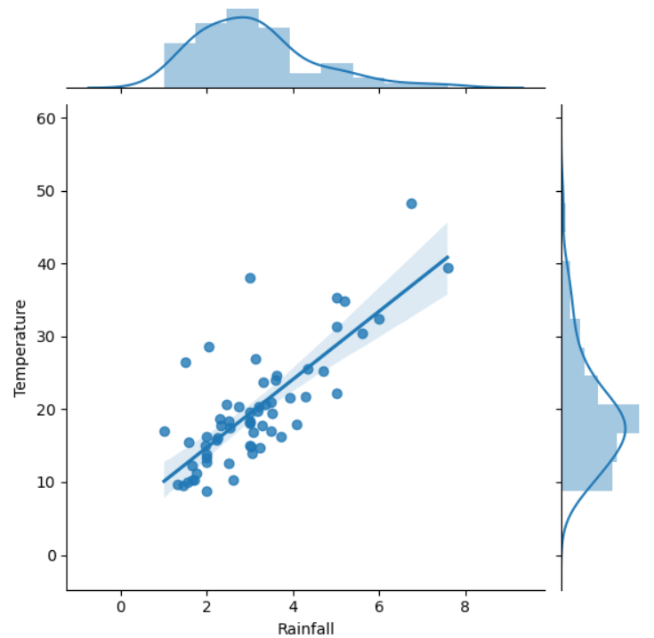
Task5: Use the Seaborn package to create a regression plot
Popular type of graph--Good for looking at distribution and data points at the same time.
Has option to display different kind of graph- the parameter called kind.
Here, we will see scatter with regression line, as well as distribution.
Graphing yields a much better overall view of the data than simply looking at tables.

