Slide 1
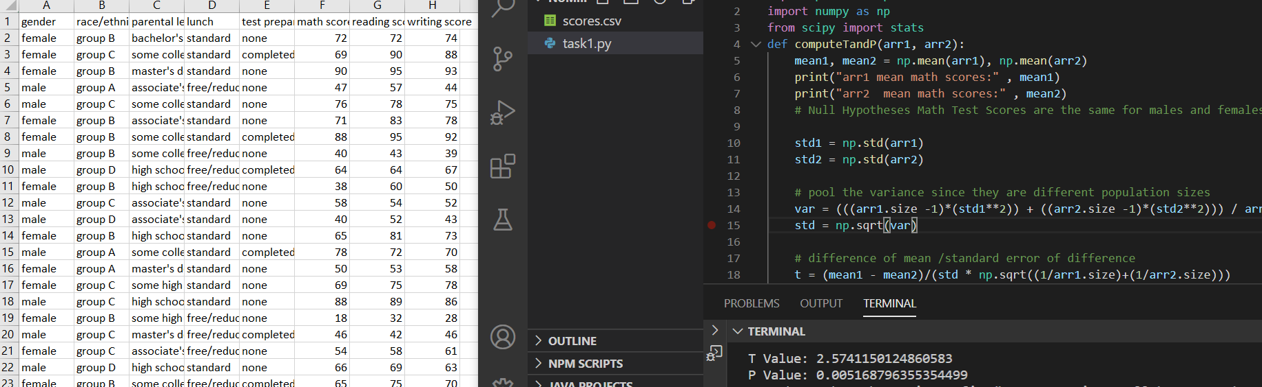

Providing Statistical Analysis of Testing using Python Numpy
Dave Dalsveen

Slide 2
Visual Studio Code
The main Visual Studio Icons we are using are:
Explorer
Run->run without debugging
Code editor Window
Debugging Controls
Status Bar (run tests)

Slide 3
Task1: Analyze the T-Test problem and use the Python Pandas to read from the CSV into a Data Frame.
Describe the problem.
Create a Null Hypothesis
Use the Python Pandas to read from the CSV into a DataFrame.
Observe the dimensions of the DataFrame.
Print the DataFrame.

Slide 4
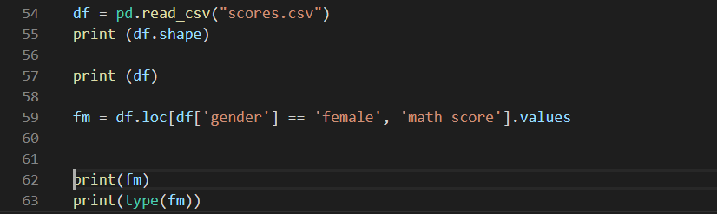
Task2: Obtain two Numpy arrays from the DataFrame column to represent Female student scores and Male Student scores.
Extract the math score data for female students using a condition.
Check the type of the array.
Print the array.
Extract the male math scores int o another array.

Slide 5
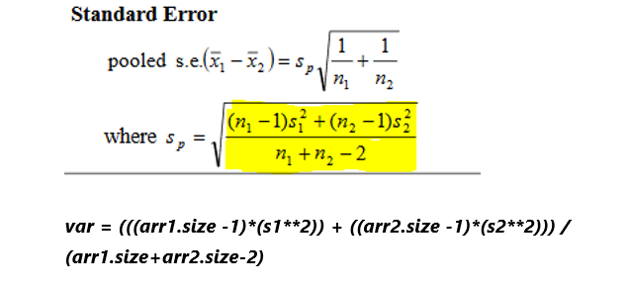
Task3: Compute the variance of the two arrays using the standard deviation from each array.
Compute the mean of each sample array using Numpy.
Implement the function.
Compute the pooled variance since population sizes are different
Analyze the formula and convert it into python code.

Slide 6
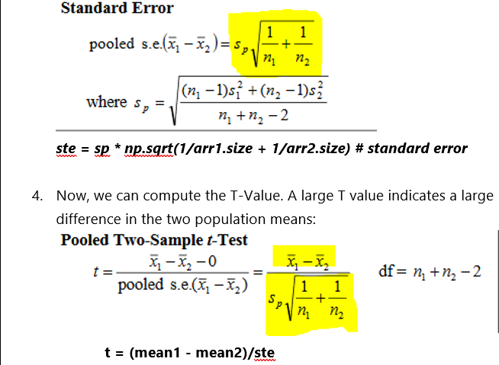
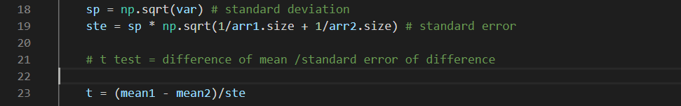
Task4: Add the Numpy code to compute the pooled Variance and standard deviation and determine the T-value and P-value of the data sets.
Use the Formula to compute pooled standard deviation.
Use the pooled standard deviation to compute standard error.
Use the difference between the means and standard error to compute the t value
Compute Degrees of Freedom
Compute P value using stats

Slide 7
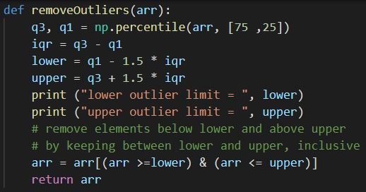
Task5: Add the function to remove outliers from each set of data, then re-compute the T-value and P-value.
Create a function to remove outliers programmatically.
Shouldn’t normally alter original data before investigation.
Compute the upper and lower quartiles.
Remove them from the array using the calculated InterQuartile (IRQ) range.

