Slide 1
Homework 1
Special Directions on Machine Learning (SDML)
Fall 2019, NTU CSIE
Prof. Shou-De Lin
TA: Ywuan-Chai Chong

Slide 2
AI CUP 2019
Abstract labeling 論文標註 The contestants should use the provided materials to predict if a sentence in a thesis should be classified as the following categories: Background, Objectives, Methods, Results, Conclusions, or Others. Note that a sentence may have multiple classifications, e.g. a sentence may be classified as both Objective and Methods.
Abstract classification 論文分類 [SDML HW1] The contestants should use the provided materials to predict the classification of a thesis into the following categories: Theoretical Paper, Engineering Paper, Empirical Paper or Others. Note that a thesis may have multiple classifications, e.g. a thesis may be both a Theoretical Paper and an Engineering Paper.

Slide 3
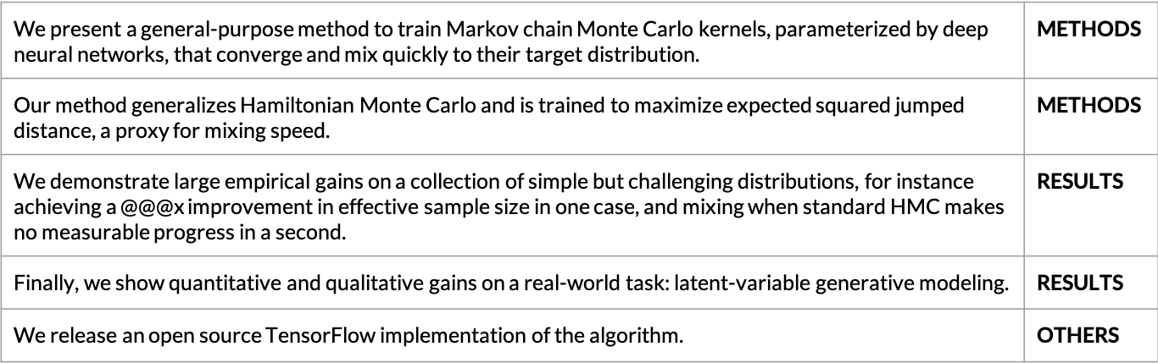
AI CUP 2019 (cont.)
Abstract labeling
Paper Title: Generalizing Hamiltonian Monte Carlo with Neural Networks
Paper types: Theoretical, Empirical
Abstract classification

Slide 4
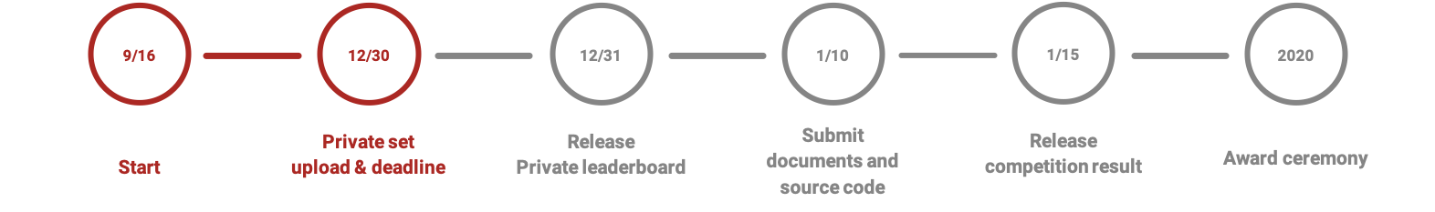
AI CUP 2019 (cont.)

Slide 5
AI CUP 2019 (cont.)
Abstract labeling prizes (total 350,000 NTD):
Trend Micro Elite Award in Artificial Intelligence: 100,000 NTD
Student Group Leaderboards Champion: 100,000 NTD
Student Group Leaderboards 2nd Runner Up: 60,000 NTD
Student Group Leaderboards 3rd Runner Up: 40,000 NTD
Student Group Leaderboards 4th ~ 9th place: 10,000 NTD
Abstract classification prizes (total 350,000 NTD):
Trend Micro Elite Award in Artificial Intelligence: 100,000 NTD
Student Group Leaderboards Champion: 100,000 NTD
Student Group Leaderboards 2nd Runner Up: 60,000 NTD
Student Group Leaderboards 3rd Runner Up: 40,000 NTD
Student Group Leaderboards 4th ~ 9th place: 10,000 NTD
In addition to the top 8 ranking award for the Student Leaderboard Group, teams ranking in the top 25% and whose private score is above Baseline (Baseline: 0.69) will be presented with a Certificate of Workshop Award.

Slide 6
Introduction
Topic: Abstract classification problem from AI CUP 2019.
Data: Real-world research thesis (abstract).
Extra Data: Real-world citation networks.

Slide 7
Abstract Classification
Goal: To predict the classification of a thesis into the following categories:
Theoretical Paper
Engineering Paper
Empirical Paper
Others
Note that a thesis may have multiple classification, e.g., a thesis may be both a Theoretical Paper and an Engineering Paper.
For the task of HW1
Real-world datasets are used. (Provided by AI CUP 2019)
All the labels are annotated by the authors of the paper.
Trainset 7000
Public Testset 20000
Private Testset 20000
Sample Submission 40000
Predict with your model
(20k)
Public
Testset
Private Testset
All Zeros (20k)

Slide 8
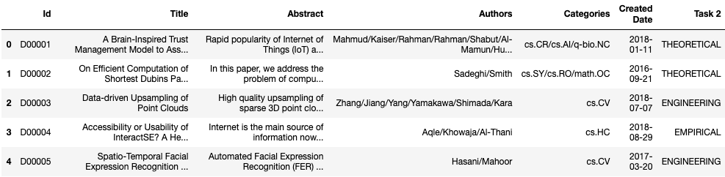
Data
Id
流水號
Title
論文題目
Abstract
論文摘要
Authors
作者們
Categories
論文類別
Dates
發佈日期
Label
分類類別

Slide 9
Data (cont.)
Id
Serial number.（流水編號，無特別意義。）
Title
Title of the paper.（論文文章標題。）
Abstract
Abstract of the paper. Each sentence is be separated by $$$. （論文摘要，以 $$$ 將句子隔開。）
Authors
Authors of the paper. Each name is be separated by /.（論文作者，每個作者以 / 將句子分開。）
Categories
Each field is be separated by /.（該論文在arXiv上的分類，多個分類以 / 做分割。）
Created Date
The date which the paper uploaded to www.arxiv.com.（論文上傳至www.arxiv.com 的日期。）
Task 1 / Task 2 Label
T1 - Multilabel of each sentence in the paper. Each multilabel is be separated by space and each label is be separated by /.（ 論文摘要的句子分類，每個句子的分類以 空格 分開，同個句子多個分類以 / 分開。 ）
T2 - Multilabel of the paper. Each label is be separated by space.（ 論文的分類，多個分類以 空格 做分割。 ）

Slide 10
Data (cont.)
Generalizing Hamiltonian Monte Carlo with Neural Networks
Paper types: Theoretical, Empirical

Slide 11
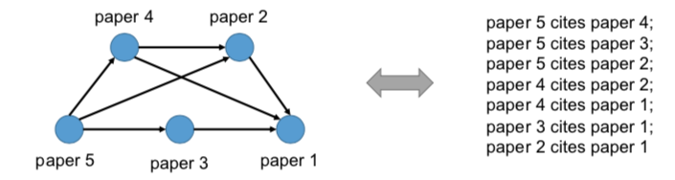
Extra Data - Citation Networks
Node: publications (e.g., papers, articles, books)
Edge: citation references
Directed edges (arcs) <a,b> =/= <b,a>
Directed Acyclic graphs (DAGs)
Temporal topological order on citations (i.e., links).

Slide 12
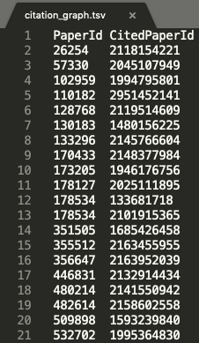
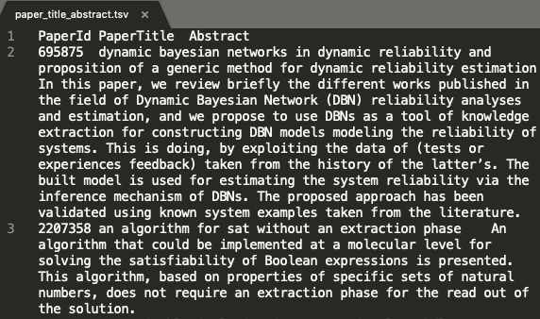
Extra Data - Citation Networks (cont.)
mag_paper_data/ |-- citation_graph.tsv |-- paper_title_abstract.tsv |-- id_paperId.tsv |-- README and others.
This graph contains
~770k nodes, ~1372k edges
~708k nodes have Title and Abstract
1780 connected components,
Largest connected components included 760k nodes, 98.77% nodes are linked
You may find some papers from Trainset (7k) + Public Testset (20k) + Private Testset (20k) which do not appear in this graph.
Using thesis title to match between dataset (trainset + testset) with this graph.
Please take a look on README - “How to normalize thesis title for mapping.”
Download link

Slide 13
TBrain Competition
Testing data will be divided into public and private testing.
You will be evaluated based on the performance of public testing only.
Maximum 2 submissions a day are premitted.
Last valid submission score will be choosen as final score before the deadline.
Remember to declare your team on the Tbrain platform.
Using extra data from the Internet is prohibited.
All rules and regulations follow AI CUP 2019.
Please use the SDML_<Student-ID> or SDML_<Group Name> as the TBrain nickname to show on the leaderboard.
Please form a team (not more than 3 people) and fill in HERE (google sheets).
For example, SDML_r07922001 or SDML_Team01 as the nickname
Competition pages:
https://tbrain.trendmicro.com.tw/Competitions/Details/9

Slide 14
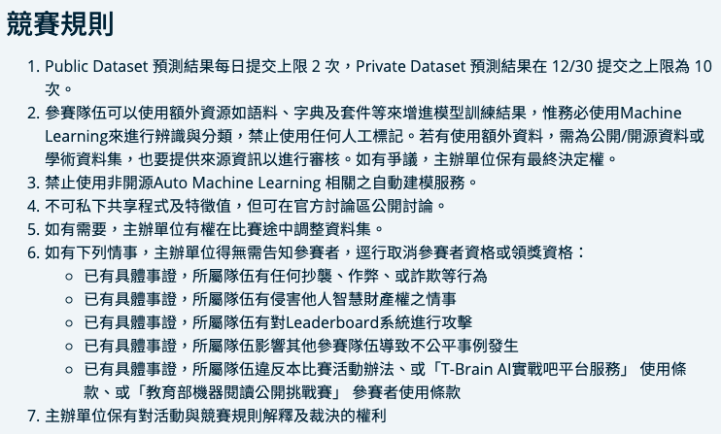

Slide 15
Grading Policy
Performance (50%)
Performance Ranking: all the participant will be ranked according to the TBrain Public testing scores.
Baselines: you need to beat our baseline for a basic score.
Simple GRU tutorial (0.68)
Bert: 0.716
BASELINE: 0.7
Report (50%)
Coverage (25%): #methods you tried; please describe and analyze the approaches with experiment results.
Novelty (25%): how novel is your model designed. (Ensemble techniques are valid, however we encourage novel single models.)

Slide 16
CEIBA Submissions
You should submit your score codes along with reports to the corresponding CEIBA entries.
Including any third-party scource codes you used.
A .zip file should be uploaded.
The format of CEIBA submissions is stated later.
Your CEIBA submissions should match your final output on the TBrain platform.
That is, your source codes should be able to reproduce your final performance scores on TBrain.
Plagiarism is strictly prohibited.
You should clearly mention all the third-party codes (if any) used in your submissions.
We will check your source codes via professional softwares.

Slide 17
Reports
Your report should be formatted in PDF files.
Only digital submissions on CEIBA are acceptable.
The report should include:
Official name and the student ID of each member.
Attempted approaches to solve specific problems.
Analyses and observations based on experiment results.
Difficulties encountered, unsolved issues, etc.
No page limit. ☺
Feel free to include all the experiment results, reference theorems or other appendices.

Slide 18
Format of CEIBA Submissions
[student-id].zip (team leader’s, e.g., r07922001.zip) |-- src/ (the source codes written by you) |-- lib/ (all the libraries, third-party source codes you used) |-- report.pdf |-- README (a ‘plaintext’ file to explain how to reproduce your results)
(You must submit this .zip to get the 50% performance points.) <Important> You should upload in .zip format. .rar, .tar, .gz, .7z, or any other formats will receive 0 points without grading.

Slide 19
Submission Deadlines
Performance due time: 2019/10/15 (Tue.) 23:59:59 (Taiwan time)
According to the system times of TBrain
Report and Source code due time: 2019/10/20 (Sun.) 23:59:59
According to the system times of CEIBA
Since the network status is unpredictable, please make your submissions as earlier as possible.
Only team leader has to submit the .zip & report.
HW1 presentation: 10/17 (Thur.)
Upload your presentation slide to CEIBA before 13:00:00 (Taiwan time).
Top 10 teams in the class will need to present (announced later).
Please prepare your own laptop and presentation slide.
For the delayed submissions:
Within 24 hours: original_task_score * 0.5
More than 24 hours: zero point for the homework.

Slide 20
Contact TA
If you have any problems, please check or post at the competition discussion page first !!!
If you have any problems, feel free to contact TAs.
TA in charge: 張緣彩
TA hour: Fri. 11:00 ~ 12:00
Email: r07922141@ntu.edu.tw

Slide 21
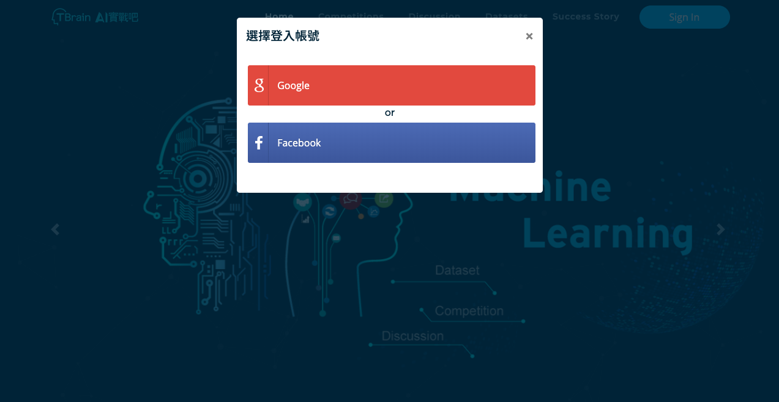
How to register at TBrain platform?

Slide 22
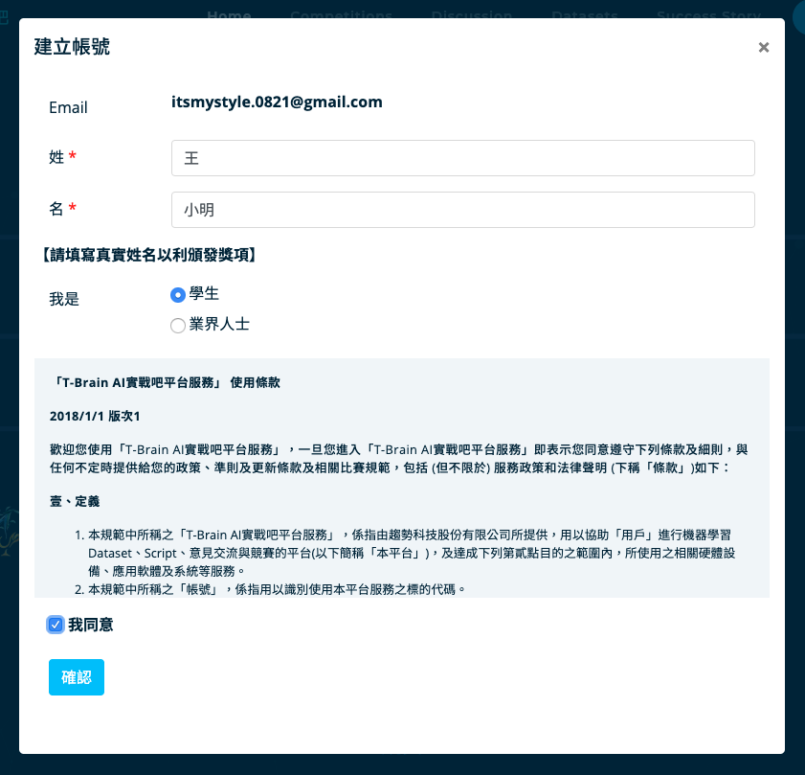
How to register at TBrain platform?
一定要填真實姓名
勾選學生組

Slide 23
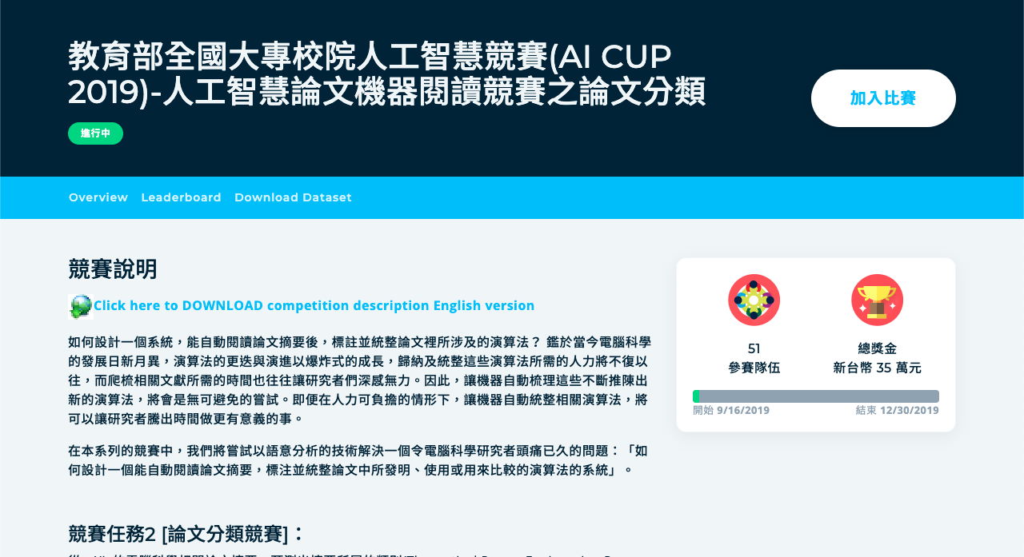
How to register at TBrain platform?
一定要填真實姓名
勾選學生組

Slide 24
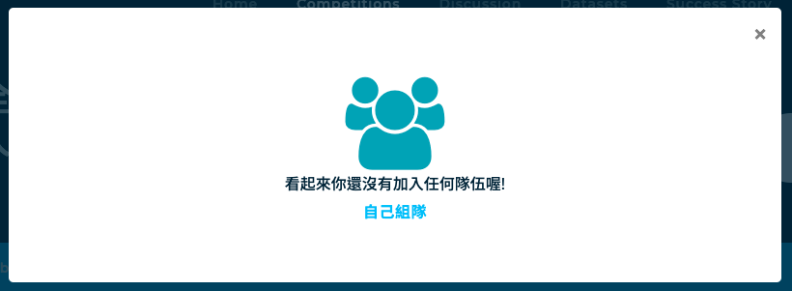
How to register at TBrain platform?
一定要填真實姓名
勾選學生組

Slide 25
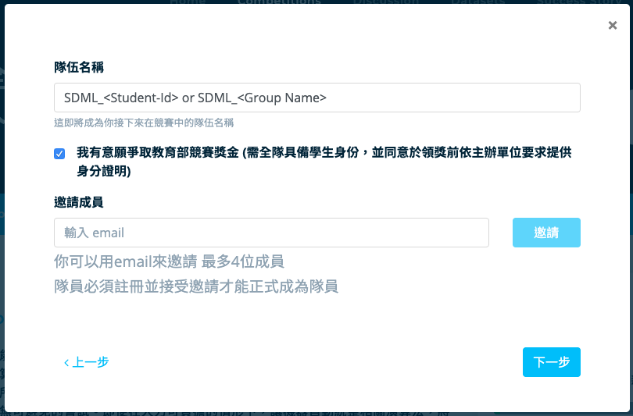
How to register at TBrain platform?
填寫隊伍名稱,註冊後隊伍名字就不能更改
一定要填真實姓名
勾選學生組
可以之後在邀請隊員

Slide 26
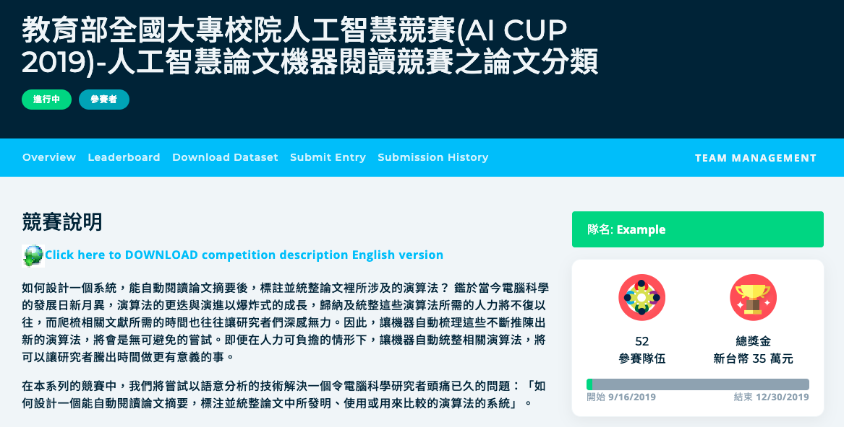
How to register at TBrain platform?
一定要填真實姓名
填寫隊伍名稱
勾選學生組
可以之後在邀請隊員

Slide 27
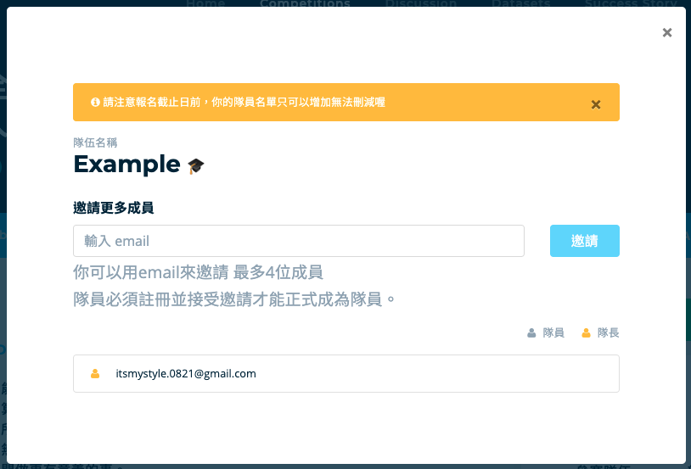
How to register at TBrain platform?
一定要填真實姓名
填寫隊伍名稱
勾選學生組
邀請隊員
可以之後在邀請隊員

