Slide 1
Version Control with Git
PSYC 5P02
Programming for Experimental Psychology
Prof. Stephen Emrich
Brock University

Slide 2
Version control
What do you do if you have a piece of code working, you then make some changes to the code, and then it breaks?
How do you work with collaborators on a project where each of you wants to make some changes to the same file at different points in time?
What happens if you accidentally go over their changes
What if you make several changes to an analysis pipeline and want records of each step?
These are all problems that can be solved with version control

Slide 3
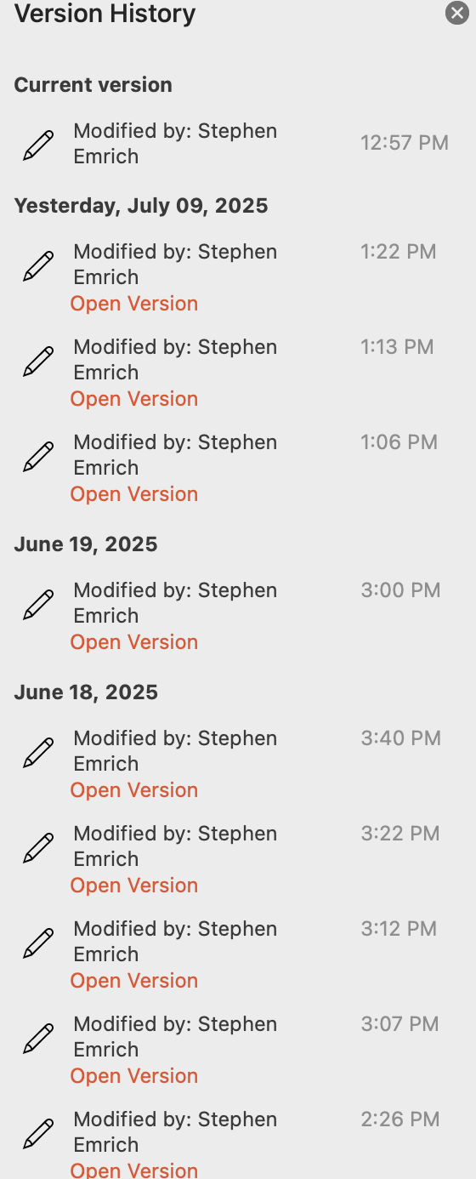
Version control
Version control is a way to:
Keep track of changes that are made to a file
Collaborate with other researchers on the same project
When syncing to an online repository, it’s also a way to ensure your files are backed up
Likely familiar with version control through Microsoft 365 apps (Word etc.) in combination with OneDrive storage
Most common form of version control for code/software: Git

Slide 4
What you will need
Create an account on Github.com
Make sure you have git installed:
MacOSX: open terminal and type $ git --version
(if not installed, follow install instructions – may want to skip Xcode install)
Windows: open WSL2 terminal and type the following commands:
$ sudo apt update
$ sudo apt install git build-essential autotools python3 r-base

Slide 5
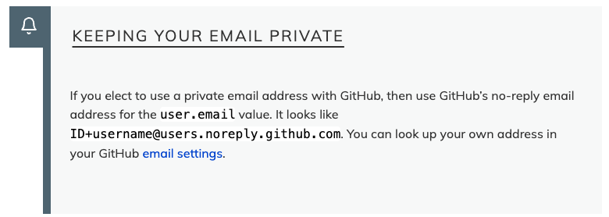
Configuring Git
We’re going to set up a few options that will be used for every Git project we create by using the --global flag and adding them to the config file:
$ git config --global user.name “Your Name”
$ git config -- global user.email “your.email@brocku.ca”

Slide 6
Configuring Git
We can view the current config file through:
$ git config --global --edit
Note that this is going to open in vi because vi is our current default text editor for git. Want to change it to something else, e.g., Sublime Text?
Mac:
$ git config --global core.editor ‘/Applications/Sublime\ Text.app/Contents/SharedSupport/bin/subl -n -w’
Windows:
$ git config --global core.editor "'c:/program files/sublime text 3/sublime_text.exe' -w"

Slide 7
Configuring git
We also want to rename the default “branch” of our repository
$ git config --global init.defaultBranch main
Since 2020 the convention is to refer to the main branch as ‘main’ and not ‘master’

Slide 8
Creating a repository
Navigate (in the terminal) to a place in your computer where you will be storing files for this course
Create a new directory called ‘recipes’
cd into that directory
Then type:
$ git init
Type $ ls -a to see that this file now has a ‘hidden’ git directory in it

Slide 9
Repositories
The git repository is the area where the full history of commits of a project are stored
Including information about who changed what and when
Note: when you create a repository in a directory, there is no need to run the $ git init command inside sub-directories
the repository is recursive
Check the status of the repository with $ git status

Slide 10
Tracking changes
Start out by making a new Markdown file called guacamole.md
Can use touch and then open in vi, or call a text editor like Notepad or Sublime
Type the following into the file, then save and exit:
# Guacamole
## Ingredients
## Instructions
Let’s check the status of our project and see what we get

Slide 11
Tracking changes
Our new file is not being tracked. We can tell git to track it using git add:
$ git add guacamole.md
Now if we check the status we will see it sees the new file, but that these changes have yet to be committed. That’s because git add only adds them to the staging area. To actually commit them to the repository, we need to use $ git commit. We’re also going to add a message describing our changes that we’re committing using -m
$ git commit -m “Create initial structure for a Guacamole recipe”
Let’s check the new status

Slide 12
Logging and comparing changes
OK let’s reopen the file, and then change the line “lemon” to ”lime”
You can then compare the new version to the old version using the line $ git diff
We now need to put it into the “staging area” with add
Now all the differences won’t be available, unless we compare it to the staging area: $ git diff --staged

Slide 13
Logging and comparing changes
OK let’s make the commit, and indicate what we’ve changed, and check the status
Now if we want to see all changes to the file, we can view them via $ git log
The --color-words option will compare word-by-word rather than line-by-line
The --oneline option will give a more simplistic breakdown
Can also use the --graph option
Exercise: try committing an empty folder. Then try it after adding some files

Slide 14
Exploring history
Make a small change to the end of the recipe file. Assume this change is junk and you’re not going to want to keep this change ultimately.
Using $ git diff always compares the current working version to the most recently committed version (the HEAD). In that way $git diff filename is the same as $git diff HEAD filename
You can compare it to even older versions by indicating how many levels below the head to compare by adding the tilde ~ and a number: $ git diff HEAD~2 filename
You can also compare using the first few characters of the unique identifier obtained through the log: $ git diff f22b25e guacamole.md

Slide 15
Restoring files
OK so before you committed your change, let’s say you want to restore your file to before you added the junk to it. You can simply use the restore command: $ git restore guacamole.md
By default it restores to the file to the most recent version (the HEAD). You can specify a version to restore to using the -s option: $ git restore -s f22b25e guacamole.md
Note that restoring it is not the same thing as committing it. If you restore to say HEAD~2, the HEAD will still be the most recently committed version

Slide 16
Ignoring files
You can make a list of files that you don’t want tracked by git using a hidden file .gitignore
You must add and commit the .gitignore file for it to ignore those files
Exercise: use touch to make some dummy files and a directory and create a .gitignore file to ignore those files

Slide 17

Github
Version control works best when you can sync it to the cloud allowing both a backup of your files/history as well as enabling the ability to collaborate
Different hosting services will work, but Github is the most popular
Create a remote repository
Use the same name as your local commit project (i.e., recipes)

Slide 18
Github
The repository must be empty, so be sure not to include the README file at this point
Connect your local repository to github:
We’re going to use SSH to do this, so we’ll need to set up your SSH
You will need to create a SSH key pair (like a lock and key to identify you as the user accessing it)
If it exists it will be under ~/.ssh as either id_ed25519/id_ed25519.pub or id_rsa/id_rsa.pub

Slide 19
Github/ssh
To create a SSH key pair use the command: $ ssh-keygen -t ed25519 -C “yourname@brocku.ca”
The saved ”identification” is the private key. Don’t ever share this
The public key will be under ~/. ssh/id_ed25519.pub
Copy the key fingerprint (or use cat ~/.ssh/id_ed25519.pub to get it later)
Notes:
Switch too https??

Slide 20


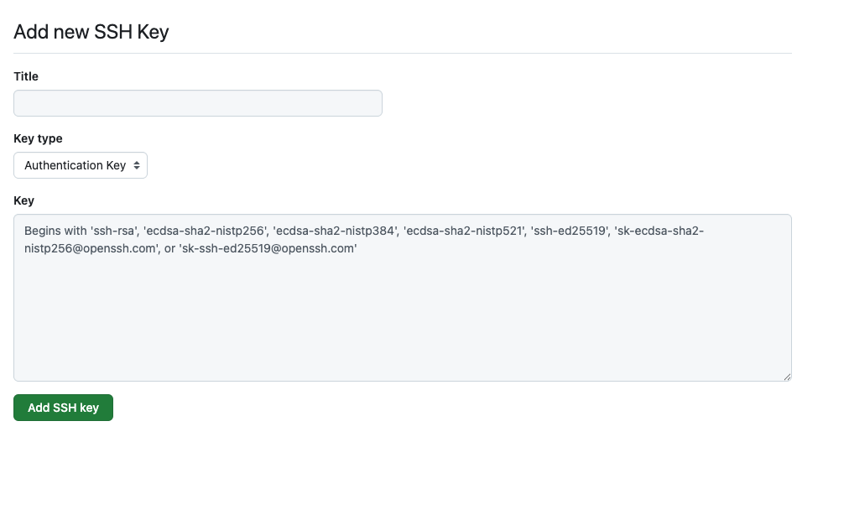
Github/ssh
Now go to Github and click your profile picture > Settings
Then:
Name and enter your key:

Slide 21
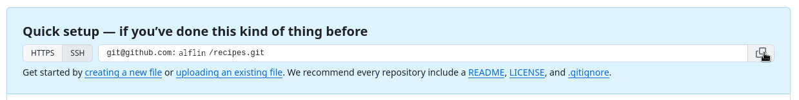
Github
3. Connect your local repository to the SSH remote:
Copy the SSH address from your github project
Then type in the terminal (with your address): $ git remote add origin git@github.com: [yourusernamehere]/recipes.git

Slide 22
Github
Now that everything is set up, we can now push the local changes to the remote: $ git push origin main
You can also pull changes from the remote repository to the local one: $ git pull origin main

Slide 23
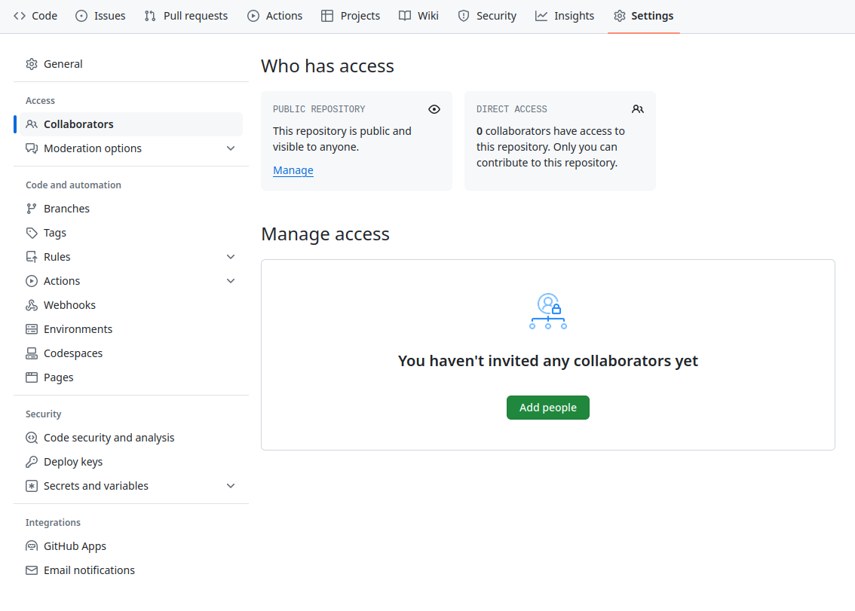
Collaborating in Github
For this section, we will work in pairs. One person will be the “owner” and the other will be the “collaborator”
The owner will first need to go to the “Settings” button to add the collaborator’s username to the project as a collaborator
The collaborator will receive a notification they will have to accept

Slide 24
Collaborating in Github
First, the collaborator will need to download a copy of the repository. This is called ”cloning a repo”
(be sure to do this in a new location) $ git clone [remote repo address] [local folder]
A collaborator can now edit files just like normal, add, commit, and push the files to the Owner’s repository
The collaborator could then pull the changes and update their local repository
Exercise: have the collaborator edit the recipe file, push it, and have the owner pull the changes

Slide 25
Managing conflicts
If the collaborator edits and commits a file, then the owner edits the original file without first having pulled the new changes, it will create a conflict between the two files
The owner must pull the changes first and merge the two files, and then commit the changes
Exercise: create a conflict between your files and then merge

Slide 26
Advanced git
Create fork (branch)
Allows you to edit the files without affecting the original repo
Can eventually create a pull request to suggest changes to the original repo
Duplicate
Create a repository from the contents of an existing repository but don’t want to merge your changes upstream in the future
Submit pull request
Ask the original owner to compare your fork to the original repo and accommodate the requests
See sources for additional info

Slide 27
Configuring the remote that points upstream
List the current configured remote:
git remote -v
Specify the upstream repo that will be synced with the fork
git remote add upstream https://github.com/ORIGINAL-OWNER/ORIGINAL-REPOSITORY.git

Slide 28
Syncing a fork
Fetch the branches and their respective commits
git fetch upstream
Check out your fork’s local default branch
git checkout main
Merge changes from upstream
git merge upstream/main

Slide 29
Problem Set 1
Available on the course repository
To complete Problem Set 1 you will need to clone (or fork? or duplicate?) the course repository
All materials must be obtained through github commands from the repository for the remainder of the course

Slide 30
Bonus lesson: Markdown
https://commonmark.org/help/tutorial/

Slide 31
Sources
https://swcarpentry.github.io/git-novice/
https://geo-python-site.readthedocs.io/en/2022.0/lessons/L2/intro-to-GitHub.html
https://docs.github.com/en/pull-requests/collaborating-with-pull-requests/working-with-forks/fork-a-repo
https://docs.github.com/en/pull-requests/collaborating-with-pull-requests/proposing-changes-to-your-work-with-pull-requests/creating-a-pull-request

