Slide 1
Novice Python and Spyder
PSYC 5P02
Computer Programming for Experimental Psychology
Stephen Emrich
Brock University

Slide 2
Spyder
Spyder is another IDE distributed by Anaconda
Allows you to see a bit more of what’s happening which I think is useful for learning
There are other IDEs that are popular (PyCharm, VScode)
Ultimately the one you use is up to you, but all of your code needs to be documented thoroughly

Slide 3
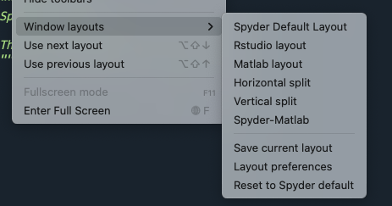
Customizable layout
Go to view > unlock panes to move things around if you like
For now we’re going to use the Matlab layout
Will make it easier to transition later

Slide 4
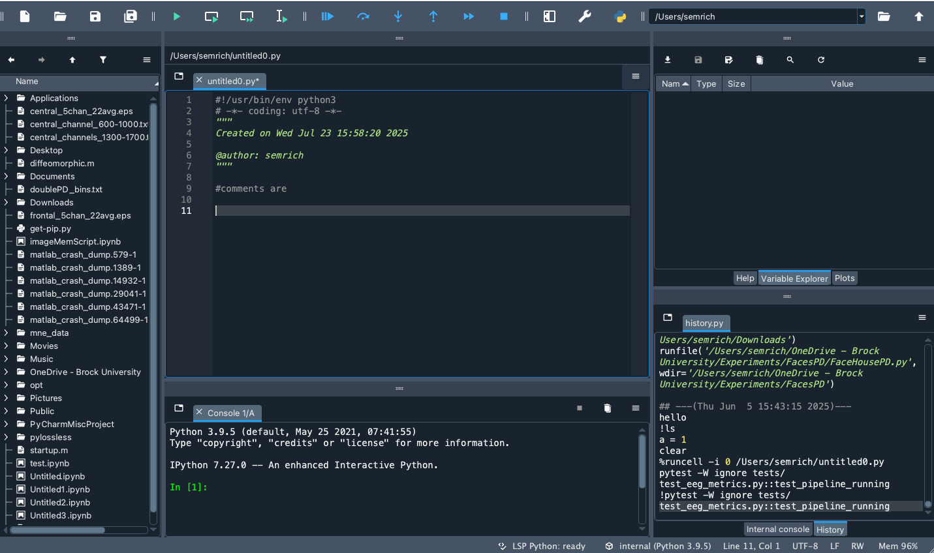
Matlab layout
Variables
Files
Script
History
Console

Slide 5
Warm-up
Let’s review some of the stuff we did last week. Make the console active, and type inside: myVar = ‘hello world’
Note that we now have some information about our new variable in the Variable Explorer

Slide 6

Variable explorer
Note that we now have some useful information about our variable in our Variable Explorer
Any variable that has been created and exists in the memory for Python to access is viewable in the Variable Explorer
Can think of as a kind of “working memory”
Try creating different variables and see what they look like in the Variable Explorer

Slide 7
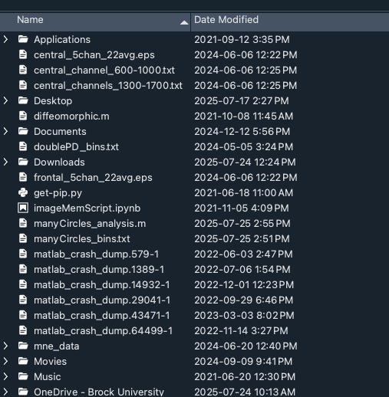
Files / Working directory
The Files list will give you a list of the current directory (displayed in the top toolbar)
Until you specify otherwise, only those files in your working directory (path) are accessible

Slide 8
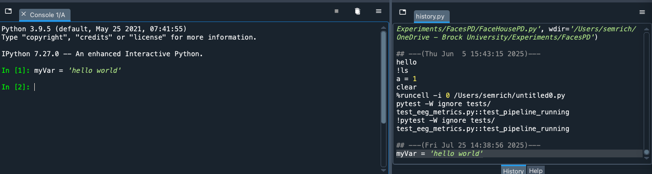
Console & History
The console is a place where we can enter commands manually
While it doesn’t save a permanent record of the code the way a Notebook does, it is available via the History tab. You can also access the history tab by pressing the UP key in the console
The console functions much like a Shell terminal.
Can use commands like cd to change directories
Can access shell commands by preceding the command with !
Can use tab to auto-complete commands/files

Slide 9
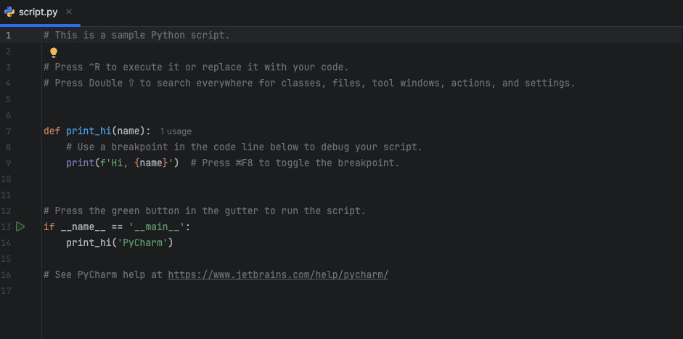
Editor
The editor pane provides a place for you to write and save .py files
Typical of non-notebook style IDEs e.g., Pycharm:
Note that the files that you will write and save are .py files. Unlike Notebook files (.ipynb), these are “plain text” files
You could just as easily write the code in a text editor like Notepad or Vi

Slide 10
How to document?
Without the use of Markup, how can we document the code
Every language have characters that denote part of the code as a “comment” - not to be executed as code. In Python we use the # character
#this is a comment not to be interpreted
Ultimately how you choose to write your code (Notebooks, Spyder, other) is up to you BUT YOU MUST DOCUMENT AND EXPLAIN YOUR CODE THOROUGHLY!

Slide 11
Loops
A Loop is a fundamental and powerful concept in programming. A loop in computer programming is an instruction that repeats until a specified condition is met.
In Python, there are two types of loops:
A for loop is a loop that runs for a preset number of times.
A while loop is a loop that is repeated as long as an expression is true.

Slide 12
For loop
A for loop is a loop that runs for a set number of times for i in range(1,5): print(i)
Uses a variable (in this case ‘I’) which is defined as a series of values (in this case, 1 through 5)
Requires a colon to define the loop
Everything contained within the loop is indented relative to the loop definition (defines the “scope” - more on that later)

Slide 13
For loop
Can also loop through items in a list mylist = ["apple", "banana", "cherry"] for x in mylist: print(x)
In this case the thing it is looping through are the items in the list
Could also index the length of the list:
mylist = ["apple", "banana", "cherry"] for i in range(len(mylist)): print(mylist[x])

Slide 14
While loop
A while loop loops through not a set number of times but while a conditional statement remains true i = 1 while i < 6: print(i) i += 1
WARNING! If your condition is never true, you will get stuck in the dreaded infinite loop!

Slide 15
Loops
There are other ways you can move around in a loop and/or exit a loop:
the break command will exit out of the loop entirely. E.g.: if i == 3: break
The continue command will skip the remaining commands in the loop and move on to the next loop iteration: i = 0 while i < 6: i += 1 if i == 3: continue print(i)

Slide 16
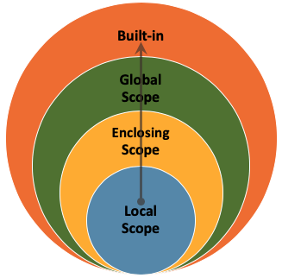
Scope
The variable scope in programming refers to the region of the code in which a variable or resource is visible and accessible.
If variables are declared within a while or for loop, their scope exists inside that loop and nothing “above” it.
In a global scope, all entities are visible throughout the entire program
Exercise: create a loop that returns the value of a local variable, then try to return the same value in the global scope

Slide 17
Python libraries
Base Python has limited capabilities
Lean and mean
By adding libraries to your script/session, you can expand on it’s capabilities
Many of the things that you will want to do will come in the form of packaged libraries
E.g., PsychoPy

Slide 18
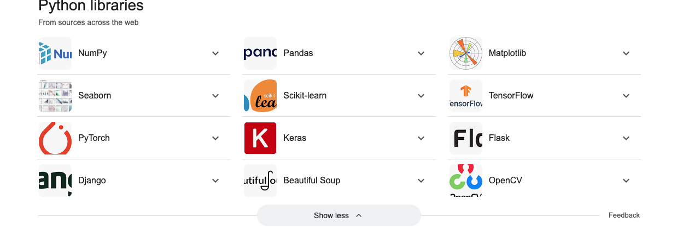

Slide 19
Python libraries
Libraries need to be imported and named. E.g., import numpy
Can also change the name of library import numpy as np
Then make calls to the functions within the library starting with the library name np.sqrt(4)

Slide 20
Python libraries
You can use from…import to load specific items from a library module
Can refer to them directly without a library name as a prefix from math import cos, pi
print('cos(pi) is', cos(pi))

Slide 21
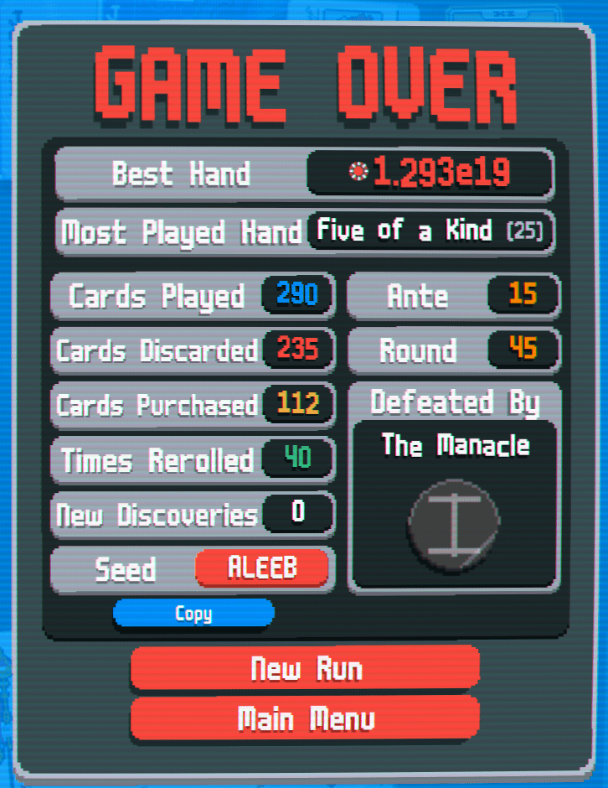
Random library/method
One of the most common libraries you will use is the random library (method)
E.g., randomizing stimuli, conditions, time, created simulated data
Important to remember that random number generators (RNGs) are seeded (tied to some other value)
In Matlab the RNG state is set to the same value every time it is opened
Can set your seed to a specific value, or get the state of the RNG at a particular point in time
Exercise: Generate different kinds of random values multiple times using both seeds and state

Slide 22
Functions
Just like loops can be used to increase the efficiency of your code by repeating blocks of code, you can also create functions -- modular bits of code that carry out a particular task or operation
Can be called repeatedly throughout your code
Functions can also take arguments (inputs) and can return values (outputs)

Slide 23
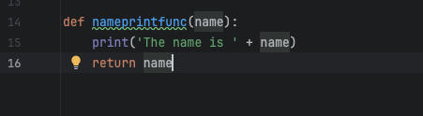
Function - try it out
argument
Return will “return” the value of the variable to the console. More useful: assign it to a variable when called: myvar = nameprtintfunc(‘Steve’)
Argument being used inside of the loop Question: what is it’s scope?

Slide 24
Functions
You can have multiple arguments separated by a comma
You can also make some arguments optional but setting a default value - e.g.: myfunc(arg1, arg2 = ‘default text’)
You can also return multiple values from a function
def adder(x,y):
z = x + y return z, x

Slide 25
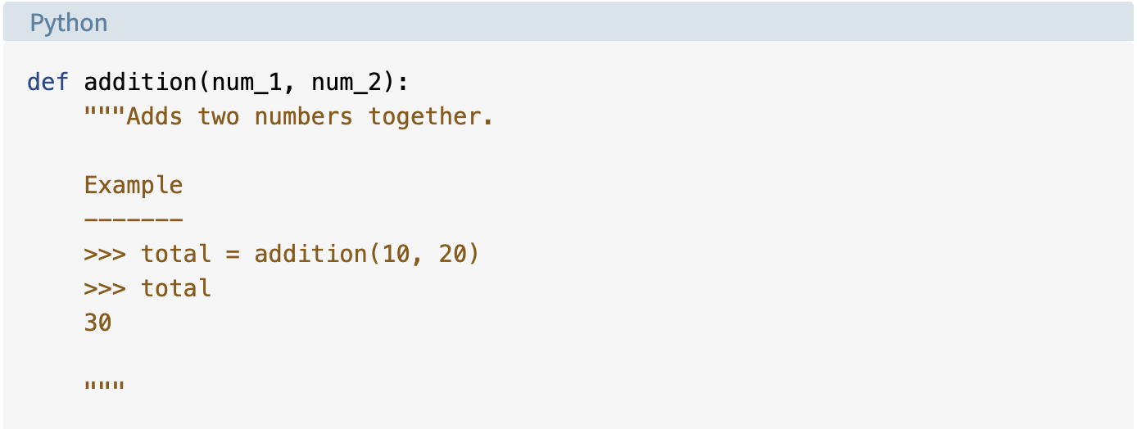
Help files
Help files are accessed using the help() command
Help files are created using documentation strings (start and end with triple ”””
Can also be used at the file level (at the beginning of your document)
Exercise: write a function that includes at least one argument and returns one variable, a loop, a random method, and a help file

Slide 26
Classes
Classes are a way for combining data and functionality together
More practically, it’s a way for you to build flexibility into your code and re-use common procedures
E..g., could create a class for handling subject info
A form of object-oriented programming

Slide 27
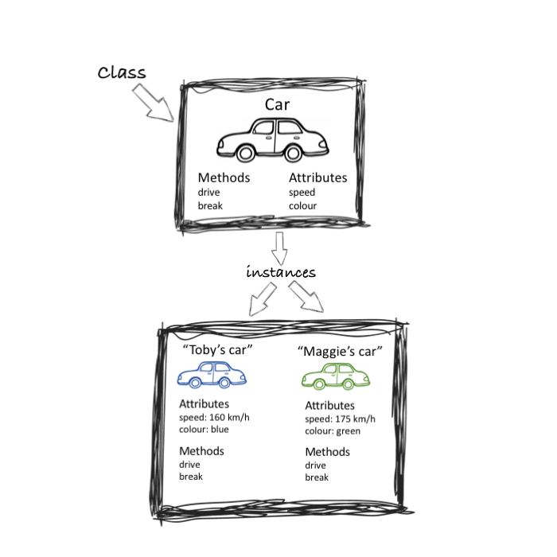
Classes
Create a class
The class has
Attributes (data)
Methods (operations)
Can create multiple instances of the class

Slide 28
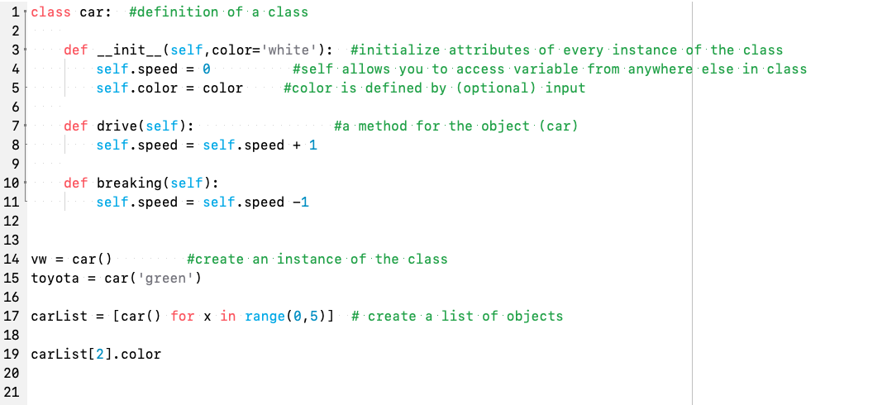

Slide 29
Classes
Classes can be stored in a separate file
Import using the:
from filename import class
convention
Exercise: create a “subject” class that contains basic demographic information, and a method that keeps track of how many times they have participated in the study

