Slide 1
Testing

Slide 2
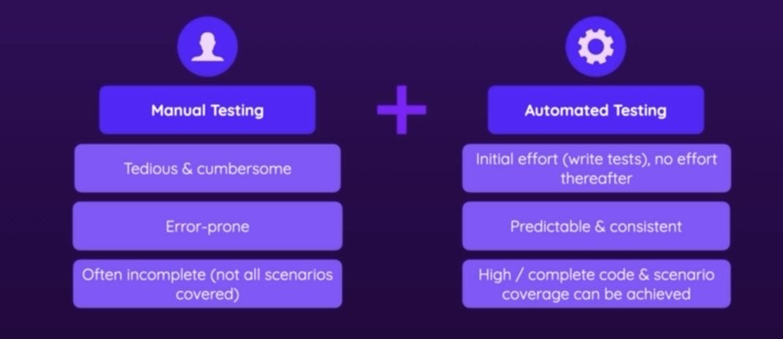
What is Testing
Verify “if something works as intended”

Slide 3
What are unit Tests
What is a Unit
A building block of your app
Ideally, the smallest possible building block
E.g. A function, a class or a component
An app is a combination of all units
All units were tested the overall app should work (integration tests)
Changes are always tested against all units to avoid bugs

Slide 4
Why unit Testing
Avoid endless amounts of manual testing
Allows you to cover 100% of your code scenarios
Code changes are tested against all scenarios (almost ) instantly
Write cleaner and better code (because testing then becomes easier)

Slide 5
Other Testing
Unit Testing
Testing the individual blocks of an application
Every building block(unit) is tested standalone
If all building blocks works the overall app works
Integration Testing
Test the combination of building blocks
Verify if building blocks (units) work together
Even if all units work standalone the combination may fail
End-End (E2E) Testing
You focus testing entire flow and application features. Test the actual things real users would do. Real users use your app and its features , not individual units

Slide 6
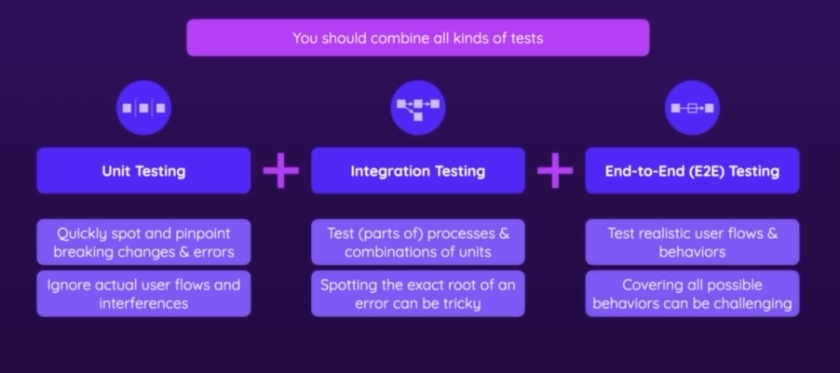

Slide 7
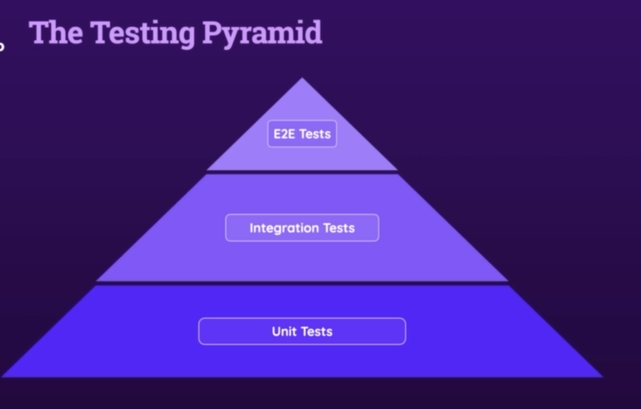

Slide 8
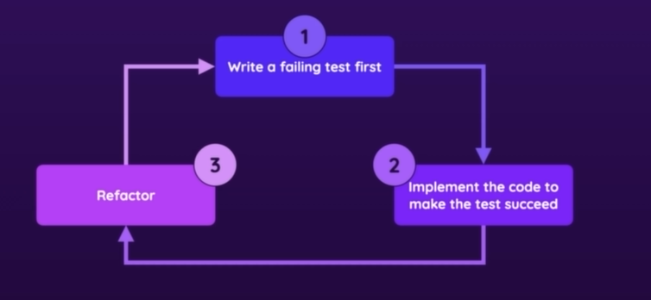
Test-Driven Development(TDD)
A framework /philosophy for writing tests

