Slide 1
FORMS

Slide 2
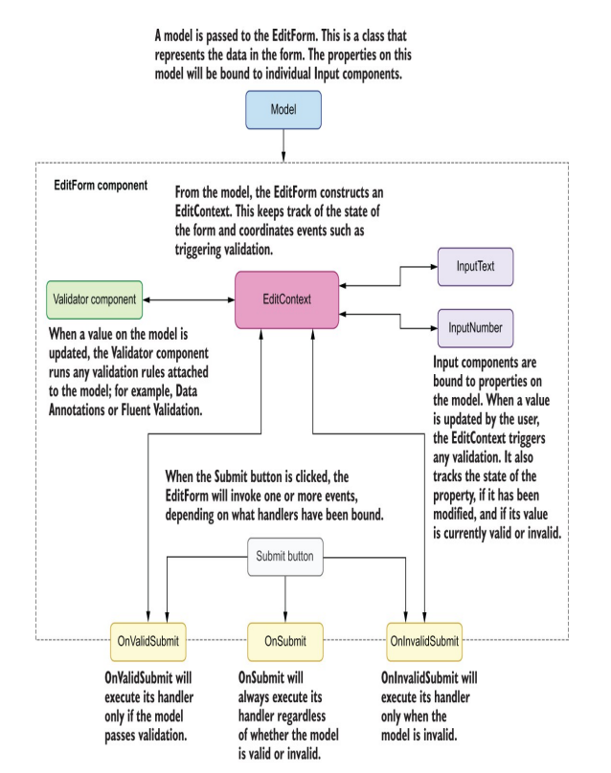

Slide 3
Overview of Forms
The primary component is EditForm—a drop-in replacement for an HTML form element. Inside this, we add a validator component and various input components along with a standard HTML Submit button.
We pass a model into the EditForm, which is an instance of a class that represents the data we want to collect with the form. Internally, the EditForm component constructs an EditContext—this is the brain of the form’s system. It keeps track of all the input components and the state of the model. Whenever a value is updated on the model, it will trigger validation via a validator component. Blazor ships with a validator component called DataAnnotationsValidator, which allows the validation of models using the Data Annotations. Different validator components can be used to support different validation systems—more on this later.
The EditForm offers three events for handling form submits. The OnSubmit event is the same as the standard submit event on an HTML form. It will be invoked whenever the Submit button is clicked, and the handler is responsible for making sure the model is valid. The OnValidSubmit event is my personal favorite. This event is triggered when the Submit button is clicked but with a key difference: the EditForm will check with the EditContext first to make sure the model is valid. The handler will be called only when the model is valid. This makes writing the handler much simpler, as no validation code needs to be written. The final event is OnInvalidSubmit. As you can probably guess, this works in the opposite way to the OnValidSubmit event. It will only be invoked when the form is submitted but the model is invalid.
Now we’ve covered what is going on under the covers, at a high level. It’s time to start building so we can see everything in action and really understand the nitty-gritty of it all.

Slide 4
Basic EditForm configuration
The EditForm component is used to define a Blazor form. As a minimum, a model and a submit action must be defined.
The Reset button clears the form by creating a new instance of the defined class.
Clicking the Submit button will invoke the OnValidSubmit event and call the SubmitForm method.
A new instance of the class is created when the component is initialized and assigned to the EditForm’s Model parameter. Input components in the form will be bound to its properties.
The SubmitForm method is called whenever the EditForm’s OnValidSubmit event is invoked

Slide 5
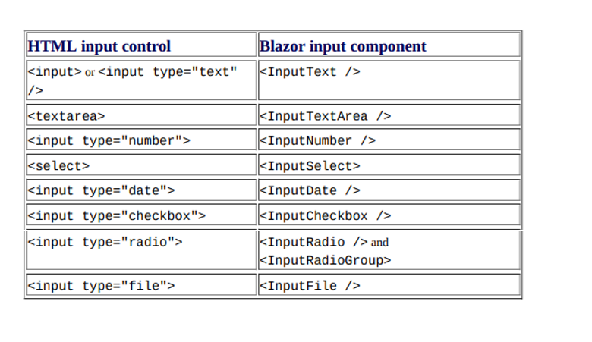
Collecting data with input components

Slide 6
Collecting Data in Input Component
The group is made up of a label and input component. The input components are bound to properties on the model using the @bind directive.
@bind="_someValue“
Now we’re using it like this:
@bind-Value="_someValue“
This is because we are now performing two-way binding on a component rather than an HTML element. When binding to a component, we must specify the property on the component we wish to bind to

Slide 7
Creating inputs on demand
At some point, you will need to allow the user to create inputs on demand. In our case, this is route instructions.
Sometimes there is no way for us to know up front how many inputs to give the user. We need to build the form in a way that allows the user to dynamically add route instructions as they see fit. On the surface this can seem a bit daunting, but it’s relatively simple to achieve. We will use a simple foreach loop over the collection of route instructions we defined on the form model at the start of the chapter:

Slide 8

Validating the model
Validation is the most important part of building forms. Without validation, the system can end up containing all kinds of rubbish data. Out of the box, Blazor includes a few components to help us do this .They are DataAnnotationsValidator ValidationSummary ValidationMessage.
The DataAnnotationsValidator component allows Blazor forms to work with the Data Annotations validation system, which is the default for ASP.NET Core applications. This system works by decorating properties on a model with attributes that define the validation rules. For example, to make a text property required, we would do the following:
The ValidationSummary component displays all validation messages for a model. This can be useful when you want to have all the validation messages for a form grouped together in one place.
Finally, the ValidationMessage component displays a validation message for a specific property on the model. This allows a validation message to be displayed directly under, or next to, an input component, making it easy for the user to see where the problem is.
You can also use external Validation Libraries (https://fluentvalidation.net/)

Slide 9

Using FluentValidator
Defining a validator class means inheriting from the AbstractValidator base class. The type parameter T is the class to be validated
We define the validation rules inside the constructor using the RuleFor method. This takes a lambda expression defining which property is to be validated. We then chain methods together to state what makes the property valid and what error message to show if it’s not.
Or the following for a List

Slide 10

FluentValidation on Client side
We need to tell Blazor how to understand and process them. To do this, we will install a package into the Client project, which is going to do all the heavy lifting for us. It’s called Blazored.FluentValidation (https://github.com/blazored/fluentvalidation)
This package contains one component called FluentValidationsValidator, which, when included in an EditForm component, will allow the form model to be validated according to any Fluent Validation rules.
To set up the Client project, we’re going to add a package reference to the csproj file.
Then we will add the following using statement to the _Imports.razor at the root of the project. @using Blazored.FluentValidation
We are now ready to add the validation components to our form. The first thing we’ll do is tell the EditForm component that we want the model to be validated with Fluent Validation. To do this, we add the FluentValidationsValidator component somewhere between the opening and closing tags of the EditForm. I prefer to add it right at the top, directly under the opening EditForm tag.

Slide 11
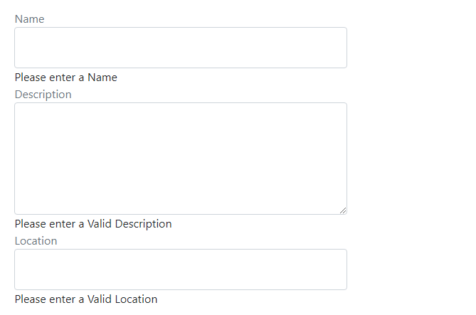
We now need to add a ValidationMessage component under each of the existing inputs on the form.
The ValidationMessage component requires a single parameter to be set, called For. The For parameter takes an expression specifying which property on the model it should show validation messages for.
Example:

Slide 12
Styling Validation Messages
If we use the browser developer tools to inspect the HTML of the page, we can see another effect of validation. An invalid class is added by Blazor’s validation system incase a input is invalid. To help toward accessibility, an aria attribute was also applied, aria-invalid.
EditContext keeps track of the state of the form. It knows the state of each property on the model at any given time. When validation is executed, the input component bound to a property is updated with CSS classes that represent that property’s state. Those classes are:
valid
Invalid
modified
We can use these classes to style inputs based on their validation state, and that’s exactly what we’re going to do now
The validation message component renders the validation message we specified in our validator class. It outputs the message in a div with a class of validation-message.

Slide 13
Summary
The primary advantage of using Blazor form components over traditional HTML forms is validation.
The EditForm component is a drop-in replacement for the HTML form element. Blazor ships with component versions of all the standard HTML input controls.
The EditForm requires a model that represents the data the form will collect, as well as a handler for one of the submit events it exposes (OnSubmit, On-ValidSubmit, OnInvalidSubmit).
Internally, the EditForm will construct an EditContext, which is the brain of the form and keeps track of the validation state of the model, as well as coordinates validation events.
To use Blazor’s input components, they must be bound to a property on the model passed to the EditContext. This is done using the @bind directive.
Blazor ships with a validation component called DataAnnotationsValidator, which enables the Data Annotations validation system to be used with models.
The validation system in Blazor is flexible and extendable, and other validation systems can easily be added by swapping out the validator component

