Slide 1
OPERATORS

Slide 2
Operators
Operators are symbols that are used to perform operations on operands.
For example, consider the expression 2 + 3 = 5, here 2 and 3 are operands, and + and = are called operators

Slide 3
Types of Operators in C#
Operators are classified based on the type of operations they perform on operands in C# language, They are classified as follows :
Arithmetic Operators
Relational Operators
Logical Operators
Bitwise Operators
Assignment Operators
Unary Operators
Ternary/ Conditional Operators

Slide 4
Operators
The operators can also be categorized based on the number of operands:
Unary Operator: The Operator that requires one operand (variable or value) to perform the operation is called Unary Operator.
Binary Operator: Then Operator that requires two operands (variables or values) to perform the operation is called Binary Operator.
Ternary Operator: The Operator that requires three operands (variables or values) to perform the operation is called Ternary Operator. The Ternary Operator is also called Conditional Operator.

Slide 5
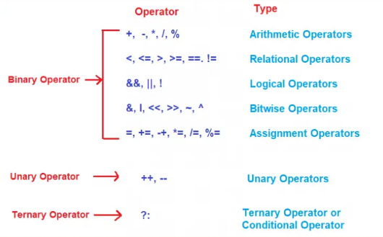

Slide 6
BINARY OPERATORS

Slide 7
Arithmetic Operators
Addition Operator (+) - The + operator adds two operands
Subtraction Operator (-) - The – operator subtracts two operands.
Multiplication Operator (*) - The * operator multiplies two operands.
Division Operator (/) - The / operator divides two operands.
Modulus Operator (%) - The % operator returns the remainder when the first operand is divided by the second

Slide 8
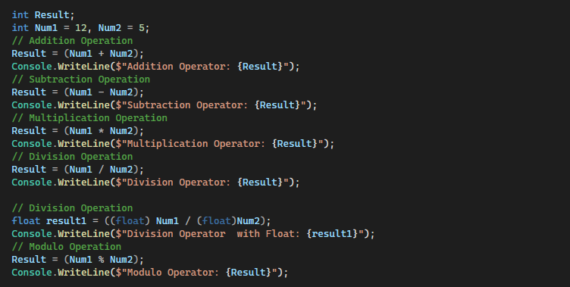
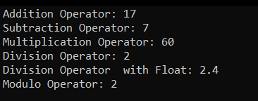

Slide 9
Assignment Operators in C#
The Assignment Operators in C# are used to assign a value to a variable. Here are the assignment operators:
Simple Assignment - This operator is used to assign the value of the right-hand side operand to the left-hand side operand.
Add Assignment (+=):It is used to add the left-hand side operand value with the right-hand side operand value and then assign the result to the left-hand side variable.
Subtract Assignment (-=): It is used to subtract the right-hand side operand value from the left-hand side operand value and then a
Multiply Assignment (*=): It is used to multiply the left-hand side operand value with the right-hand side operand value and then assign the result to the left-hand side variable.
Division Assignment (/=):It is used to divide the left-hand side operand value with the right-hand side operand value and then assign the result to the left-hand side variable.
Modulus Assignment (%=):It is used to divide the left-hand side operand value with the right-hand side operand value and then assigns the remainder of this division to the left-hand side variable.

Slide 10
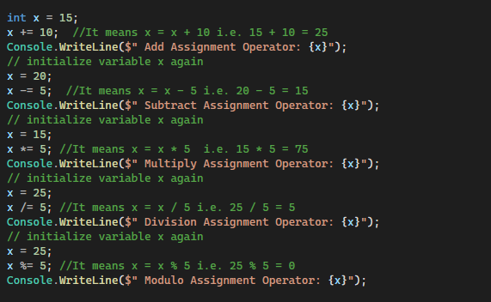
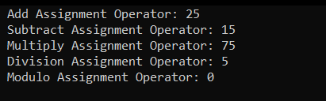

Slide 11
Relational Operators
Relational operators determine the relationship between two operands and returns the Boolean results, i.e. true or false after the comparison
Equal to (==) - This Operator is used to return true if the left-hand side operand value is equal to the right-hand side operand value.
Not Equal to (!=):This Operator is used to return true if the left-hand side operand value is not equal to the right-hand side operand value.
Less than (<):This Operator is used to return true if the left-hand side operand value is less than the right-hand side operand value.
Less than or equal to (<=):This Operator is used to return true if the left-hand side operand value is less than or equal to the right-hand side operand value
Greater than (>):This Operator is used to return true if the left-hand side operand value is greater than the right-hand side operand value.
Greater than or Equal to (>=):This Operator is used to return true if the left-hand side operand value is greater than or equal to the right-hand side operand value

Slide 12
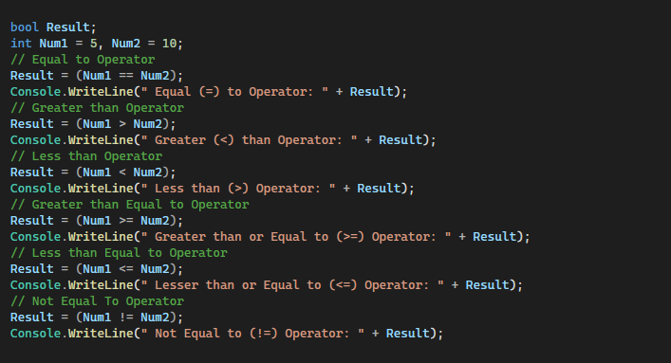
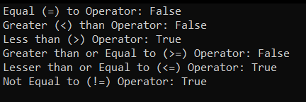

Slide 13
Logical Operators
The Logical Operators are mainly used in conditional statements and loops for evaluating a condition. These operators are going to work with boolean expressions.
Logical OR (||): This operator is used to return true if either of the Boolean expressions is true.ps for evaluating a condition.
Logical AND (&&): This operator is used to return true if all the Boolean Expressions are true.
Logical NOT (!): This operator is used to return true if the condition in the expression is not satisfied. Otherwise, it will return false

Slide 14
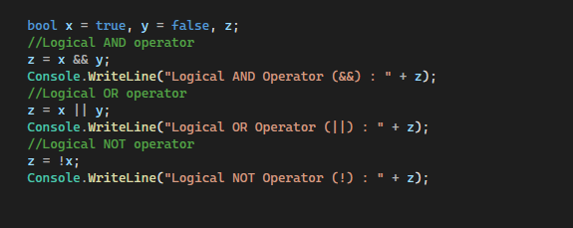


Slide 15
Bitwise Operators
The Bitwise Operators in C# perform bit-by-bit processing. They can be used with any of the integer (short, int, long, ushort, uint, ulong, byte) types.
Bitwise OR (|) - Bitwise OR operator is represented by |. This operator performs the bitwise OR operation on the corresponding bits of the two operands involved in the operation.
int a=12, b=25;
int result = a|b; //29
12 Binary Number: 00001100
25 Binary Number: 00011001
Bitwise OR operation between 12 and 25:
00001100
00011001
========
00011101 (it is 29 in decimal)

Slide 16
Bitwise AND (&) - Bitwise OR operator is represented by &. This operator performs the bitwise AND operation on the corresponding bits of two operands involved in the operation
int a=12, b=25;
int result = a&b; //8
How?
12 Binary Number: 00001100
25 Binary Number: 00011001
Bitwise AND operation between 12 and 25:
00001100
00011001
========
00001000 (it is 8 in decimal)

Slide 17
Bitwise XOR (^):The bitwise OR operator is represented by ^. This operator performs a bitwise XOR operation on the corresponding bits of two operands. If the corresponding bits are different, it gives 1. If the corresponding bits are the same, it gives 0.
For example,
int a=12, b=25;
int result = a^b; //21
How?
12 Binary Number: 00001100
25 Binary Number: 00011001
Bitwise AND operation between 12 and 25:
00001100
00011001
========
00010101 (it is 21 in decimal)

Slide 18
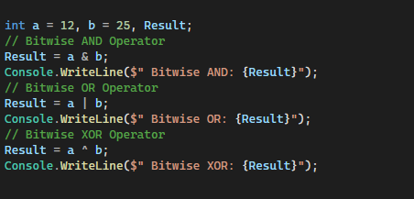

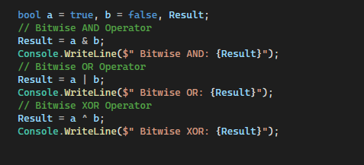


Slide 19
UNARY OPERATORS

Slide 20
Increment Operators
Post Increment Operators: The Post Increment Operators are the operators that are used as a suffix to its variable. It is placed after the variable. For example, a++ will also increase the value of the variable a by 1.
Pre-Increment Operators: The Pre-Increment Operators are the operators which are used as a prefix to its variable. It is placed before the variable. For example, ++a will increase
Post Decrement Operators: The Post Decrement Operators are the operators that are used as a suffix to its variable. It is placed after the variable. For example, a-- will also decrease the value of the variable a by 1. the value of the variable a by 1
Pre-Decrement Operators: The Pre-Decrement Operators are the operators that are a prefix to its variable. It is placed before the variable. For example,--a will decrease the value of the variable a by 1.

Slide 21
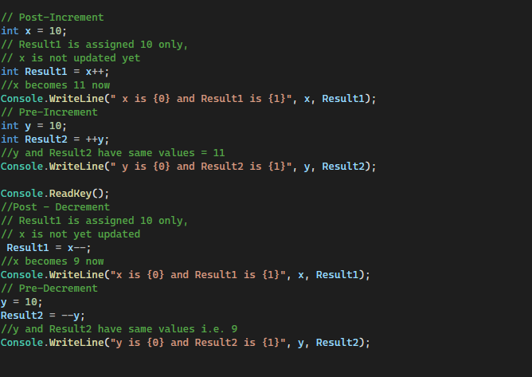
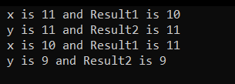

Slide 22


Steps to understand Increment and Decrement operators
The First step is Pre-Increment or Pre-Decrement. Is there any pre-increment or pre-decrement in the expression? There is no pre-increment but there is a pre-decrement in the expression i.e. –y. So, execute that pre-decrement operator which will decrease the value of y by 1 i.e. now y becomes 19.
The second step is Substitution. So, substitute the values of x and y. That means x will be substituted by 10 and y will be substituted by 19.
The third step is Evaluation. So, evaluate the expression i.e. 10 * 19 = 190.
The fourth step is the Assignment. So, assign the evaluated value to the given variable i.e. 190 will be assigned to z. So, now the z value becomes 190.
The last step is Post-Increment and Post-Decrement. Is there any post-increment or post-decrement in the expression? There is no post-decrement but there is a post-increment in the expression i.e. x++. So, execute that post-increment which will increase the value of x by 1 i.e. x becomes 11.

Slide 23
TERNARY OPERATORS

Slide 24


Ternary Operators
The Ternary Operator in C# is also known as the Conditional Operator (?:). It is actually the shorthand of the if-else statement. It is called ternary because it has three operands or arguments. The first argument is a comparison argument, the second is the result of a true comparison, and the third is the result of a false comparison.
Syntax: Condition? first_expression : second_expression;

