Slide 1

Model Deployment with Flask
LISUM02
10th August 2021
By,
Joseph Antony
Submitted to: https://github.com/joeanton719/Data-Glacier/tree/main/Week4_Flask

Slide 2
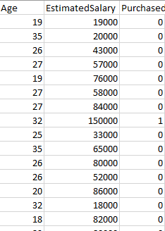

Tasks Involved
The data used for this task contains market information such as prospective buyers' Age, Estimated Salary, as well as whether the customer purchased the product (Purchased).
Trained a Logistic Regression model to predict whether a customer will purchase a product based on prospective buyers' Age and Salary.
Finally, deployed Logistic Regression model to a web-app using Flask API.
This way, we can predict potential customers using the web-app.

Slide 3
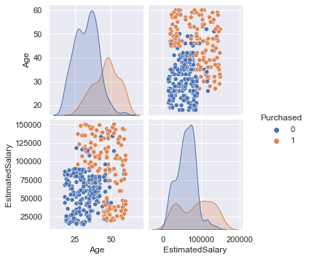
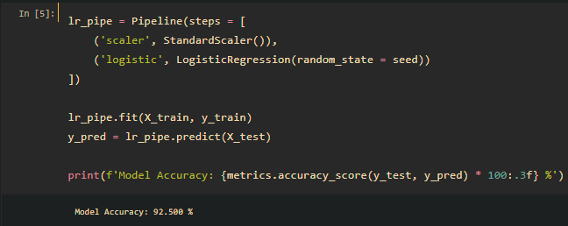
Model Validation
Customers who are earn higher than $100,000 and older than 40 years are more likely to purchase a product.
After splitting the data into train and test set, Logistic Regression model was used for predicting on test set.
The model achieved a high accuracy of almost 92.5%.

Slide 4
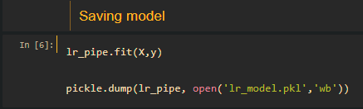
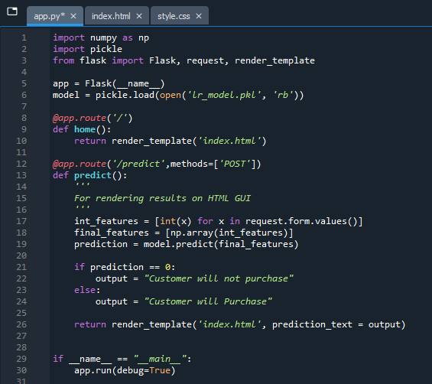
Saving Model & Creating Web-App using Flask API
The model was then trained on the whole dataset before saving the model to pickle format.
Pickling is done to convert python object to character object.
Next, created a python file to create the web app using Flask API module.

Slide 5
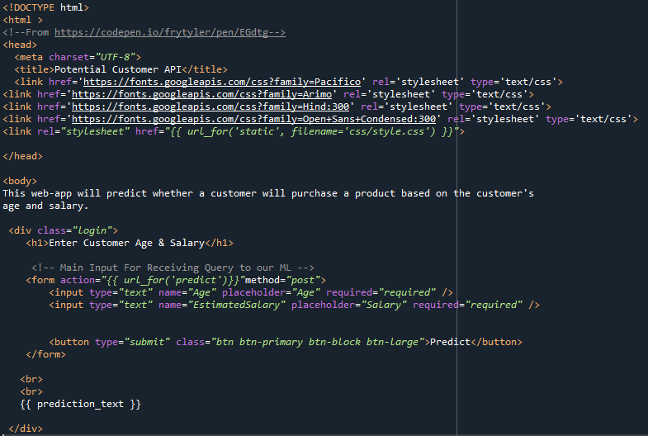
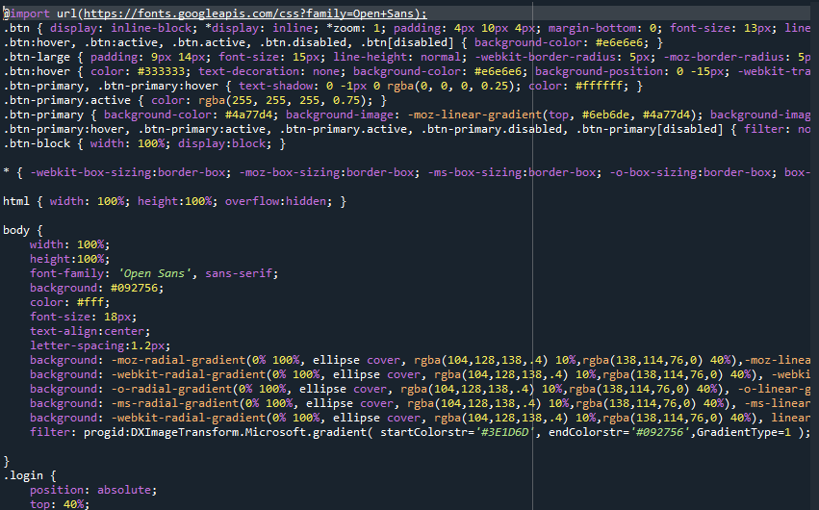
HTML
CSS

Slide 6
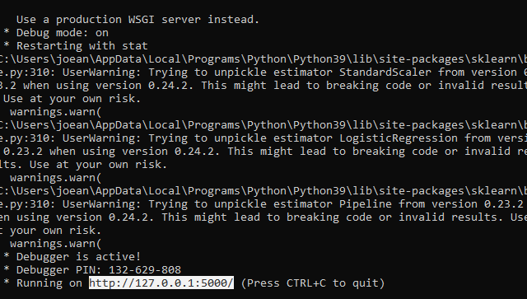
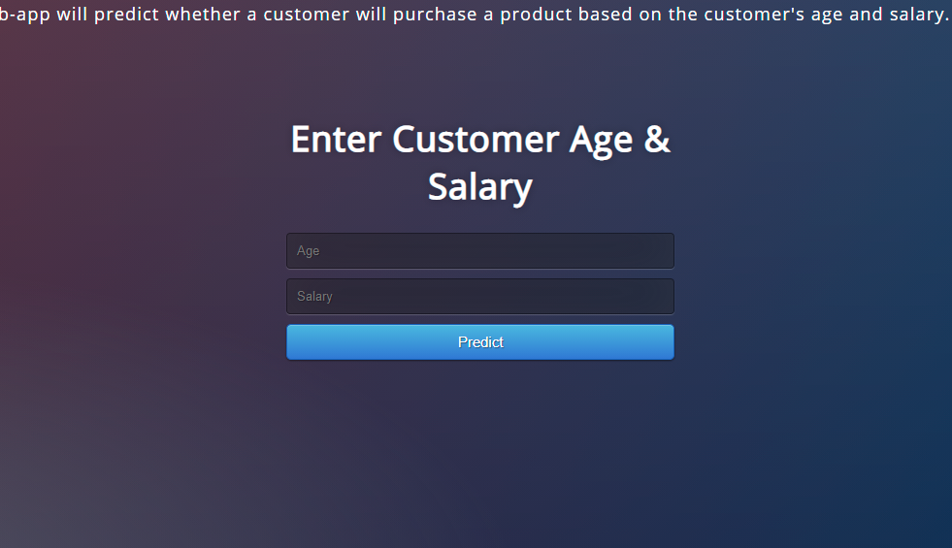
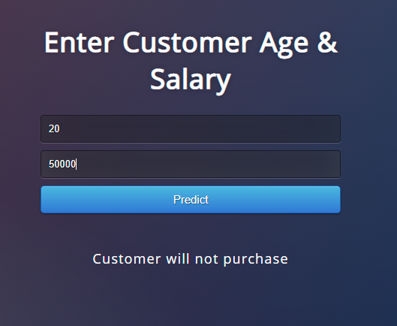
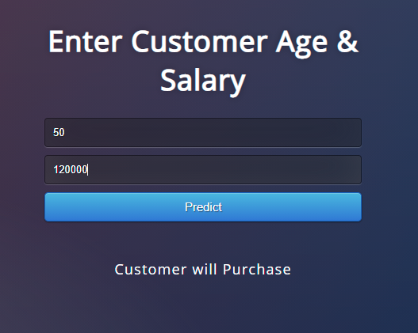
Model Deployment
Finally, created the web-app and deployed the model into the web-app.
Based on the model, we can now use the web application to predict potential customers based on Age and Salary

Slide 7
The End

