Slide 1

Week 5: Cloud and API deployment
LISUM02
11th August 2021
By,
Joseph Antony

Slide 2
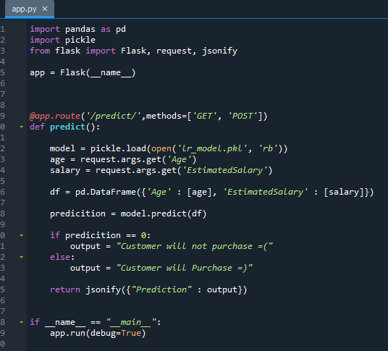
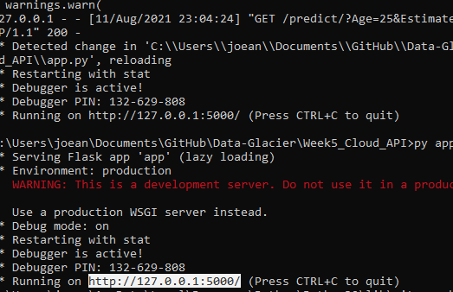

Dataset
Same dataset was used as the one used for deploying using Web-App last week.
Serialization was done using python pickling.
Like last time, created an application using Flask API.
Ran the app using windows command prompt.

Slide 3
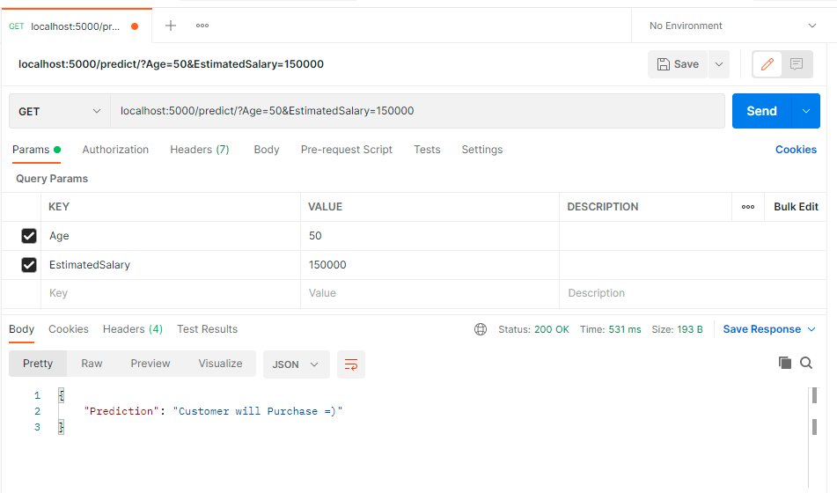
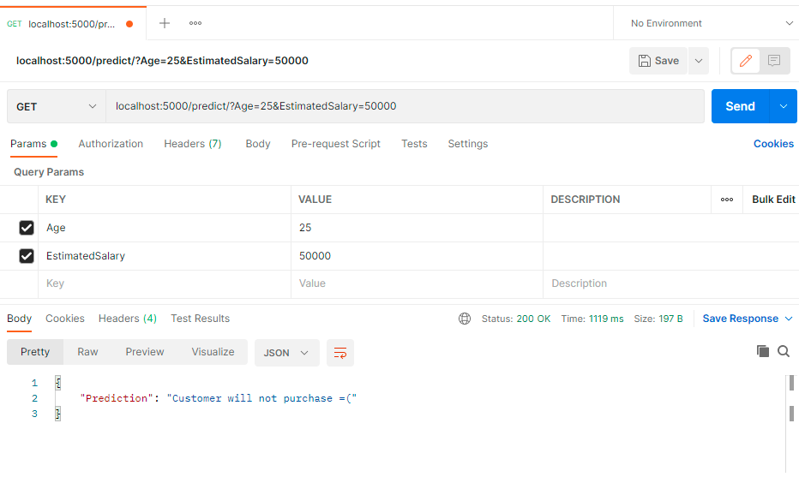
Model Deployment on Postman API
Deployed the model on to Postman API. The model worked perfectly.

Slide 4
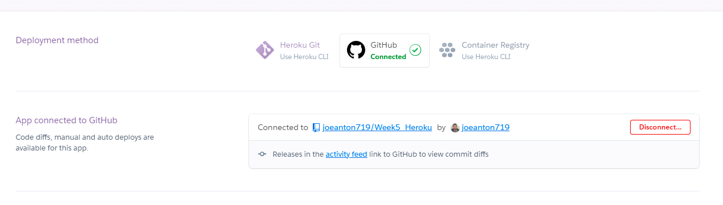

Slide 5
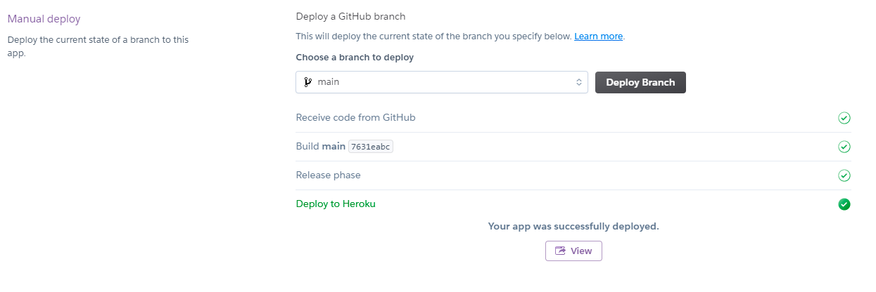

Slide 8
The End

