Slide 1

Week 5: Cloud and API deployment
LISUM02
11th August 2021
By,
Joseph Antony
Submitted to: https://github.com/joeanton719/Week5_Heroku

Slide 2
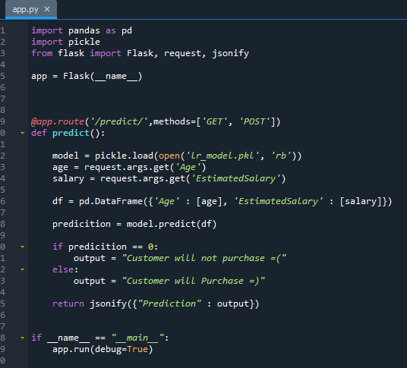
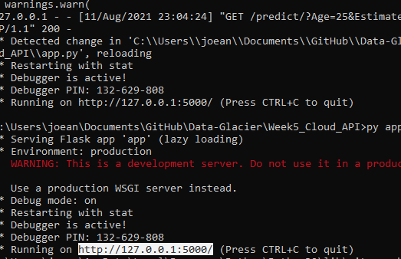

Dataset
Same dataset was used as the one used for deploying using Web-App last week.
Serialization was done using python pickling.
Like last time, created an application using Flask API.
Ran the app using windows command prompt.

Slide 3
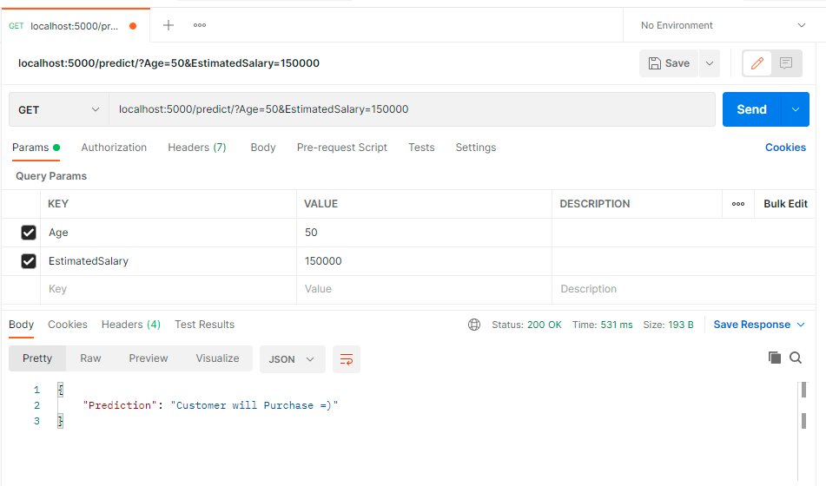
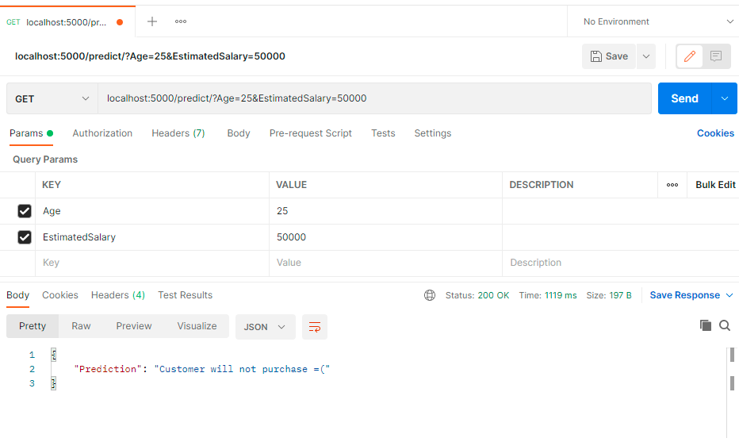
Model Deployment on Postman API
Deployed the model on to Postman API. The model worked perfectly.

Slide 4
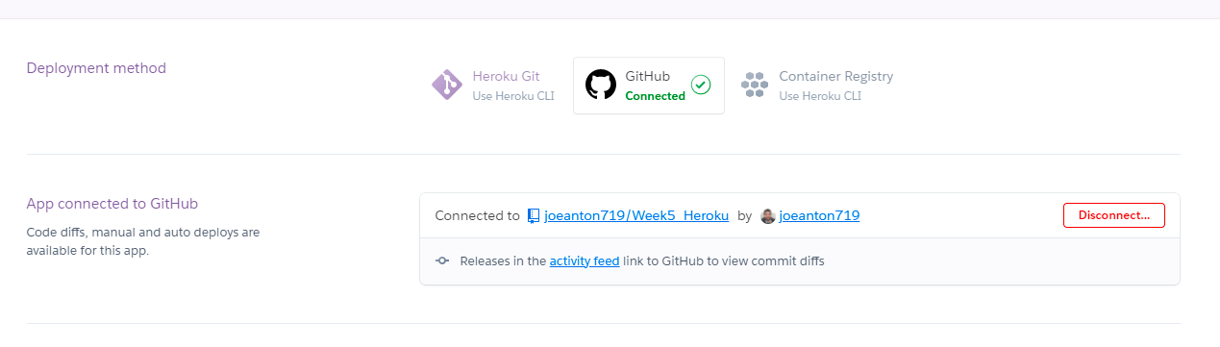

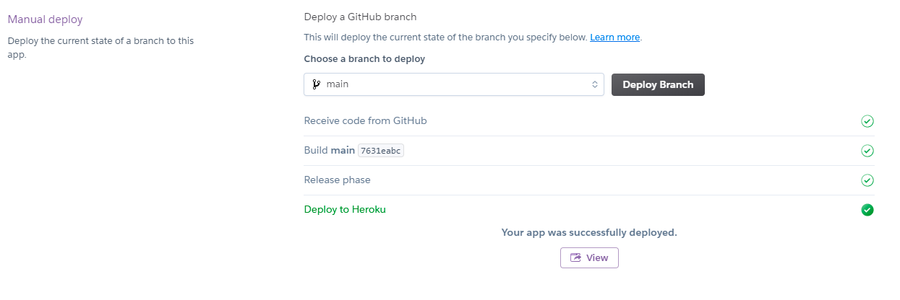
Model Deployment on Heroku App
Next, Also deployed the model on to Heroku Platform.
Connected GitHub repo with necessary files to the Heroku App.

Slide 5
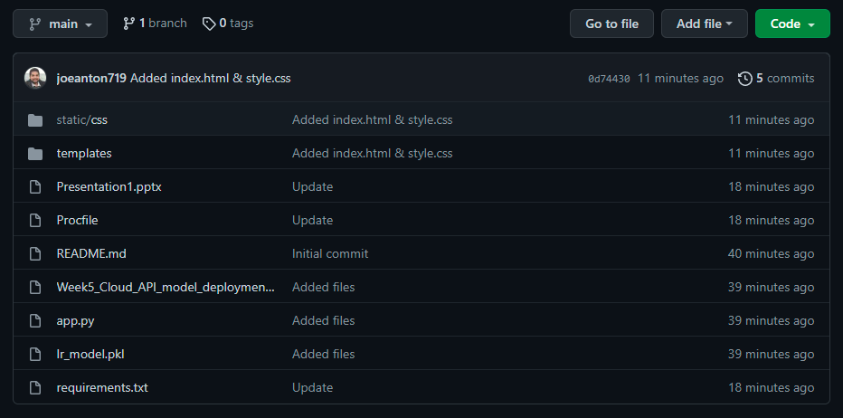
Model Deployment
The repo contains all necessary files including requirements.text (which includes all necessary packages for deployment and Procfile)
The model was successfully deployed on Heroku Application.

Slide 6
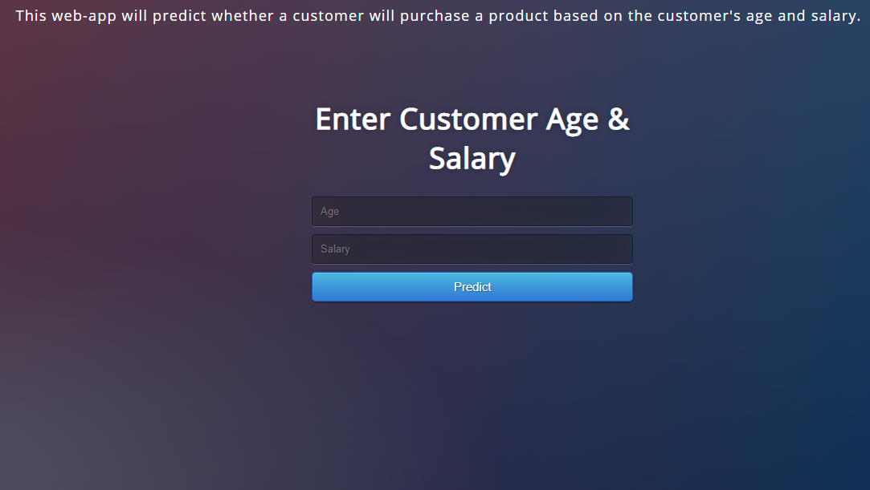
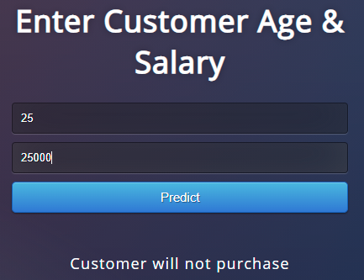
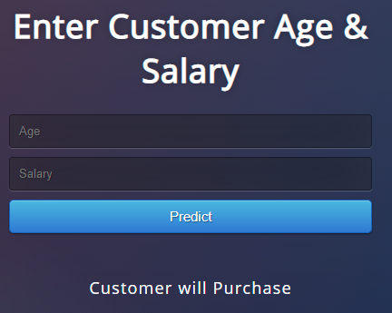
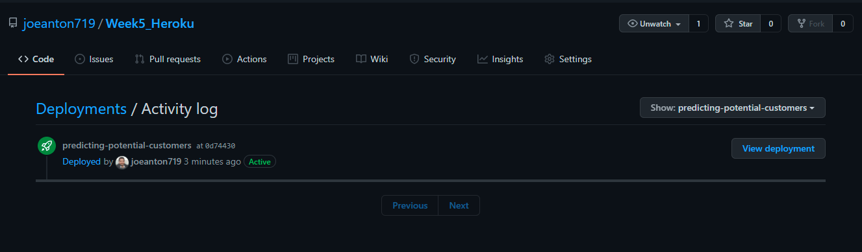
Model Deployment
Model deployed and ran successfully on the Heroku App.

Slide 7
The End

