Slide 1
Machine Learning Model

Slide 2
Description of data preprocessing
In order to improve the overall data quality. Duplicate and Outliers values were not found in the dataset. However, there were some missing values that had to be removed.
We created our target value based on increased up of both variables
Moreover, no encoding labels or custom encoding had to be used because all input data was numeric.

Slide 3
Description of feature engineering and feature selection
It is an important step for building interpretable models, reducing the risk of overwhelming the algorithms and saving time of doing unnecessary data transformation.
Random forests consist of 4 –12 hundred decision trees, each of them built over a random extraction of the observations from the dataset and a random extraction of the features. Not every tree sees all the features or all the observations, and this guarantees that the trees are de-correlated and therefore less prone to over-fitting.
The features selected comes from the correlation analysis, which is calculated by the Pearson’s r formulaTo establish the model, the features selected are shown below:
High, iexClose, deathIncrease, negativeIncrease, positiveIncrease, totalTestResultsIncrease, iexClose_deathIncrease_up, date_delta
For Random Forest, the Standardization and Normalization process was not required because this is not a distance-based model, which each node is not comparing feature values, it is simply splitting a sorted list that requires absolute values for branching. Basically, it RF model is based on partitioning the data to make prediction. This means that does not require normalization.
Feature selection using Random forest comes under the category of Embedded methods. Embedded methods combine the qualities of filter and wrapper methods. They are implemented by algorithms that have their own built-in feature selection methods. Some of the benefits of embedded methods are highly accurate, generalize better, interpretable.

Slide 4
Description of how data was split into training and testing sets
For splitting the data, we will be using train_test_split from sklearn.
This command distributes the data into training and testing set according to the ratio provided. Without that ratio specification, by default the ratio will be 0.25, which means the 25% of testing data set is represented by the 0.25 at the end.
In this case, we have used the default ratio.

Slide 5
Explanation of the model choice, including limitations and benefits
Random Forest
Based on an overall good predictive performance, low overfitting and easy interpretability, to derive the importance of each variable on the tree decision.
For imbalanced data, we used Balanced Random Forest, which randomly under-samples each boostrap sample to balance it.
Some of the benefits of embedded methods from Random Forest are highly accurate, generalize better, interpretable.
The limitations are Correlated features will be given equal or similar importance, but overall reduced importance compared to the same tree built without correlated counterparts. Also, Random Forests and decision trees, in general, give preference to features with high cardinality(Trees are biased to these type of variables ).

Slide 6
Explanation of changes in model choice
The first version of the model was run with a target value that considered the price increase as one class and the opposite as another class. Then, new categorical variables were created that considered as a class (1), the simultaneous rise in price and the variables (positive, hospitalized, death and totaltestresults) separately, this left a better result in model precision using the target variable(iexClose_hospitalizedIncrease_up), which 1 is for the simultaneous rise in price and the increase in hospitalized patients, 0 for the rest. Also, with respect to the first model, other variables such as volume, low, hospitalizedCurrently, negative, death, positive and total TestResults) were removed. Instead, variables such as: iexClose, high, deathIncrease, totalTestResultsIncrease, negativeIncrease, positiveIncrease, and date_delta were included. Finally, We run the model with iexClose, high, deathIncrease, totalTestResultsIncrease, negativeIncrease, positiveIncrease, and date_delta as a feature values for the different target values that has been already made it and the best model was 0.8420 with volume_hospitalizedIncrease_Up.

Slide 7
Description of training model process
In order to generalize well the new data. This is the stage where the algorithm is trained by feeding datasets and the learning takes place. The weights of the model are initialized randomly. By this way, the algorithm will learn to adjust the weights accordingly.

Slide 8
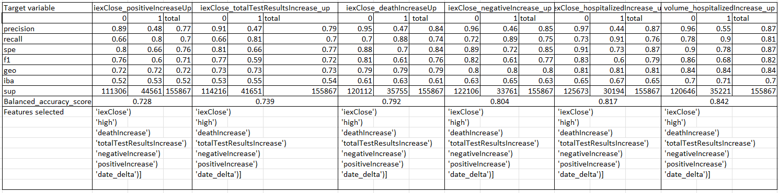
Description of current accuracy score
The best model was the 0.842. This result means the arithmetic mean of sensitivity (true positive rate) and specificity (true negative rate), or the area under the ROC curve with binary predictions rather than scores.

Slide 9
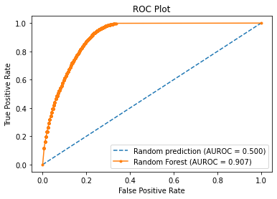
ROC Curve

Slide 10
References
https://towardsdatascience.com/feature-selection-using-random-forest-26d7b747597f
https://towardsdatascience.com/random-forest-for-imbalanced-dataset-example-with-avalanches-in-french-alps-77ffa582f68b
https://medium.com/analytics-vidhya/feature-selection-feature-engineering-3bb09c67d8c5

