Slide 1
Does Closing prices for equities impacted by Covid statistics?

Slide 2
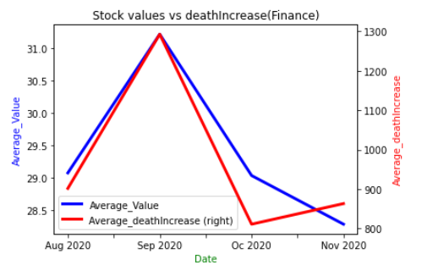
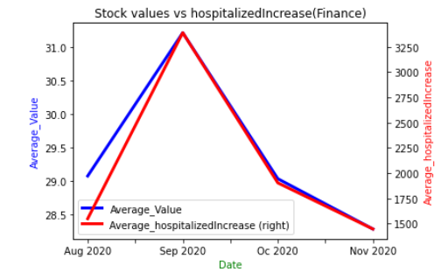
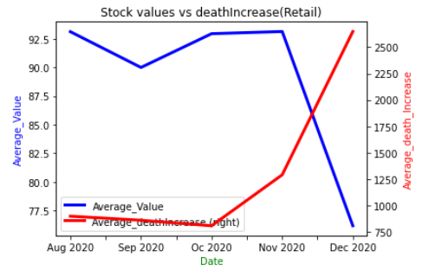
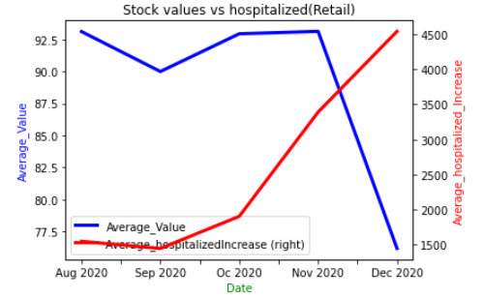
Why is it important

Slide 3
Description of the source of data
Source data; KAGGLE: https://www.kaggle.com/nroll12/us-equity-market-covid19 "How has the U.S. Stock market been impacted by Covid-19?"
CDC: Covid- National_history.csv "Contain daily data on the COVID-19 pandemic for the
US and individual states" Commuication through Slack

Slide 4
Questions expected to be answered
Does an increase covid deaths cause the stock market to go down?
Does an increase in hospitalizations caused the stock to go down?

Slide 5
Description of the data exploration phase of the project

Slide 6
Description of the analysis phase of the project

