Slide 1

Approaches to Learning

Slide 2

School/College
Surface approach to learning
Content delivered by teacher
Content recited back to teacher
Tasks
Assessment
Exams

Slide 3
Surface Learning
'Scrape the surface' of the material being studied, without carrying out any deep processing of the content.
Concentrate purely on assessment requirements
Accept information and ideas passively
Memorise facts and procedures routinely
Ignore guiding principles or patterns
Fail to reflect on underlying purpose or strategy
(www2.rgu.ac.uk, 2017)

Slide 4

University
Move towards a deep approach to learning
Some content given by tutor
Study independently
Know where to look for help
Become critical thinker
Reflect on findings

Slide 5
Deep Learning
A serious attempt to turn other people's ideas into your own personalised structure of knowledge.
Endeavour to understand material for yourself
Interact vigorously and critically with content
Relate ideas to previous knowledge and experience
Use organising principles to integrate ideas
Relate evidence to conclusions
Examine the logic of arguments
(www2.rgu.ac.uk, 2017)

Slide 6
Strategic Learning
Students who adopt a strategic approach to learning consciously set out to achieve the highest possible grades and tend to work according to the following general pattern:
Put steady effort into study
Seek out the right conditions and materials
Put time and effort to maximum effect
Know the requirements and criteria of assessment
(www2.rgu.ac.uk, 2017)

Slide 7
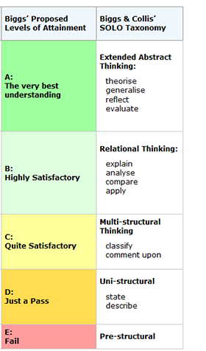
Constructive Alignment
Constructive alignment takes the outcomes students are to learn, and aligns teaching and assessment to those outcomes.
Outcome statements contain a learning activity (a verb) that students need to perform to achieve the outcome, such as “apply expectancy-value theory of motivation”, or “explain the concept of… “.
Learning is constructed by what activities students do, not about what teachers do.
Assessment is about how well students achieve the intended outcomes, not about how well they report back to tutors what they have been told or what they have read (John Biggs, 2017).

Slide 8
References
John Biggs. (2017). Constructive Alignment. [online] Available at: http://www.johnbiggs.com.au/academic/constructive-alignment/ [Accessed 3 Dec. 2017].
www2.rgu.ac.uk. (2016). How students learn: what learning involves. [online] Available at: http://www2.rgu.ac.uk/celt/pgcerttlt/how/how5a.htm [Accessed 3 Dec. 2017].

