Slide 1
Assessment Introduction

Slide 2
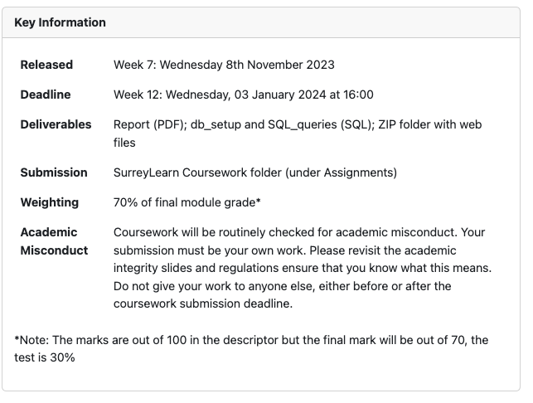

Slide 3
How Long Should Plan to Spend on The Coursework?
One credit is typically described as being equal to 10 hours of notional learning.
This module is worth 15-credits. So, 150 notional hours of learning.
We have 44 hours of lectures and labs
So, this leaves 106 hours.
This is around 3-weeks of additional study.
The assessment should take you between 2 and 3 weeks.

Slide 4
Some Coursework Tips
Read the Assignment Brief Carefully
Identify Key Components and Requirements
Check the Marking Criteria
Highlight Important Details
Start Early
Make a Timeline; consistency is key!
We have about 7 weeks
Factor in time for breaks and Christmas

Slide 5
Part 1
Database Design and Implementation
[65 Marks]

Slide 6
Part 2
Web Front-end to the Database
[35 Marks]

Slide 7
This part of the assessment requires you to create a Node.js application to connect to the database created in Part 1.
You will display records based on input data or choices made by the user of your website.
You do not have to interact with all tables in your database. For instance, you may only implement functionality around a single table.

Slide 8
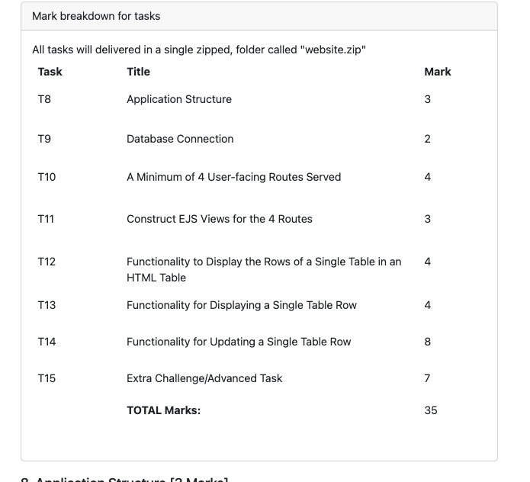

Slide 9
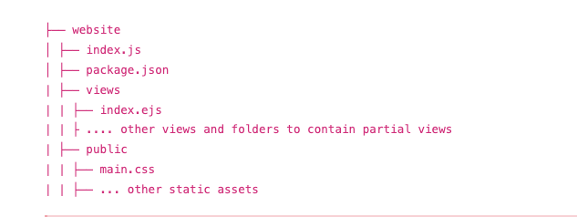
Ensure you follow the application structure specified in task 8

Slide 10
Preparing Your Website for Submission
Ensure you’ve:
Based your project on the structure specified in task 8.
Included a package.json (generated using npm init) file in the root of your project.
The package.json file must include the script "start" that will run your program (e.g., "start": "nodemon index.js").
Since your dependencies are in the package.json folder, please delete your node_modules folder before submitting.
Before running your program, we will run the "db_setup.sql" file; you should ensure this file is up to date.

