Slide 1
COM1025: Web and
Database Systems
The Internet and Node.js
(Slides credited to Dr. Manos Panaousis)
Week 8

Slide 2
Computer Networking

Slide 3
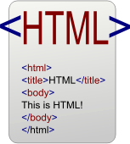

From the Internet to the Web
Computers (PCs, servers,
laptops, smart phones, tablets, …)
Computer networks
A particular
interconnected network of computer networks
= Internet
“particular” =
A special set of networking protocols (TCP/IP)

Slide 4







How does the Internet work?
Each network interface of a networked computer on the Internet (host) has a unique address (~street number).
One computer may have n>1 network interfaces so n>1 addresses (e.g. a PC has both LAN and WiFi connections).
Data from one host (source) to another (destination) is divided
into packets (~letters/parcels).
1 2
Those packets are sent separately from the source to the destination via a number of routers (~post offices).
1
2

Slide 5
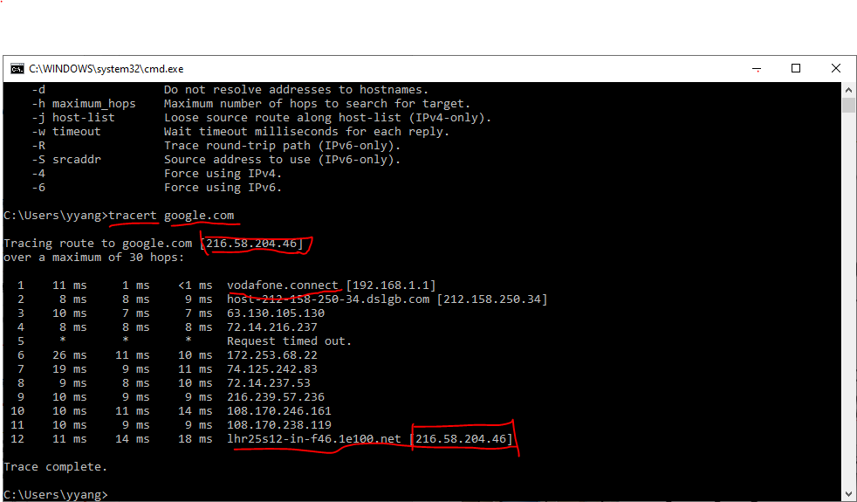
Traceroute

Slide 6

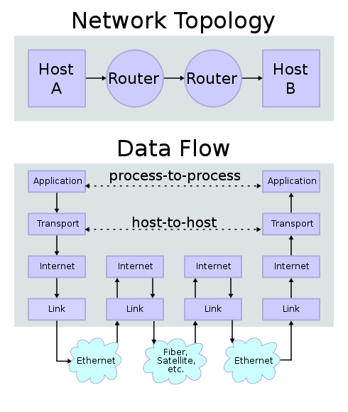
Four abstract layers of the Internet
Application layer: HTTP(S), FTP, SMTP, DNS, …
Transport layer: TCP, UDP
Internet layer: IP
Link layer: the
Web
underlying networking architecture below IP (Ethernet, 802.11)

Slide 7
UDP vs TCP
UDP:
Anything where you don't care too much if you get all data
always
Tunnelling/VPN (lost packets are ok - the tunnelled protocol takes care of it)
Media streaming (lost frames are ok)
Online games that don't care if you get every update
Local broadcast mechanisms (same application running on different machines "discovering" each other)
(Speed)
TCP:
Almost anything where you have to get all transmitted data
Web
SSH, FTP, telnet
SMTP, sending mail
IMAP/POP, receiving mail
(Reliability)

Slide 8
Four abstract layers of the Internet
Application layer: HTTP(S), FTP, SMTP, DNS, …
Transport layer: TCP, UDP
Internet layer: IP
Link layer: the
Web
underlying networking architecture below IP (Ethernet, 802.11)

Slide 9
IP and IP addresses
The communications protocol sending data packets from one host to the other via routing is called the Internet Protocol (IP).
Two editions: IPv4 and IPv6.
The unique address of each host is called its IP address.
IPv4: 32-bit, normally written as 4-segment dot-decimal format a.b.c.d, where each segment is an 8-bit integer between 0 and 255: e.g. 172.16.254.1.
IPv6: 128-bit, new-generation IP address, but wide development is still to come,
https://www.google.com/intl/en/ipv6/statistics.html#tab=per- country-ipv6-adoption

Slide 10
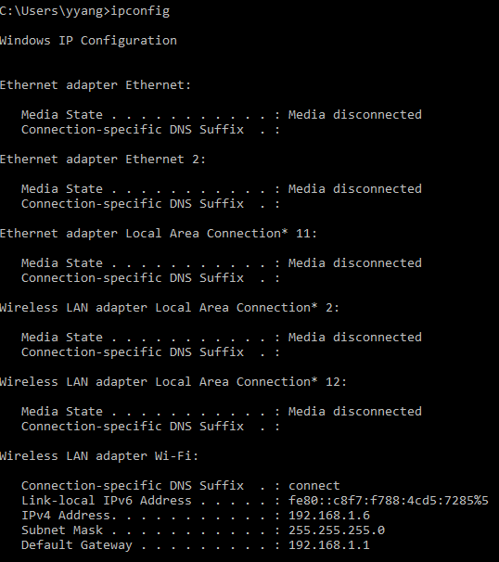
Check your own IP

Slide 11
From IP addresses to domain names
IP addresses are difficult to remember!
How can one remember meaningless IP addresses?
And many different IP addresses?
And much longer 128-bit IPv6 addresses?

Slide 12
From IP addresses to domain names
IP addresses are difficult to remember!
How can one remember meaningless IP addresses?
And many different IP addresses?
And much longer 128-bit IPv6 addresses?
More user-friendly domain names are introduced as aliases of IP addresses.
DNS (domain name system) servers convert domain names to IP
addresses.
Multiple domain names may point to the same IP address.
Syntax: hostname.sub_domain.….top_level_domain
Example 1: surreylearn.surrey.ac.uk ⇒ 131.227.132.44

Slide 13
From IP addresses to domain names
IP addresses are difficult to remember!
How can one remember meaningless IP addresses?
And many different IP addresses?
And much longer 128-bit IPv6 addresses?
More user-friendly domain names are introduced as aliases of IP
addresses.
DNS (domain name system) servers convert domain names to IP addresses.
Multiple domain names may point to the same IP address.
Syntax: hostname.sub_domain.….top_level_domain
Example 1: surreylearn.surrey.ac.uk ⇒ 131.227.132.44
Example 2: localhost ⇒ 127.x.x.x (on many systems just 127.0.0.1) = the
current machine itself (Local debug)

Slide 14
CSS

Slide 15
CSS = Cascading Style Sheet
CSS is a language that describes the presentation of a document written in a markup language
Describes the appearance and layout of a web page
Composed of CSS rules, which define sets of styles
CSS saves a lot of work
It can control the layout of multiple web pages all at once.

Slide 16
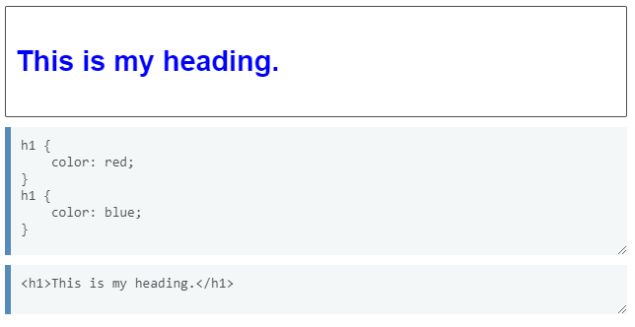
CSS = Cascading Style Sheet
What does “cascading” mean?
Each HTML element can be styled by a number of style sheets one cascading on top of another.
This means order matters (we will go back here soon)

Slide 17

CSS
A CSS file is composed of style rules:
selector: Specifies the HTML element(s) to style.
A selector can refer to an existing tag that is part of the HTML structure like unordered lists, paragraphs, inputs, or it can refer to a custom class, element’s name, or ID that we create.
rules we enter in between the braces apply to the selector we specify.
property: The name of the CSS style.
value: The value for the CSS style.
Note that in CSS, we use the colon (:) instead of an equal sign (=) to assign values.
Saved in a filename.css file.

Slide 18
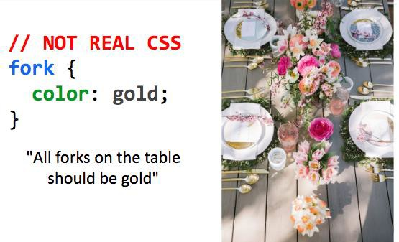
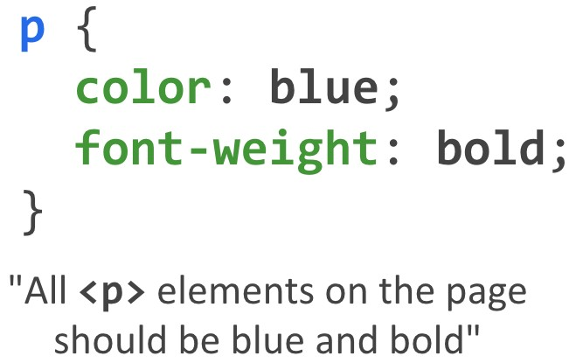
CSS

Slide 19

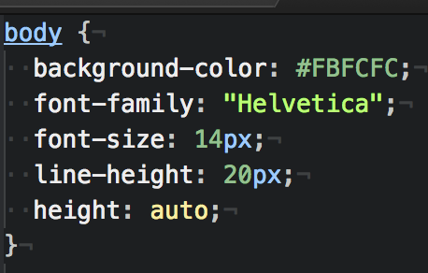
Examples

Slide 20
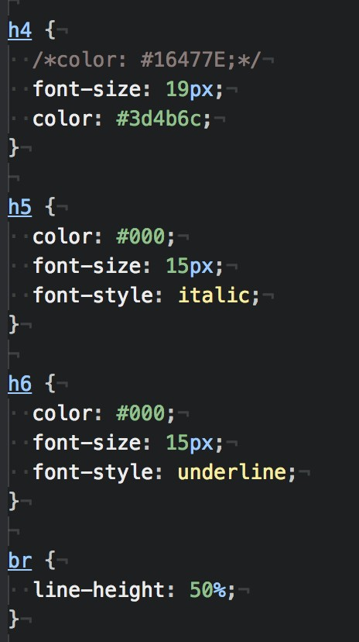
Examples

Slide 21
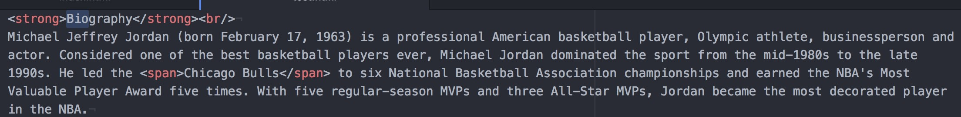
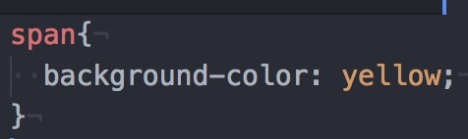
<div> and <span>
Two generic tags with no intended purpose or style:
<div>: a generic block element
<span>: a generic inline element
In contrast, some tags, e.g., <strong>, has built-in styles (defined in your web browsers)
HTML
CSS
But won't we often want multiple generic containers?
How do we distinguish two generic containers?
In other words, how do we select a subset of elements instead of all elements on the page?

Slide 22
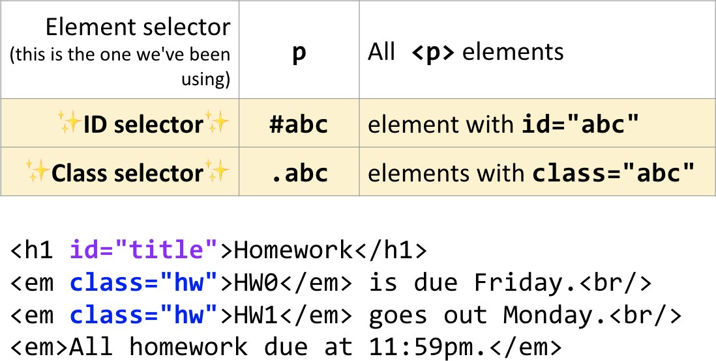
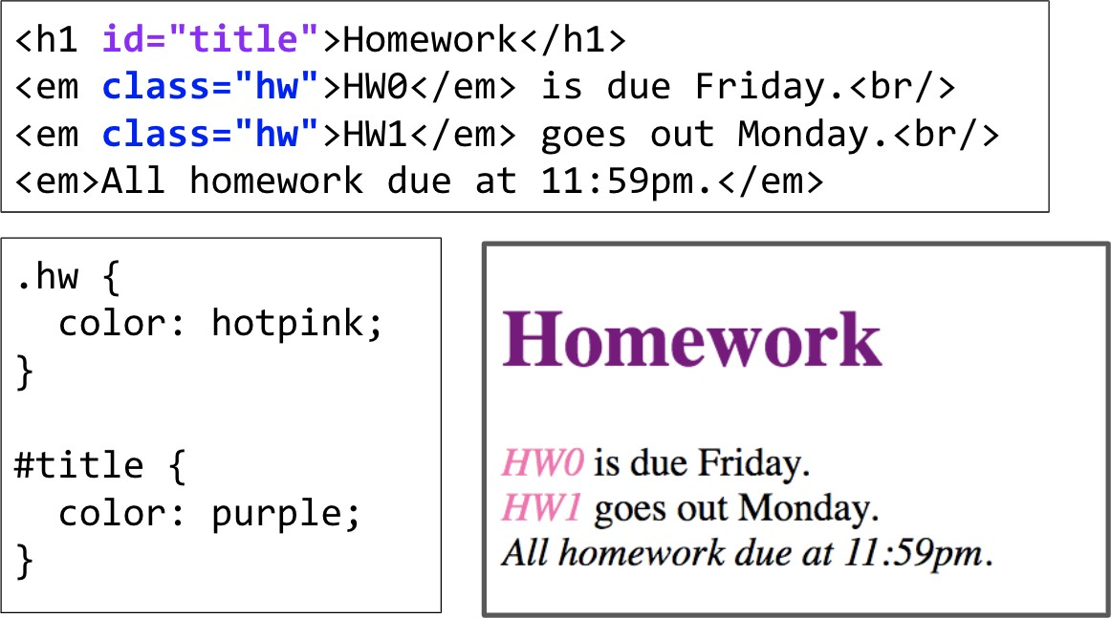
CSS Selectors: Classes and Ids
Often used with span and div to create generic elements: e.g. <span class="highlight"> is like creating a "highlight" element

Slide 23
Classes
We attach classes to our tags to apply different styles to the same selector type
adding the ability to be more specific about which occurrence we are talking about
We use classes by giving them rules in CSS
We refer to classes as attributes in elements that support them
from our HTML document by using class=“nameOfOurClass.”
When defining classes in our CSS file, we precede their name with a period to specify they are a class

Slide 24
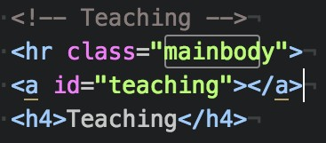
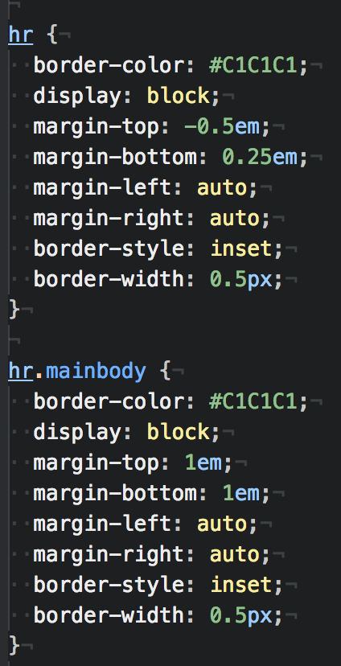
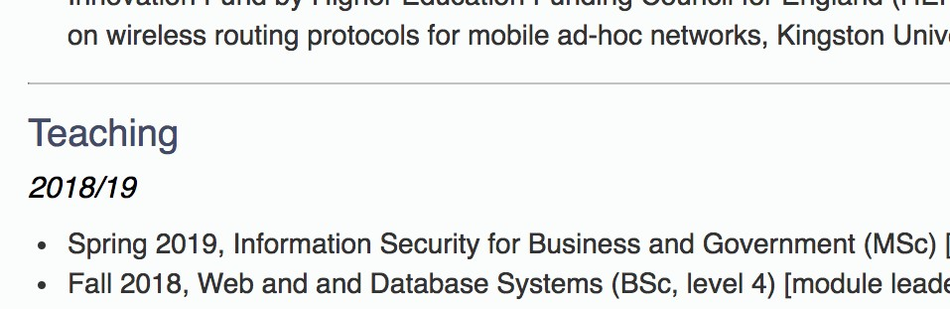
Examples

Slide 25
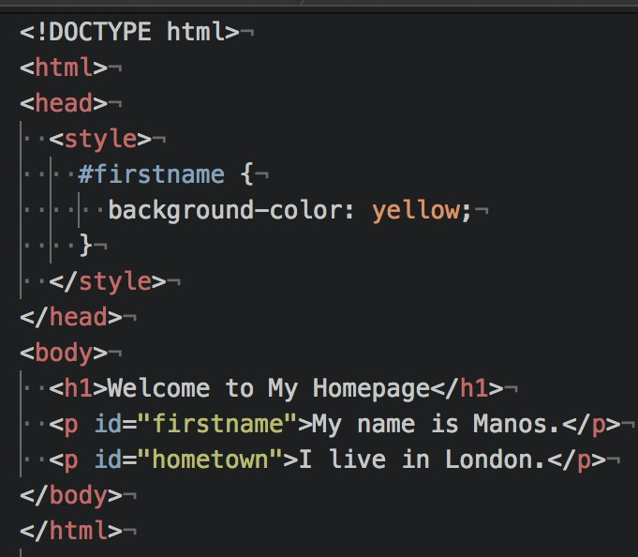
IDs
The ID attribute is used similar to how a class is used, with two differences:
The ID is defined with a # instead of a period
You should use an ID only once on a page, as it should identify something unique to the document.

Slide 26
Some CSS properties
There are over 500 CSS properties! Here are a few:
Font face (mdn) | font-family: Arial;
Font color (mdn) | color: gray;
Background color (mdn) | background-color: orange;
Border (mdn) | border: 5px solid orange;
Text alignment (mdn) | text-align: left;
Mozilla Developer Network (MDN) is one of the best reference for HTML elements
and CSS properties
The actual W3 spec is more hard to read (meant for browser developers, not web developers)

Slide 27
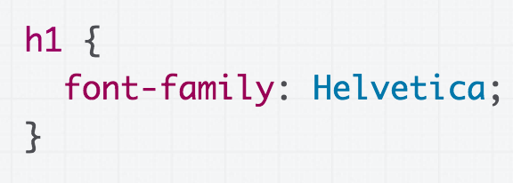
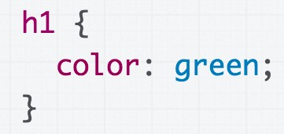
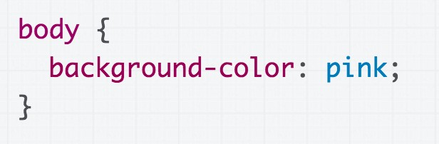
Some CSS properties
Font face: font-family
Some Texts
Font color: color
Some Texts
Some Texts
Assign a background-colour to body
to make the page a different colour.

Slide 28
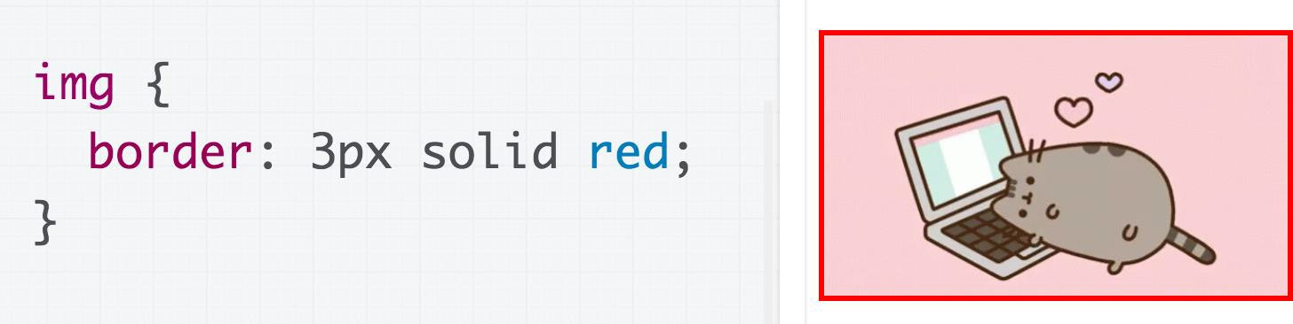
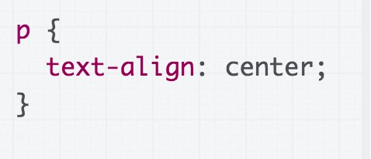
Some CSS properties
Border: border (border shorthand syntax)
Text alignment: text-align (note: don't use <center>)
Welcome to my personal webpage. You can find here more information about my recent publications and projects.

Slide 29
How to add CSS to HTML
CSS can be added to HTML elements in 3 ways:
Inline - by using the style attribute in HTML elements
Internal - by using a <style> element in the <head> section of the html file.
External - by using an external CSS file

Slide 30
Inline CSS
Styles defined using the style attribute inside the HTML elements are called inline styles
Syntax
style="property_1:value_1; …; property_n:value_n;”
E.g. <h1 style="color:blue;margin-left:30px;">This is a heading</h1>
Basically it is a list of CSS properties which define the style of the current HTML element.
The value of a property may take several sub-values
separated by space, e.g. “border: 5px solid black”

Slide 31
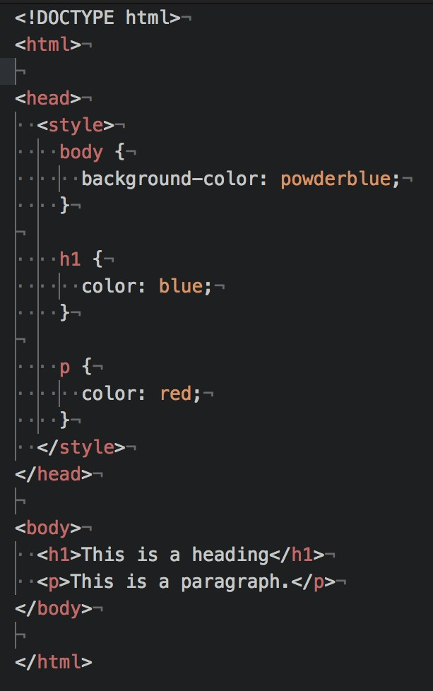
Internal CSS
An internal CSS is used to define a style for a single HTML page.
It is defined in the <head> section of an HTML page, within a <style> element:

Slide 32
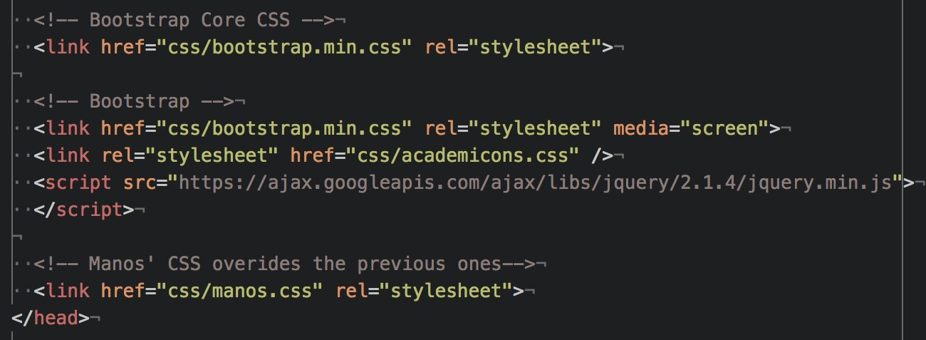
External CSS
An external style sheet is used to define the style for many HTML pages
With an external style sheet, you can change the look of an entire web site, by changing one file!
To use an external style sheet, add a link to it in the <head>
the HTML page
Multiple <link> elements are allowed
section of

Slide 33
Precedence of CSS styles
Inline styles (highest precedence)
Internal and external style sheet(s)
When there are multiple <link> and <style> elements in the <head> element, the style sheet appearing later takes precedence
Browser default styles (lowest precedence)

Slide 34

HTML forms

Slide 35
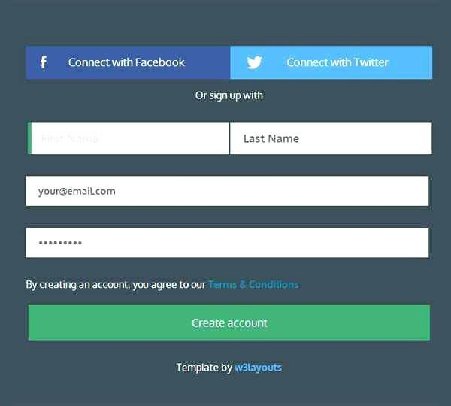
Example

Slide 36
Forms
An HTML form is a collection of HTML elements embedded within a page.
Purpose
Used for web server to collect data from users (client), which is submitted to a server-side program/script for generating dynamic web pages
By adding different types of elements, you can create different form fields, such as text fields, pull-down menus, checkboxes, and so on.
All Web forms start with an opening <form> tag, and end with a closing </form> tag

Slide 37
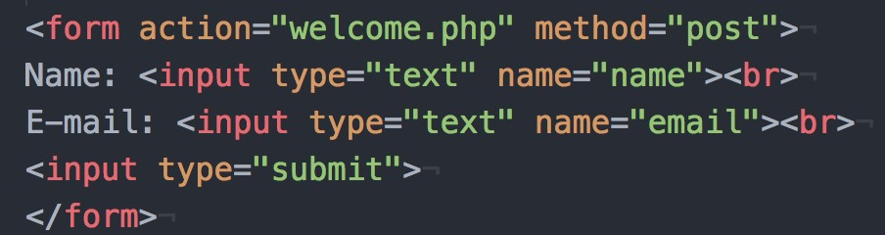
Forms’ attributes
Two attributes within the opening <form> tag:
The action attribute defines where the data will be sent to:
It is normally a URL pointing to a server-side program/script, but it can also be a mailto URL
This should either be an absolute URL or a relative URL
The method attribute tells the browser how to send the form data:
GET is for sending small amounts of data and makes it easy for the user to resubmit the form
POST can send much larger amounts of form data

Slide 38
<input>
<input> elements are used within a <form> element to declare input
controls that allow users to input data
Attributes (e.g.):
Type: specifies the type <input> element to display, e.g. text, button, checkbox, etc.
Name: specifies the name of an <input> element
Q: How is “name” attribute used?
A: it can be used on the client side by JavaScript and the server script uses it to retrieve its value as entered by the user in that input field.

Slide 39
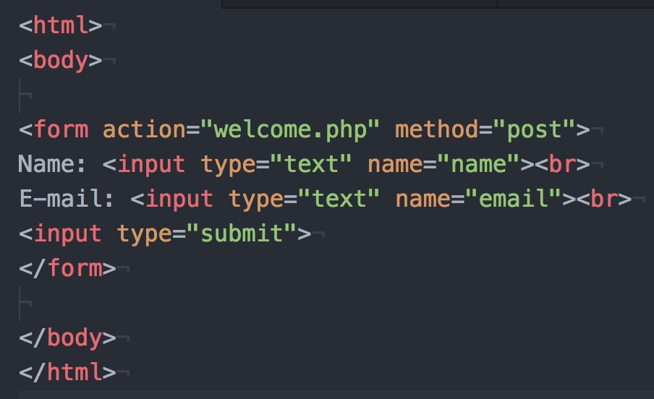
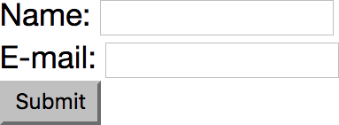
Example

Slide 40
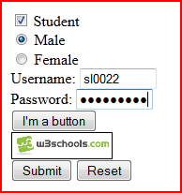
Form: <input> controls
<input type="…" …>: various input controls
type="checkbox": check box
type="radio": radio button
type="text": one-line text box (default type)
type="password": password input box
type="file" (*): an input field with a
“Browse…” button for localizing a local file
type="button": a clickable button
type="submit": a submission button
type="image": an image as the submission button
type="reset": a reset button (for clearing all fields)
type="hidden" (*): a hidden input field

Slide 41
Forms: two data submission methods
method="get" (the default method)
The form data is URL encoded and appended to the URL of the receiver (i.e. value of the action attribute) as a query string
…/process_form.php?name=Manos+Panaousis&mail=e.Panaousis@s urrey.ac.uk
Data size is limited to the maximum size of a URL (depends on user agent)
The URL (with the data) can be bookmarked and re-submitted without filling the form again
Form data is visible in the address bar, so not for password!
method="post"
The form data is sent to the server as the message body of an HTTP request, not part of the URL
Not limited to the maximum size of a URL
Form data is invisible in the address bar, so sensitive information is less exposed (but not necessarily secure – which requires HTTPS)

Slide 42
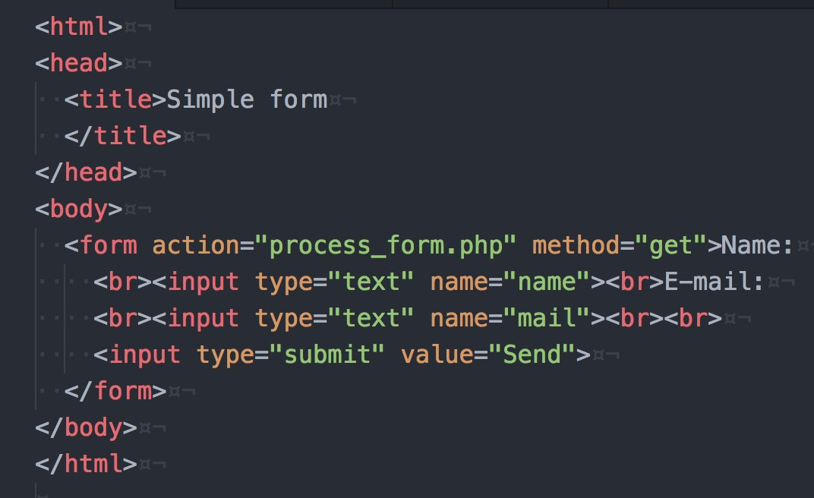
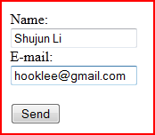
Forms: a simple example
After clicking “Send” button, your will see the following URL in the address bar of your web browser:
…/process_form.php?name=Shujun+Li&mail=hooklee%40gmail.com

Slide 43
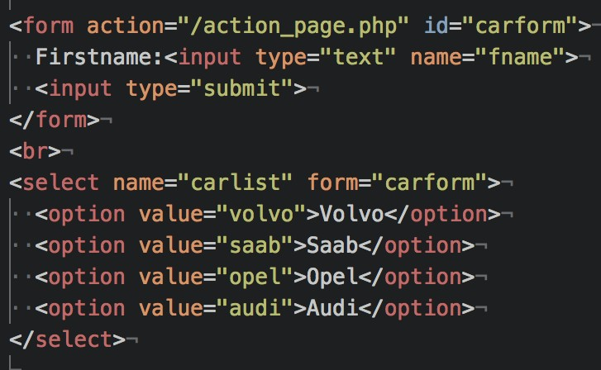
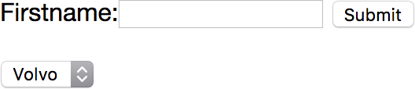
<select>

Slide 44
How to handle submitted data
When the data is submitted via HTTP GET method (e.g. <form …
method="get">)
The data is accessible as an array $_GET
In a web form: <input type="text" name="username">
I entered “manos” and submitted the data
Address bar of web browser (URL): http://.../...?...username=manos...
Server side: $_GET['username'] retrieves the submitted data
“manos” associated with the name (key) “username”
When the data is submitted via HTTP POST method (e.g. <form
… method="post">)
The data is accessible as an array $_POST
Everything else is the same as above

Slide 45
HTTP

Slide 46
HTTP
The Hypertext Transfer Protocol (HTTP) is designed to enable communications between clients and servers.
HTTP is a two-party communication protocol:
Party 1 – The client @ Computer 1: A web browser (also called a “user
agent”) that requests web pages
Party 2 – The server @ Computer 2: A program that handles requests of web pages from multiple clients
Steps:
A client submits an HTTP request to the server.
The server returns an HTTP response to the client.
The response contains status information about the request
and may also contain the requested content.
HTTP uses the Transmission Control Protocol (TCP)

Slide 47


Web browser vs. Web (HTTP) server
The program running at the server side is normally called a web
server or an HTTP server
Two most widely used web (HTTP) servers
Apache HTTP Server: cross-platform, used in our labs and for your
coursework (We will use this one)
Microsoft IIS (Internet Information Services, formerly known as Internet Information Server): Windows platforms only
Security?
It has a secure edition HTTPS (HTTP Secure)
HTTPS allows both end-to-end encryption of all communications between the web server and the web browser, and also server/client authentication
Its uses a cryptographic protocol called TLS/SSL

Slide 48

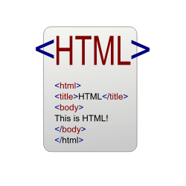



From static to dynamic web pages
Server-side
Program/Script
A requested web page is not necessarily a static one
It can be a server-side program/script residing on the web server
Why do we need dynamic programs/scripts?
HTTP(S)
TCP IP
URL
Handle dynamic data.
Interact with users.
Do more with less code!
…

Slide 49
Request a dynamic web page
User ⇒ Web browser
URL http://... (optionally + data)
Web browser ⇒ Web server
URL http://... (optionally + data)
Web server:
Server-side
Program/Script
URL ⇒ Local file path
Execute the local file as a program and
record the output (HTML code)
HTTP(S)
TCP IP
URL
+data
Web server ⇒ Web browser
HTML code generated above
Web browser ⇒ User
The received HTML code shown (in a web browser) as a web page

Slide 50
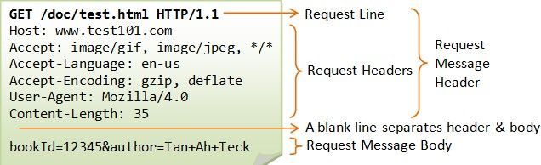
Sending a client request
Once the connection is established, the user-agent (e.g. web browser, a crawler) can send the request
A client request consists of text directives divided into:
The first line contains a request method (GET, POST) followed by its
parameters:
the path of the document, i.e. an absolute URL without the protocol or domain name
the HTTP protocol version

Slide 51
Sending a client request
Subsequent lines represent an HTTP header, giving the server information about what type of data is appropriate (e.g. what language), or other data altering its behavior (e.g. not sending an answer if it is already cached).
Then, the Request Message itself is included

Slide 52
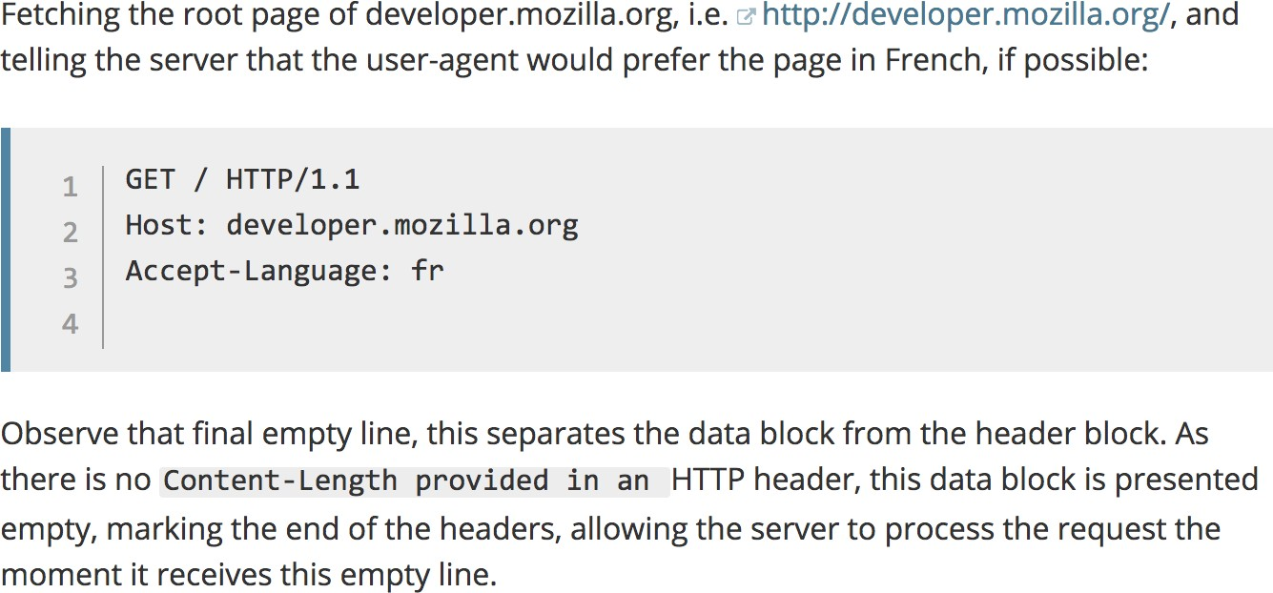
Example of a request

Slide 53
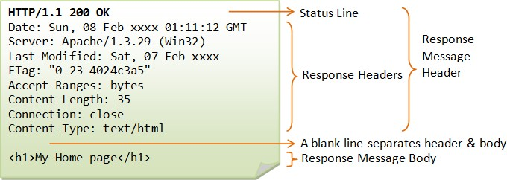
Structure of a server response
The web server processes the request, and ultimately returns a response
A server response is formed of text directives, divided into the following blocks:
The first line, the status line, consists of an acknowledgment of the
HTTP version used, followed by a status request (and its brief meaning in
human-readable text).
Subsequent lines represent specific HTTP headers, giving the client information about the data sent (e.g. type, data size, compression algorithm used, hints about caching).

Slide 54
Structure of a server response
A server response is formed of text directives, divided into the following blocks:
Similarly to the block of HTTP headers for a client request, these HTTP
headers form a block ending with an empty line.
The final block is a data block, which contains the optional data.

Slide 55
Beyond URL: data transmission
Client (web browser) ⇒ Web server
An HTTP request contains: URL (what web page?), data (what data is sent to the requested web page?)
Two main ways (called HTTP request methods or verbs in HTTP
terms) for transmitting data from client to server:
GET
Requests data from a specified resource.
Data transmitted as part (query string) of the URL: http://.../...?data1=value1&data2=value2...#fragment_ID
POST
Submits data to be processed to a specified resource.
Data transmitted as the message body of an HTTP request.

Slide 56
The GET method
the query string (name/value pairs) is sent in the URL of a GET request:
e.g., /test/demo_form.php?name1=value1&name2=value2
GET method sends the encoded user information appended to the page request
The page and the encoded information are separated by the ? Character
The GET method produces a long string that appears in your server logs
GET requests should be used only to retrieve data
GET requests should never be used when dealing with sensitive data
Note: GET can't be used to send binary data, like images or word
documents, to the server (string exclusively)
To be covered: PHP provides $_GET associative array to access all the
sent information using GET method
GET requests remain in the browser history and they can be bookmarked

Slide 57
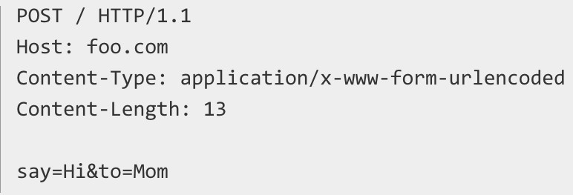
The POST method
the query string (name/value pairs) is sent in the HTTP message body of a POST
request:
It has no limit on data size (unlike GET method that is capped by max-length of URL)
The POST method transfers information via HTTP so its security depends on
HTTP protocol:
By using Secure HTTP you can make sure that your information is secure
To be covered: PHP provides $_POST associative array to access all the sent information using the POST method
POST requests do not remain in the browser history and they cannot be
bookmarked

Slide 58


File extension matters!
How can the web server know if a requested file should be treated as a server-side program/script?
File extension matters!
When the extension is “htm” or “html” the
PHP
module
web server knows what the client requests is a static web page
When the extension is a different one (e.g. “php” or “asp”), the web server knows a server-side program/script needs invoking
HTTP Server

Slide 59
The Web/HTTP is stateless
HTTP protocol itself is stateless (memoryless)
So is the Web!
Each HTTP request is processed without knowledge of any prior requests
A stateless protocol does not require the server to retain information or status about each user for the duration of multiple requests
No need to dynamically allocate storage to deal with conversations in
progress
It minimises time/bandwidth that would otherwise be spent reestablishing a connection for each request
If a client session dies in mid-transaction, no part of the system needs to be responsible for cleaning up the present state of the server

Slide 60



The Web/HTTP is stateless
In many applications, we want the web server to have memory
of the client’s visiting history
E.g., For a registered user of a website, he/she should be able to log in once for the whole website
So we need some mechanism to make the Web (HTTP) stateful
(= memoryful).
Save information about historical visits to the web server
So the web server keeps a memory of the past
What information do we need to save?
Data submitted via HTML forms
Data submitted via URLs (query strings, may not be via a form)
Who visited what, when and from where and how?
Maximally, everything about the visit history of every visitor!

Slide 61
Making Web/HTTP stateful
Q: How do we save such information?
A: Multiple ways
As web (HTTP) cookies (client-side data, short- and long-term)
As session variables (server-side data, short-term)
In databases (server-side, long-term)
In data files (server-side data, long-term)
We will cover everything!

Slide 62


Sessions
A (client-side) Web/HTTP session lasts from the first time the user visits a web server until the web browser closes
Q: How is the session ID maintained during a Web
session?
ID =
2fp8nq22d6vh2q a788nngm2644
Name=Manos Login=True Index=100
…
Stored as a (client-side) session cookie
Communicated as a URL parameter as part of the
query string of each URL
Note: Each client-side session has a unique ID and can be associated with a number of session variables stored at the server side

Slide 63
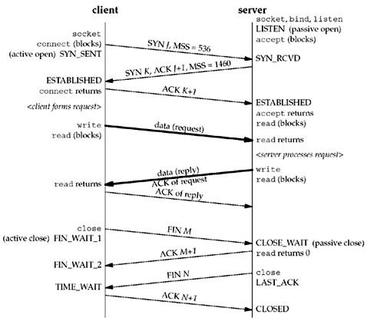
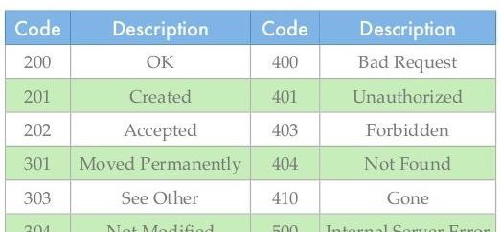
A typical HTTP session (3 phases)
The client establishes a TCP connection:
The client must know the IP address and the port number of the desired server
The client sends its request to the server, and waits for the answer
The server processes the request, sending back its answer, providing a status code and returned data

Slide 64
Response status codes
HTTP response status codes indicate if a specific HTTP request has been successfully completed
Responses are grouped into five classes:
Information responses:
e.g. 100 Continue: Indicates that everything so far is OK and that the client should continue with the request or ignore it if it is already finished:
To have a server check the request's headers, a client must
send Expect: 100-continue as a header in its initial request and receive a 100 Continue status code in response before sending the body
Successful responses:
e.g. 200 OK: The request has succeeded

Slide 65
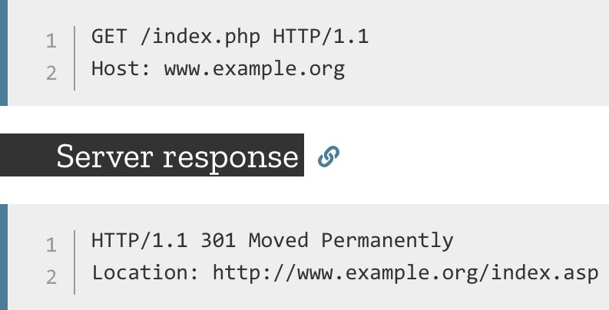
Response status codes
Redirection messages:
e.g. 301 Moved Permanently: indicates that the resource requested has been definitively moved to the URL given by the Location headers
Client error responses:
e.g. 404 Not Found: the server can not find requested resource
This response code is probably the most famous one due to its frequent
occurrence on the web
e.g. 403 Forbidden: indicates that the server understood the request but refuses to authorise it

Slide 66
Response status codes
Server error responses:
e.g. 500 Internal Server Error
Wrong implementation of server side script

Slide 67
Cookies

Slide 68



HTTP Cookies
An HTTP cookie is a small piece of text file that is downloaded onto ‘terminal equipment’ after sent by the server to the user's web browser when the user accesses a website:
It remembers stateful information for the stateless HTTP protocol
It allows the website to recognise the user’s device and store some information about the user’s preferences or past actions
When receiving an HTTP request, a server can
send a Set-Cookie header with the HTTP response
Set-Cookie: <cookie- name>=<cookie-value>

Slide 69


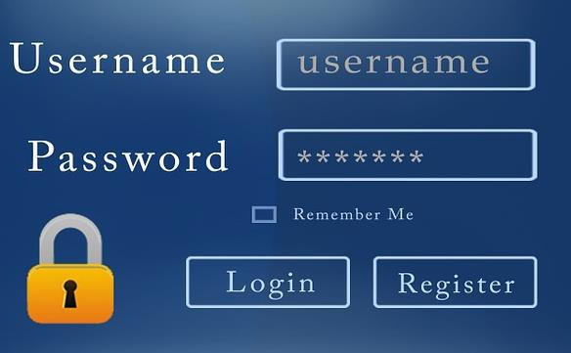

HTTP cookies
Cookies can be used for a variety of reasons:
PERSONALISATION - remember your preferences on a site:
e.g. whether you read the oldest or newest comments first; the volume on the video player.
TRACKING - understand how you are using the site:
e.g. to tell what the most popular news story of the day is; to record how you responded to a new design or version of the site.
SESSION MANAGEMENT - for logging in to a service or to make sure you're logged in securely:
these cookies may contain information such as your email address and your name – the information you gave when you signed up
the website you signed up to is the only site that can access this information
Cookies are sent with every request, so they can worsen
performance (especially for mobile data connections)

Slide 70
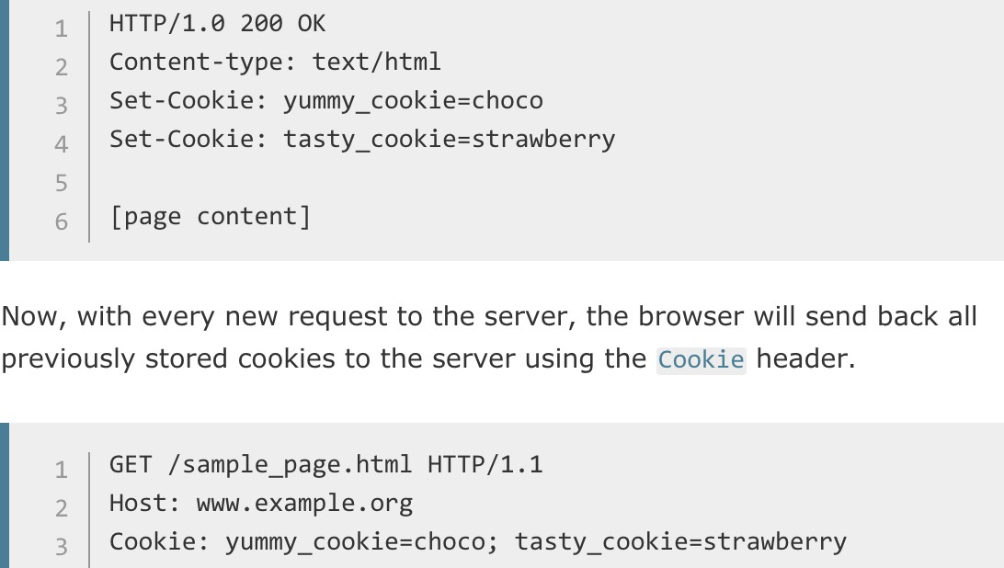
Creating cookies
Cookie is composed by server-side program/script (e.g., PHP) and sent to
the client via “Set-Cookie” in HTTP response
The cookie can be stored by the browser, and then the cookie is sent with requests made to the same server inside a Cookie HTTP header

Slide 71
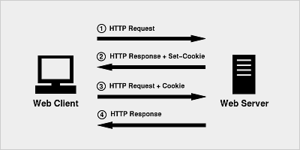
HTTP cookies

Slide 72
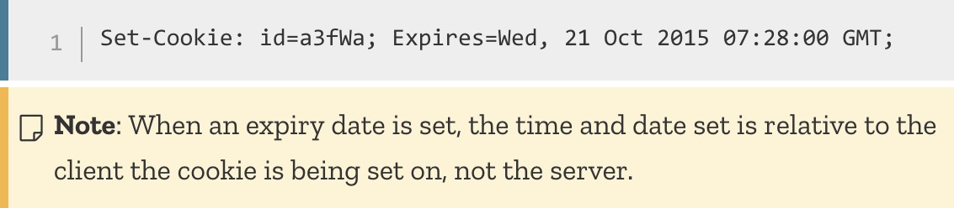
Session and Permanent cookies
The cookie created above is a session cookie
it is deleted when the client shuts down, because it didn't specify an Expires or Max-Age directive.
However, web browsers may use session restoring, which makes most session cookies permanent, as if the browser was never closed.
Instead of expiring when the client closes, permanent
cookies expire at a specific date (Expires) or after a specific length of time (Max-Age).

Slide 73

HTTP cookies
Cookies are stored for a particular domain:
They can be made accessible to a single domain name (e.g. www.foo.com) or all its subdomain names (e.g. *.foo.com).
Cookies have an expiration time:
Default: expire once the web browser closes = session cookies
Secure Cookies (*): Cookies made valid for HTTPS only
A secure cookie will only be sent to the server when a request
is made using SSL and the HTTPS protocol
However, confidential or sensitive information should never be stored or transmitted in HTTP Cookies as the entire mechanism is inherently insecure and this doesn't mean that any information is encrypted

Slide 74

HttpOnly cookies
HttpOnly Cookies (*):
Cookies available to server only
HttpOnly is an additional flag included in a Set-Cookie HTTP response header
Using the HttpOnly flag when generating a cookie helps mitigate the risk of client side script accessing the protected cookie.
To prevent cross-site scripting (XSS) attacks, HttpOnly cookies are inaccessible to JavaScript's Document.cookie API

Slide 75






Cookies in different web browsers
Google Chrome
– “Settings” – “+ Show advanced settings” - “Privacy” section – “Content settings…” button – “Cookies” section (“All cookies and site data…” button for viewing cookies)
Mozilla Firefox
– – – “History” section – “remove individual cookies” link (cookie viewer) / “Firefox will” drop-down list “Use custom settings for
history” (cookie settings)
Microsoft Internet Explorer (MSIE)
Viewer: – “Internet Options” menu item – “General” tab – “Browsing history” section – “Settings” button – “View files” button – search files using “cookie” as keyword
Settings: – “Internet Options” menu item – “Privacy” tab – “Advanced”
button – “Override automatic cookie handling” checkbox

Slide 76


Privacy?
Contrary to a common belief, cookies do not contain software programs, so cannot install anything on a computer
Cookies generally do not contain any information that would identify a person (Personal Identifiable Information - PII)
Usually they contain a string of text or "unique identifier”
acting like a label
When a website sees the string of text it set in a cookie, it knows the browser is one it has seen before
However, cookies may violate the user’s privacy as it gives the remote server access to local data
Cookies can be disabled in the web browser by the user

Slide 77
The GDPR, Cookie Consent
The EU General Data Protection Regulation (GDPR) has now been in force
The GDPR is an over-arching piece of legislation dealing with all aspects
of the processing of personal information
Cookies are mentioned once in the GDPR, in Recital 30:
“Natural persons may be associated with online identifiers…such as internet protocol addresses, cookie identifiers or other identifiers…. This may leave traces which, in particular when combined with unique identifiers and other information received by the servers, may be used to create profiles of the natural persons and identify them.”

Slide 78
End of Week 7

