Slide 1
COM1025: Web and
Database Systems
The HTTP and Further JavaScript
(Slides credited to Dr. Manos Panaousis)
Week 8

Slide 2
Last Week
We considered the foundations of how the internet works
We created some simple JavaScript programs. We ran these programs in the Node.js environment.
  However, we did not use any Node.js features. We just used JavaScript features.
Notes:
Develop students' understanding of the theory, design, and development of database systems and the key role database systems play in the real world
Equip students with the basic knowledge of frontend and backend web technologies that can be used to interface a database system
Develop students' analytical and problem-solving skills via modelling data of real-world problems
Perspective of the designer and developer of db systems

Slide 3
This Week
This week, we will be learning about Node.js features, and why we need them
Specifically, we will consider:
  How to create simple web applications
  Using templating languages
  Using a package manager
  Using a web framework
Notes:
We will be learning about the Node Package Manager (npm)

Slide 4

HTTP

Slide 5

Visit: https://http-server-leqm.onrender.com/

Slide 6
HTTP
The Hypertext Transfer Protocol (HTTP) is designed to enable communications between clients and servers.
HTTP is a two-party communication protocol:
  Party 1 – The client @ Computer 1: A web browser (also called a “user
agent”) that requests web pages
  Party 2 – The server @ Computer 2: A program that handles requests of web pages from multiple clients
Steps:
  A client submits an HTTP request to the server.
  The server returns an HTTP response to the client.
  The response contains status information about the request
and may also contain the requested content.
HTTP uses the Transmission Control Protocol (TCP)

Slide 7


Web browser vs. Web (HTTP) server
The program running at the server side is normally called a web
server or an HTTP server
  Two most widely used web (HTTP) servers
    Apache HTTP Server: cross-platform, used in our labs and for your
coursework Microsoft IIS (Internet Information Services, formerly known as Internet Information Server): Windows platforms only
    NodeJS (We will use this one)
Security?
It has a secure edition HTTPS (HTTP Secure)
  HTTPS allows both end-to-end encryption of all communications between the web server and the web browser, and also server/client authentication
  Its uses a cryptographic protocol called TLS/SSL

Slide 8

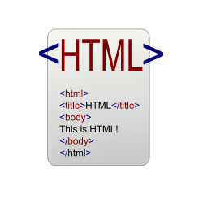



From static to dynamic web pages
Server-side
Program/Script
A requested web page is not necessarily a static one
It can be a server-side program/script residing on the web server
Why do we need dynamic programs/scripts?
HTTP(S)
TCP IP
URL
Handle dynamic data.
Interact with users.
Do more with less code!
…

Slide 9

Request a dynamic web page
User ⇒ Web browser
  URL http://... (optionally + data)
Web browser ⇒ Web server
  URL http://... (optionally + data)
Web server:
Server-side
Program/Script
URL ⇒ Local file path
Execute the local file as a program and
record the output (HTML code)
HTTP(S)
TCP IP
URL
+data
Web server ⇒ Web browser
  HTML code generated above
Web browser ⇒ User
  The received HTML code shown (in a web browser) as a web page

Slide 10
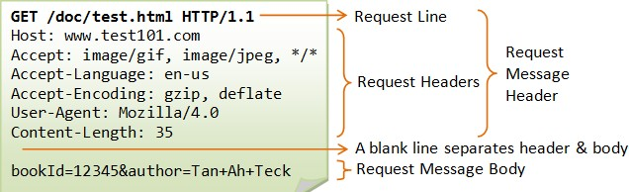
Sending a client request
Once the connection is established, the user-agent (e.g. web browser, a crawler) can send the request
A client request consists of text directives divided into:
  The first line contains a request method (GET, POST) followed by its
parameters:
    the path of the document, i.e. an absolute URL without the protocol or domain name
    the HTTP protocol version

Slide 11
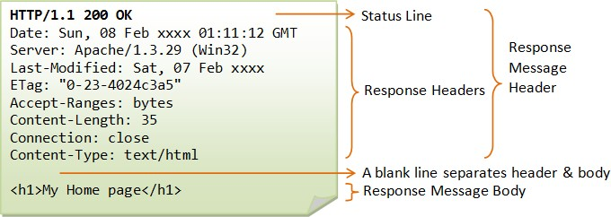
Structure of a server response
The web server processes the request, and ultimately returns a response
A server response is formed of text directives, divided into the following blocks:
  The first line, the status line, consists of an acknowledgment of the
HTTP version used, followed by a status request (and its brief meaning in
human-readable text).
  Subsequent lines represent specific HTTP headers, giving the client information about the data sent (e.g. type, data size, compression algorithm used, hints about caching).

Slide 12
The GET method
the query string (name/value pairs) is sent in the URL of a GET request:
  e.g., /test/demo_form.php?name1=value1&name2=value2
    GET method sends the encoded user information appended to the page request
    The page and the encoded information are separated by the ? Character
The GET method produces a long string that appears in your server logs
GET requests should be used only to retrieve data
  GET requests should never be used when dealing with sensitive data
Note: GET can't be used to send binary data, like images or word
documents, to the server (string exclusively)
To be covered: PHP provides $_GET associative array to access all the
sent information using GET method
GET requests remain in the browser history and they can be bookmarked

Slide 13
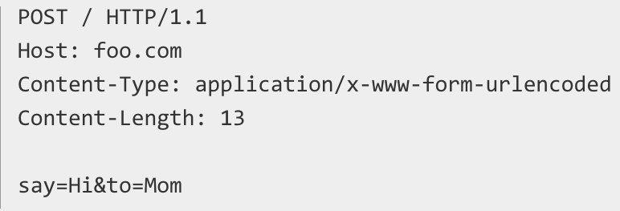
The POST method
the query string (name/value pairs) is sent in the HTTP message body of a POST
request:
It has no limit on data size (unlike GET method that is capped by max-length of URL)
The POST method transfers information via HTTP so its security depends on
HTTP protocol:
  By using Secure HTTP you can make sure that your information is secure
To be covered: PHP provides $_POST associative array to access all the sent information using the POST method
POST requests do not remain in the browser history and they cannot be
bookmarked

Slide 14
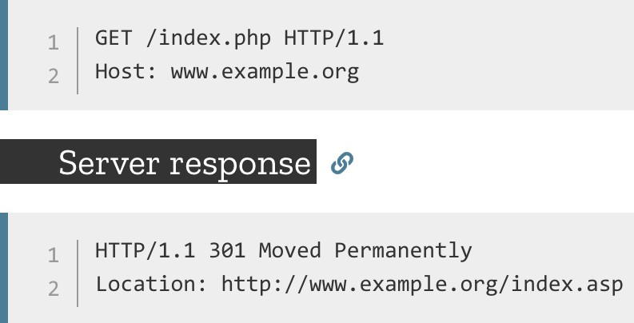
Response status codes
Redirection messages:
  e.g. 301 Moved Permanently: indicates that the resource requested has been definitively moved to the URL given by the Location headers
Client error responses:
  e.g. 404 Not Found: the server can not find requested resource
    This response code is probably the most famous one due to its frequent
occurrence on the web
  e.g. 403 Forbidden: indicates that the server understood the request but refuses to authorise it

Slide 15
Response status codes
Server error responses:
  e.g. 500 Internal Server Error
    Wrong implementation of server side script

Slide 16
The Web/HTTP is stateless
HTTP protocol itself is stateless (memoryless)
  So is the Web!
  Each HTTP request is processed without knowledge of any prior requests
  A stateless protocol does not require the server to retain information or status about each user for the duration of multiple requests
No need to dynamically allocate storage to deal with conversations in
progress
It minimises time/bandwidth that would otherwise be spent reestablishing a connection for each request
If a client session dies in mid-transaction, no part of the system needs to be responsible for cleaning up the present state of the server

Slide 17



The Web/HTTP is stateless
In many applications, we want the web server to have memory
of the client’s visiting history
  E.g., For a registered user of a website, he/she should be able to log in once for the whole website
So we need some mechanism to make the Web (HTTP) stateful
(= memoryful).
  Save information about historical visits to the web server
    So the web server keeps a memory of the past
What information do we need to save?
  Data submitted via HTML forms
  Data submitted via URLs (query strings, may not be via a form)
  Who visited what, when and from where and how?
    Maximally, everything about the visit history of every visitor!

Slide 18
Making Web/HTTP stateful
Q: How do we save such information?
A: Multiple ways
  As web (HTTP) cookies (client-side data, short- and long-term)
  As session variables (server-side data, short-term)
  In databases (server-side, long-term)
  In data files (server-side data, long-term)
We will cover everything!

Slide 19


Sessions
A (client-side) Web/HTTP session lasts from the first time the user visits a web server until the web browser closes
Q: How is the session ID maintained during a Web
session?
ID =
2fp8nq22d6vh2q a788nngm2644
Name=Manos Login=True Index=100
…
Stored as a (client-side) session cookie
Communicated as a URL parameter as part of the
query string of each URL
Note: Each client-side session has a unique ID and can be associated with a number of session variables stored at the server side

Slide 20
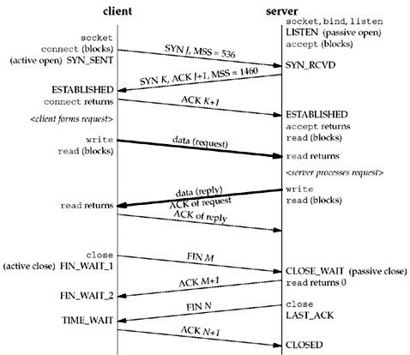
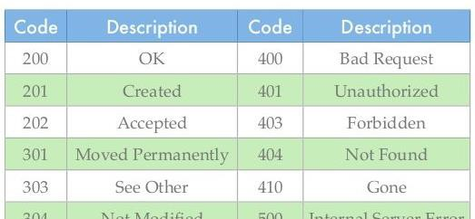
A typical HTTP session (3 phases)
The client establishes a TCP connection:
  The client must know the IP address and the port number of the desired server
The client sends its request to the server, and waits for the answer
The server processes the request, sending back its answer, providing a status code and returned data

Slide 21
Cookies

Slide 22



HTTP Cookies
An HTTP cookie is a small piece of text file that is downloaded onto ‘terminal equipment’ after sent by the server to the user's web browser when the user accesses a website:
  It remembers stateful information for the stateless HTTP protocol
It allows the website to recognise the user’s device and store some information about the user’s preferences or past actions
When receiving an HTTP request, a server can
send a Set-Cookie header with the HTTP response
  Set-Cookie: <cookie- name>=<cookie-value>

Slide 23


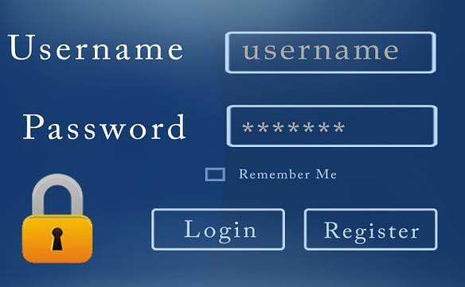

HTTP cookies
Cookies can be used for a variety of reasons:
  PERSONALISATION - remember your preferences on a site:
    e.g. whether you read the oldest or newest comments first; the volume on the video player.
  TRACKING - understand how you are using the site:
    e.g. to tell what the most popular news story of the day is; to record how you responded to a new design or version of the site.
  SESSION MANAGEMENT - for logging in to a service or to make sure you're logged in securely:
    these cookies may contain information such as your email address and your name – the information you gave when you signed up
    the website you signed up to is the only site that can access this information
Cookies are sent with every request, so they can worsen
performance (especially for mobile data connections)

Slide 24
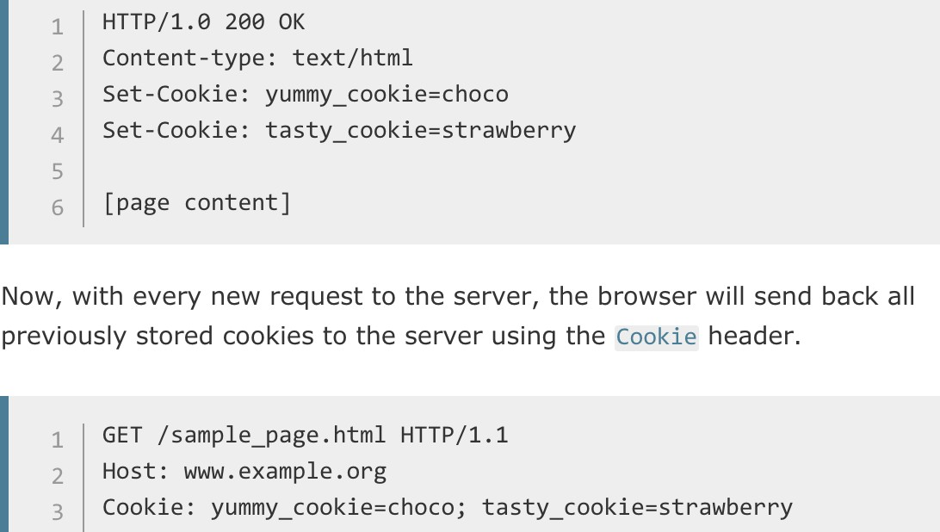
Creating cookies
Cookie is composed by server-side program/script (e.g., PHP) and sent to
the client via “Set-Cookie” in HTTP response
The cookie can be stored by the browser, and then the cookie is sent with requests made to the same server inside a Cookie HTTP header

Slide 25
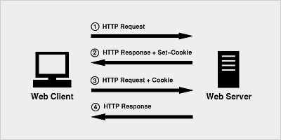
HTTP cookies

Slide 26
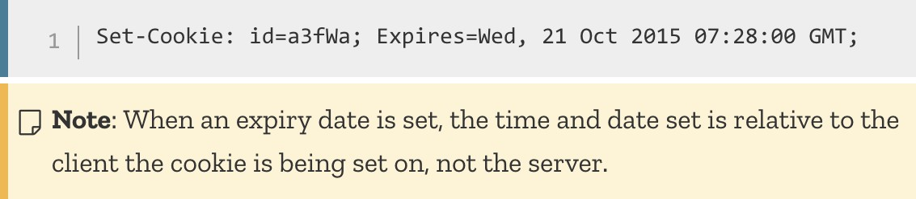
Session and Permanent cookies
The cookie created above is a session cookie
  it is deleted when the client shuts down, because it didn't specify an Expires or Max-Age directive.
  However, web browsers may use session restoring, which makes most session cookies permanent, as if the browser was never closed.
Instead of expiring when the client closes, permanent
cookies expire at a specific date (Expires) or after a specific length of time (Max-Age).

Slide 27

HTTP cookies
Cookies are stored for a particular domain:
  They can be made accessible to a single domain name (e.g. www.foo.com) or all its subdomain names (e.g. *.foo.com).
Cookies have an expiration time:
  Default: expire once the web browser closes = session cookies
Secure Cookies (*): Cookies made valid for HTTPS only
  A secure cookie will only be sent to the server when a request
is made using SSL and the HTTPS protocol
  However, confidential or sensitive information should never be stored or transmitted in HTTP Cookies as the entire mechanism is inherently insecure and this doesn't mean that any information is encrypted

Slide 28

HttpOnly cookies
HttpOnly Cookies (*):
  Cookies available to server only
  HttpOnly is an additional flag included in a Set-Cookie HTTP response header
  Using the HttpOnly flag when generating a cookie helps mitigate the risk of client side script accessing the protected cookie.
    To prevent cross-site scripting (XSS) attacks, HttpOnly cookies are inaccessible to JavaScript's Document.cookie API

Slide 29


Privacy?
Contrary to a common belief, cookies do not contain software programs, so cannot install anything on a computer
Cookies generally do not contain any information that would identify a person (Personal Identifiable Information - PII)
  Usually they contain a string of text or "unique identifier”
acting like a label
  When a website sees the string of text it set in a cookie, it knows the browser is one it has seen before
However, cookies may violate the user’s privacy as it gives the remote server access to local data
Cookies can be disabled in the web browser by the user

Slide 30
The GDPR, Cookie Consent
The EU General Data Protection Regulation (GDPR) has now been in force
The GDPR is an over-arching piece of legislation dealing with all aspects
of the processing of personal information
Cookies are mentioned once in the GDPR, in Recital 30:
  “Natural persons may be associated with online identifiers…such as internet protocol addresses, cookie identifiers or other identifiers…. This may leave traces which, in particular when combined with unique identifiers and other information received by the servers, may be used to create profiles of the natural persons and identify them.”

Slide 31
The anatomy of a node project
Notes:
“Learn about the key technologies of Database systems and the World Wide Web (WWW)”. Why is the important?
Databases are the core component of most computer application.

Slide 32
A Typical Node.js Project
| ── my-project
  |── package.json
  |── package-lock.json
  |── node_modules
  |── index.js
A node project is a folder that contains a package.json file.
The package.json file contains information about the project, including the packages it uses.
A package.lock file contains information about the packages that are installed in the project
There should be at least one JavaScript that will be the entry point for your application: e.g., index.js, app.js

Slide 33
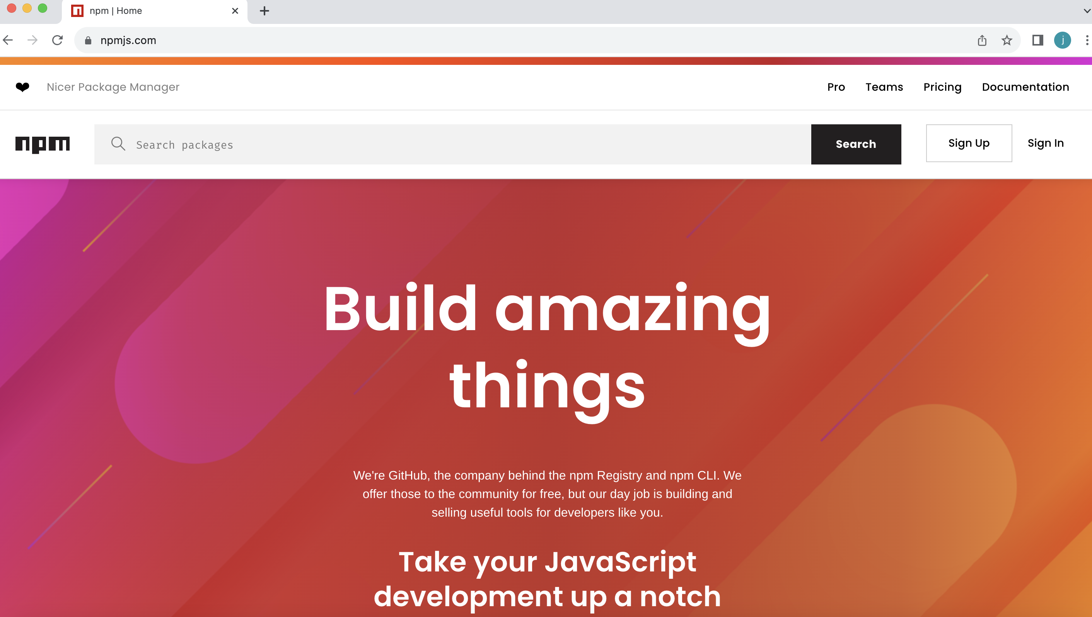
The Node Package Manager
The node package manager can be used to manage node projects (https://www.npmjs.com/)

Slide 34
The Node Package Manager(NPM)
npm is:
  a package manager for JavaScript
  if you have Node.js installed, you have npm installed!
  the world's largest software registry
  it provides a command-line interface (CLI) for managing packages and other tasks
  it can be used to install, manage, and publish packages, manage dependencies, and run scripts

Slide 35
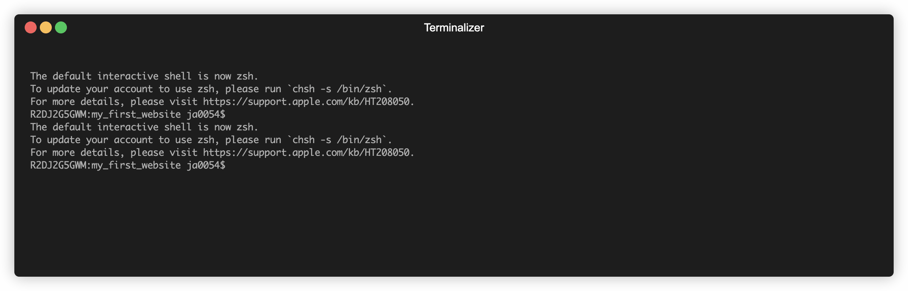
Getting Started with NPM
- Ensure your have NodeJS installed
- In the directory of your project run the terminal command: npm init
- You can keep pressing enter to accept the defaults.

Slide 36
You now have a package.json file
{
"name": "my_first_website",
"version": "1.0.0",
"main": "index.js",
"scripts": {
"test": "echo \"Error: no test specified\" && exit 1"
},
"author": "",
"license": "ISC",
"dependencies": {
},
"devDependencies": {},
"description": ""
}
The `package.json` file contains information about the project and is split into sections.
For this module, there are only three sections we care about:
The `devDependencies` field is a list of packages that the project depends on in development mode.
The `dependencies` field is a list of packages that the project depends on.

Slide 37
Getting Started with NPM
After running “npm init”; we can now install some packages
You can find packages by searching the https://www.npmjs.com/
Repository
Packages are open source and free
There are over 1.2million packages
Many are downloaded millions of times a week

Slide 38
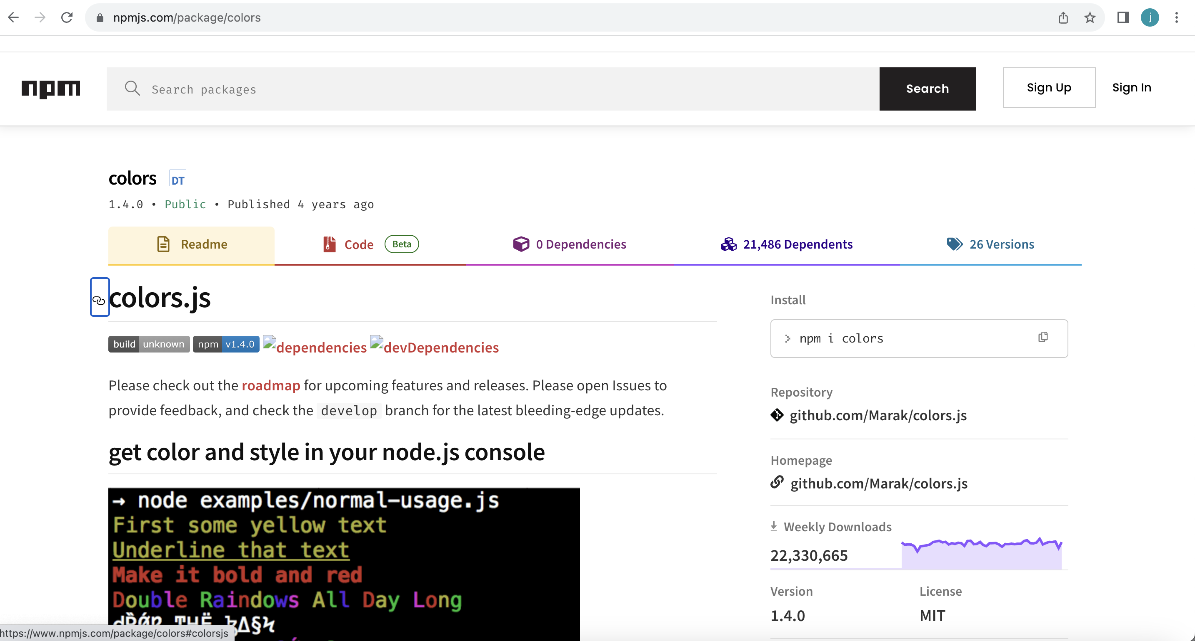
Let’s Install Colors (i)
This package lets us print different colors to the console
Name of the package
The source code
Documentation
Downloads

Slide 39
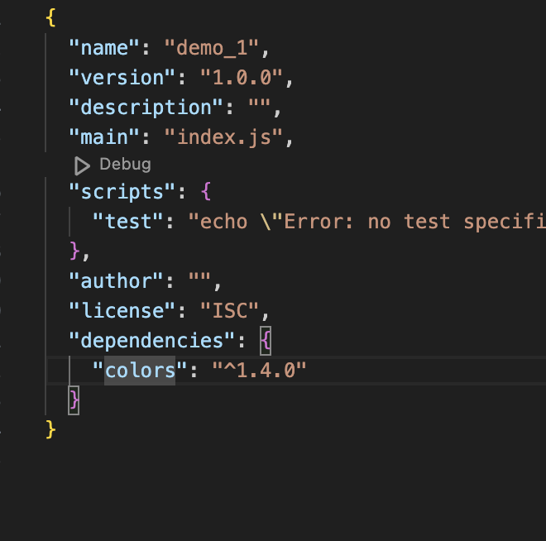
Let’s Install Colors.js (ii)
Dependencies are installed from command line.
  Ensure your terminal window is pointed to the root of your project.
> npm install colors
Packages are stored in the "node_modules" folder
Dependencies listed in the ”package.json” file
Packages are stored in the "node_modules" folder

Slide 40

Using Packages
const colors = require('colors’); // save the package to a const
console.log('Hello World!'.rainbow);

Slide 41
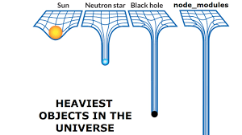
Some TIPS
Since packages have dependencies the ”node_modules” folder gets very heavy
Use .gitignore to exclude "node_modules" from version control
Delete the ”node_modules” folder before submitting your assessment
We can install the dependancies by running “npm install”

Slide 42
DEMO (see Lecture TAB)
Notes:
“Learn about the key technologies of Database systems and the World Wide Web (WWW)”. Why is the important?
Databases are the core component of most computer application.

Slide 43
Web Development Frameworks
Notes:
“Learn about the key technologies of Database systems and the World Wide Web (WWW)”. Why is the important?
Databases are the core component of most computer application.

Slide 44

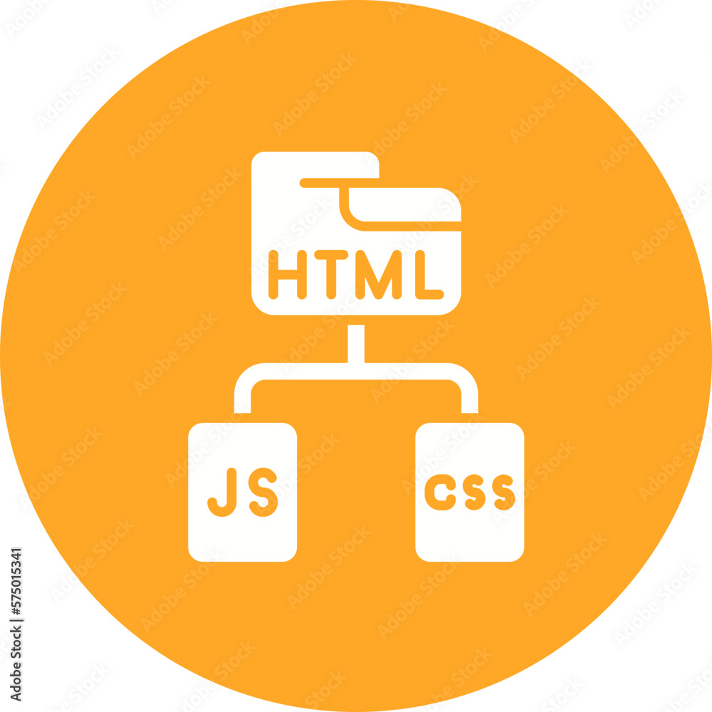

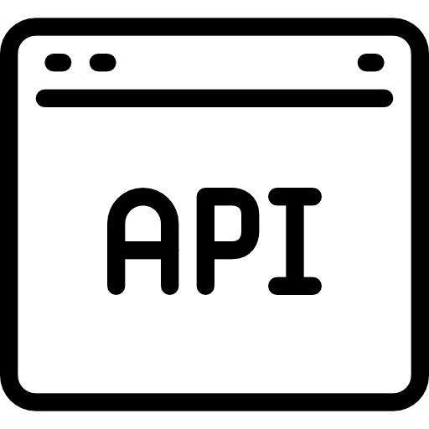
Front end vs back-End Development
Front-End:
HTTP Requests
Back-end:

Slide 45
WEB FRAMEWORKS
Web Frameworks Simplify the process of web development
They abstract low-level details
Common web frameworks include:
  Express.js (Node.js)
  Django (Python)
  Ruby on Rails (Ruby)
  Flask (Python)
  Laravel (PHP)
  Spring Boot (Java)
This is what we will use

Slide 46

A minimal and flexible Node.js web application framework
Express includes a routing system that enables developers to define routes for different HTTP methods and URLs.
Makes it easy to create a structured and organized API or web application with specific endpoints.
Express can be integrated with various template engines, such as EJS or Pug.

Slide 47
Creating and Express Application
> npm install express
const express = require("express");
const app = express();
const port = 3000;
app.get("/", (req, res) => {
res.send("Hello World!");
});
app.listen(port, () => {
console.log(`Example app listening at http://localhost:${port}`);
});
The above example uses the express package to create a new web-server that listens on port 3000. We can then set up listeners to respond to any given HTTP request.

Slide 48
Serving HTML files
const express = require("express");
const path = require("path"); // this is a built in node package
const app = express();
const port = 3000;
app.get("/", (req, res) => {
res.sendFile(path.resolve(__dirname, "index.html"));
});
app.listen(port, () => {
console.log(`Example app listening at http://localhost:${port}`);
});
Above, we return an index.html file when a request is received to the root of our website.
path.resolve is a Node.js method that resolves a sequence of path segments into an absolute path
  e.g., if your current directory is “/user/example” the output would be “/user/example/index.html”

Slide 49
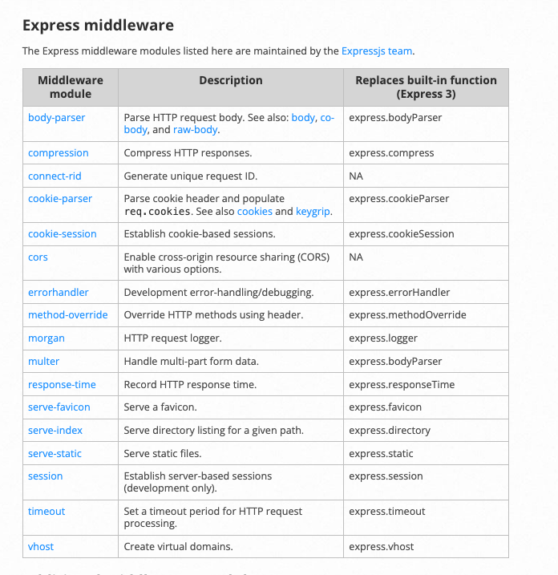
Using the Static Middleware
Currently we cannot serve static assets such as CSS and images in our HTML pages.
  We are only sending a single HTML file, not linked assets (e.g., images, css, and JavaScript)
To configure this functionality, we need to use some middleware.
Middleware can is bult into express, and there is also third-party modules you can use
We can use middleware to handle concerns such as

Slide 50
Serving Static Assets
Below, we instruct express to serve assets from a folder in our root directory called public
Note, use “express.use” to set up middleware
const express = require("express");
const path = require("path");
const app = express();
app.use(express.static(path.join(__dirname, "public")));
Above, express looks up the files relative to the static directory public:
  the name of the static directory is not
  if we place the image foo.jpeg in the public folder we would reference it in index.html like this, <img src="foo.jpeg" />.

Slide 51
DEMO
Notes:
“Learn about the key technologies of Database systems and the World Wide Web (WWW)”. Why is the important?
Databases are the core component of most computer application.

Slide 52
What’s wrong with just HTML
Serving plain HTML files provides us with a means to present a website
How do we inject data into our html pages?
Shared components or layouts must be replicated across different HTML files
As web applications grow in complexity, maintaining a large codebase written in pure HTML becomes increasingly challenging.
The lack of a clear separation of concerns makes it difficult to manage the presentation layer independently from the application logic

Slide 53
Templating to the Rescue
Templating allows for the dynamic generation of content in web applications
Templating promotes code reusability by separating the HTML structure from the data
Shared components
Templating ensures consistent layouts across different pages of a website.
Some popular templating languages include: EJS, Handlebars, Mustache , and Pug

Slide 54
Express supports templating
We’ll use EJS
EJS is simple to use. First, we need to install it:
> npm install ejs
We can now tell express to render our html pages using ejs. Below is a full example.

Slide 55
Using EJS (i)
const express = require("express");
const path = require("path");
const app = express();
const port = 20000;
app.set("view engine", "ejs");
app.use(express.static(path.join(__dirname, "public")));
app.get("/", (req, res) => {
res.render("index");
});
app.listen(port, () => {
console.log(`Example app listening at http://localhost:${port}`);
});

Slide 56
Using EJS (iI)
Express will assume that we have an index.ejs file in a views folder which lives in the root directory of your project.
EJS, is a superset of HTML. This means, to get the above example to work, we can simply rename our any html file to index.ejs and move it to a views folder.
Using EJS, we now have some dynamic capabilities within our HTML views.

Slide 57
EJS Allows HTML to be chunked
<!-- views/common/header.ejs -->
<ul>
<li><a href="home">Home</a></li>
<li><a href="about"></a>About</li>
<li><a href="contact">Contact</a></li>
</ul>
<!-- views/index.ejs -->
...
<body>
<%- include('common/header'); %>
<h1>Home Page</h1>
<img src="test.jpeg" alt="wtf" />
</body>
...

Slide 58
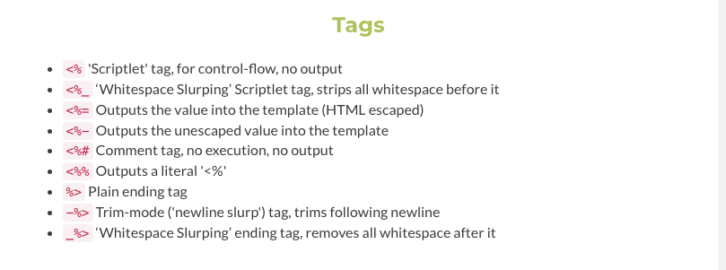
Different types of Tags
We will investigate more dynamic EJS tags next week
You can get a full list of tags from the EJS docs:

Slide 59
DEMO (SEE Lecture TAB)
Notes:
“Learn about the key technologies of Database systems and the World Wide Web (WWW)”. Why is the important?
Databases are the core component of most computer application.

Slide 60
End of lecture
Notes:
“Learn about the key technologies of Database systems and the World Wide Web (WWW)”. Why is the important?
Databases are the core component of most computer application.

Slide 61
End of Week 8

