Slide 1
Internet Technology
(Week 9)
Laying Out Forms

Slide 2
Mock TCA
Well Done for those who did it
Feedback will be given in todays lecture

Slide 3
Accessible Forms Are Important
More people will be able to fill out your forms
More customers
Better overall user experience
Utilise analytics packages (you will see how people interact with you forms)
https://webaim.org/techniques/forms/

Slide 4
The Data Protection Act
Anyone who processes personal information must comply with the eight principles
It provides individuals with important rights, including the right to find out what personal information is held about them

Slide 5
The eight data protection principles
Information must be:
Fairly and lawfully processed
Processed for specified purposes
Adequate, relevant and not excessive
Accurate and up-to-date
Not kept for longer than is necessary
Processed in line with individuals’ rights
Secure
Not transferred outside the European Economic Area without adequate protection

Slide 6
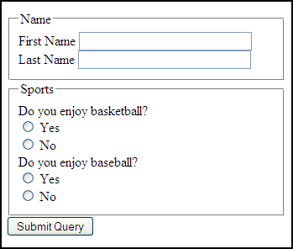
Step 1 Group Common Form Fields
<fieldset> for grouping form element
<legend> adds a caption to the field set

Slide 7
Step 2 - Separate Lines Use <p> Tags
Notes:
action: specifies the URL of a script on a server that will receive and process the data sent, and return any results. this will be a script (PHP,ASP, Perl) or a CGI program
method="post": the information is sent to the server as part of the data body and will not be visible in the URL box in the user’s browser
if you are using a mailto action you must use post
Get: adds valur into URL – perfect for searches, as you can bookmark a URL search result
post: URL is never sen by user …keeps data more secure

Slide 8
Steps to Adding Styles

Slide 9
The CSS Recipe
Give the form an ID
Constrain the width of the form
Align the inputs

Slide 10
References
HTML Forms http://www.w3schools.com/html/html_forms.asp
HTML <input> tag http://www.w3schools.com/tags/tag_input.asp
HTML <select> tag http://www.w3schools.com/tags/tag_select.asp
HTML <label> tag http://www.w3schools.com/tags/tryit.asp?filename=tryhtml_label
HTML <fieldset> tag http://www.w3schools.com/tags/tag_fieldset.asp

