Slide 1
Internet Technology (Unit Code: CDA400)

Slide 2
Internet Technology (week 2)
Recap of week 1
HTML5 Template
Some New Tags
Web Standards
Complete HTML table task
Start assessment 1

Slide 3
About the Unit
TwoParts
HTML
CSS
One Assessment, in January 2018

Slide 4
Element syntax
Element
Opening tag
Attribute name
<a href="http://www.w3schools.com">Click here for 3schools</a>
“Attribute value”
Content
May include other elements
Element name
Notes:
The link address is specified in the href attribute

Slide 5
Element syntax
Basic building block of an HTML document
container for content
each type of element may contain certain other elements
each type of element may have certain attributes
some elements don’t need closing tag (“void” elements) e.g. <img>
Notes:
The link address is specified in the href attribute

Slide 6
HTML Headings
Six levels of headings, elements h1 to h6
<h1>This is biggest heading</h1>
<h2>This is smaller heading</h2>
Use the heading order sensibly and do not skip heading levels (e.g. from h2 to h6)
<h1> should only be used once
Notes:
Headings define the structure of the document and screen readers use them to create a table of contents for the page

Slide 7
HTML Images: img element
Image type: PNG, JPEG and GIF
<img> tag is empty, i.e. it contains attributes only, and has no closing tag
<img src="pulpit.jpg" alt="Pulpit rock">
src attribute: exact filename of picture, with path if necessary
alt attribute: specifies an alternate text for an image, if the image cannot be displayed and is also used by search engines
Notes:
The most common embedded content in websites is images
The most common of image type, supported by all modern browsers … Portable Network Graphics
<img> tag is empty, which means that it contains attributes only, and has no closing tag … Src stands for "source".

Slide 8
Links: anchor element <a>
Syntax: <a href="url">Link text</a>
Example:
<a href="http://www.w3schools.com/" target="_blank">
Visit W3Schools
</a>
Link text should clearly identify the target of each link
Use text that makes sense when read out of context, e.g. avoid “click here”
Notes:
The most common embedded content in websites is images
The most common of image type, supported by all modern browsers … Portable Network Graphics
<img> tag is empty, which means that it contains attributes only, and has no closing tag … Src stands for "source".

Slide 9
HTML Comment
<!-- This is a comment -->
Add comments for the purpose of making the source code easier to understand
Comments are not displayed in the browsers
It is also a good practice to "hide" scripts from browsers without support for it
This will be checked in your assessment !
Notes:
The most common embedded content in websites is images
The most common of image type, supported by all modern browsers … Portable Network Graphics
<img> tag is empty, which means that it contains attributes only, and has no closing tag … Src stands for "source".

Slide 10
Top-level structure
<!DOCTYPE html> <html> <head> <title>Page Title</title> </head> <body> The content of the page.... </body> </html>
This file contains HTML
Start of HTML content
Meta-information
Visible page content
End of HTML content
Notes:
A little bit history about hypertext. Originated from Vannevar Bush, hypertext is an idea of linking documents together to make it easier to keep track of relationships between documents. The concept is more focus on individual, instead of a global system linking documents from many sources.
----
Other then the obvious, the letter "L," there's not much of a difference between the two extensions. Most, if not all, web browsers and servers will treat a file with an HTM extension exactly as it would a file with an HTML extension, and vice versa
http://www.sightspecific.com/~mosh/WWW_FAQ/ext.html
-----

Slide 11
Some Common Mistakes
1 <hmtl>
2 <head>
3 <h1> My first web page</h1>
4 </head>
5 <body>
6 <p1> This is a paragraph …. </p1>
7 <img scr="image.jpg" alt="description">
8 <a href="http://www.w3schools.com"></a>
9 </body>
10 </html>
Notes:
A little bit history about hypertext. Originated from Vannevar Bush, hypertext is an idea of linking documents together to make it easier to keep track of relationships between documents. The concept is more focus on individual, instead of a global system linking documents from many sources.
----
Other then the obvious, the letter "L," there's not much of a difference between the two extensions. Most, if not all, web browsers and servers will treat a file with an HTM extension exactly as it would a file with an HTML extension, and vice versa
http://www.sightspecific.com/~mosh/WWW_FAQ/ext.html
-----

Slide 12
Week 1: Create Your Own Simple Web Page
Basic HTML Structure
Creating a title
Including section headers
Starting a paragraph
Inserting images on a page
Creating a link to another web page
Adding comments

Slide 13
Internet Technology (week 2)
<br> creates a line break
Introducing the unordered list element
Used for lists (obviously) and for navigation links
HTML
Browser Output
<ul>
<li>List item one</li>
<li>List item two</li>
<li>List item three</li>
</ul>
List item one
List item two
List item three

Slide 14
Internet Technology (week 2)
Recap of week 1
Web Standards
Make another web page using Table Elements

Slide 15
Web Standards
We need to write valid W3C HTML
World Wide Web Consortium = W3C
W3C is a committee that lays down web standards
Some browsers may tolerate errors, however we need consistency across all of them.
Browsers will interpret HTML/CSS using the W3C specification.

Slide 16
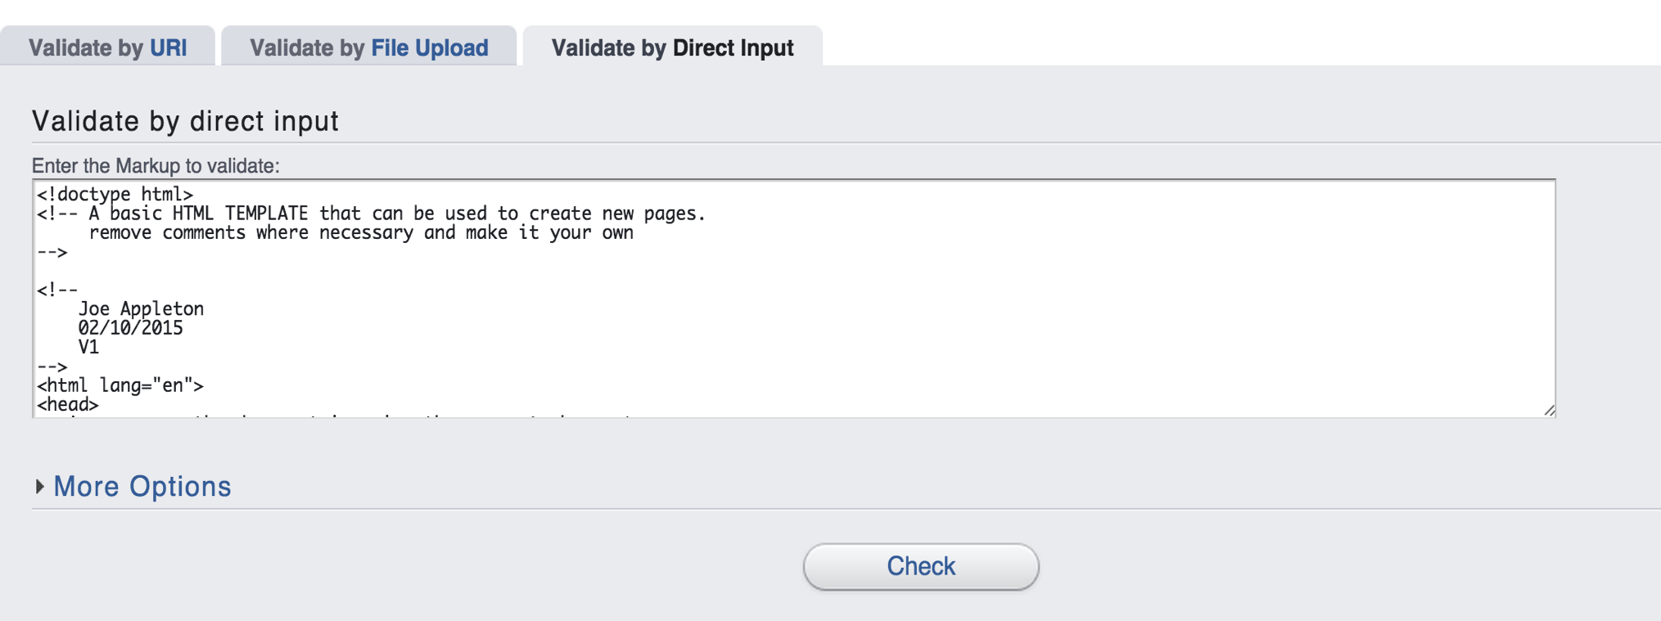
How do we validate HTML?
W3C offers a online validation service
https://validator.w3.org/
Your HTML must be valid from now on

Slide 17
Table Elements
The <table> tag encompasses the whole table
It contains rows, each one is a <tr> element
Each row may contain a mixture of heading and data cells which are defined by the <th> and <td> tags
Optionally you may also add a <caption> to your table

Slide 18
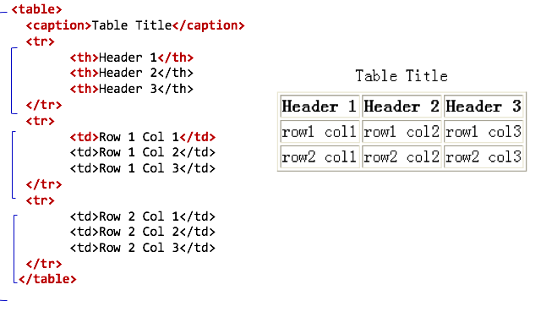
A basic 3 x 3 table
<

Slide 19
Table Attributes
The <table>, <td> and <th> tag elements can also contain attributes to modify the look and feel of the table.
<table border= "1"> this can be used until we introduce CSS
<th colspan="2">, <td colspan="2"> defines the number of columns a cell should span

Slide 20
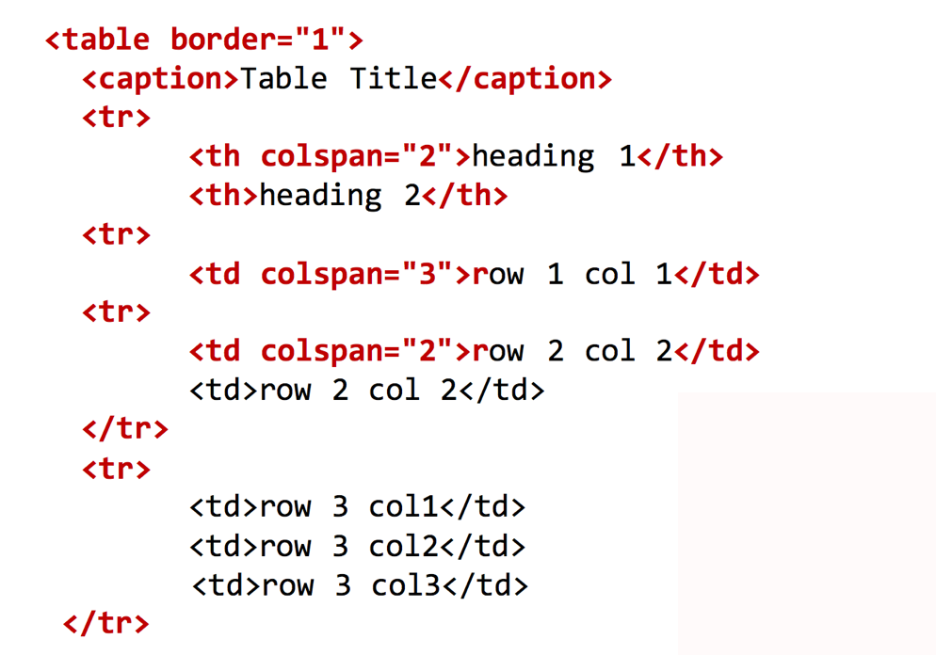
Example of Attributes

Slide 21

This weeks advanced tasks

