Slide 1
Internet Technology
(Week 9)
Laying Out Forms

Slide 2
Mock TCA is Marked and Live
Very good work, most are now marked.
The mock TCA can be found in the Assessment tab on sol
Review the quiz to get your mark

Slide 3
Accessible Forms Are Important
More people will be able to fill out your forms
More customers
Better overall user experience
Utilise analytics packages

Slide 4
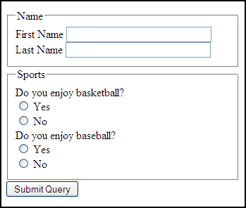
Step 1 Group Common Form Fields
<fieldset> for grouping form element
<legend> adds a caption to the field set

Slide 5
Step 2 - Separate Lines Use <p> Tags
Notes:
action: specifies the URL of a script on a server that will receive and process the data sent, and return any results. this will be a script (PHP,ASP, Perl) or a CGI program
method="post": the information is sent to the server as part of the data body and will not be visible in the URL box in the user’s browser
if you are using a mailto action you must use post
Get: adds valur into URL – perfect for searches, as you can bookmark a URL search result
post: URL is never sen by user …keeps data more secure

Slide 6
Steps to Adding Styles

Slide 7
The CSS Recipie
Give the form an ID
Constrain the width of the form
Align the inputs

Slide 8
References
HTML Forms http://www.w3schools.com/html/html_forms.asp
HTML <input> tag http://www.w3schools.com/tags/tag_input.asp
HTML <select> tag http://www.w3schools.com/tags/tag_select.asp
HTML <label> tag http://www.w3schools.com/tags/tryit.asp?filename=tryhtml_label
HTML <fieldset> tag http://www.w3schools.com/tags/tag_fieldset.asp

